Slide 1
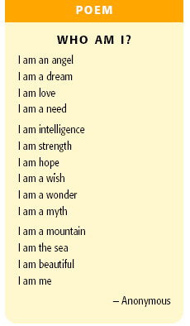
Teaching
Poetry

Slide 2
Poetry in the Classroom
Poetry is meant to be read, heard, and enjoyed, rather than "studied".
Ask students to respond to the words they hear and read in poems, and to picture the images that the words create.
SIGHT SOUND SMELL TASTE TOUCH

Slide 3
Fear of Poetry
Students may say "I don't get it" and say that they do not like poetry because they are fearful that they do not understand the "correct meaning“
Encourage discussion about the poems and the students' responses, making it clear that all responses are valid
Each reader/listener makes meaning according to his or her own experiences and prior knowledge

Slide 4
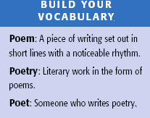

Slide 5
Teaching Poetry
Poetic Pictures
Sounds Like… Looks Like
Set to Music
Prose and Poetry
Writing Poetry
Questions & Discussion
Oral Recitation
Reader’s Theatre
Poetry Partners
Teacher Read Alouds

Slide 6
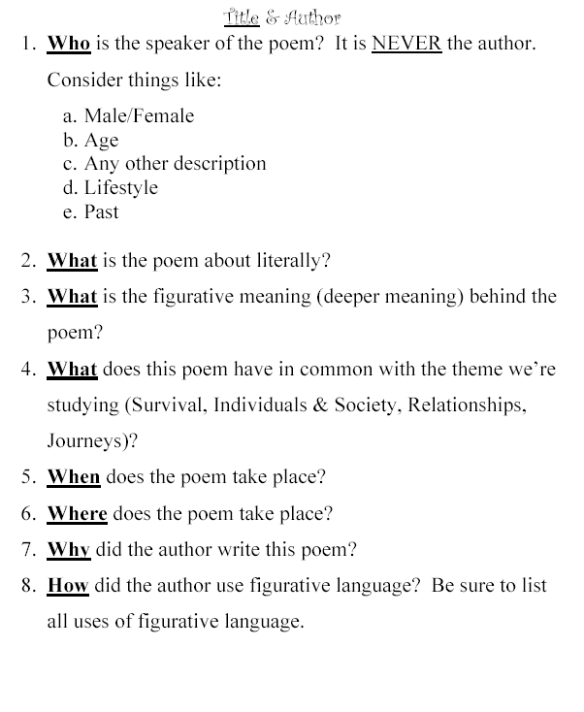
Questions and Discussion

Slide 7
Oral Reading or Recitation:
Have students choose a poem to read or recite aloud to their groups or the whole class.
They may do this individually or in Readers Theatre or choral reading groups.

Slide 8
Chant
If you want to be healthy, you need to sleep enough.
If you want to be healthy, you need to sleep enough.
If you want to be healthy, you need to sleep enough.
You need to sleep, sleep enough!
Page 83

Slide 9
Reader’s Theatre
Have students use only the combination of their voices, volume and repetition to create a poetry performance.

Slide 10
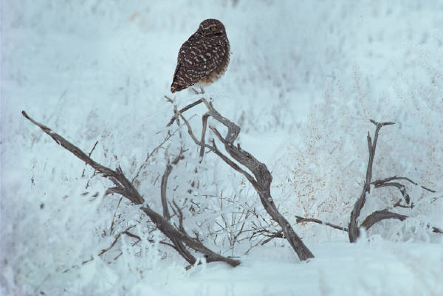
Hold fast to dreams
For if dreams die
Life is a broken-winged bird
That cannot fly.
Hold fast to dreams
For when dreams go
Life is a barren field
Frozen with snow.
- Langston Hughes

Slide 11
Poetry Partners:
Have students partner to share their own and other poetry.
Provide opportunities for them to read aloud to their partners and to discuss their experiences with each selection.

Slide 12
Teacher Read Alouds:
Read poetry aloud to the students daily.
Talk about why you enjoy the poems.
This provides opportunities to introduce and discuss specific poetic formats, styles, techniques, and language..

Slide 13
Poetic Pictures
One way to introduce how description is used in poetry to evoke images is to ask them to draw what they think the poem describes.
Then have them circle the words that helped to evoke the images that they drew.
Discuss how the circled words created the images and how students can use the technique in their own writing.

Slide 14
In a Far-away Land by Wang Luobin
There is a nice, pretty girl,
In a far-away land.
When people pass by her tent,
They always stop and take a double-glimpse.
People said that she always keeps a lamb beside her.
I wish I can be a young lamb,
Running towards you,
Until I am by your side.
I wish her narrow quirt always
Whips me gently.

Slide 15
Take Me Home, Country Roads
- John Denver
Almost heaven,
West Virginia,
Blue Ridge Mountains,
Shenandoah River.
Life is old there,
Older than the trees;
Younger than the mountains,
Growing like a breeze.
Country roads, take me home,
To the place I belong,
West Virginia,
Mountain Mamma,
Take me home, country roads.

Slide 16
Looks Like ... Sounds Like:
Audio and video recordings are useful as models of oral reading of poetry, and demonstrate the need for expression and clarity.
As well, video recordings combine words with images to give students one interpretation of the poem.
Encourage students to create their own audio or video interpretations of favorite selections (their own and/or others' poetry).

Slide 17
Set to Music - Performing Poetry:
Select poems or song lyrics that can be, or have been, set to music.
Have students work out the meaning conveyed through the words and rhythm by speaking or singing the poem to the music chosen.

Slide 18
Set to Music - Performing Poetry:
Encourage them to involve the audience by having members participate in the chorus or repeated phrases.
Have students develop appropriate actions to accompany the words.

Slide 19
Prose and Poetry –
What's the Difference?:
Have them read and compare a short story and a poem about a similar topic.
Have them create a chart or Venn diagram on which they list the similarities and differences between the two genres.

Slide 20
Venn Diagram
Prose
Similar
Poetry

Slide 21
Writing Poetry:
Use models of various types of poetry and have students experiment with writing each type.
Some types of poetry include haiku, limerick, lyric, sonnet, diamante, concrete, ballad, and free verse.

Slide 22
Teaching Poetry
Questions & Discussion
Oral Recitation
Reader’s Theatre
Poetry Partners
Teacher Read Alouds
Poetic Pictures
Sounds Like… Looks Like
Set to Music
Prose and Poetry
Writing Poetry

