Slide 1
Pattern Recognition on MNIST and Fashion MNIST
CS 4795
Kyle Allan : 3720130

Slide 2
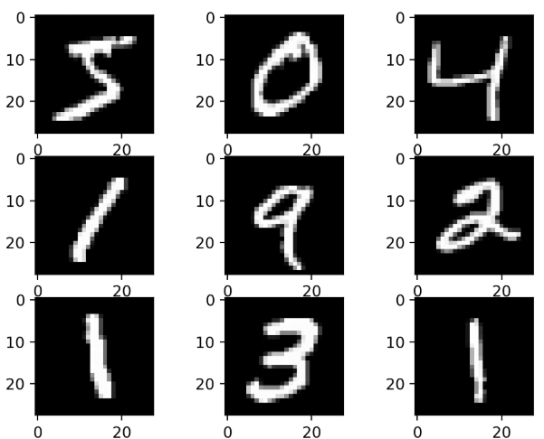
Introduction
Built 3 increasingly deep Convolutional Neural Networks using Python to recognize:
Handwritten digits from the MNIST dataset
Fashion items from Fashion MNIST
Analyze each's performance

Slide 3
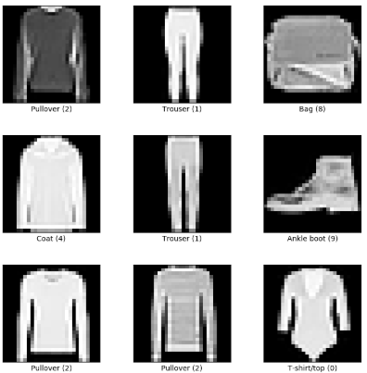
MNIST and Fashion MNIST
MNIST dataset
A dataset of 28x28 grayscale images of handwritten digits
Fashion MNIST
A dataset of 28x28 grayscale images of fashion items
Each containing a total of 70 000 images with:
60 000 training images
10 000 testing images

Slide 4

Convolutional Neural Network
Specialized Neural Network for image data
Consists of
3 types of layers:
Convolution – Feature Extraction
Pooling – Dimensional Reduction
Dense – Image Classification

Slide 5
Prepping The Data
Load both datasets
Relabel the classes in Fashion MNIST
Combine the datasets from MNIST and Fashion MNIST
Normalize pixel values to range [0,1]
Add channel dimension
One-hot encode the labels – aligns labels with the output of the CNN

Slide 6
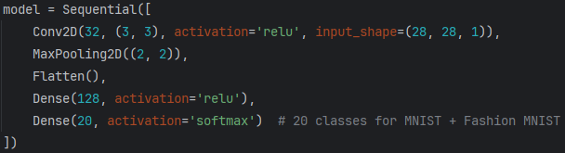
First Model:
Each line:
Conv2D() – includes 32 feature detectors that slide over the image with the activation function ReLU (introduces non-linearity)
MaxPooling2D() – Reduces the spatial dimension of the feature maps to 14x14
Flatten() – Converts the 2D feature maps into 1D vector for the dense layers
Dense(128…) - Fully connected layer with 128 neurons
Dense(20…) - Output layer with 20 neurons (one for each class MNIST 0-9 and Fashion MNIST 10-19) and Softmax generates a probability distribution over the 20 classes

Slide 7
Other Models
Deep Model
3 convolutional layers
2 pooling layers
2 dense layers with 256 neurons
1 dropout layers for regularization
Deepest Model
5 convolutional layers
2 pooling layers
2 dense layers with 512 neurons
3 dropout layers for regularization

Slide 8
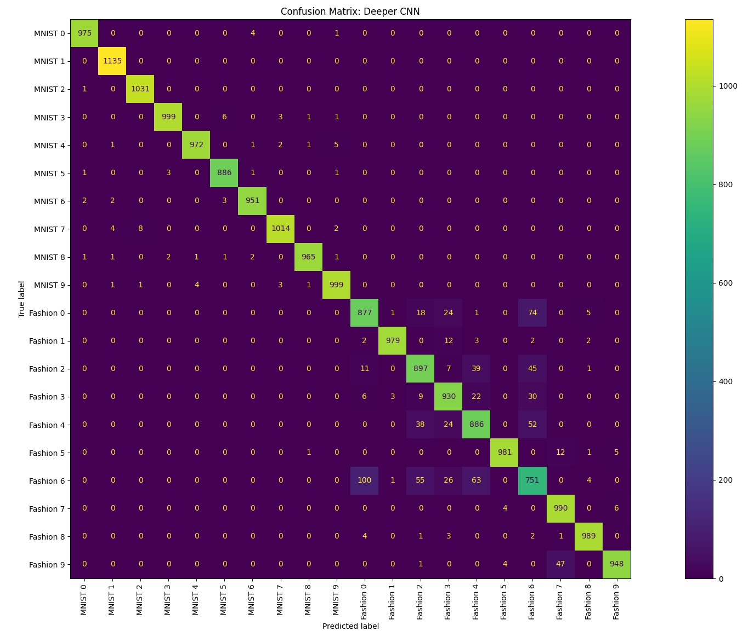
Analyzing Accuracy Across Models
Simple Model - 94.81%
Deep Model – 95.78%
Deepest Model – 95.03%

Slide 9
Conclusion
Gained a high-level understanding of Convolutional Neural Networks
Specific layers and their purpose
Gained an understanding of preparing data for CNNs and understanding its output
Saw that making models deeper does not always mean it becomes more accurate

Slide 10
GitHub
https://github.com/Kyle-Allan/CS-4795-Project

