Slide 1
Recognizing Handwritten Digits Using a CNN on the MNIST Dataset
CS 4794 Artificial Intelligence Kyle Allan

Slide 2
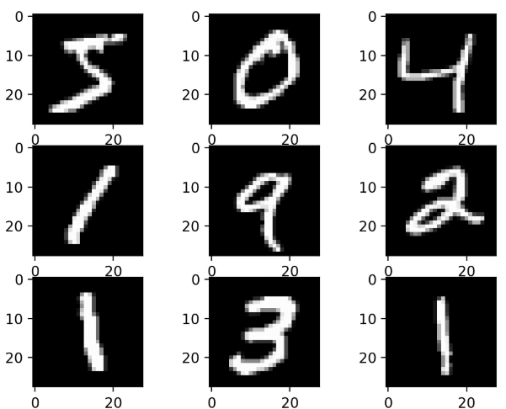
Introduction
Build a Convolutional Neural Network using Python to recognize handwritten digits 0-9 from the MNIST dataset

Slide 3
Details
MNIST dataset
A dataset of 28x28 grayscale images of handwritten digits
60 000 training images and 10 000 testing images
Convolutional Neural Network
Specialized for image data
Convolution layers, pooling layers, fully connected layers

Slide 4
Methodology
Load the MNIST dataset
Build the CNN
Train the model on the 60 000 training images and optimize
Test the model on the 10 000 images

Slide 5
Challenges
Building an accurate CNN model
Classifying ambiguous digits (1 vs 7)

Slide 6
GitHub
https://github.com/Kyle-Allan/CS-4795-Project

