Slide 1
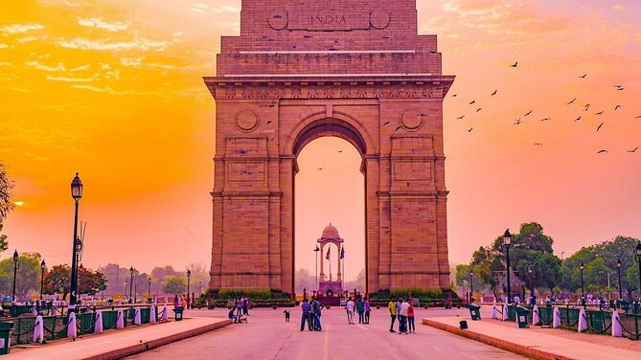
Air quality in Delhi, India
Aidan Frederick, Ben Walter, & Kyle Maher

Slide 2
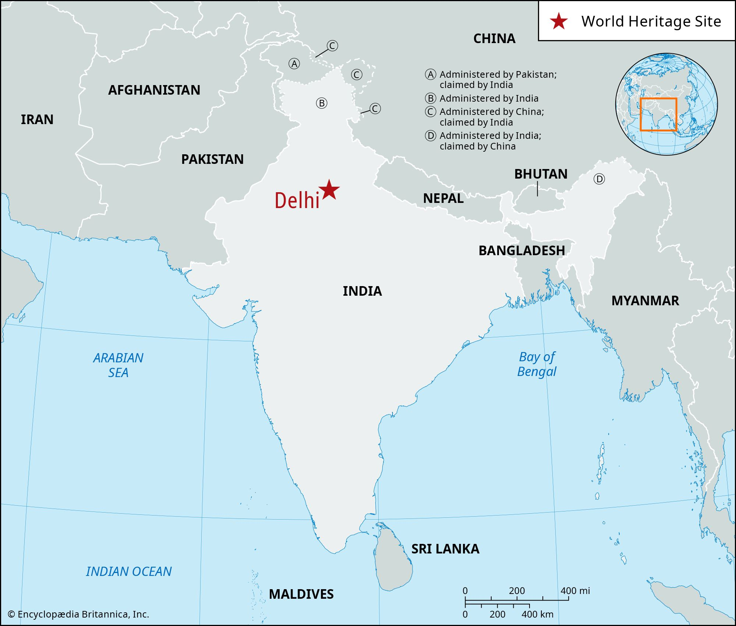
Why Delhi?
The City of Delhi is one of the world's most populous cities
34.7 million people within only 1,484 square kilometers
Results in 29,000 people per square mile
With so many people in one space, a few questions arise:
How significant is air pollution in Delhi?
When is it at its least and greatest for any given season?
What circumstances affect these values?
How is air quality projected to change?
https://worldpopulationreview.com/cities/india/delhi

Slide 3
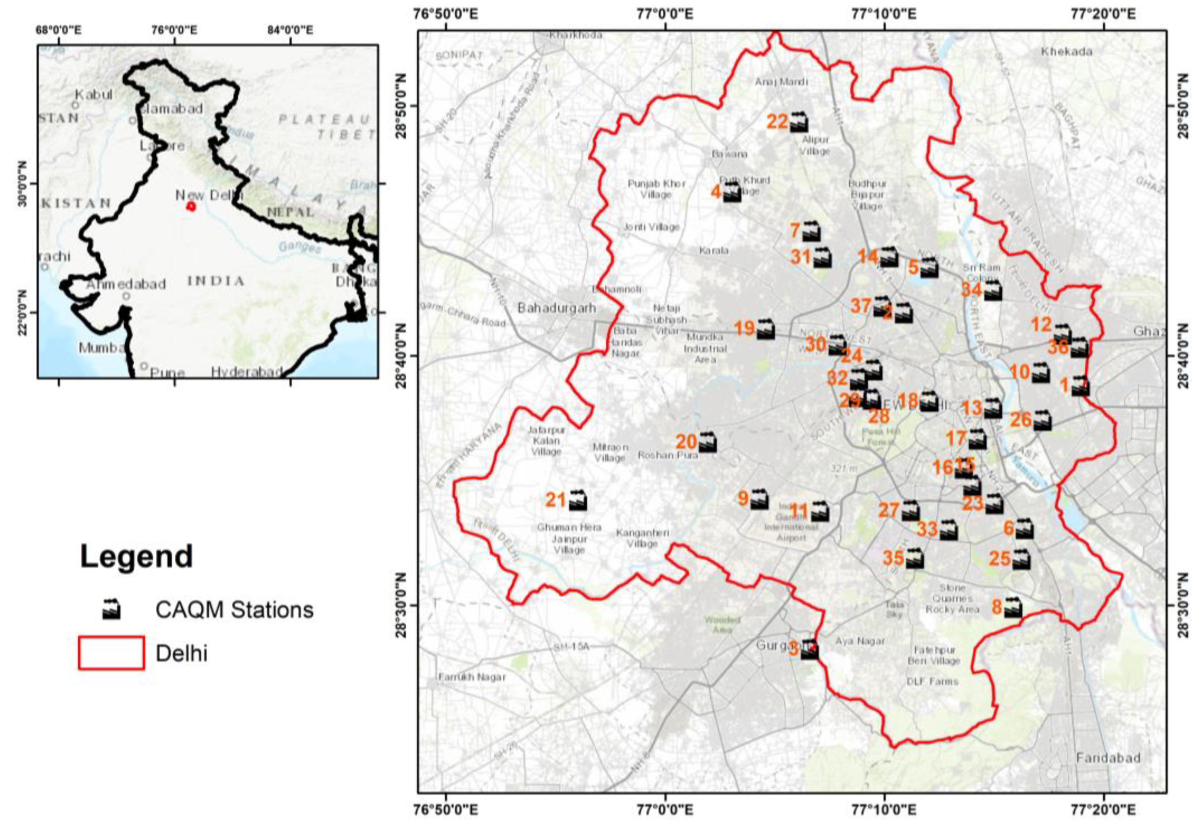
Continuous air quality monitoring stations
Station Chosen for Analysis:
North Campus, DU, Delhi
Rational:
Several years of relatively consistent data
Located on a university campus
Dense population surrounding the station
https://www.mdpi.com/2073-4433/13/12/2090

Slide 4
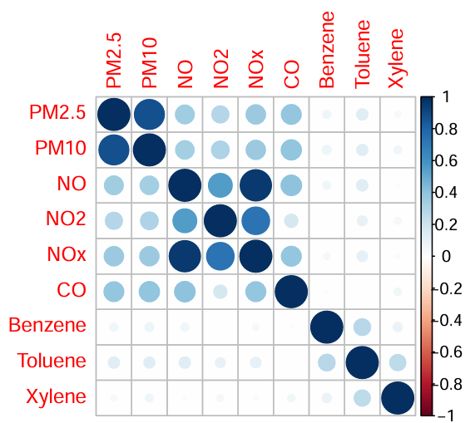
Selecting a Parameter
Correlation Insights:
High concentrations of CO, NO, NO2, NOx, PM2.5 and PM10 occur at the same time
High concentrations of Benzene, Toluene, and Xylene occur together
Linked to car emissions
Parameter focus: PM2.5
Represents concentration of particulates that are less than 2.5 micrometers in diameter
Exposure is linked to:
Aggravated asthma
Decreased lung function
Increased respiratory symptoms
Difficulty breathing
World Health Organization recommended limit
Daily Average: 15 μg/m³
Annual Average: μg/m³
https://www.epa.gov/pm-pollution/health-and-environmental-effects-particulate-matter-pm
https://smartairfilters.com/en/blog/who-updates-air-quality-pollution-guidelines/?srsltid=AfmBOoqbp1QL4WJ8VLsTe03reEG0aoykdb1SQHJ0gm2tYN5swiW4Krct

Slide 5
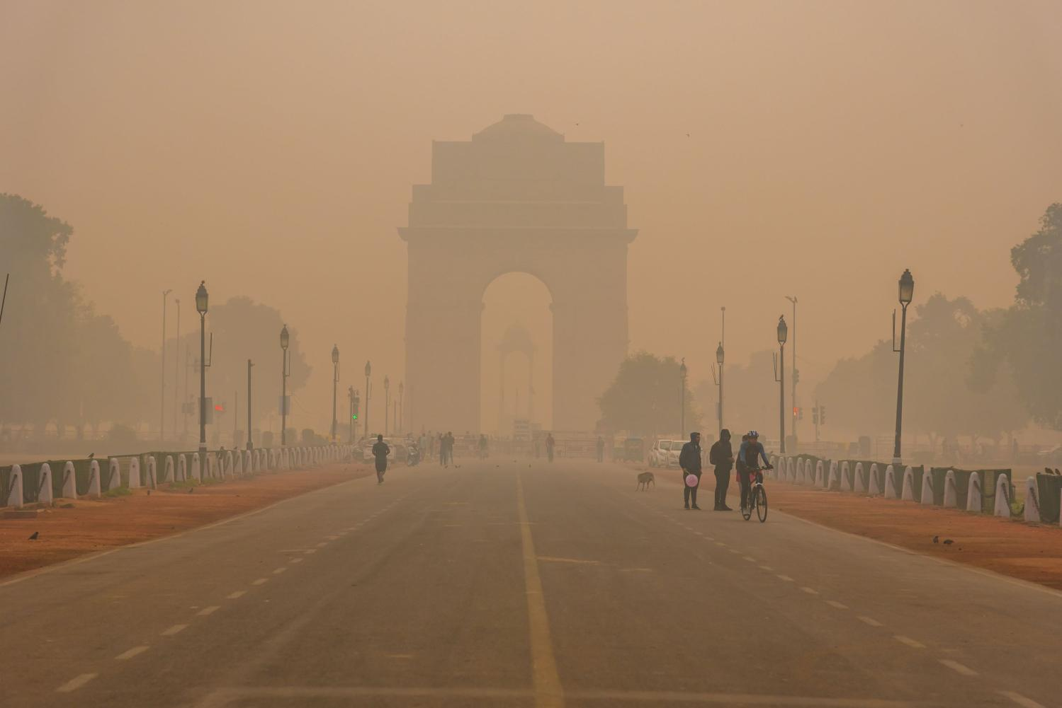
Particulate Sources
The following influence air quality in Delhi:
Stoves
Vehicles with modified fuel
Idling Vehicles
Field burnings after harvest
Celebrations and Festivals
Livestock
Dust storms
Badarpur Thermal Power Station
https://www.iqair.com/us/india

Slide 6
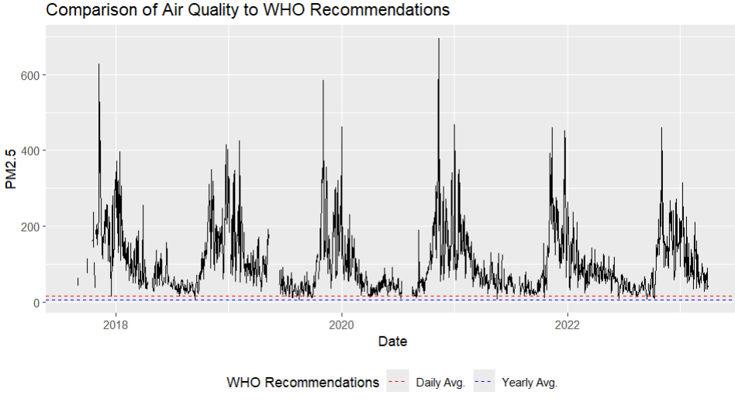
PM2.5 Recommended Limits, and Delhi
The World Health Organization recommends PM2.5 levels below 15𝑢𝑔/𝑚3 for a daily average and below 5𝑢𝑔/𝑚3 for a yearly average.
Plotted below are those limits with respect to our PM2.5 data.
Delhi sees frequent periods of PM2.5 values far exceeding the WHO's recommendations.
Summer months tend to have the values closest to safe limits while the late fall and winter months see the highest spikes.

Slide 7
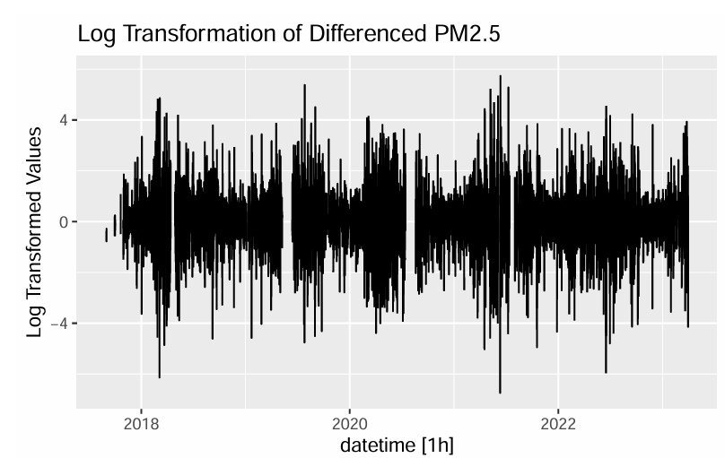
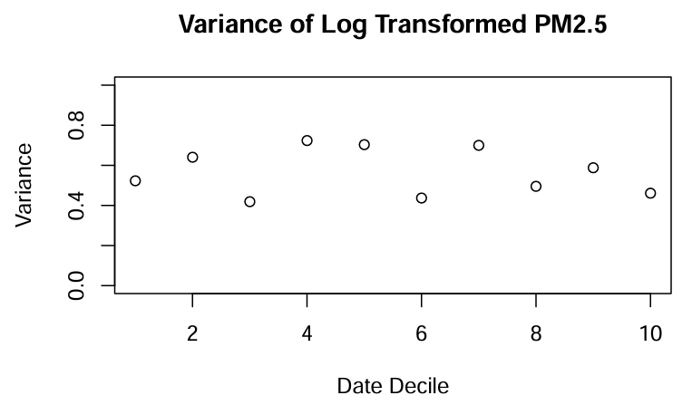
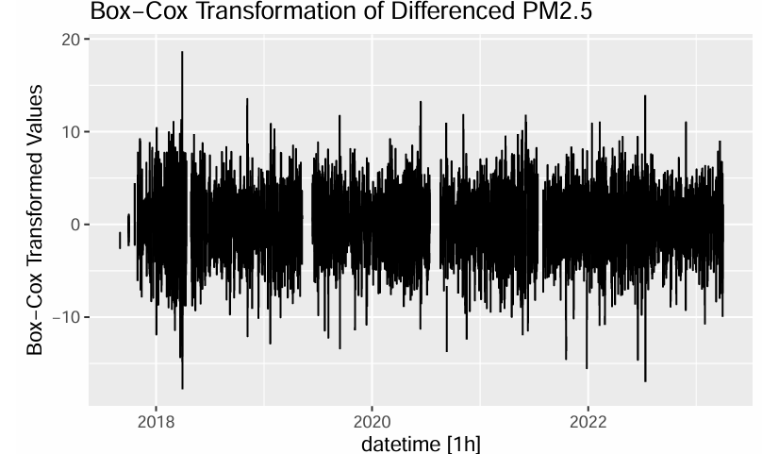
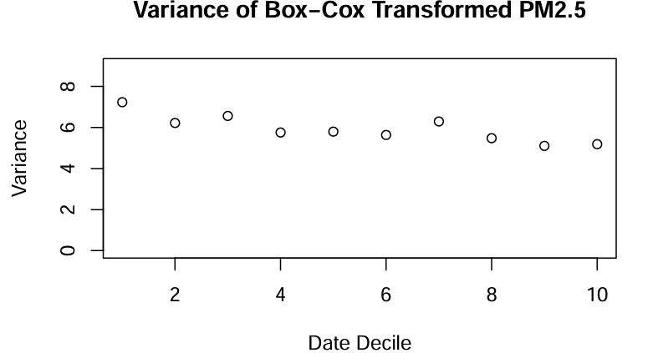
Achieving Stationarity
Log transformation outputs near stationary series
Variance remains changing
Box-Cox transform returns effectively stationary data
Decreasing but mostly stable variance

Slide 8
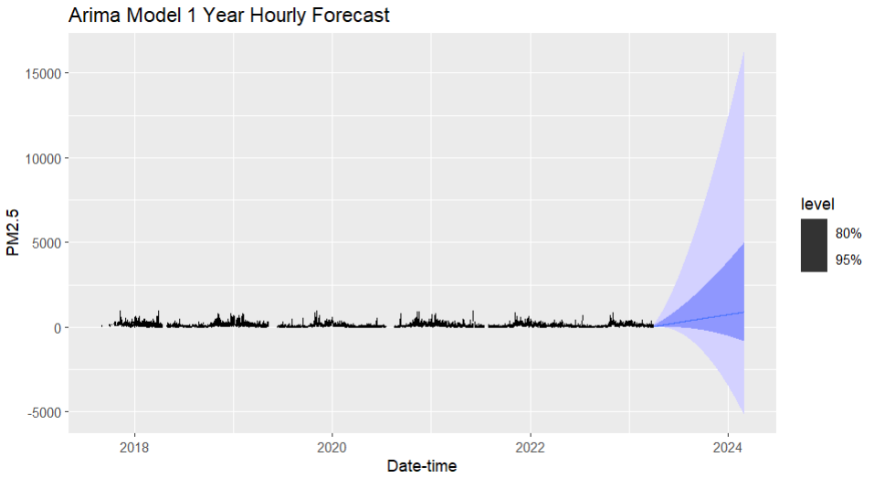
Initial Hourly Modeling Attempts
ARIMA Model
Resulted in extreme forecast prediction intervals
Neural Network Model
Also resulted in extreme forecast prediction intervals
STL with ETS
Issues with missing values
Mean Imputation
Also resulted in extreme forecast prediction intervals

Slide 9
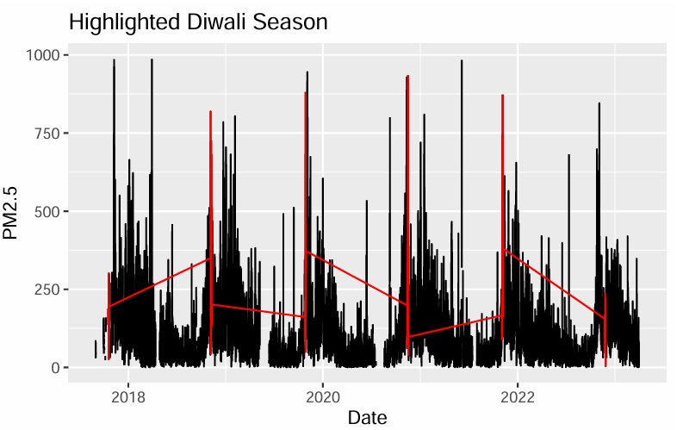

Diwali Festival
The yearly Diwali celebration generally results in a spike in particulate levels due to fireworks, candles, and thrown gulal (colored powder)
Influence accounted for with a dummy variable

Slide 10
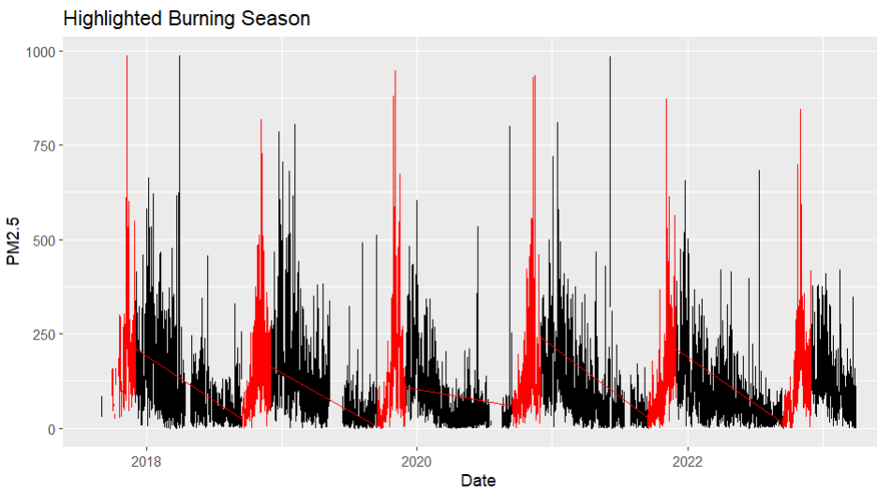
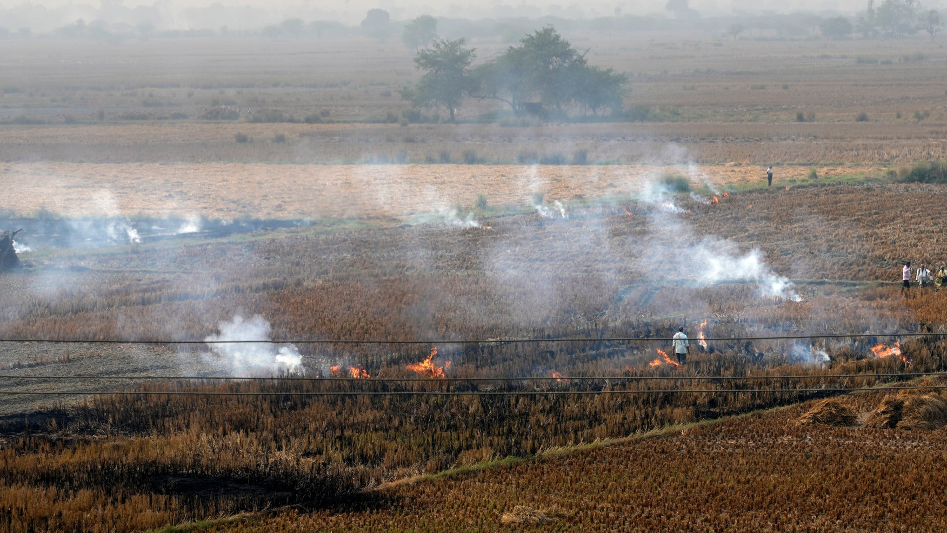
Crop Burning Season
Crop burns in Delhi occur between September and November and result in a predictable spike in air particulates before winter
Influence accounted for with a dummy variable

Slide 11
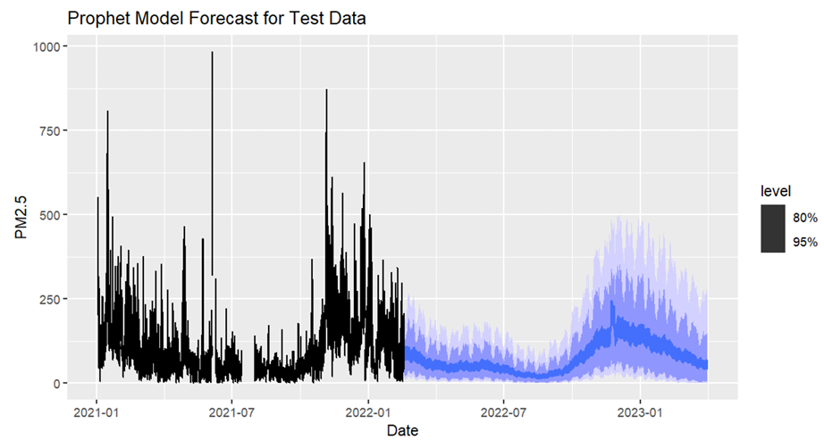
The Prophet Model
Due to the presence of multiple layers of seasonality, only the Prophet model could handle hourly data
However, the model returned exceptionally high RMSE and MAPE values
MAPE: ~96% suggests that this model poorly represents the data
The Forecasts routinely underestimate PM2.5 values during Diwali and burn seasons.
Point estimates have significantly less variance compared to real data points in general
The Prophet model is unlikely to be the best forecasting choice

Slide 12
Predicting Weekly Data
Change in Strategy:
Aggregated the hourly data to weekly
Eliminates daily seasonality, making data easier to work with and yielding better results
A train-test split was implemented (80%-20%)
Interpolation:
STL/ETS models require no missing values in the data
Estimated missing values in data using a Dynamic Harmonic Regression (DHR) Model
K = 7 Fourier paired terms
Models Generated:
STL/ETS Decomp: constrained positive with log(PM2.5) data
Neural Network Autoregression: 3 lagged inputs, 1 yearly seasonal input, and 2 hidden nodes
DHR: K=6, with ARIMA(0,1,2)(1,0,0)[52] errors
First differenced data, second order MA component
First order seasonal AR component (yearly)
Combined Model:
Average of the predictions of the 3 models above
Bootstrap 1000 sample paths into prediction intervals

Slide 13
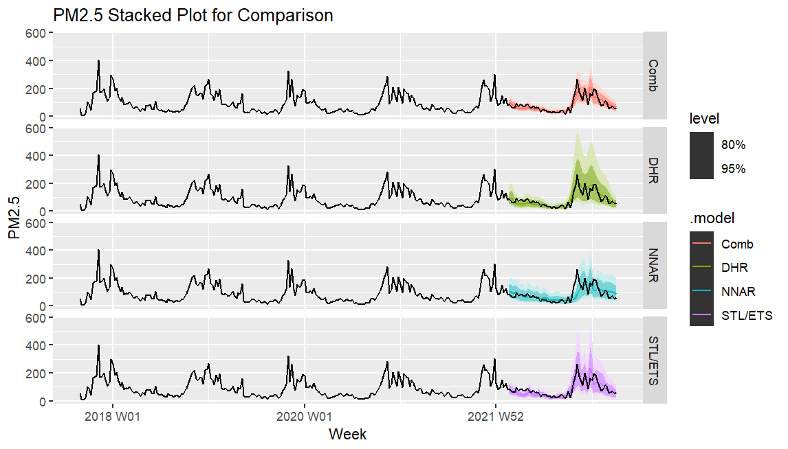
Comparisons and Final Model Choice
Combination and STL models best mirror data visually
DHR model has the widest intervals and worst distributional forecasts
Choosing a Model:
Combined and DHR models have highest point accuracy (RMSE/MAPE)
DHR distributional forecasts are far worse than the Combination model's (CRPS)
Final Choice: Combination Model
Model | RMSE | MAPE | CPRS
DHR | 26.1 | 28.6 | 61.3
Combination | 26.8 | 26.7 | 13.6
STL/ETS | 28.1 | 28.8 | 16.0
NNAR | 40.7 | 33.9 | 19.3

Slide 14
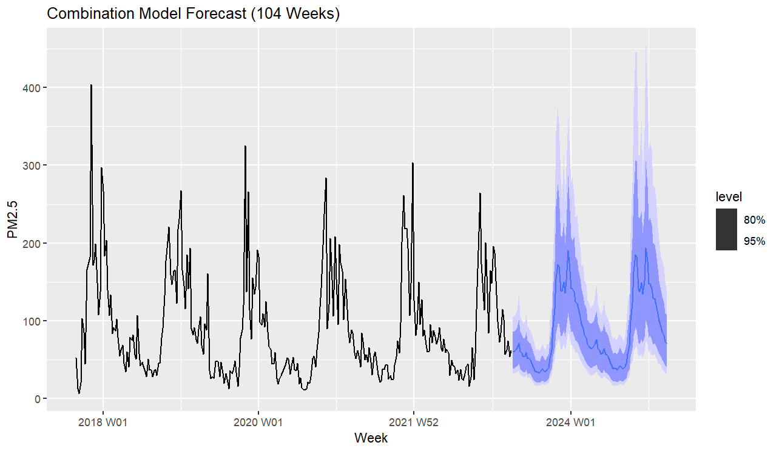
Final Forecasting
Combination model forecasts of 104 weeks, or roughly 2 years producing the following:
PM2.5 air pollution is projected to decrease slightly from 2023-2025,
An increase is within our prediction intervals.
The lowest estimate in August of 2023
33.15853 𝜇𝑔/𝑚3
Still above the WHO's safe daily limits.
Highest estimate occurs in December of 2023
189.5962 𝜇𝑔/𝑚3
Exceeds any safe values

Slide 15
summary
Raw Data
Hourly PM2.5 concentration from September 2017 to March 2023 in Delhi, India
Data Processing
Box-cox transformation required to stabilize the variance
Initial Problems
The standard models could not make forecasts within reasonable prediction intervals at the hourly level
Improvements
Weekly aggregation removed daily seasonality allowing for the standard models to be used effectively
The Combination model built from the average of STL/ETS, DHR ARIMA, and Neural Net forecasts performed best
PM2.5 Forecasts from the Combination Model
A slight decrease is projected by the point forecasts
A significant increase remains within the forecast prediction intervals
Extreme seasonality is expected to continue
Air pollution in Delhi remains a significant problem for Delhi residents
Even the generous side of the forecast prediction intervals show many days far above the WHO’s recommended limit

Slide 16

Q & A

Slide 17
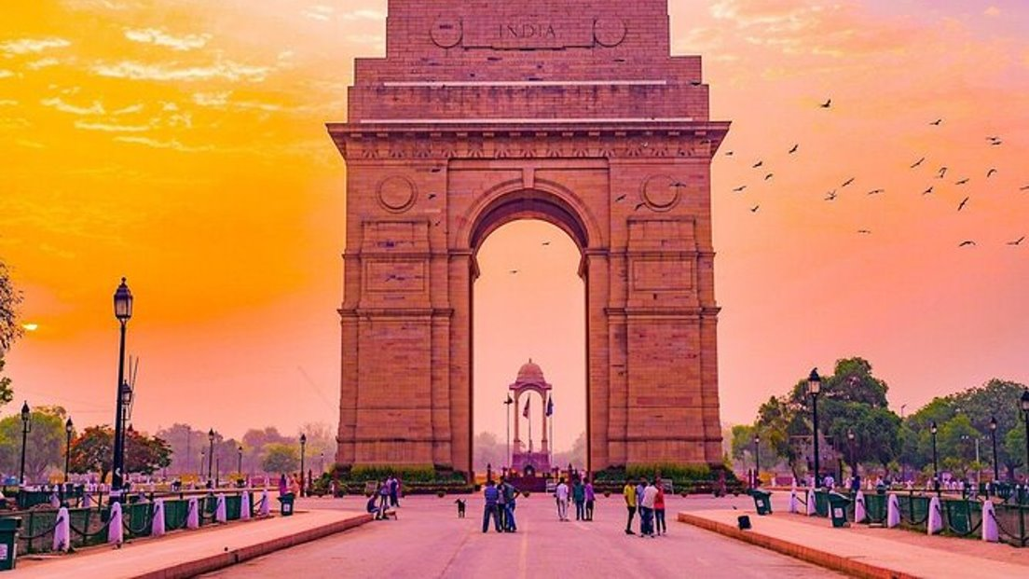
Thanks

