Slide 1
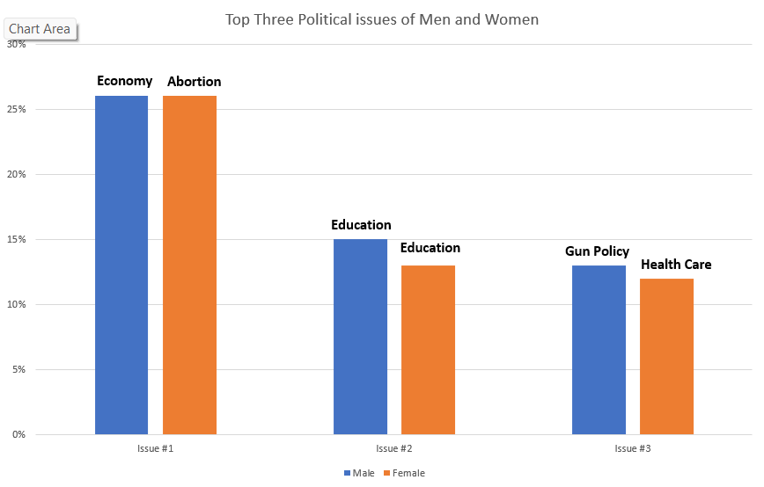
The Difference Between Sex and Top Political Issues
By Kyle Weber & Professor Laura Pyott
Department of Mathematics, West Chester University
Abstract
Introduction
Results
Conclusion
The Ram Poll is a political poll meant to track the short- and long-term politics of Pennsylvania’s undergraduate students. The poll focuses on collecting students voting information, political views, important social issues, and demographics. The 2022 Ram Poll was distributed to 10 PASSHE schools, receiving a total of 948 responses and a response rate of 6.2%.
My research question seeks to find the difference if any between sex and the issues students find the most important. Using the issue rank section of the Ram Poll where participants were asked to select the top three issues, they are most concerned about, I found the difference in opinion between both males and females on what current issues are the most pressing. The results of the poll show that men and women do have differing concerns on political issues with the number one issue for women being abortion while for men it is the economy. This difference stays for most of the issues with both sexes showing a difference in what issues they ranked most highly.
The Ram Poll seeks to collect information on voting, demographics, and political issues among undergraduate students. In this case the Ram Poll provided the necessary data to determine the top issues among men and women. My hypothesis is that men and women both have different priorities when it comes to social and political issues. If there is a difference in opinion, then understanding the breakdown of voting constituents needs and desires allows for politicians to effectively manage what issues they base their campaign around. In this case, knowing which issues both men and women hold in the highest priority can help individuals running for either election or reelection know what issues the most voters care about. This break down is especially important when the population percentages are not equal. If the voting break down is 45-55 male-female, curating issues towards what females regard the most important might help swing more voters towards a particular side election.
After tabulating the responses, the top three issues for men in order from highest to lowest was, Economy with 26% of the vote, Education with 15%, and Gun policy with 13%. For females, the top three from highest to lowest was, Abortion with 26%, Education with 13%, and Healthcare with 12%. Additionally, the lowest ranked for men was Violent Crime with 1 vote, and the lowest ranked for women being COVID-19 policies with also 1 vote. Judging by the rankings of the poll there is a difference between men and women when it comes each genders ranking of political issues.
Looking at the results of the poll and data gathered, there is clearly a difference between men and women in their political and social priorities. While the second ranked issues remain the same, the first, third are different with the remaining lower ranked issues also being different. I think it is fair to say that the men and women do different priorities when it comes to political issues, however, the practical significance of this is up for debate. While it might be impossible to find the exact reason for the difference, ultimately just knowing that there is a difference can have important impacts. Knowing the top issues for each demographic could prove to be important in certain circumstances, allowing a politician to tailor their campaigns towards certain groups and away from others.
Methodology
References
In October, a PASSHE wide survey was sent out to 10 different schools receiving a total of 948 responses. The responses were recorded and put into an R data file where code was written to determine the difference between what men and women found to be the three most important issues affecting the country. This code allowed for the top three issues of men and women to be compared and the difference in each group's priorities to be determined.
Gothreau, C. (2021, May 20). How gender shapes public opinion in American politics. Center for American Women and Politics. Retrieved November 30, how-gender-shapes-public-opinion-american-politics 2022, from https://cawp.rutgers.edu/blog/
Kittilson, M. (2016, May 9). Gender and political behavior. Oxford Research Encyclopedia of Politics. Retrieved November 30, 2022, from https://oxfordre.com/politics/view/10.1093/acrefore/9780190228637.001.0001/acrefore-9780190228637-e-71
Pew Research Center. (2022, May 20). Public opinion on abortion. Pew Research Center's Religion & Public Life Project. Retrieved November 30, 2022, from https://www.pewresearch.org/religion/fact-sheet/public-opinion-on-abortion/

