Slide 1




Predictive Health Monitoring of Engine Classification Using Machine Learning and NASA C-MAPSS Data
By: Kyle Keshmeshian
Notes:
Hello my name is Kyle Keshmeshian and welcome to my Predictive Health Monitoring of Engine Classification Using Machine Learning project

Slide 2

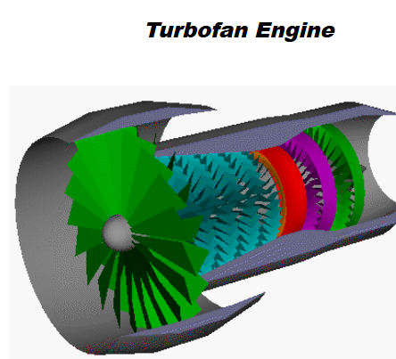
Introduction
Dataset: NASA C-MAPSS (Turbofan engine degradation simulation)
Goal: Classify aircraft engine status as “Normal” or “At Risk”
Target Variable: Based on Remaining Useful Life (RUL)
Status = 1 if RUL ≤ 30 (At Risk)
Status = 0 if RUL > 30 (Normal)
Notes:
“In this project, I developed a machine learning model to predict the health of aircraft engines.
Using the turbofan engine degradation simulations from the NASA C-MAPSS dataset, my goal was to classify each engine operating status as either normal or at risk of failure.
The dataset contains over 20,000 flight cycles with engines operating under various conditions.
Each cycle has 21 sensor readings, an engine ID, and 3 operational settings.
Since there's no direct engine status label, I created my classification target based on Remaining Useful Life, labeling engines with RUL ≤ 30 as ‘At Risk.’
This project’s real-world significance is that accurately predicting engine failure can prevent dangerous situations and save lives.”

Slide 3
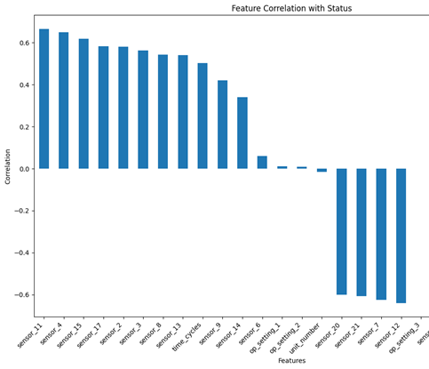
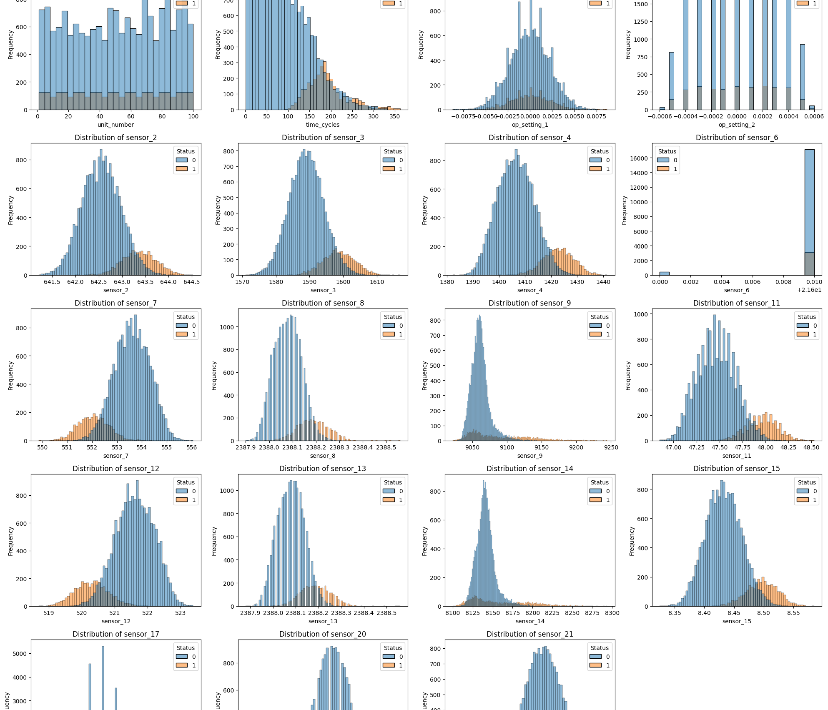
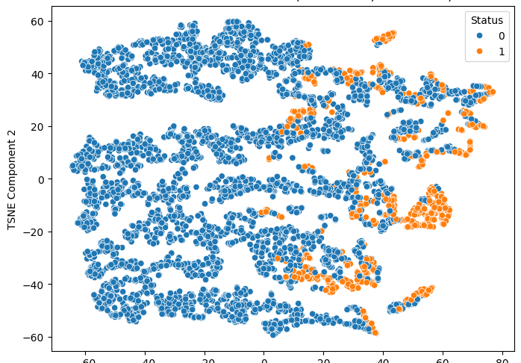
Exploratory Data Analysis
20,631 cycles, 26 features
No missing values
Engine Status labeled using RUL
Removed low-impact features: low correlation & low variance
Applied standardization to all features
Used t-SNE to visualize separability of classes
Class imbalance:
85% Normal, 15% At Risk
Notes:
During exploratory data analysis, I removed features that were irrelevant, based on correlation and variance.
To prepare the data for modeling, I standardized all features so that they contribute equally in calculations.
Then I applied t-SNE to visualize class separation and while there’s some overlap, the clusters suggested the data was reasonably separable
As displayed in the TSNE plot, a challenge during exploratory analysis was the class imbalance —
only 15% of the data represents engines that are at risk, which could cause the model to overlook failures.
I addressed this later by adjusting evaluation metrics and model parameters.

Slide 4
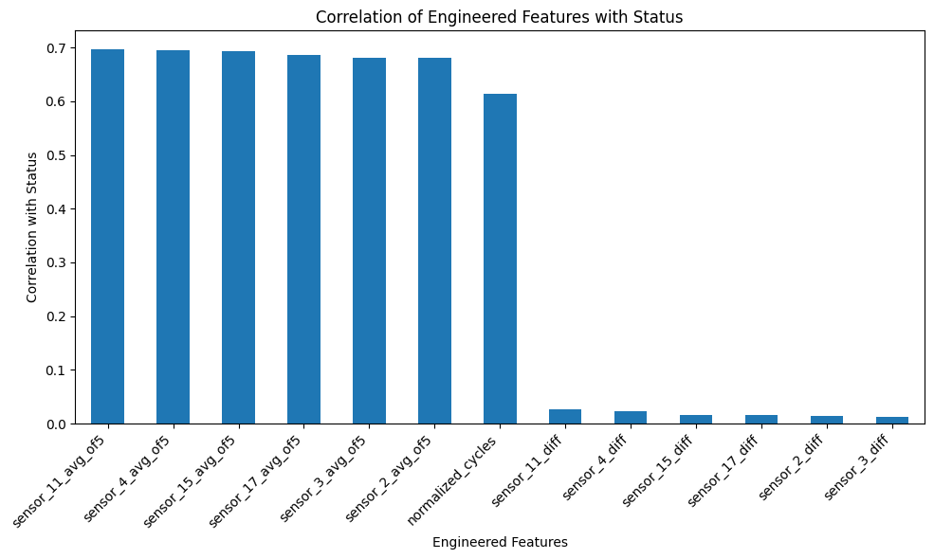
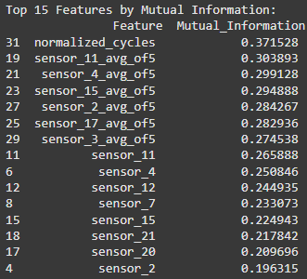
Feature engineering
Created 13 new features from original data
Key engineered features:
sensor_#_avg_of5 – mean of past 5 cycles
normalized_cycles – cycle number relative to engine lifespan
Dropped noisy features
Selected top 15 features using mutual information
Notes:
“To improve model performance, I created 13 new features using the original sensor data.
One of the features that stood out was the sensor_#_avg_of5 — this is a rolling average of sensor data over 5 cycles. It helps smooth out short-term noise and capture long-term degradation trends
Next was normalized_cycles — this represents how far along each engine is in its lifespan. This feature was great at identifying patterns across engines of different lifespans.
I also experimented with features like sensor_#_diff that were meant to capture rate of change, but they added noise instead of value — so I ended up removing them.
Then Finally, I used mutual information to rank features and selected the top 15 to avoid overfitting. The strongest features were the ones that captured degradation trends, such as the rolling averages and normalized time.”

Slide 5
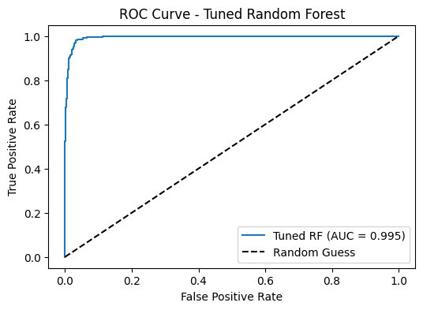
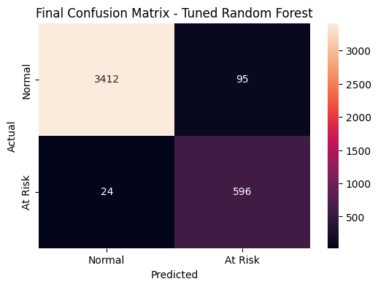
Model Comparison
Models tested:
Logistic Regression
XGBoost
Random Forest
Multi Layer Perceptron (MLP)
Tuned Random Forest:
Recall: 0.961 (with 3.9% FNs)
AUC: 0.995
Evaluation focused on Recall
Notes:
In my model testing I tested Logistic Regression, XGBoost, Random Forest, and Multi-Layer Perceptron (MLP) models. While accuracy was high across all models, I focused on Recall as the main metric.
Because in this case, where an at-risk engine is incorrectly predicted as normal (or in other words, a false negative) could have serious consequences
Logistic Regression gave a strong baseline, and MLP performed decently, but the tree-based models were the most effective overall.
After tuning, Random Forest clearly stood out as a clear winner when It correctly identified over 96% of engines at risk of failure.
Based on both performance and consistency, Random Forest was the safest and most reliable model for this classification task.”

Slide 6
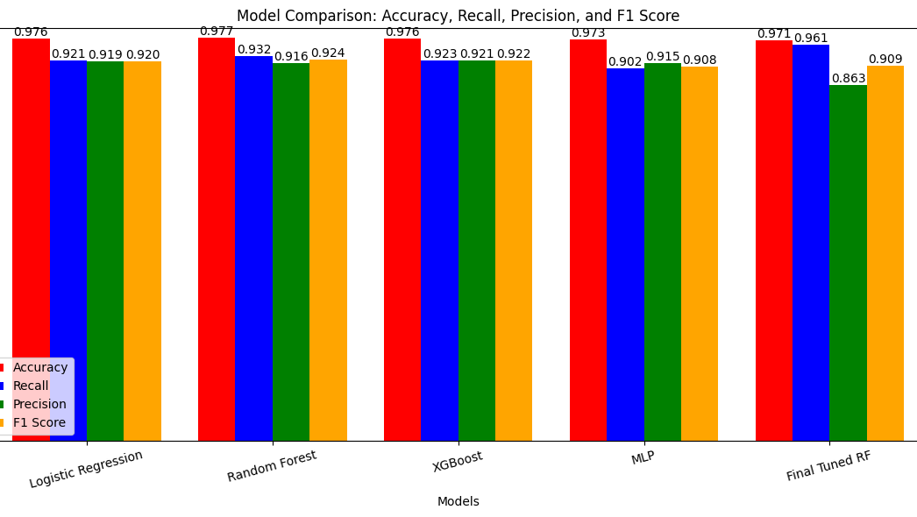
Conclusion, Key takeaways, Limits, & Future
Final Model: Tuned Random Forest
Recall: 0.961 (with 3.9% FNs)
AUC: 0.995
Key success factors:
Feature engineering
Focus on recall
Limitations:
Hard to Interpret without sensor labels
Class imbalance (15% at risk)
Future Work:
Use labeled sensor data
Test on other types of engines
Notes:
In conclusion, This project successfully built a predictive model that can monitor engine health and flag engines at risk of failure.
After testing multiple models, Random Forest emerged as the best — with a recall of 0.961 and AUC of 0.995 — meaning it was both reliable and precise.
The biggest factor in this success was feature engineering. By normalizing cycles and applying rolling averages to the sensor data, I was able to highlight the slow degradation of engines and improve classification accuracy.
A key takeaway for me was the importance of choosing the right evaluation metric. While accuracy looked good, it was recall that mattered most.
Unfortunealy the dataset came with its own limitations, for example, The sensor data lacked real-world labels, which made interpretation difficult. And the class imbalance can lead to biased models.
In the future, I’d love to see how this model performs labeled sensor data in real time, and even apply it to different types of engines to improve generalization.

Slide 7

Thank You for listening!

