Slide 1
Selenium GoodReads Scraper
Kyle Benzle

Slide 2


Slide 3


Slide 4


Slide 5
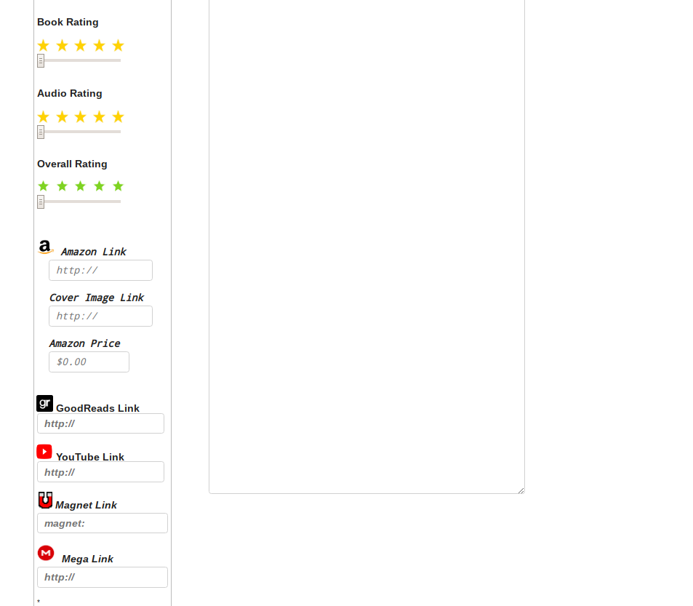


Slide 6



Slide 7
book_title
post_text
book_author
book_narrator
book_genre
short_genre
book_year
book_length
book_publisher
book_star
image_link
amazon_link
amazon_price
goodreads_link
reviews

Slide 8
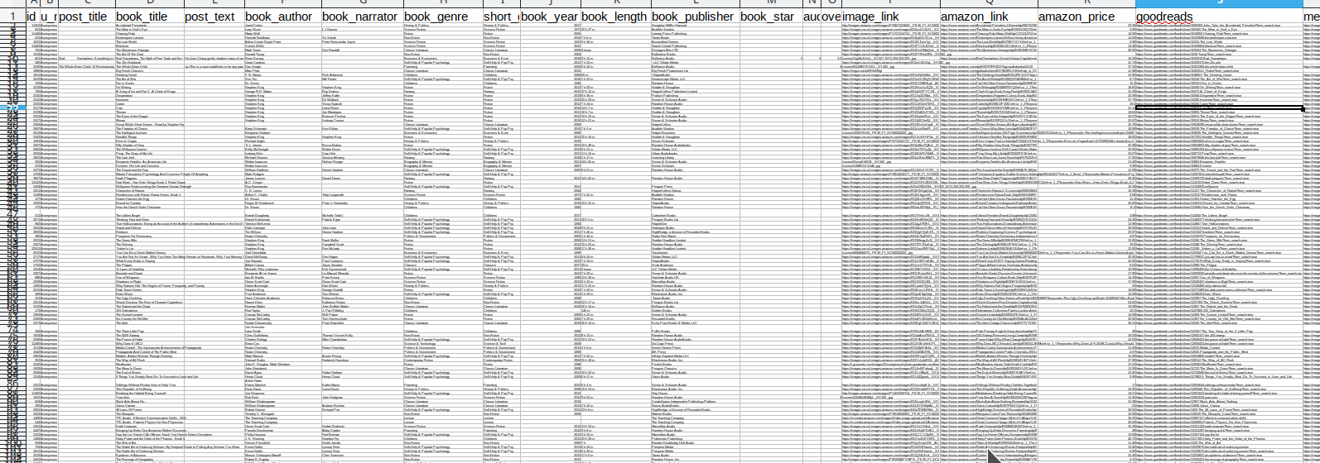

Slide 9

Download Data for Top 100 SciFi Books

Slide 10
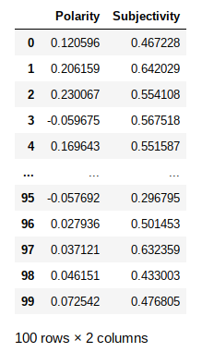
outputAnalysis = explodedDf['book_review'].apply(lambda x: sent_func(x))
sentAnalysis = pd.DataFrame(list(outputAnalysis), columns =['Polarity', 'Subjectivity'])

Slide 11
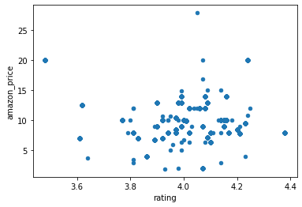
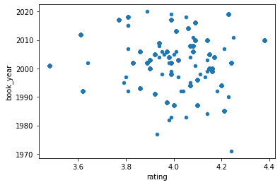
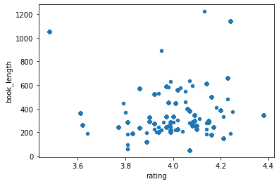
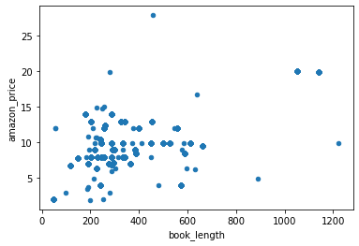

Slide 12
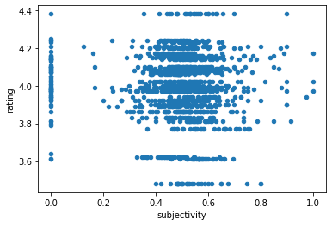
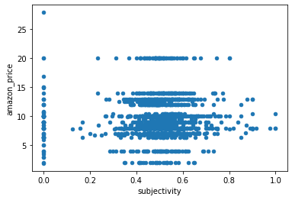
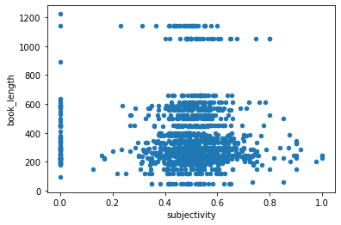
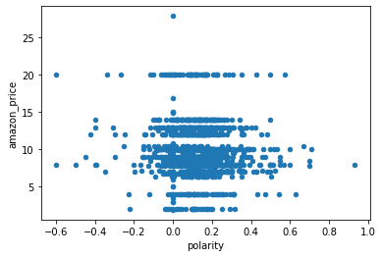

Slide 13
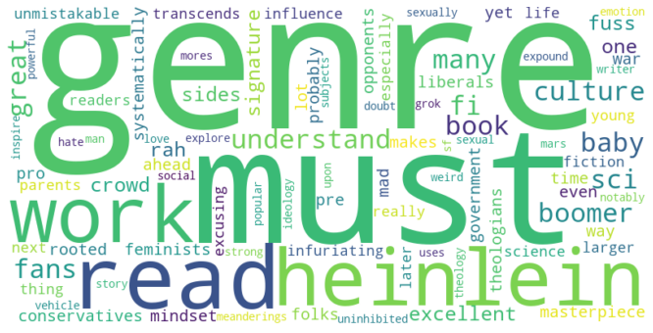



Slide 14
PriceModel =
smf.ols(formula='amazon_price ~ book_length + book_year + rating', data=df)
OLS Regression Results
==============================================================================
Dep. Variable: amazon_price R-squared: 0.306
Model: OLS Adj. R-squared: 0.304
Method: Least Squares F-statistic: 203.7
Date: Wed, 09 Dec 2020 Prob (F-statistic): 1.93e-109
Time: 22:33:29 Log-Likelihood: -3467.4
No. Observations: 1391 AIC: 6943.
Df Residuals: 1387 BIC: 6964.
Df Model: 3
Covariance Type: nonrobust
===============================================================================
coef std err t P>|t| [0.025 0.975]
-------------------------------------------------------------------------------
Intercept -18.7455 18.225 -1.029 0.304 -54.497 17.006
book_length 0.0093 0.000 24.612 0.000 0.009 0.010
book_year 0.0135 0.009 1.492 0.136 -0.004 0.031
rating -0.4473 0.462 -0.969 0.333 -1.353 0.458
==============================================================================

Slide 15
RatingModel =
smf.ols(formula='rating ~ book_length + amazon_price + book_year + subjectivity', data=explodedDf)
OLS Regression Results
==============================================================================
Dep. Variable: amazon_price R-squared: 0.306
Model: OLS Adj. R-squared: 0.304
Method: Least Squares F-statistic: 203.7
Date: Wed, 09 Dec 2020 Prob (F-statistic): 1.93e-109
Time: 22:33:29 Log-Likelihood: -3467.4
No. Observations: 1391 AIC: 6943.
Df Residuals: 1387 BIC: 6964.
Df Model: 3
Covariance Type: nonrobust
===============================================================================
coef std err t P>|t| [0.025 0.975]
-------------------------------------------------------------------------------
Intercept -18.7455 18.225 -1.029 0.304 -54.497 17.006
book_length 0.0093 0.000 24.612 0.000 0.009 0.010
book_year 0.0135 0.009 1.492 0.136 -0.004 0.031
rating -0.4473 0.462 -0.969 0.333 -1.353 0.458
==============================================================================

Slide 16
Thank you!

