Slide 1
A Case Study in Ames Iowa
How to Invest in Housing

Slide 2
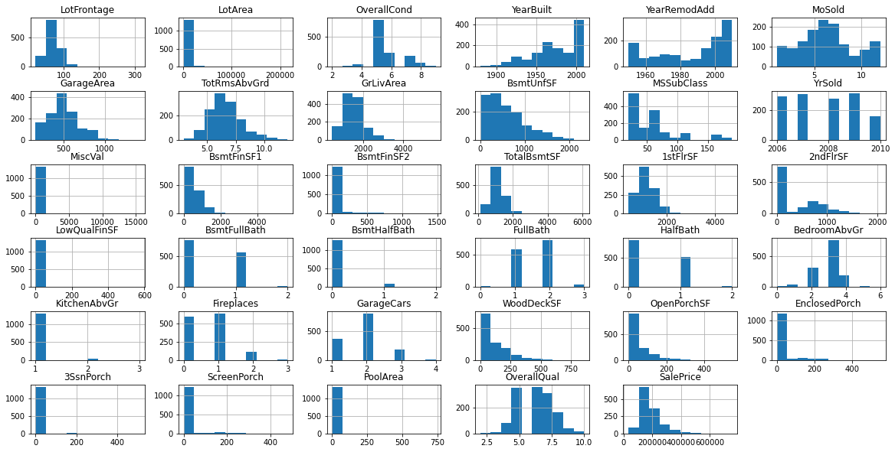

Slide 3
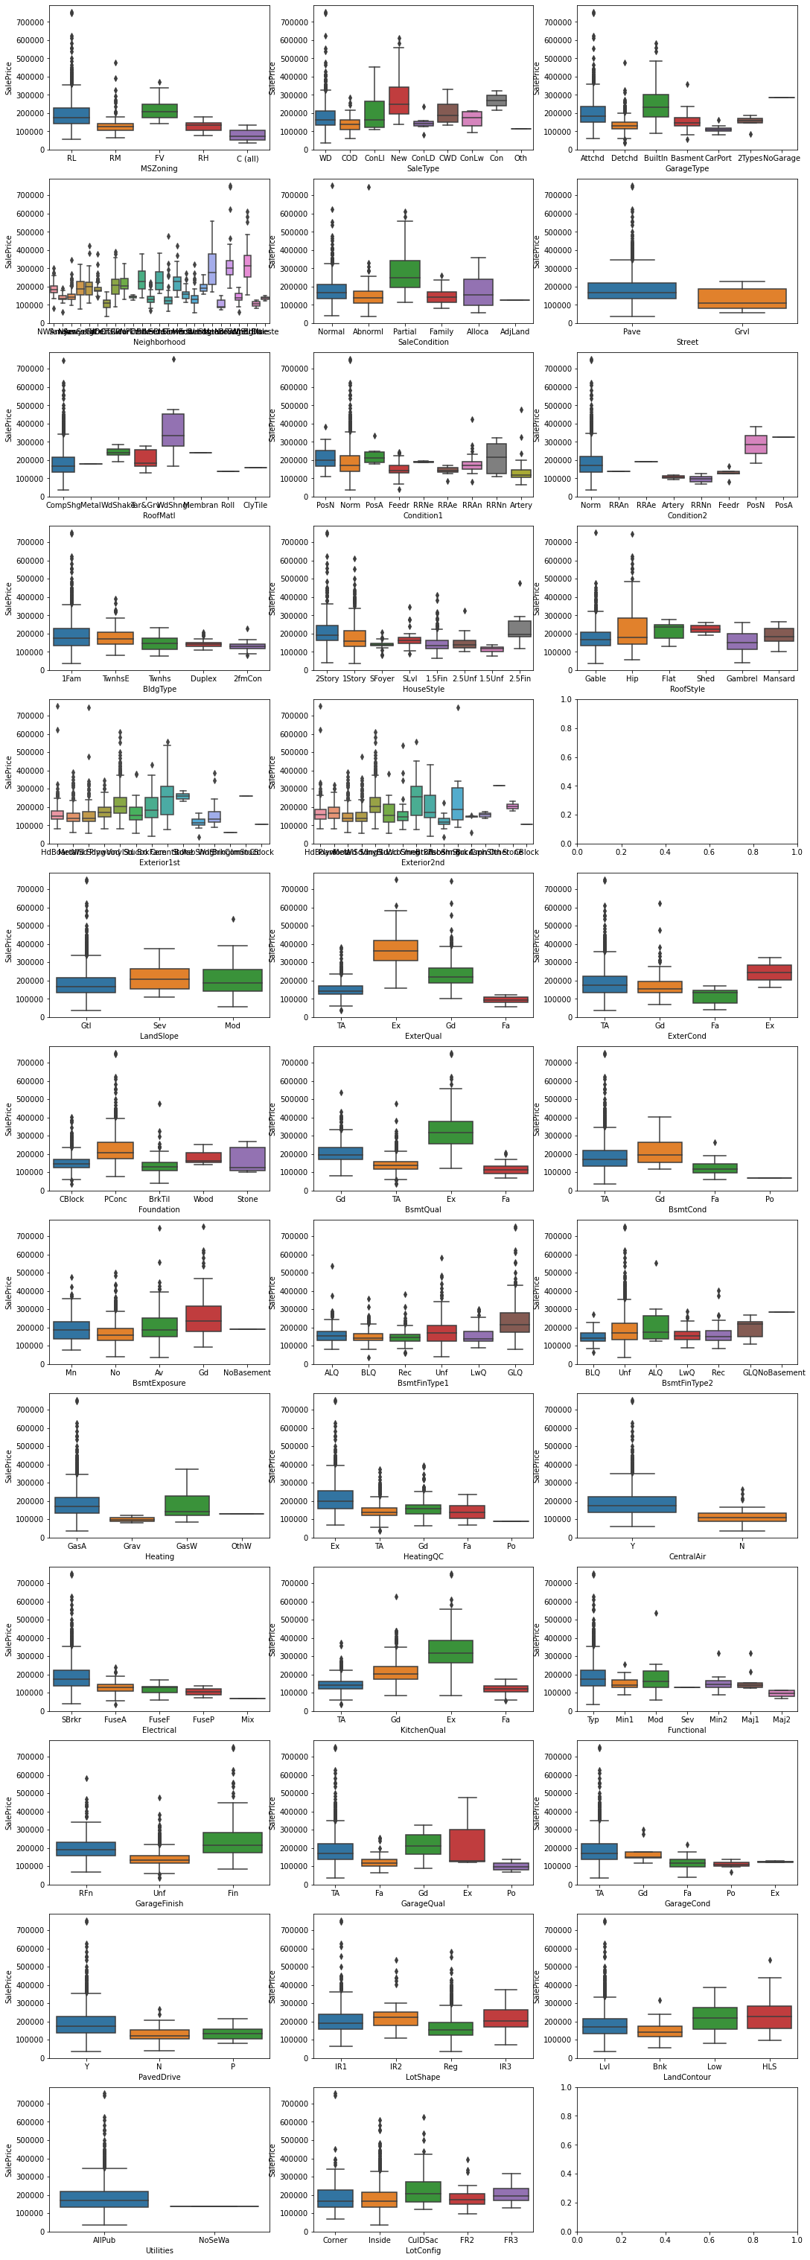

Slide 4
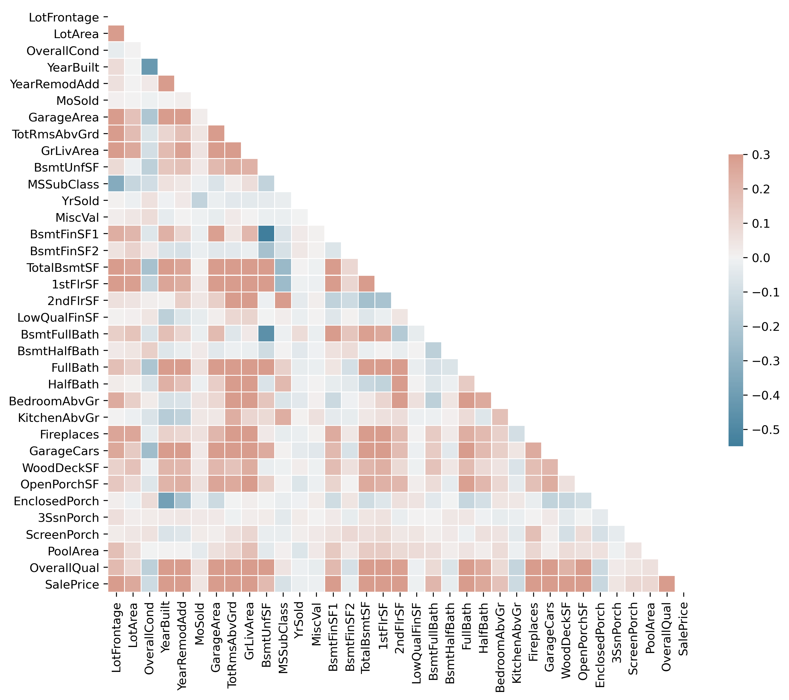
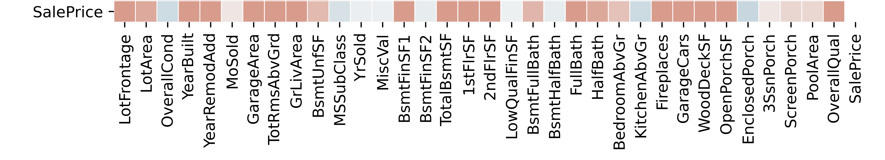

Slide 6
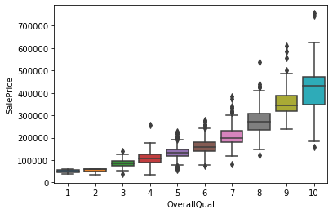
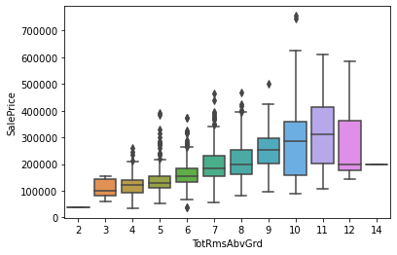

Slide 7
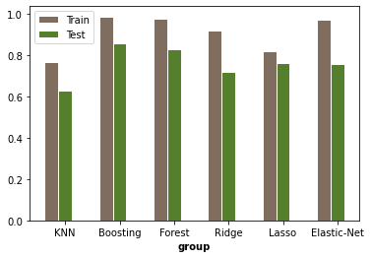
R^2 for each model

Slide 8
OverallQual 5.511098e-01
GrLivArea 1.048316e-01
1stFlrSF 3.950110e-02
TotalBsmtSF 3.405322e-02
TotRmsAbvGrd 3.219547e-02
FullBath 2.523578e-02
GarageCars 2.502288e-02
BsmtFinSF1 2.077941e-02
LotArea 1.503432e-02
GarageArea 1.239014e-02
2ndFlrSF 1.237187e-02
YearBuilt 1.035300e-02
LotFrontage 7.319079e-03
YearRemodAdd 6.743176e-03
OpenPorchSF 5.601502e-03

Slide 9
