Slide 1

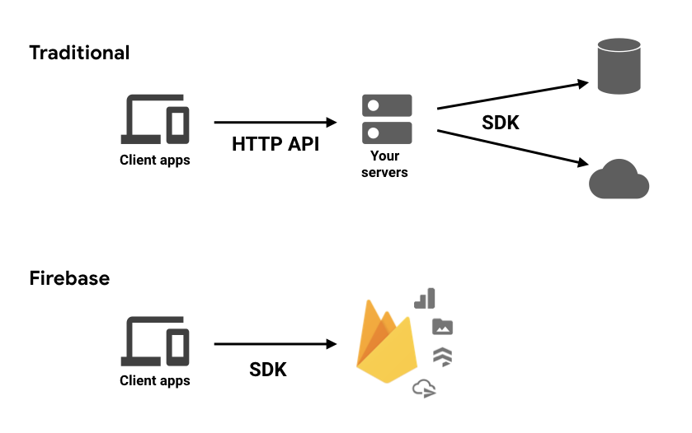
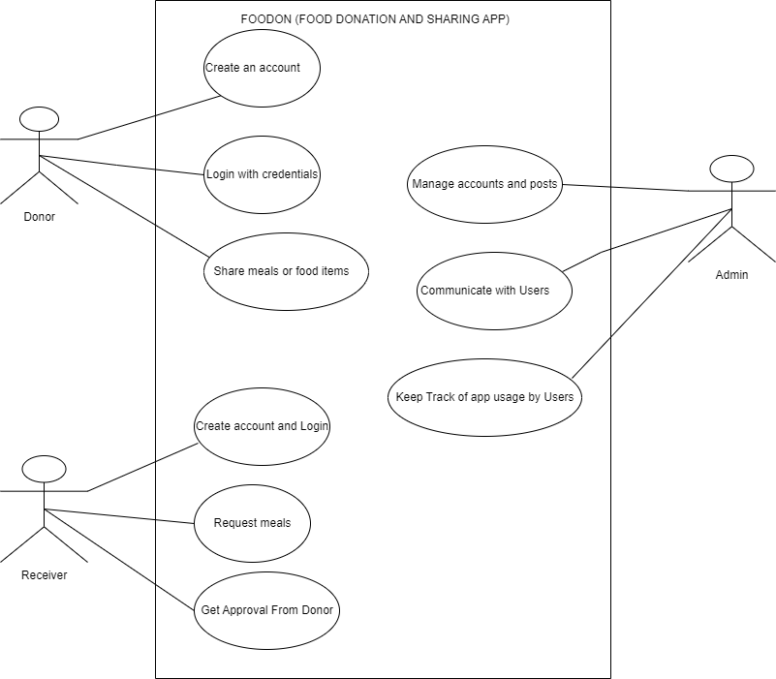

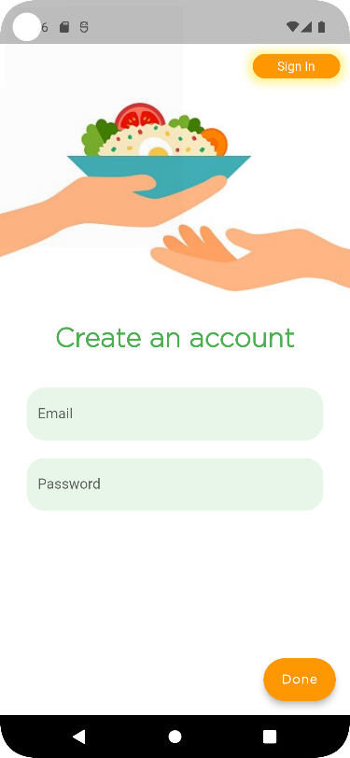
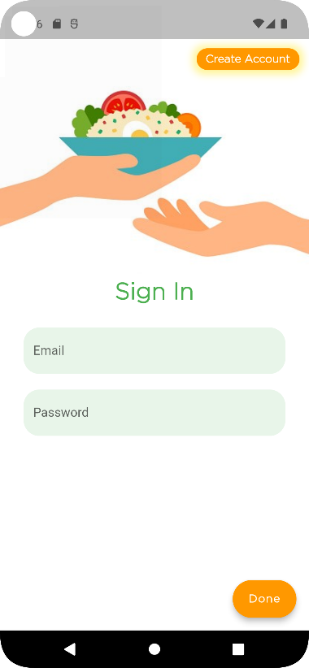
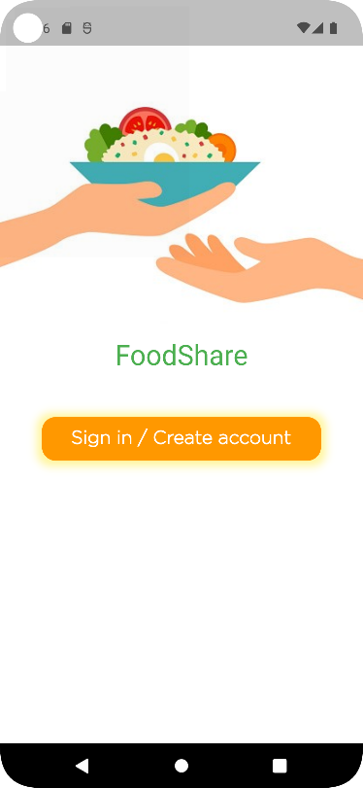
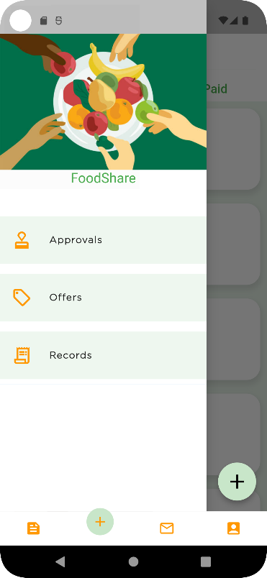
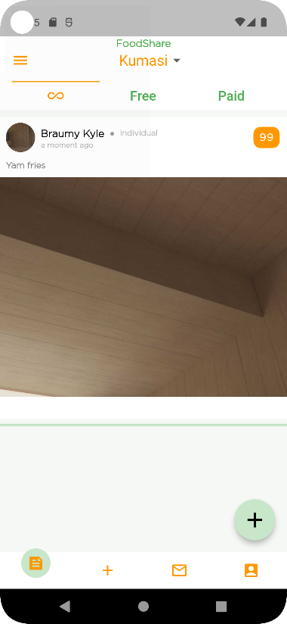
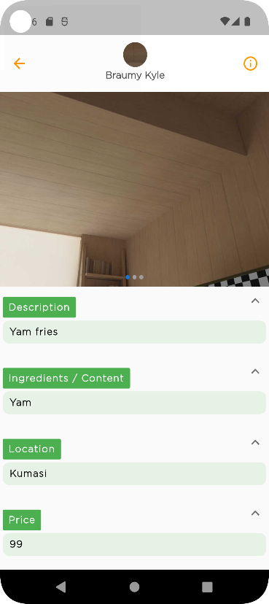
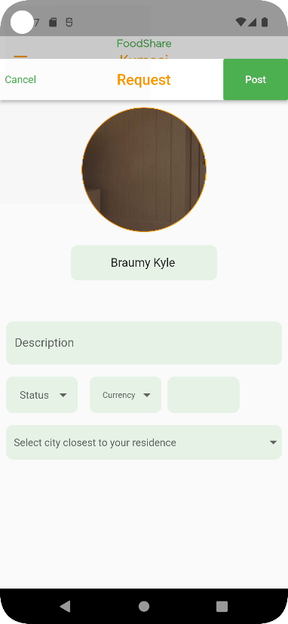
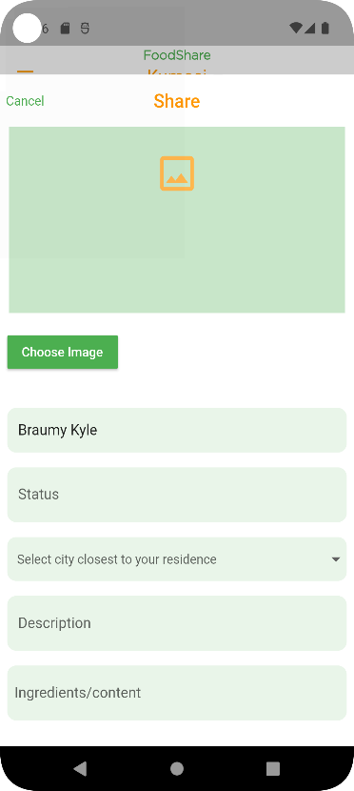
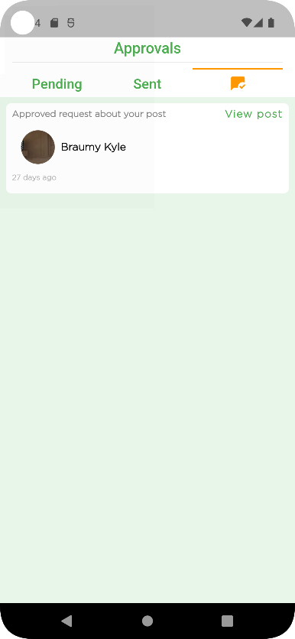
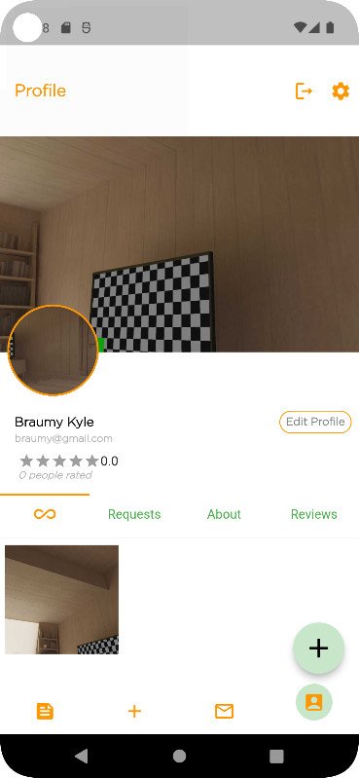
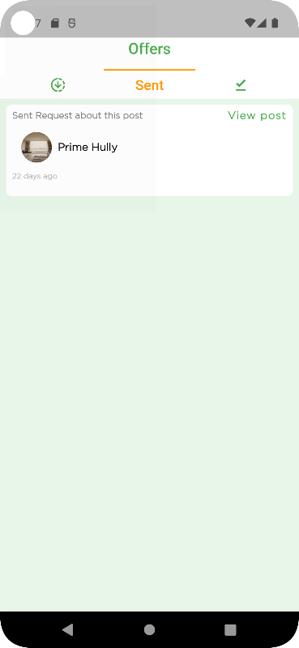
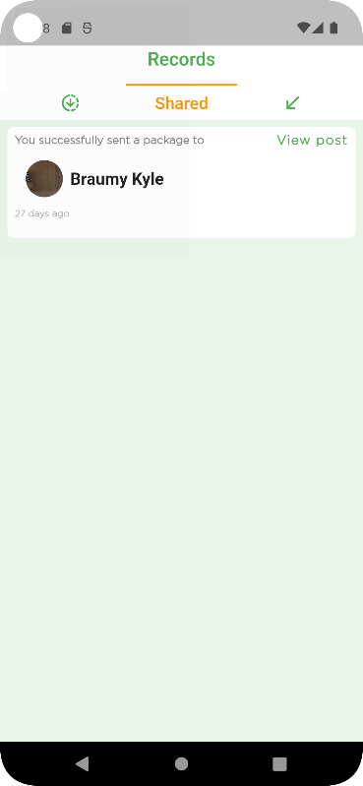
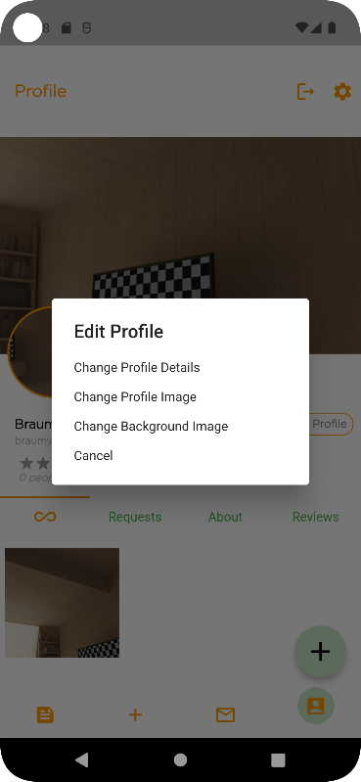
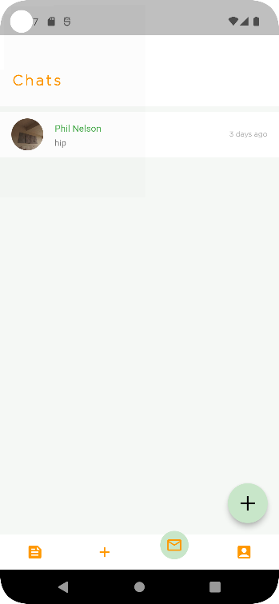
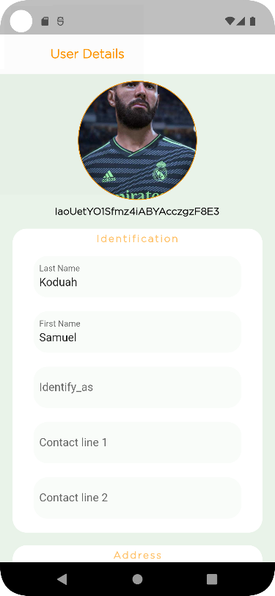
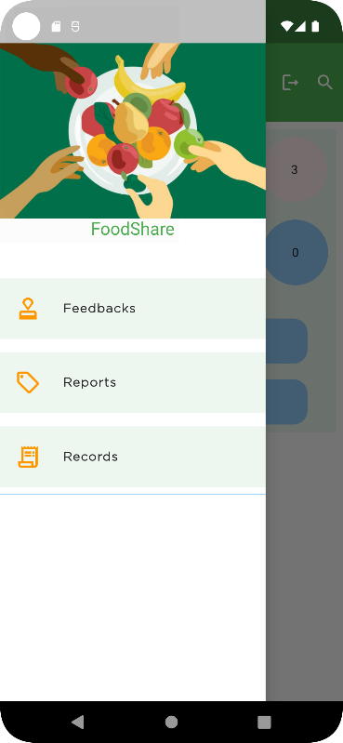
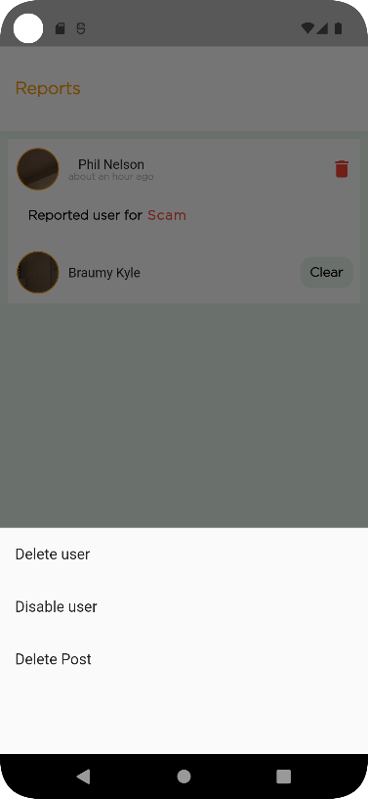
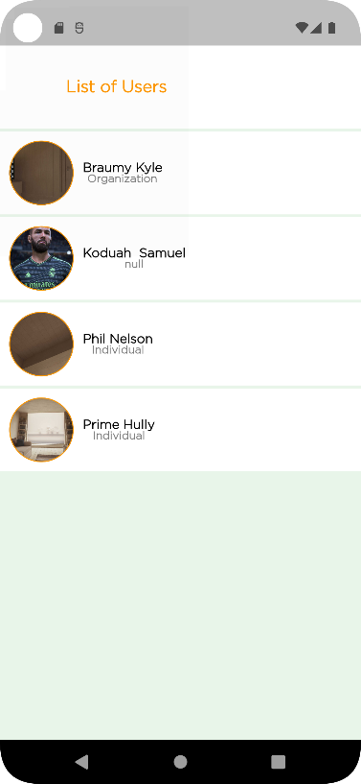
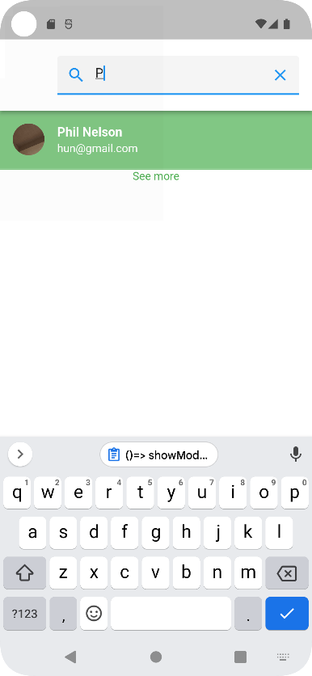
DEVELOPING A FOOD-DONATION AND SHARING
MOBILE APPLICATION TO CURB HUNGER CRISIS
Benjamin L. Ollennu, Samuel K. Sarpong
College of Science | Department Of Computer Science | KNUST, Ghana
ABSTRACT
METHODOLOGY
IMPLEMENTATION AND RESULTS
There is a global food crisis, and many people are perishing from a lack of adequate food each day. Many individuals are physically famished and begging for charity, despite the fact that many of them do not even receive two meals every day. Given this, it is best to contribute extra food to those in need as opposed to throwing it away. In order to support SDG2 (stop world hunger) and improve wellbeing, we should promote food donation and sharing. The system provides a platform with powerful features to share excess food with communities or individuals who are hunger-stricken, for free or at a low cost. Less useful features were supplied by the earlier systems.
On the basis of the android architecture, the system (FOODON) was created as a mobile application.
The mobile application was easier to program because to the use of Android Studio IDEA.
Plugins were made available for the application using the Flutter SDK.
Both the application's front end and back end are programmed using Dart.
The online database used to store user and application data and verify user credentials was Flutter Firebase by Google.
Here are some user features :
Require log in credentials to use the app.
Personalize profiles
Share meals or food items.
Send an acceptance request to indicate interest in a specific post.
Request meals or food items.
Make an offer to users requesting for food items or meals.
Communicate in-app.
Report posts and other users.
Review other users.
Rate other users.
Send a feedback to developer for app improvement.
INTRODUCTION
Since 2019, the number of people experiencing acute food insecurity has increased from 135 million to 345 million, meaning that as many as 828 million people go to bed hungry every night. A total of 50 million individuals in 45 different nations are on the verge of going hungry.
According to a study, more than 99 million children under the age of five are still underweight and undernourished worldwide, and hunger is to blame for about half of all child fatalities. Food is being squandered throughout.
Here are some Admin features :
Require log in credentials to use the app.
Handle posts and account reports.
Keep track of the app usage by users.
Handle feedbacks from users.
Delete users and posts from database.
Disable users from using the app.
PROBLEM STATEMENT
TEST & EVALUATION
According to an Oxfam research from 2021, between 7,750 and 15,345 people die from hunger and malnutrition every day. This indicates that up to 11 people every minute pass away from starvation. The research states that this is higher than the COVID death rate, which was approximately 7 persons per minute in July 2021.
Food and Agriculture Organization of the United States found that 1.3 billion tonnes, or almost one-third, of the food produced annually for human consumption worldwide is lost to waste. The majority of people are unaware of the amount of food they waste every day, including uneaten leftovers, perishable foods, and fruit and vegetable portions that may be used in other ways.
By creating a food donation system that enables consumers to receive extra food from vendors, restaurants, residences, and volunteers, as well as supporting the battle against Zero Hunger (SDG 2).
We got people who tested the system and provided the following feedback:
They enjoyed how easy the software was to use.
Its user interface is friendly.
Amazing in-app communication capabilities.
The ability of the user to influence the system intrigued them.
For them, the ability to request meals or specific food products was a wonderful advantage.
System Interface
CONCLUSION
This study was motivated by the alarming rates of the global hunger crisis as well as food waste.
The creation of this system has demonstrated its potential as an effective software tool for using cutting-edge technology to fight global food waste and famine.
PROJECT AIMS AND OBJECTIVES
REFERENCES
This initiative intends to create a platform for people, organizations, or food merchants to connect and share meals and leftovers with people living in hunger-stricken places. This system includes key features such as indicating the number of nutrient-dense products and materials needed to produce meals and a chatroom to enhance user communication. This system aims to combat world hunger(SDG2), food wastage and promote good health(SD3)
https://www.epa.gov/recycle/preventing-wasted-food-home
https://www.wfp.org/global-hunger-crisis
https://www.unep.org/thinkeatsave/get-informed/worldwide-food-waste
https://www.goodgoodgood.co/articles/how-we-can-all-help-end-world-hunger
https://www.fao.org/news/story/en/item/196402/icode/
We give thanks to the All-Powerful God for His direction and favor throughout our effort. Additionally, we are very appreciative to Dr. Eric Opoku Osei, our supervisor, for his presence and the guidance he provided us with throughout the project. We are grateful.

