Slide 1
Hearthstone Design Process
By Kyle Dennison

Slide 2
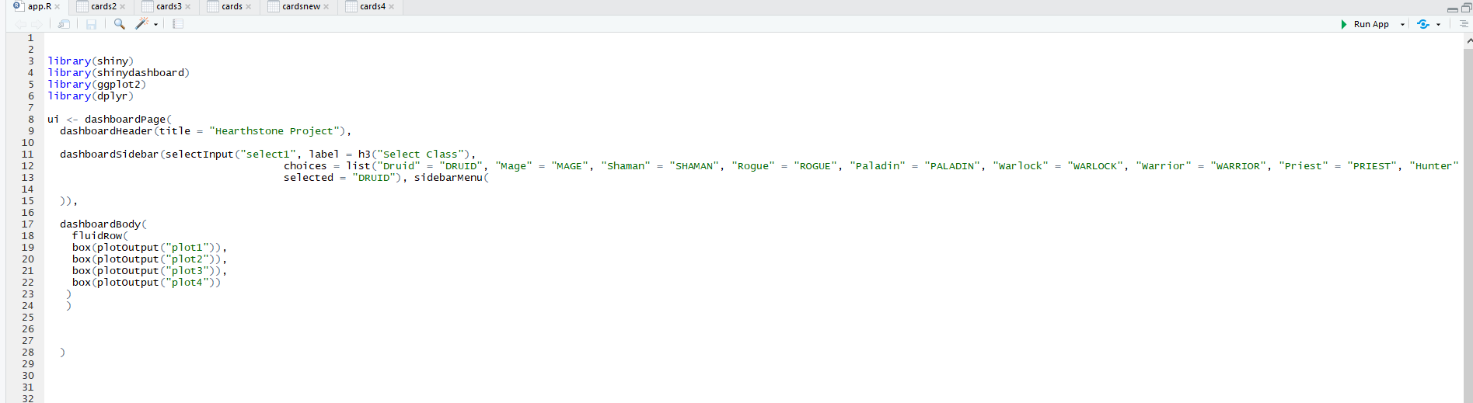
The UI

Slide 3
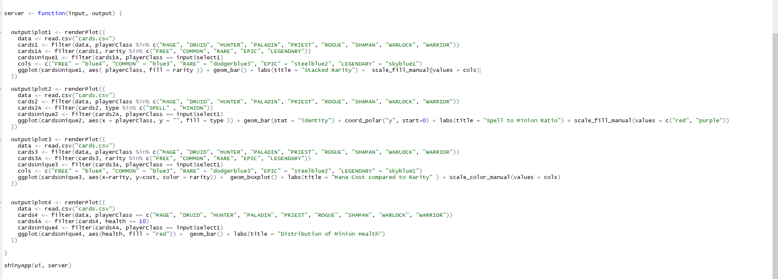
The Server

