Slide 1
Modeling Worldwide Suicide Data
By Kyle Dennison and Joshua Ingram

Slide 2
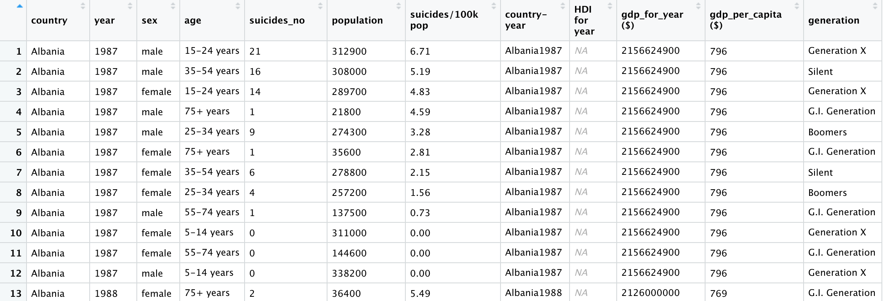
Dataset
“Suicide Rates Overview 1985 to 2016”
https://www.kaggle.com/russellyates88/suicide-rates-overview-1985-to-2016

Slide 3
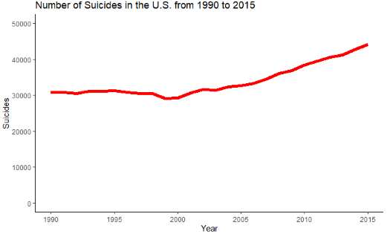
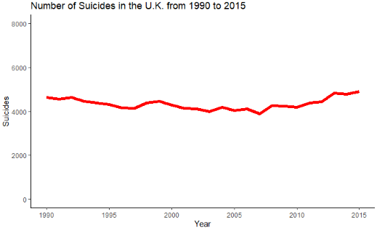

Slide 4
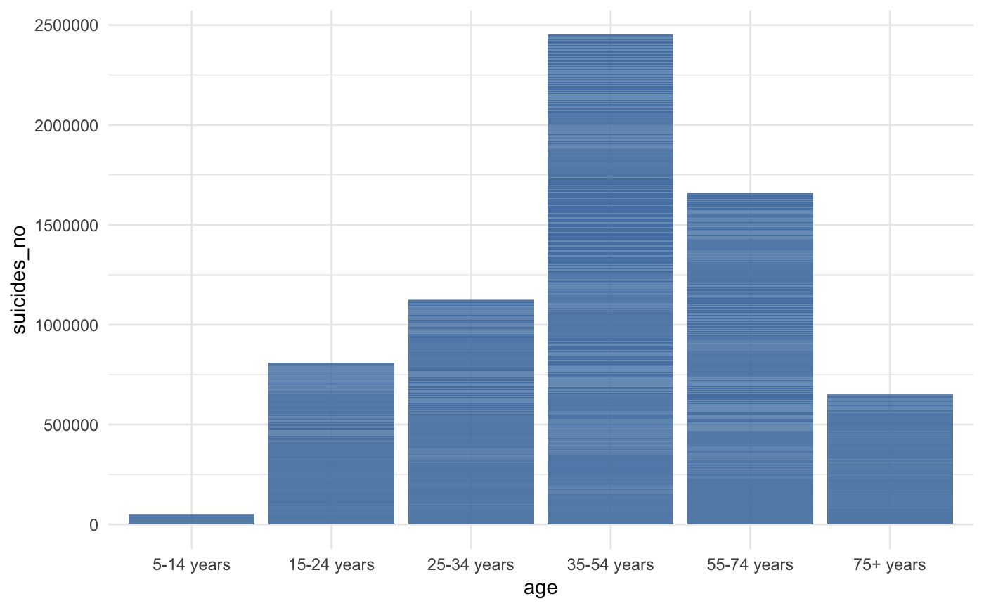

Slide 5
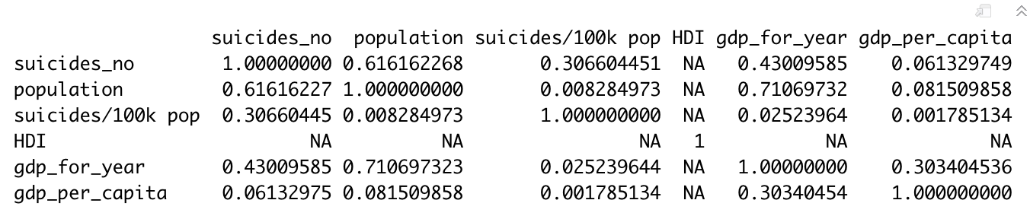
Correlations
VIF

Slide 6
Question 1
How accurately can demographic information like sex, age, and generation be used to predict the number of suicides per 100K population?
How does this accuracy change over the years?
Does a single decision tree, bagged model, or RandomForrest technique perform best at this task?

Slide 7
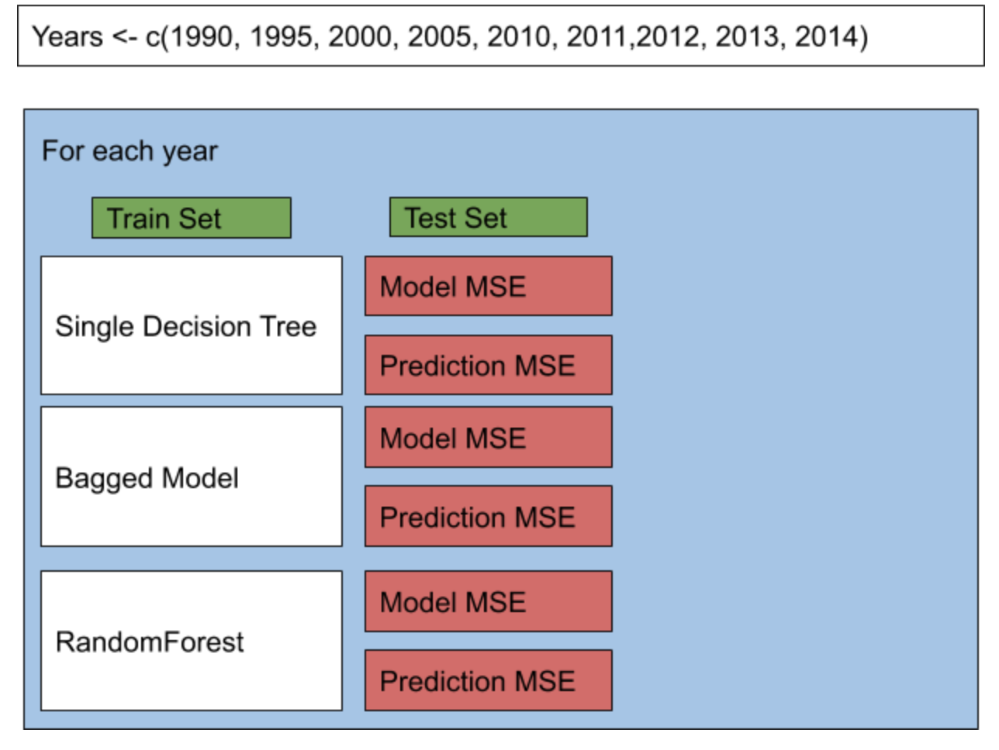

Slide 8
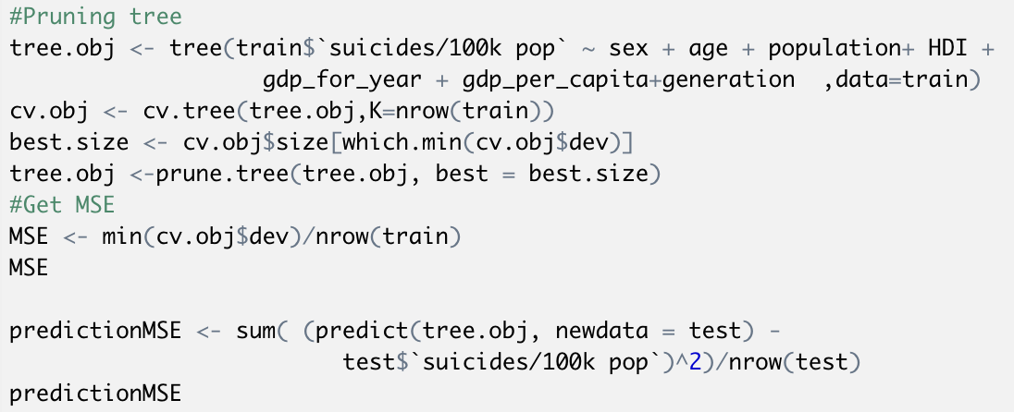


Slide 9
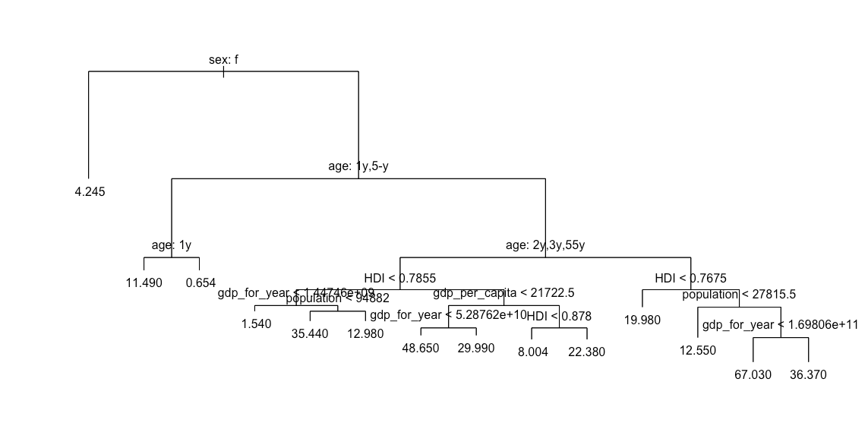

Slide 10
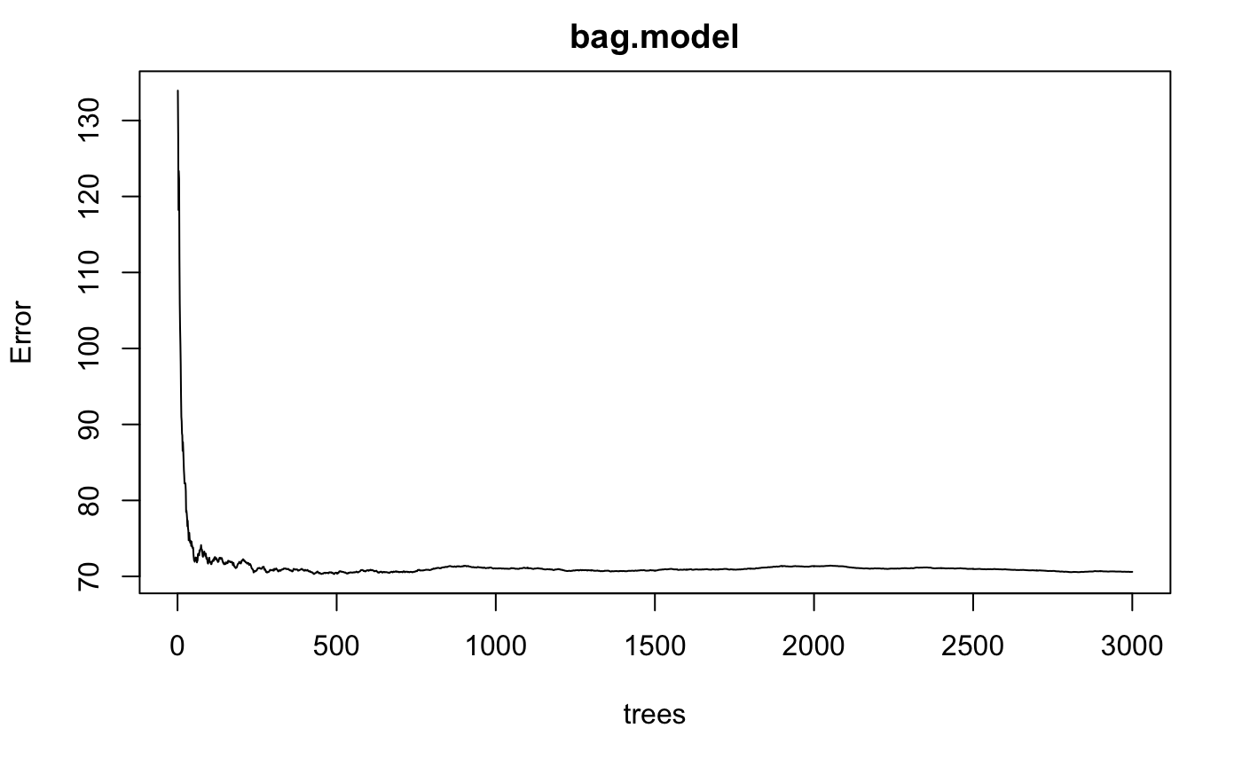

Slide 11
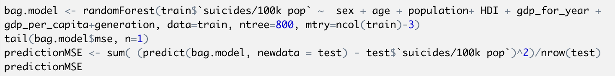

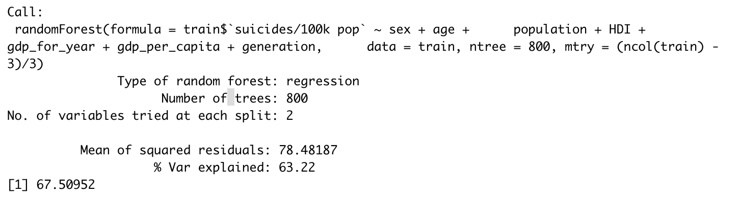

Slide 12
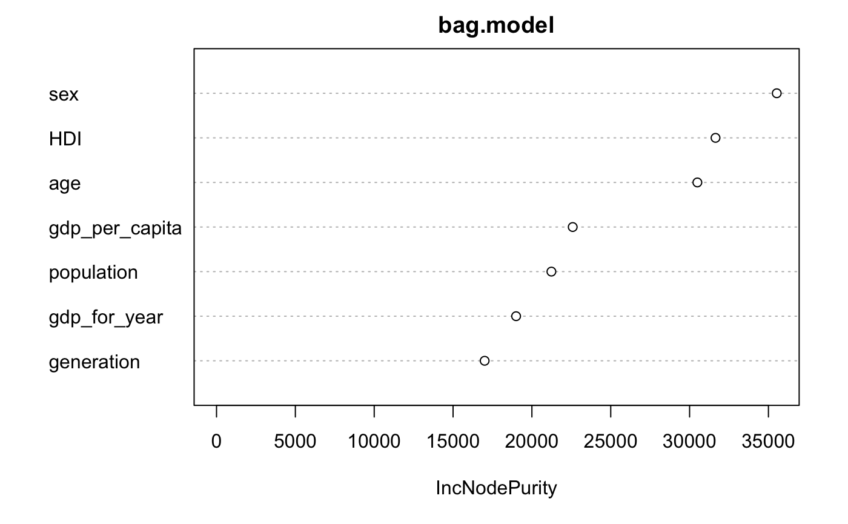
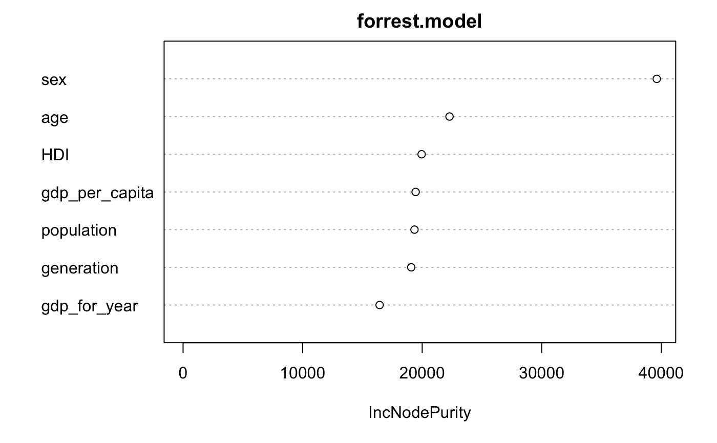

Slide 13
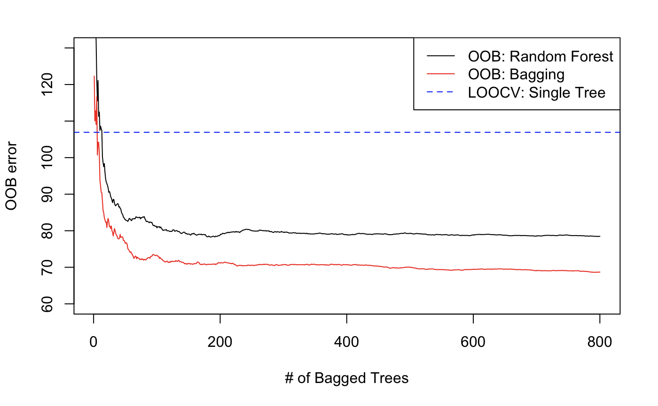

Slide 14
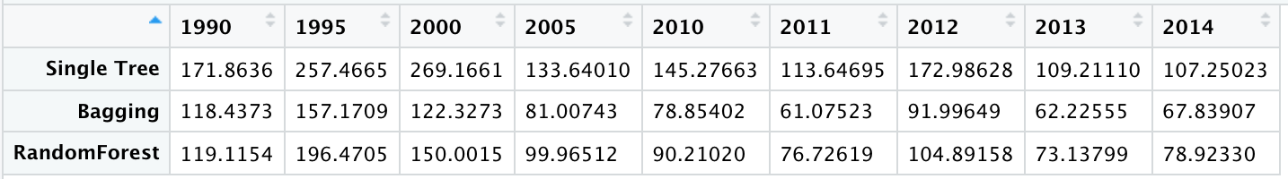
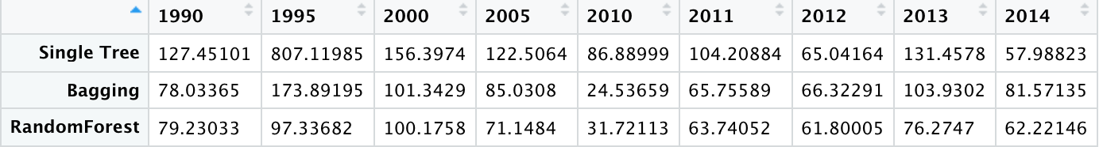
Model MSE
Prediction MSE

Slide 15
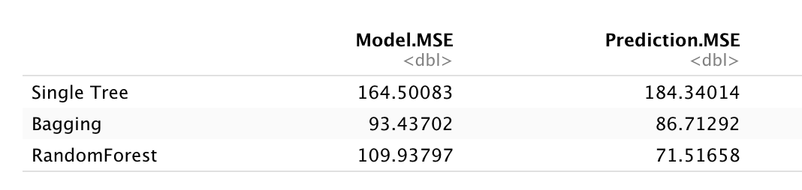

Slide 16
Question 2
Is there an association between GDP per capita and suicides per 100k?
If so, could there be significant interaction between GDP per capita and a country’s region or development level?

Slide 17
Data Wrangling
5.81% of the values were NA
2 Subsets of the data
Suicides by demographic information (demographic.suicides)
Aggregate Suicides (aggregate.suicides)
2 new variables
Region (Asia, Africa, etc.)
Development (high, medium, low or very low, and unknown)
After model selection and due to the limitation of the log(y) transformation, observations that had 0 suicides were removed (15.04% rows for demographic.suicides, 2.7% rows for aggregate.suicides)

Slide 18
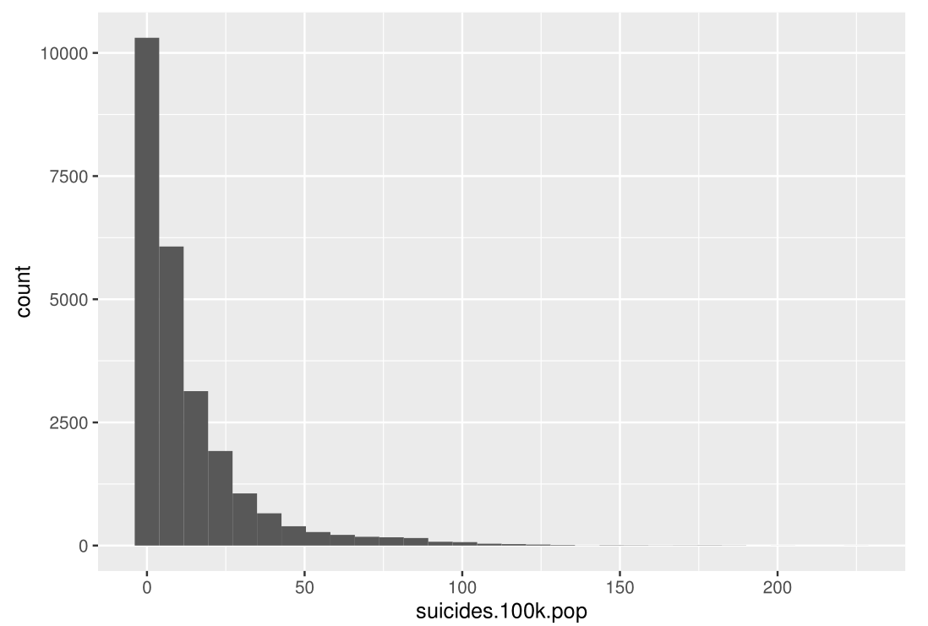
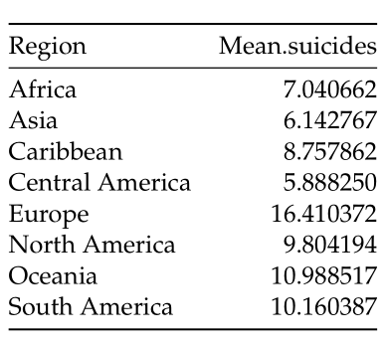
Data Overview

Slide 19
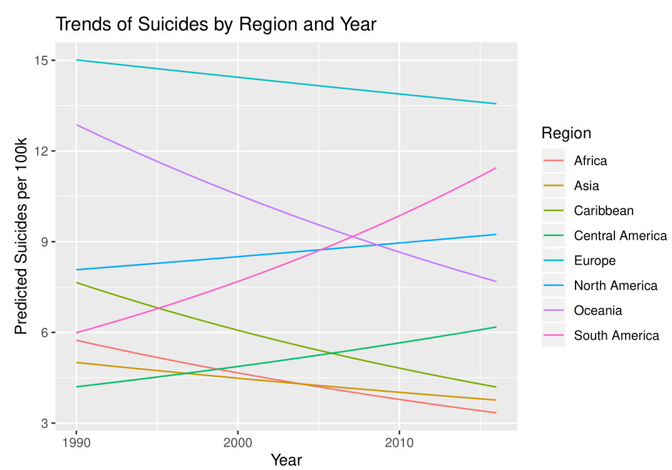
Data Overview

Slide 20
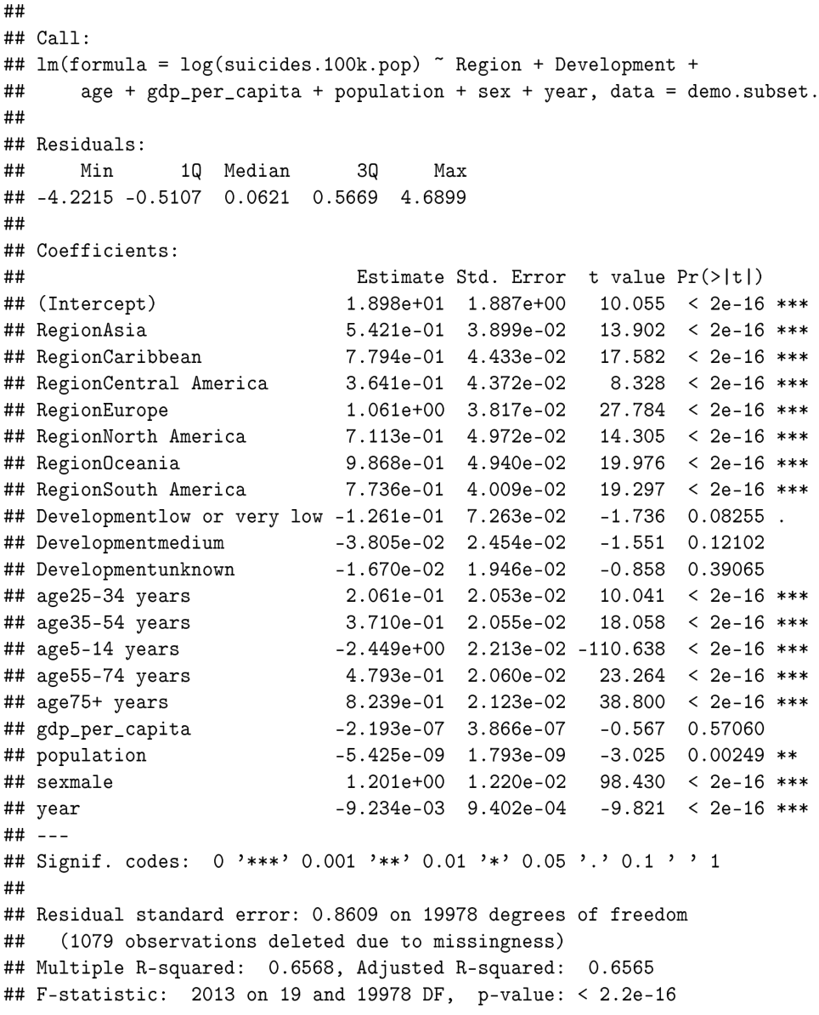
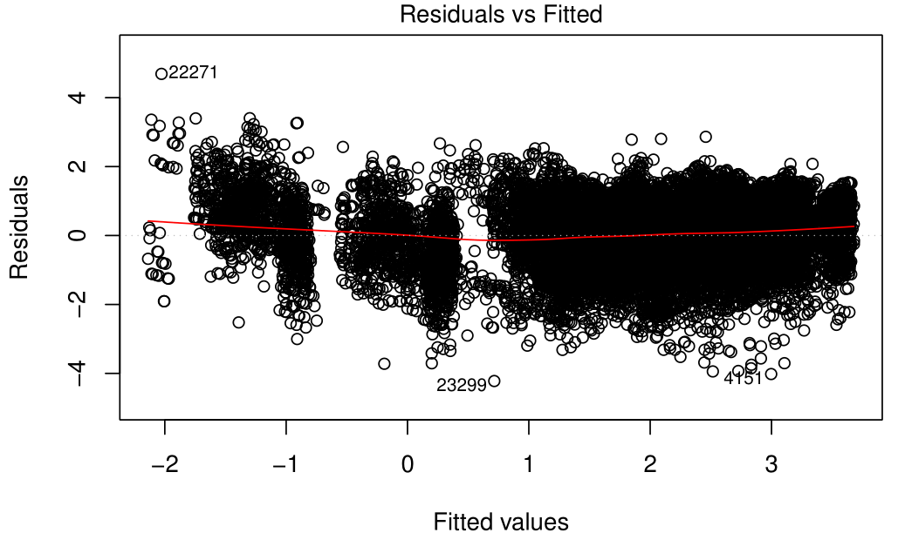
Demographic Suicides Model
log(y) transformation

Slide 21
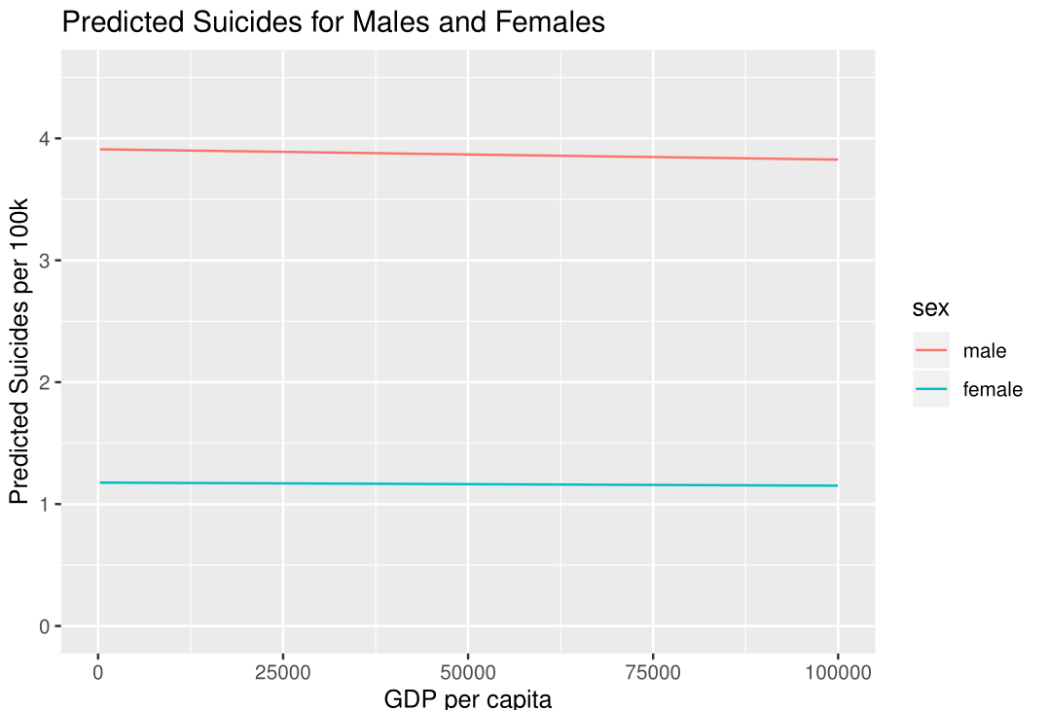
Demographic Model Visualization
“Holding all other variables constant, on average, we predict that the number of suicides per 100k will be 3.324 times greater for males than that of females”

Slide 22
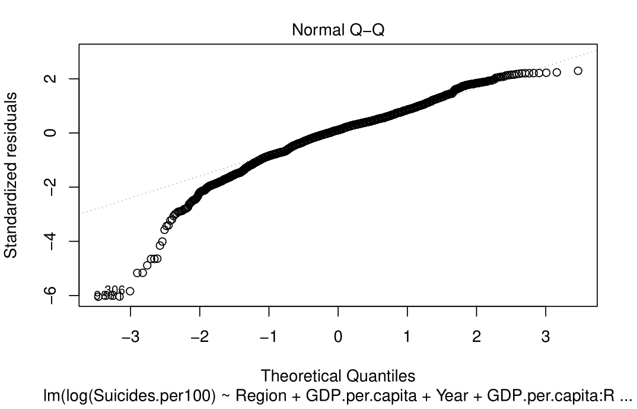
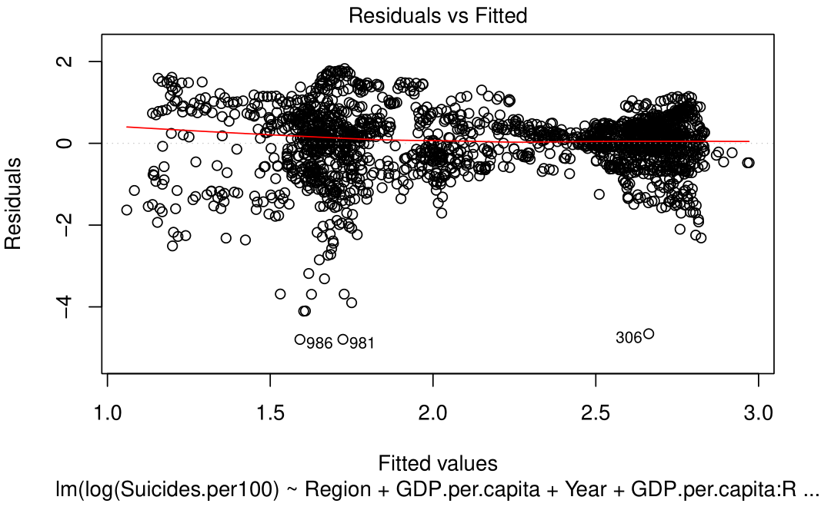
Aggregate Suicide Data Model Selection
Log(Suicides.per100) ~ Region + GDP.per.capita + Year + GDP.per.capita:Region

Slide 23
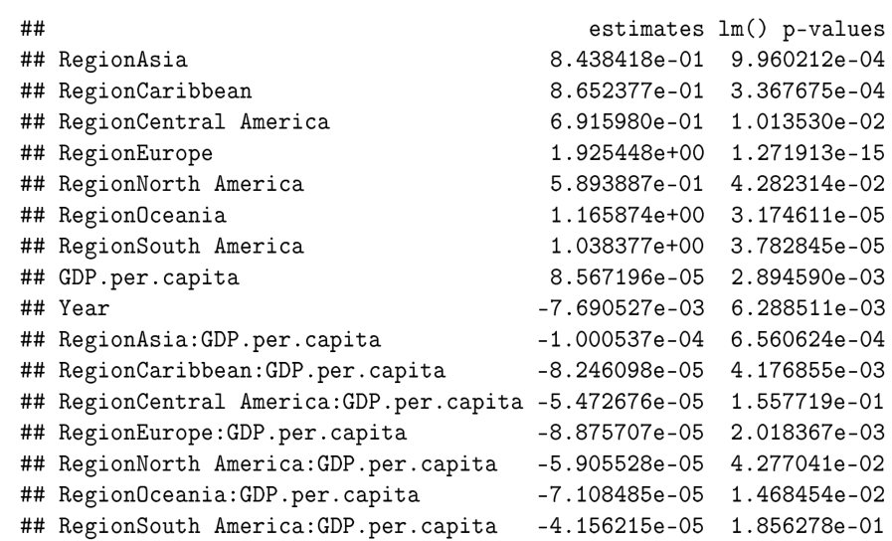
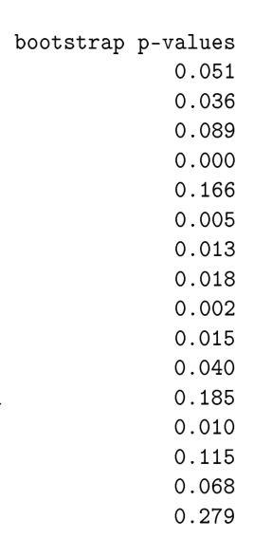
Aggregate Suicide Data Model Selection

Slide 24
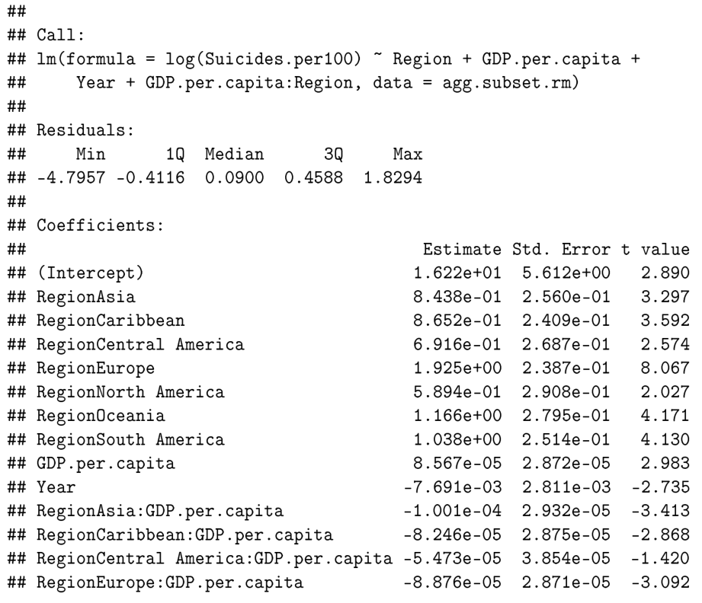
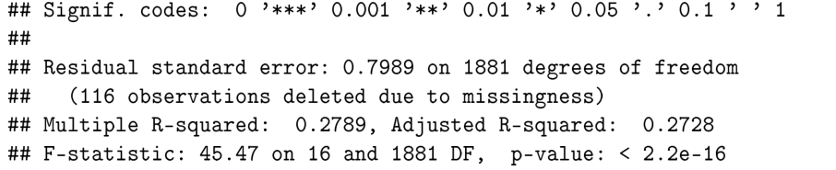
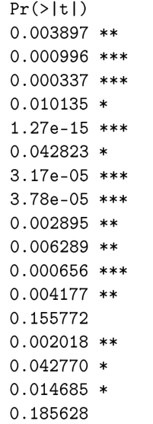

Final Aggregate Suicide Data Model

Slide 25
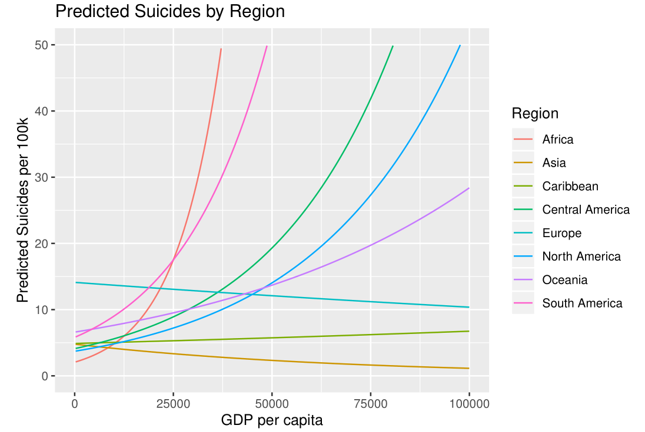
Model Interpretation and Visualization
“In the year 2015 in North America, we predict, on average, for the number of suicides per 100k to increase by 2.7% for every $1,000 increase in GDP per capita.”

