Slide 1
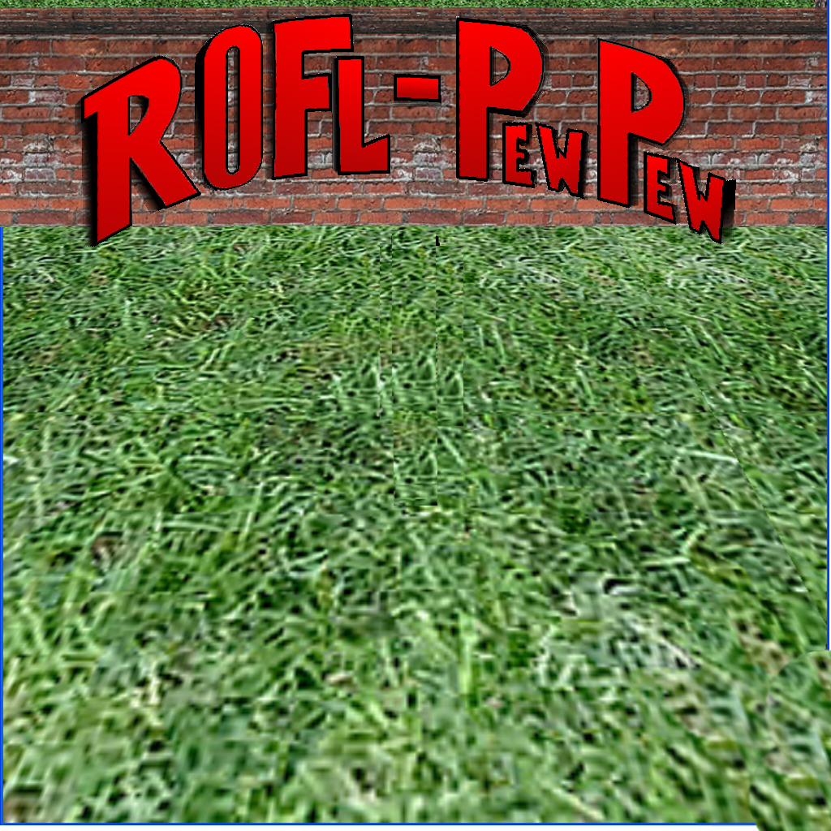
Advanced Project CS4431
Gage Patterson
Adam Humenuik
Kyle Galvin
Scott Herman
Mike Rioux
Todd Burton
Notes:
<number>

Slide 2
Two Contributing Teams
Team Gate’s Wallet
Scott Herman
Gage Patterson
Kyle Galvin
Team Ballmer’s Peak
Mike Rioux
Adam Humeniuk
Todd Burton

Slide 3
ROFLPewPew
What is it?
A multi-perspective shooter style game programmed in C#.
Goal?
Survive swarms of hostile zombies while also advancing through the levels.
Plus!
A network ready game with up to four players able to face off with each other for high action gameplay.

Slide 4
Tools Used
C# version 3.5
Visual Studio Suite – C# IDE
OpenTK – C# OpenGL library
OpenAL – C# sound library
GIMP – Image Editing
Blender – 3D modeling
Resharpen – code editing tool
Doxygen – code documentation tool
SubVersion – code repository
Coffee!

Slide 5
Sounds
Used OpenAL sound libraries
All functionality encapsulated in one SoundHandler class
Name and location for each sound
Sounds stored in .wav format
Upper limit of five sounds at once
Provided a mute function

Slide 6

Sounds
Simply call the play function of the SoundHandler class and specify the name of the sound to be played
Background music for each level
15 zombie roars, 5 boss roars, pistol, rifle, shotgun, reload ammo, player death, etc.
Background Music
Gun Sounds
Zombie Roars
Boss Roars
Player Sounds

Slide 7
Text
TextHandler class handles all functionality for displaying text on screen
Specify the location of the alphabet image
The alphabet image contains all letters and numbers at specific locations

Slide 8
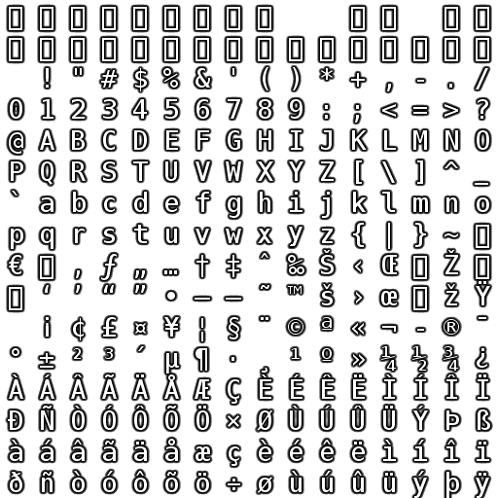

Slide 9
Text
Based on ASCII code, the specific letter block is drawn as an image
Simply call the WriteText function, specify the text to print, the location, and size

Slide 10
Images
Similar to drawing text, created an ImageHandler class
Load each image once when the game loads
To draw an image, specify its loaded number, location, size similar to drawing text
Images in our game are stored as transparent PNG files

Slide 11


Health Bars
Used Adobe Flash CS5 to draw them
Load health bar and background images into game
Expand/compress the health bar image width based on the player’s numerical health value

Slide 12
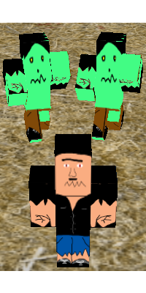
Graphics
All textures
Ground/Walls
Logos
Various Titles
Blood Splatters
Splash Screen

Slide 13


Textures
Grid
Mapping
Types
Size

Slide 14









Logos / Various Titles
Game Over / Win
Levels
Controls Menu
Sound on/off
Gun Available/Selected
Splash Screen
Buttons

Slide 15





Blood Splatters
Gimp Demonstration
Alpha Curves
Special Brushes

Slide 16
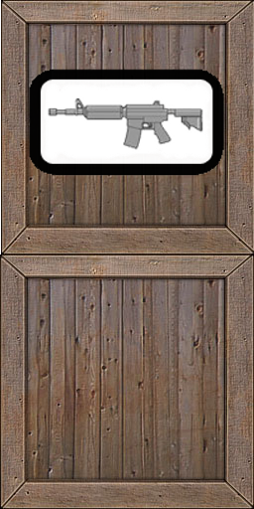







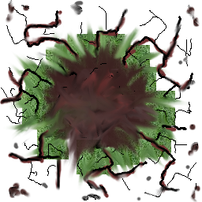
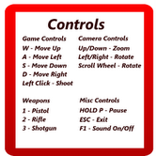

Misc Textures

Slide 17
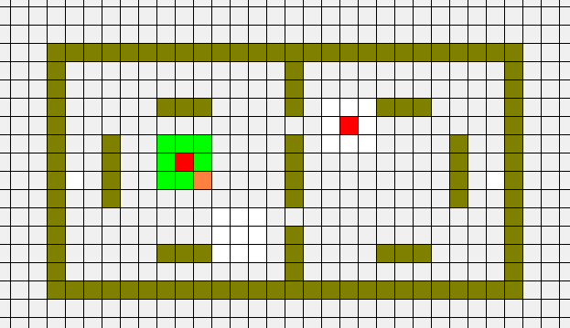
Collision Checks
Broad and narrow phase collision detection enhances efficiency
Zombies spread out evenly

Slide 18
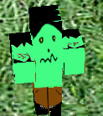
3D Object Loading and Animation
3D Objects are saved in .obj files
These are loaded when the game first runs
The game draws these objects based on their assigned index value stored in a buffer
Animation is accomplished through simple OpenGL translate and rotate calls

Slide 19
Shooting Logic
Each gun has a different cooldown
The bullets go towards where the mouse is
The direction is set by transforming the mouse’s pixel location into OpenGL space

Slide 20
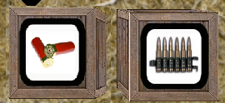
Ammo Pick Ups
There are two different pick up types in the game: rifle ammo and shotgun ammo
Whenever the player kills a zombie there is a chance that an ammo crate will spawn
When the player walks over the crate it will increase the players ammo for that weapon type

Slide 21
Effects Handler
This class holds all of the logic for blood splatters showing up and fading out
It also handles other special effects which will be seen in the single player demo

Slide 22
Pathfinding
Refered to this tutorial http://www.codeguru.com/csharp/csharp/cs_misc/designtechniques/article.php/c12527
A* algorithm
Manhattan hueristic
Uses a byte[,] grid to find the shortest path.
1 is open, 0 is a wall.

Slide 23
Tile List
When the level is loaded a tile list is created to be used in path finding and collision.
The tile list contains information about walls and their position as well as the min/max values for each level.
The tile list is used for:
Creates the byte[,] used for enemy path finding
Player collision with walls
Bullet collision with walls
Ammo crate spawning in multiplayer

Slide 24
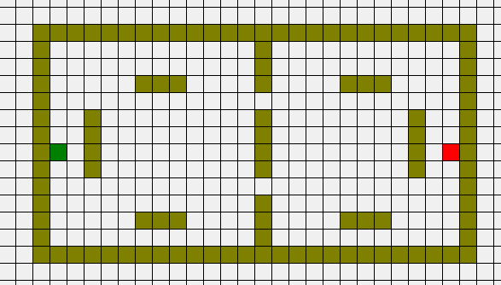
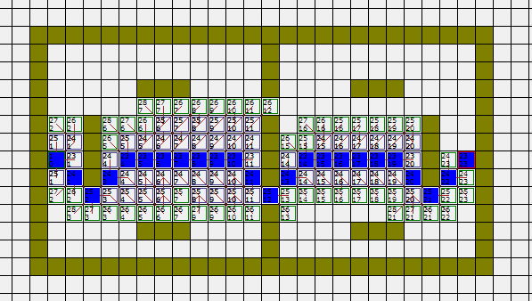
Path Finding Example
Initial state of the map
Shortest path is found
Green represents start
Red represents finish
Values are calculated based of the Manhattan heuristic

Slide 25
Level Design
XML files store data pertaining to each level.
Wall Locations
Player spawn points
Enemy spawn points
Very easy to edit and create levels with no impact on the code base.

Slide 26
Networking
Up to 4 players connected at a time
Network architecture based on TCP protocol
Data encapsulated in 32 bit chunks
Game connects on port 9999

Slide 27
Packet Structure
32 bit header describes the size and function of the packet.
3 Major parts to the header:
Action: Create/Delete/Update/Request
Type: Player/Bullet/Powerup
Count: Number of objects in this packet.

Slide 28
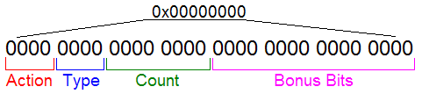
Packet Structure In Depth
Example: 0x11010000 will translate to…
Action : 1 = Delete
Type : 1 = AI
Count : 1
The server will send a packet with this data to all clients. All clients will then handle the packet appropriately and delete an enemy from their game state.

Slide 29
Packet Structure In Depth (Cont.)
Each type is associated with a type size.
Each type size describes the number of 32 bit values the network uses to represent that object.
Packet size = (Count * TypeSize + 1) * 32bits
Packet structure declares itself complete when it reads enough data to fill its size as determined by the header calculation

Slide 30
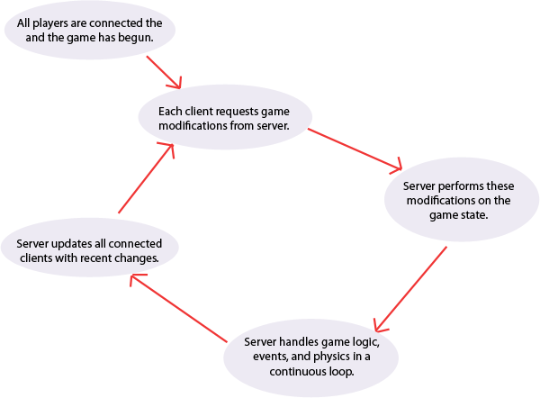
Network Process Flow

Slide 31
A Game Made with Potential
This game has been designed to compliment adding new features with ease.
Single Player:
•Additional levels.
•Player Levels
•Advanced mesh objects.
•New weapons/Crate types (i.e. grenades, power-ups)
Multiplayer:
•More players per game instance.
•Co-operative single player games.
•Ranking system.
•Statistics accumulated each game and saved to a database.
•Team versus Team.

Slide 32
Presentations
Single Player Demo
Adam Humenuik, Todd Burton, and Mike Rioux
Multiplayer Demo
Kyle Galvin, Scott Herman, and Gage Patterson

