Slide 1


Slide 2


Slide 3

Wergaia

Slide 4
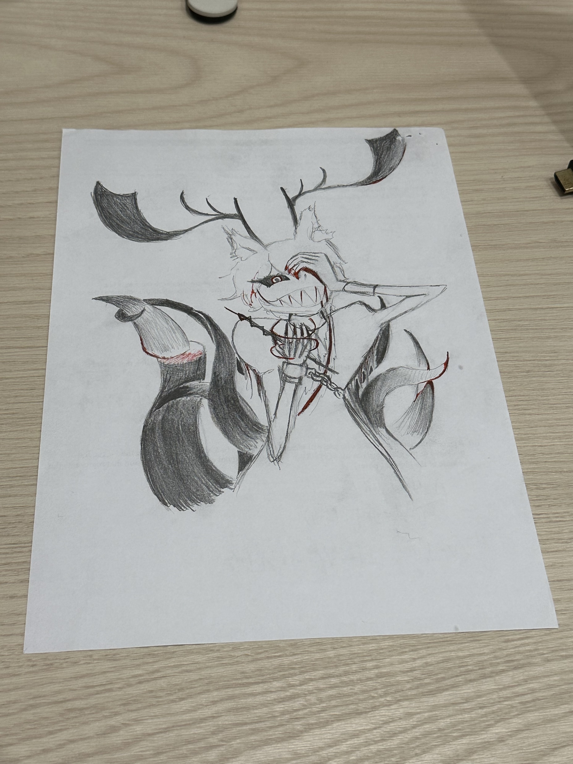
https://www.youtube.com/shorts/0dXxNEILw38

