Slide 1
Efficiently Compiling Efficient Query Plans for Modern Hardware
By Kyle Imrie

Slide 2
Background on the Paper and the Author

Slide 3


Who is the author?
Paper was published by Thomas Neumann in June of 2011
Professor of Query Optimization and Database Systems at the Technical University of Munich

Slide 4
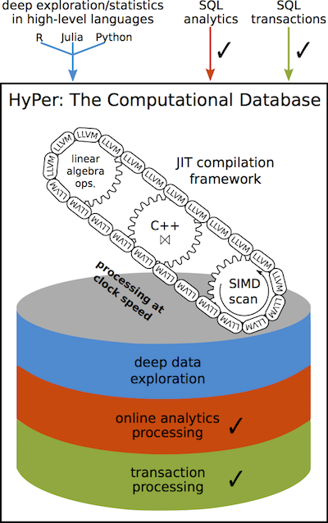
What else did he accomplish?
In April of 2011, he presented at the 27th International IEEE Conference on Data Engineering in Germany
At this presentation, he introduced HyPer, a hybrid OLTP/OLAP database management system
The ideas covered in this presentation are built into HyPer

Slide 5
What are the main takeaways of this paper?
What are the weaknesses of the Volcano style of query optimization?
How does the HyPer DBMS tackle these issues?
How is it all implemented and how well does it perform?

Slide 6
Weaknesses of the Volcano model of query optimization

Slide 7
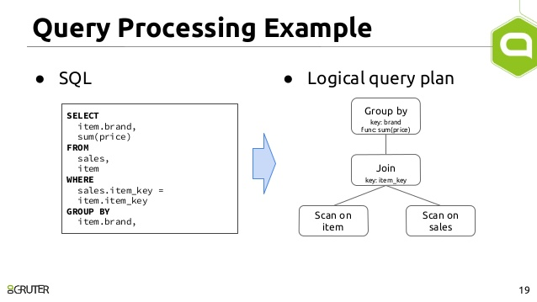
What is the Volcano model?
When you are telling SQL to run a query against your database, what is happening behind the scenes? Your declarative statements are translated into physical algebra and executed repeatedly over a stream of data tuples.

Slide 8
Components of a Query Plan
Picture each step of your logical plan as a function/method in some programming language, with a single data tuple as its input. Everytime you call this method, it does some work and outputs its results and seeks to the next tuple in the data stream.
In the iterative model, where you can have many intermediary steps as well as one final step, these functions are called millions of times. One of the aims of the author was to reduce the CPU consumption spent on these calls.

Slide 9
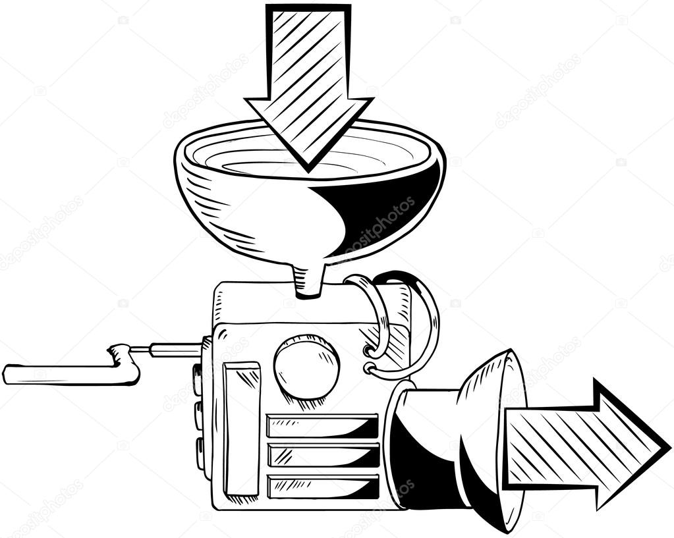
Other Issues
What if we operate on multiple tuples of data at once?
Vectorization is a step in the right direction, but it incurs the cost of having to load your data into memory (removes ability to pipeline together different operators into one)

Slide 10
How does the paper solve these issues?

Slide 11
Three Main Points: The Secret Sauce of HyPer
Processing is data centric, not operator centric
Emphasize data and code locality
Queries are compiled into native machine code

Slide 12
Moving from Operator Model to Data Model
In the iterative model, the operators would pull up the data tuples one at a time, constantly cycling through the extremely-high throughput CPU cache memory.
The system described in the paper seeks to keep as much data in the CPU registers for as long as possible.
In this way, the direction of data flow is reversed compared to the iterator model (the data is pushed to the operators rather than pulled from.

Slide 13
What does Data/Code Locality Mean?
Strong Data Locality => Data is stored close to where it will be processed, i.e in CPU registers
Weak Data Locality => Data is most often found in main memory or on disk
Strong Code Locality => Data is frequently being pushed in volume to the operators, allowing the operators to work longer without fetching more data
Weak Code Locality => Each time an operator iterates over a tuple, time is spent seeking to the next data tuple from memory

Slide 14
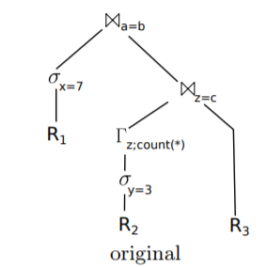
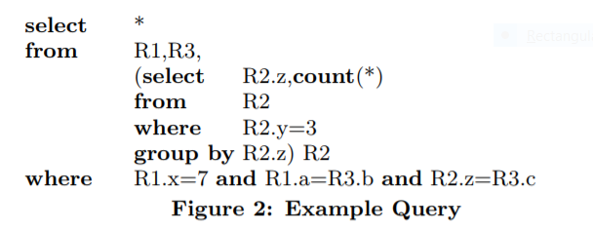
Example Query: Iterator Model
Notes:
Start from the top of the graph; Top Join operator asks for data tuples from left => puts those into a hash table => asks right operator for data tuples, continues recursively
Data is materialized in memory constantly; how would the data-centric model work?

Slide 15
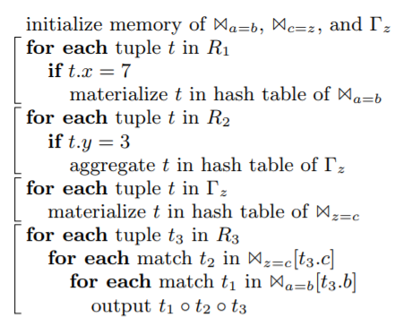
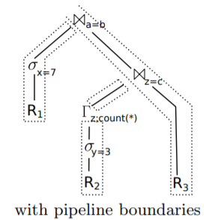
Example Query: Data-Centric Model
Notes:
Each dotted section represents a separate pipeline; all operations within those pipelines can be completed fully in CPU without materialization. Materialization points lie between the pipelines. Each FOR LOOP represents one of the pipelines. The boundaries of each operator become blurred; query plan is data-centric. Strong code locality as small cde fragments iterate over large quatities of data. Strong performance!

Slide 16
How do we build these plans?

Slide 17
Going from Algebra to Machine Code
When it comes to compiling your SQL query, the model introduced in this paper is quite similar to the iterator model:
SQL query is parsed
Query is translated into physical algebra
Algebraic expression is optimized
Instead of this expression being passed as an operator, we compile it into an imperative program (see prev example)

Slide 18
How well does it perform?

Slide 19
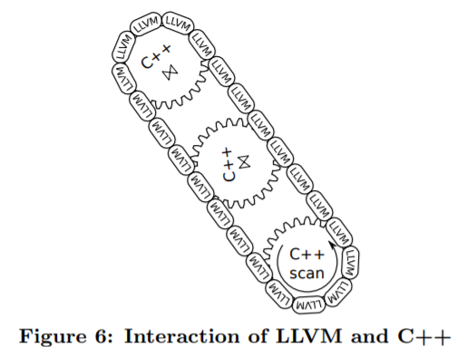
Inner Workings of the HyPer Compiler
Initial experiments in full C++ compilation at runtime led to full seconds of compiling time.
Instead, they compiled machine code using the Low Level Virtual Machine compiler framework, using C++ for data structure management. The C++ is pre-compiled; only the LLVM code is compiled at runtime.
Total compilation time in milliseconds.

Slide 20
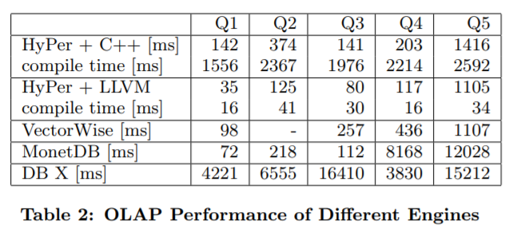
The TPC-H Benchmarks

Slide 21
Conclusions
While the iterator model offers a simple interface, it comes with performance costs
Putting data first: By reversing the data flow in our query plans, we can achieve great results
The C++/LLVM framework can produce machine code that rivals hand-crafted solutions

Slide 22
Questions?

