Slide 1
The Case for Learned Index Structures
Authors: Tim Kraska, Alex Beutel, Ed H. Chi, Jeffrey Dean, Neoklis Polyzotis
Presenter: Ruijia Mao

Slide 2
Agenda
Introduction
Range Indexes - B-Tree Index
Point Index - Hash-Map Index
Existence Index - Bloom Filter Index
Conclusion & Future Work

Slide 3
Introduction

Slide 4
Introduction:
Index Examples
B-Tree Index
Hash-Map Index
Bloom Filter Index

Slide 5
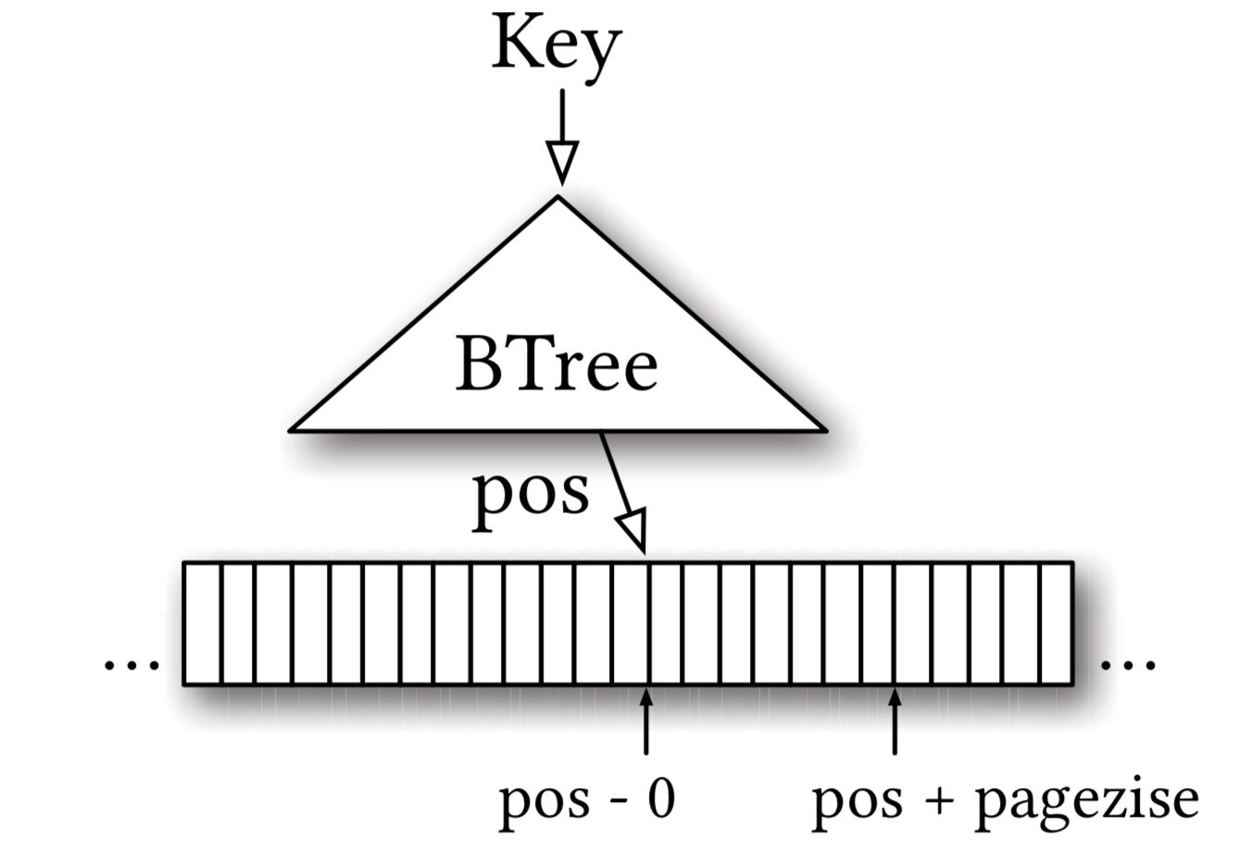
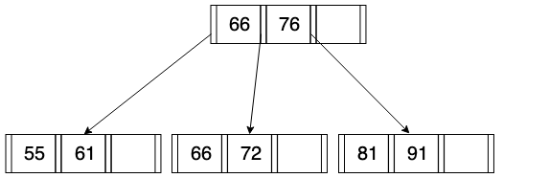
Introduction:
B-Tree Index

Slide 6
Introduction:
Hash-Map Index

Slide 7
Introduction:
Bloom Filter
Notes:
a bit array of size m and k hash functions, which each map a key to one of the m array positions (see Figure9(a)).
To add an element to the set, a key is fed to the k hash-functions and the bits of the returned positions are set to 1. To test if a key is a member of the set, the key is again fed into the k hash functions to receive k array positions. If any of the bits at those k positions is 0, the key is not a member of a set.
a Bloom filter does guarantee that there exists no false negatives, but has potential false positives.

Slide 8
Introduction:
Indexes are models
General purpose index structures assume nothing about data distribution
Learned indexes - learn a model that reflects patterns in the data - automatic synthesis of specialized index structures

Slide 9
Introduction:
Indexes are models
Indexes are to a large extent learned models
B-Tree Index - take a key as an input and predicts the position of a data record in a sorted set
Bloom Filter - binary classifier
Notes:
It is based on a key predicts if a key exists in a set or not
important differences. For example, a Bloom filter can have false positives but not false negatives.

Slide 10
Range Indexes

Slide 11
Range Indexes
Maps a key to a position
For efficiency, indexing only the first key of every page
Notes:
Range index structure, like B-Trees, are already models: given a key, they “predict” the location of a value within a key-sorted set. It is guaranteed that the key of the record at that position is the first key equal or higher than the look-up key.
it maps a key to a position with a min- and max-error (a min-error of 0 and a max-error of the page-size), with a guarantee that the key can be found in that region if it exists

Slide 12
Range Indexes
The B-Tree is a model, or in ML terminology, a regression tree
it maps a key to a position with a min- and max-error, with a guarantee that the key can be found in that region if it exists.
Notes:
it maps a key to a position with a min- and max-error (a min-error of 0 and a max-error of the page-size), with a guarantee that the key can be found in that region if it exists
we can replace the index with other types of ML models, including neural nets, as long as they are also able to provide similar strong guarantees about the min- and max-error.

Slide 13
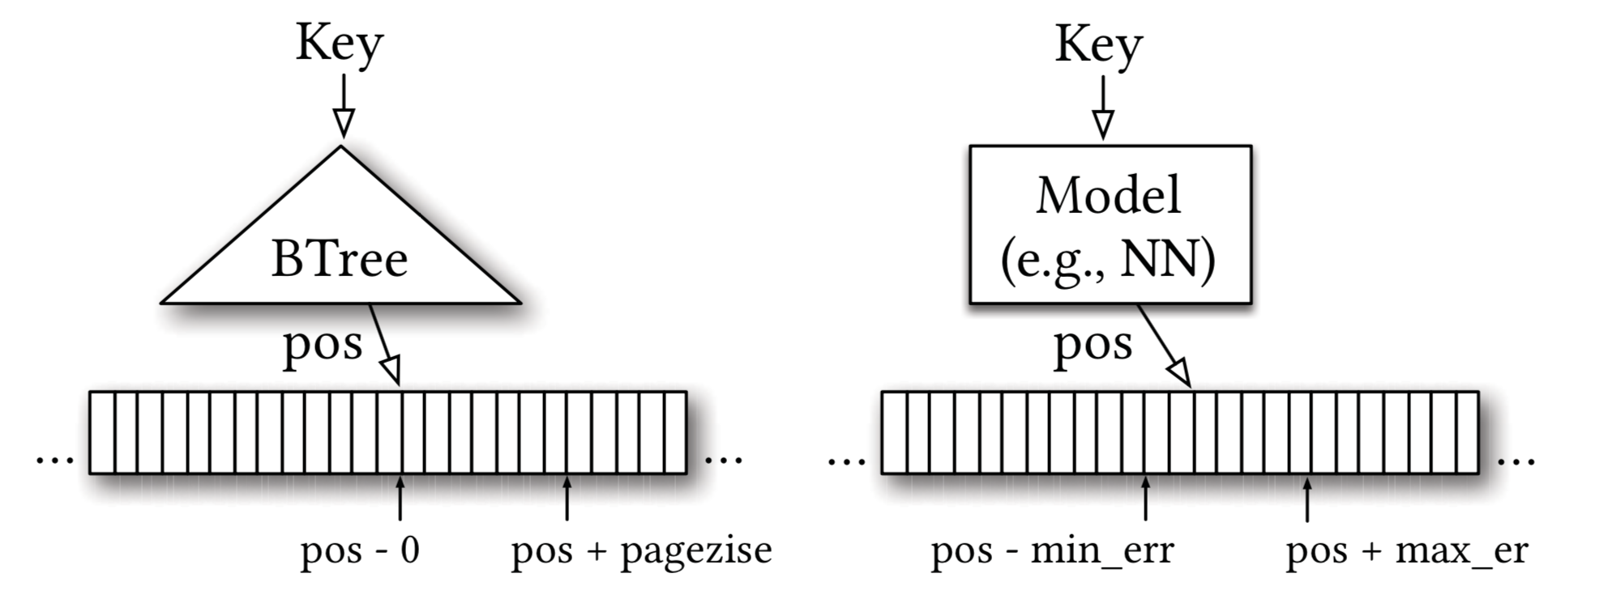
Range Indexes
Notes:
At first sight it may seem hard to provide the same guarantees with other types of ML models, but it is actually surprisingly simple. First, the B-Tree only provides the strong min- and max-error guarantee over the stored keys, not for all possible keys. For new data, B-Trees need to be re-balanced
That is, for monotonic models the only thing we need to do is to execute the model for every key and remember the worst over- and under-prediction of a position to calculate the min- and max-error.
Second, and more importantly, the strong error bounds are not even needed. The data has to be sorted anyway to support range requests, so any error is easily corrected by a local search around the prediction (e.g., using exponential search) and thus, even al- lows for non-monotonic models.

Slide 14
Range Index Models are CDF Models
A model that predicts the position given a key inside a sorted array effectively approximates the cumulative distribution function (CDF).
p = F(Key) ∗ N
p is the position estimate
F(Key) is P(X ≤ Key)
Notes:
F (Key) is the estimated cumulative distribution function for the data to estimate the likelihood to observe a key smaller or equal to the look-up key P(X ≤ Key)
it implies that indexing literally requires learning a data distribution. A B-Tree “learns” the data distribution by building a regression tree. A linear regression model would learn the data distribution by minimizing the (squared) error of a linear function.
estimating the distribution for a dataset is a well known problem

Slide 15
A Frist, Naive Learned Index
Data: 200M web-server log records
Goal: building a secondary index over the times- tamps using Tensorflow
Model: trained a two-layer fully- connected neural network with 32 neurons per layer using ReLU activation functions
Notes:
the timestamps are the input features and the positions in the sorted array are the labels. After- wards we measured the look-up time for a randomly selected key (averaged over several runs disregarding the first numbers) with Tensorflow and Python as the front-end.

Slide 16
A Frist, Naive Learned Index:
Results
Model: ≈ 1250 predictions per second, ≈ 80, 000 nano-seconds (ns) to execute the model with Tensorflow, without the search time
B-Tree: traversal over the same data ≈ 300ns
Binary search the entire data: ≈ 900ns
Notes:
the timestamps are the input features and the positions in the sorted array are the labels. After- wards we measured the look-up time for a randomly selected key (averaged over several runs disregarding the first numbers) with Tensorflow and Python as the front-end.

Slide 17
A Frist, Naive Learned Index:
Problems
Tensorflow is designed for larger model
Last mile: B-Trees are good in overfitting the data with a few operations, while the models are good at approximate the general shape of a CDF
B-Trees are extremely cache- and operation-efficient
Notes:
the timestamps are the input features and the positions in the sorted array are the labels. After- wards we measured the look-up time for a randomly selected key (averaged over several runs disregarding the first numbers) with Tensorflow and Python as the front-end.

Slide 18
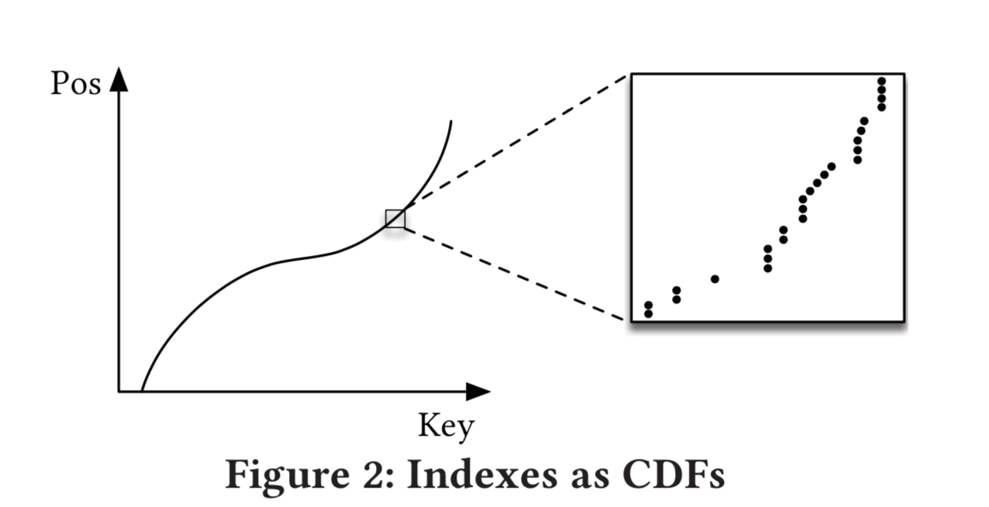
A Frist, Naive Learned Index
Notes:
The figure demonstrates, that from a top-level view, the CDF function appears very smooth and regular. However, if one zooms in to the individual records, more and more irregularities show;
Thus models like neural nets, polynomial regression, etc. might be more CPU and space efficient to narrow down the position for an item from the entire dataset to a region of thousands, but a single neural net usually requires significantly more space and CPU time for the “last mile” to reduce the error further down from thousands to hundreds.

Slide 19
The RM-Index
In order to solve challenges mentioned above, the authors developed
Learning Index Framework (LIF)
Recursive Model Indexes (RMI)
Standard-error-based search strategies
Notes:
The authors primarily focus on simple, fully-connected neural nets because of their simplicity and flexibility,

Slide 20
The RM-Index:
LIF
Learning Index Framework (LIF)
An index synthesis system: given an index specification, LIF generates different index configurations, optimizes them, and tests them automatically.
Notes:
LIF can learn simple models on-the-fly (e.g., linear regression models), it relies on Tensorflow for more complex models (e.g., NN)
However, it never uses Tensorflow at inference. Rather, given a trained Tensorflow model, LIF automatically extracts all weights from the model and generates efficient index structures in C++ based on the model specification.

Slide 21
The RM-Index:
RMI
Recursive Model Index (RMI)
A hierarchy of models. At each stage the model takes the key as an input, and based on it picks another model, until the final stage predicts the position.
Notes:
As outlined in Section 2.3 one of the key challenges of building alternative learned models to replace B-Trees is the accuracy for last-mile search.

Slide 22
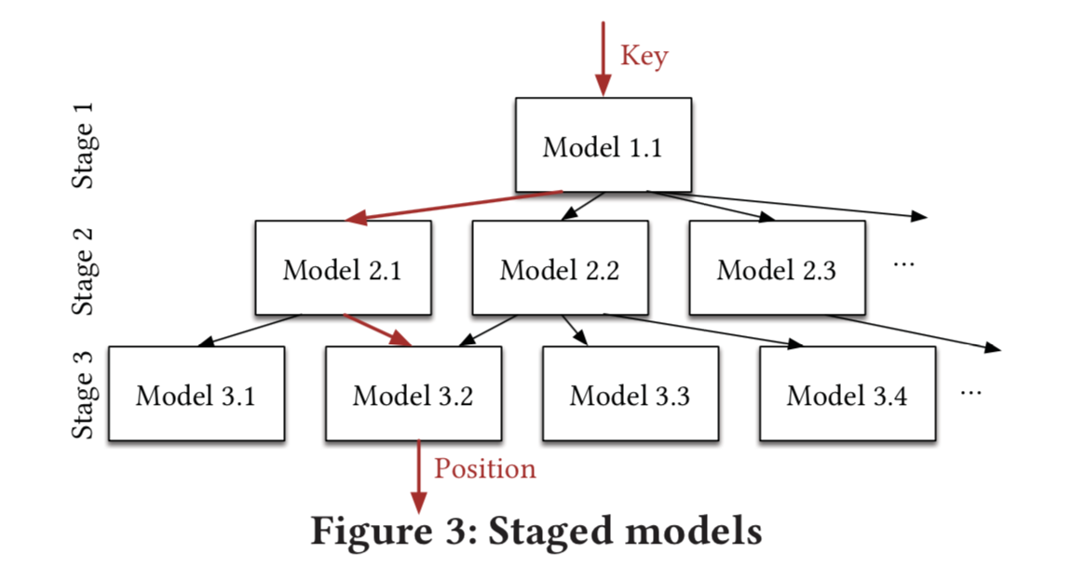
The RM-Index:
RMI
Notes:
However, recursive model indexes do not have to be trees.

Slide 23
The RM-Index:
RMI Benefits
It separates model size and complexity from execution cost.
It leverages the fact that it is easy to learn the overall shape of the data distribution.
It effectively divides the space into smaller sub- ranges, like a B-Tree, to make it easier to achieve the required “last mile” accuracy with fewer operations.
There is no search process required in-between the stages.
Notes:
As outlined in Section 2.3 one of the key challenges of building alternative learned models to replace B-Trees is the accuracy for last-mile search.

Slide 24
The RM-Index:
Hybrid Indexes
Another advantage of the recursive model index is that mixtures of models can be built.
Top layer - a small ReLU neural net
Bottom - linear regression
Notes:
For bottom stage, the index is optimized by replacing NN models with B-Trees if absolute min-/max-error is above a predefined threshold. The hybrid indexes can bound the worst case performance of learned indexes to the performance of B-Trees

Slide 25
The RM-Index:
Search Strategy
Model Biased Search - the first middle point is set to the value predicted by the model
Biased Quaternary Search - three middle points of quaternary search as pos − σ, pos, pos + σ
Notes:
For bottom stage, the index is optimized by replacing NN models with B-Trees if absolute min-/max-error is above a predefined threshold. The hybrid indexes can bound the worst case performance of learned indexes to the performance of B-Trees

Slide 26
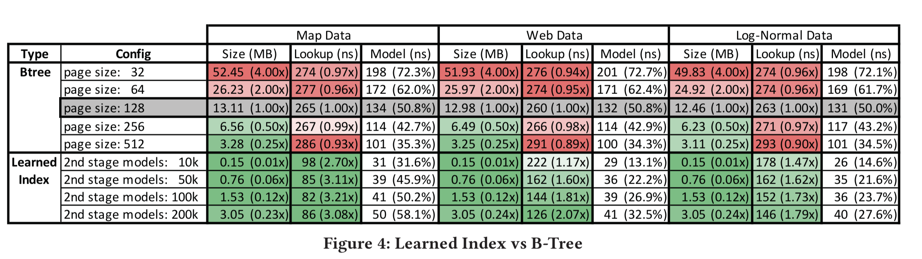
Results

Slide 27
Point Index

Slide 28
Point Index:
Hash-map Index
Conflict: too many distinct keys being mapped to the same position inside the Hash-map
Notes:
The key challenge for any efficient Hash-map implementation is to prevent too many distinct keys from being mapped to the same position inside the Hash-map, henceforth referred to as a conflict.

Slide 29
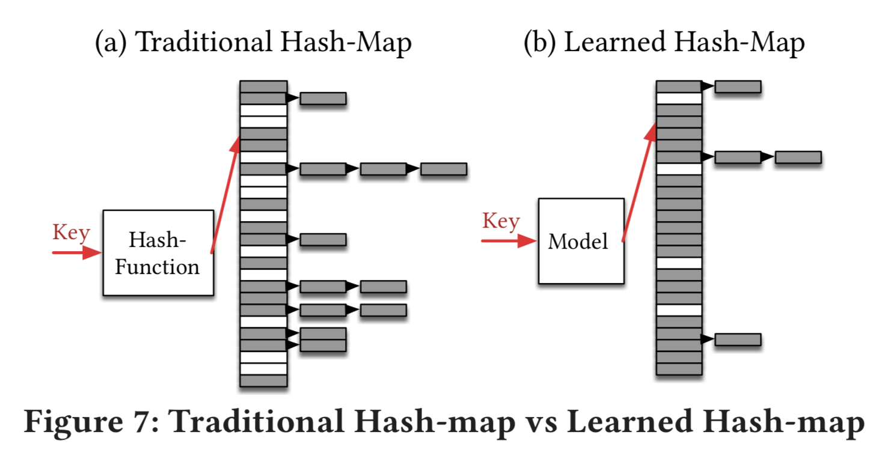
Point Index:
Hash-map Index

Slide 30
Point Index:
Hash-map Index
Learning the CDF of the key distribution is one potential way to learn a better hash function.
Use h(K) = F(K)∗M, with key K as our hash-function.
If the model F perfectly learned the empirical CDF of the keys, no conflicts would exist
Notes:
The key challenge for any efficient Hash-map implementation is to prevent too many distinct keys from being mapped to the same position inside the Hash-map, henceforth referred to as a conflict.

Slide 31
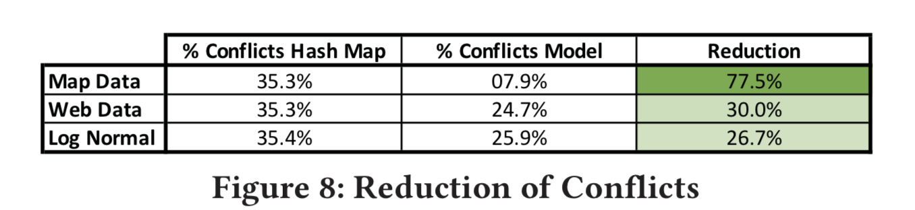
Point Index:
Results

Slide 32
Existence Index
Notes:
While both range and point indexes learn the distribution of keys, existence indexes need to learn a function that separates keys from everything else.
Stated differently, a good hash function for a point index is one with few collisions among keys, whereas a good hash function for a Bloom filter would be one that has lots of collisions among keys and lots of collisions among non-keys, but few collisions of keys and non-keys.

Slide 33
Existence Index:
Learned Bloom Filters
Separate keys from everything else
Provide a specific FPR for realistic queries in particular while maintaining a FNR of zero
Non-keys come from observable histori- cal queries
Use recurrent neural network (RNN)
Notes:
In considering the data distribution for ML purposes, we must consider a dataset of non-keys. In this work, we con- sider the case where non-keys come from observable histori- cal queries and we assume that future queries come from the same distribution as historical queries.

Slide 34
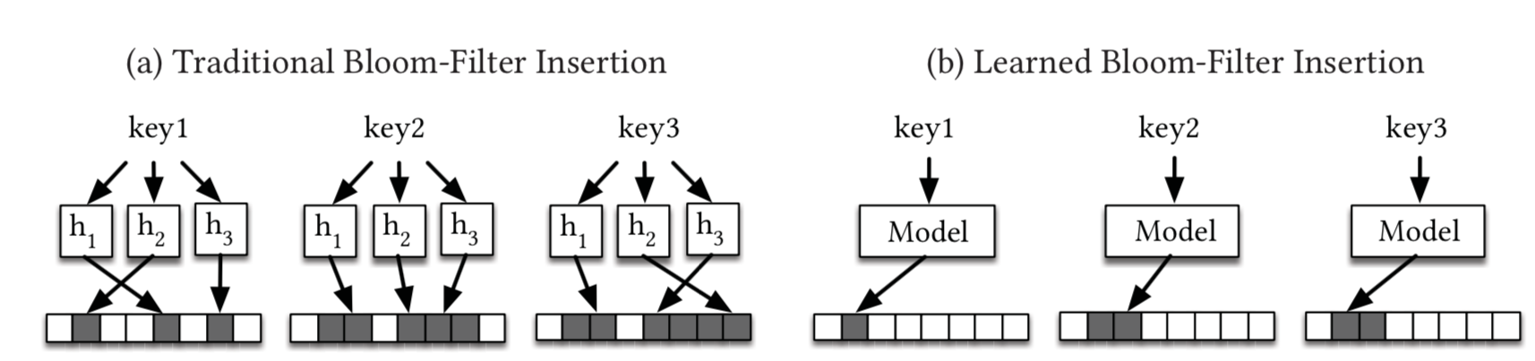
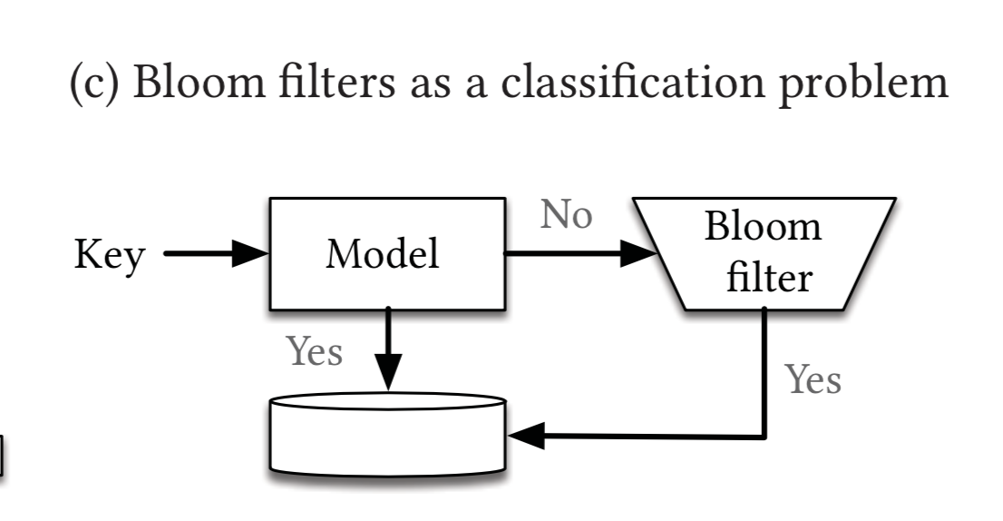
Existence Index:
Learned Bloom Filters as a Classification Problem
Notes:
Unlike Bloom filters, our model will likely have a non-zero FPR and FNR; in fact, as the FPR goes down, the FNR will go up. In order to preserve the no false negatives constraint of existence indexes, we create an overflow Bloom filter

Slide 35
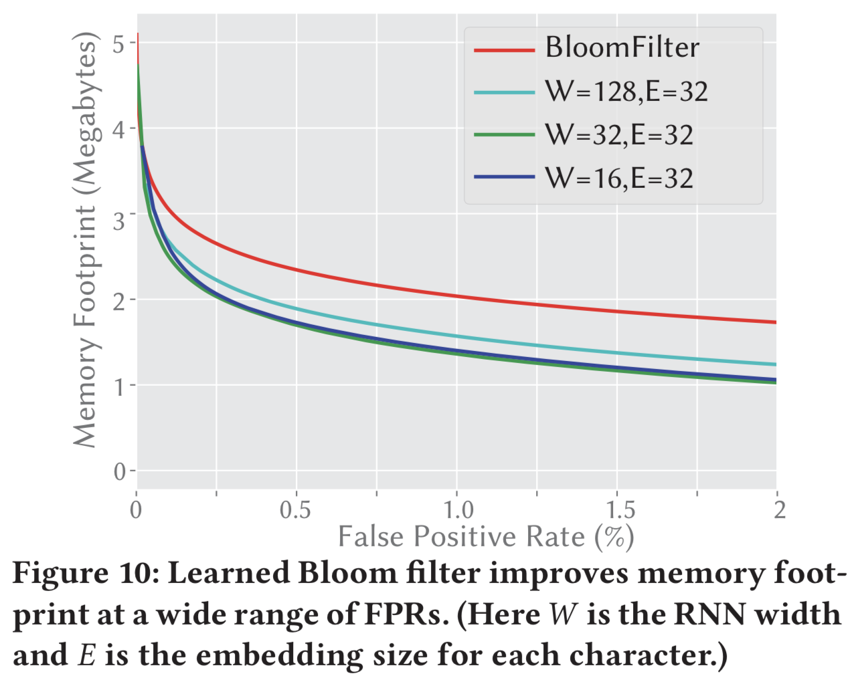
Existence Index:
Results
Notes:
blacklisted phishing URLs dataset 1.7M URL

Slide 36
Conclusion

Slide 37
Conclusion
“In summary, we have demonstrated that machine learned models have the potential to provide significant benefits over state-of-the-art indexes, and we believe this is a fruitful direction for future research. ”

Slide 38
Future Work
Other ML Models
Multi-dimensional Indexes
Learned Algorithm - sorting or join
GPU/TPU

Slide 39
Thanks
Q&A

