Slide 1
DIV IT
Laptop Repair Process
TEAMBFF
DIV IT
Laptop Repair Process
Kyle King, Sarah Niezelski, Trevor Putman, Alex Wilson, Chris Yeager
Notes:
Edit pfd (figure out problem)
fill in slide 4

Slide 2

Project Scope
“Create a new electronic form system to optimize the process of submitting incident reports for computer repairs at the ACT Help Desk”
Notes:
Problem wasn’t the Problem...
they already completed it

Slide 3
Rescoping
The Division of IT has electronic forms that they have and use, but they shift to paper tickets during the process of computer repair.
Notes:
Customer fills out information on mounted iPads before interacting with the staff
Login with directory id/password (Pulls contact info and verifies student)
Enters into queue/informs of position (~wait time)
Three options: leave laptop, wait for rep, or exit queue
If stay/leave:
Textbox problem entry and computer info and sign (liability popup)

Slide 4
Solutions Overview
Our Recommendations
Paperless labeling system
Improved data entry forms
Reduce barriers for data entry
Workstation redesign
Paperless labeling system
Workstation Redesign
iPad sign-in system
Notes:
Customer fills out information on mounted iPads before interacting with the staff
Login with directory id/password (Pulls contact info and verifies student)
Enters into queue/informs of position (~wait time)
Three options: leave laptop, wait for rep, or exit queue
If stay/leave:
Textbox problem entry and computer info and sign (liability popup)

Slide 5
Underlying Problems
System logs out every 10 minutes
Consequences
130 paper tickets per week with no digital data
Takes 1 minute to log out, log in, find file, comment
2000 paper tickets per semester
Current Issues
Notes:
Current State
Time Action
3 m Find Rep
2 m Open Form
4 m Enter Personal Info
5 m Start Diagnosis
....

Slide 6
Core Issues Identified
Digital tickets take too long to access
Forms are not detailed enough for technicians
Laptop cannot be identified without paper tickets
Paper ticket acts as fall back system

Slide 7
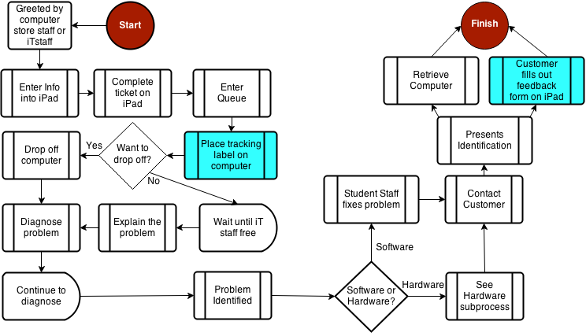
Process Flow Diagram

Slide 8
Recommendations
Shorten time to add comments digitally
New paperless labeling system
Improved form: Customer, Front end, Back end

Slide 9
Benefits to New Label System
More professional
Better security
Space saving
Cost efficient
Eco-friendly (save 4,000 pieces of paper a year)
Accessible
Data

Slide 10
Form Improvement
Customer Form
Contact information
Laptop Information
Front End Form
Additional Symptoms
Back End Form
Tests Run
Legal Release
Symptoms
Software/Hardware?
Tests run
Additional notes
Previous Incidents
Solution (if applicable)
Identified Problem
Parts Ordered
Solution

Slide 11
Reevaluation
No dedicated work space for front-end staff
Front end technicians have to share computers
Store Layout
Impossible to identify staff
Notes:
Think apple genius bar

Slide 12
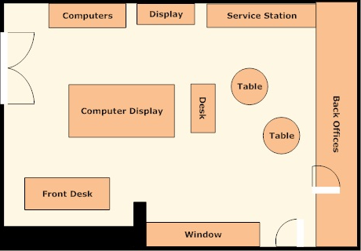
Original Store Layout
Notes:
DIT stores information on paper, but wants accessible digital data
Repair shop uses paper tickets to get student signatures and to write down comments on repairs made
Student technicians’ computers are on other side of the room from service desk
Identified issues with store layout
Students can either approach desk where student technicians fill ticket, or enter in store, approach sales desk for Technology Store, have to walk through store to get to repair shop
No employee has identification that they can help customers
Takes 3 minutes for staff to fill out preliminary information on ticket (ex. contact information, laptop information)
One person waited two minutes without being helped or even greeted...etc
All of this information can be filled out by student without staff assistance
130 tickets per week, all stored as paper
Layout of store like Apple Genius Bar, one long table where technicians have computers and students know who to talk to.
Make process flow clearer between store and repair shop
Implement changes for loaner system that integrates with new paperless system
Measured THINGS:
Takes 3 minutes for staff to fill out preliminary information on ticket (ex. contact information, laptop information)
All of this information can be filled out by student without staff assistance
130 tickets per week, all stored as paper
Store layout is hampering optimal process flows. Students approach sales desk to find out how to get to IT people. Open window for IT desk which is worthless because the students have to come behind the desk anyway
Repairs are done on cabinet facing wall, student technicians can’t sit as they work, do not have a computer to type comments into ticket, instead write on form
For right now, recommend closing window, having desk for iPad ticketing system, moving computers so they are accessible for technicians and splitting up technicians to make them more accessible
Employees NEED to wear identification (tshirt, nametag, SOMETHING)

Slide 13
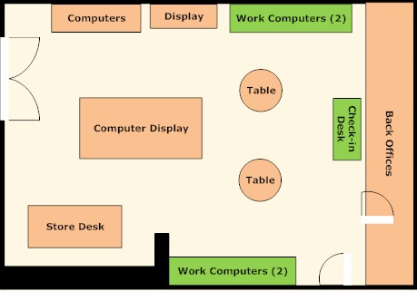
Ideal Store Layout
Notes:
Benefits: clearer separation of store and Div it

Slide 14
Benefits to Workstation Redesign
Reduced computer sharing
Work computer accessibility
Less time to enter comments digitally
More professional atmosphere
Notes:
Think apple genius bar

Slide 15
Implementation
1
2
3
Current State
Ideal State
Workstation and store layout redesign
Uniforms for front end staff
Notes:
Layout of store like Apple Genius Bar, one long table where technicians have computers and students know who to talk to.
Make process flow clearer between store and repair shop
Implement changes for loaner system that integrates with new paperless system

Slide 16
Implementation
1
2
3
Current State
Ideal State
Release iPad-based customer form for sign-in
Implement new labeling system
Notes:
Layout of store like Apple Genius Bar, one long table where technicians have computers and students know who to talk to.
Make process flow clearer between store and repair shop
Implement changes for loaner system that integrates with new paperless system

Slide 17
Implementation
1
2
3
Current State
Ideal State
Release improved back end and front end forms
Notes:
Layout of store like Apple Genius Bar, one long table where technicians have computers and students know who to talk to.
Make process flow clearer between store and repair shop
Implement changes for loaner system that integrates with new paperless system

Slide 18
Methods for Control
Customer Feedback Form
Six Sigma
Run Rules
&
Contingency Plan

Slide 19
Summary
Summary
Current State:
Paper Forms
Ineffective Layout
Work computers unused
Ideal State:
Only electronic forms
Efficient store layout
Dedicated workstations
Updated 3-Part Form
Workspace Redesign
Label System

Slide 20
QUESTions?
QUESTions?
TEAMBFF

