Slide 1
Lecture 10 - Turbulence Models
Applied Computational Fluid Dynamics
Instructor: André Bakker
© André Bakker (2002-2005)
© Fluent Inc. (2002)

Slide 2
Turbulence models
A turbulence model is a computational procedure to close the system of mean flow equations.
For most engineering applications it is unnecessary to resolve the details of the turbulent fluctuations.
Turbulence models allow the calculation of the mean flow without first calculating the full time-dependent flow field.
We only need to know how turbulence affected the mean flow.
In particular we need expressions for the Reynolds stresses.
For a turbulence model to be useful it:
  must have wide applicability,
  be accurate,
  simple,
  and economical to run.

Slide 3
Common turbulence models
Classical models. Based on Reynolds Averaged Navier-Stokes (RANS) equations (time averaged):
  1. Zero equation model: mixing length model.
  2. One equation model: Spalart-Almaras.
  3. Two equation models: k-ε style models (standard, RNG, realizable), k-ω model, and ASM.
  4. Seven equation model: Reynolds stress model.
The number of equations denotes the number of additional PDEs that are being solved.
Large eddy simulation. Based on space-filtered equations. Time dependent calculations are performed. Large eddies are explicitly calculated. For small eddies, their effect on the flow pattern is taken into account with a “subgrid model” of which many styles are available.

Slide 4
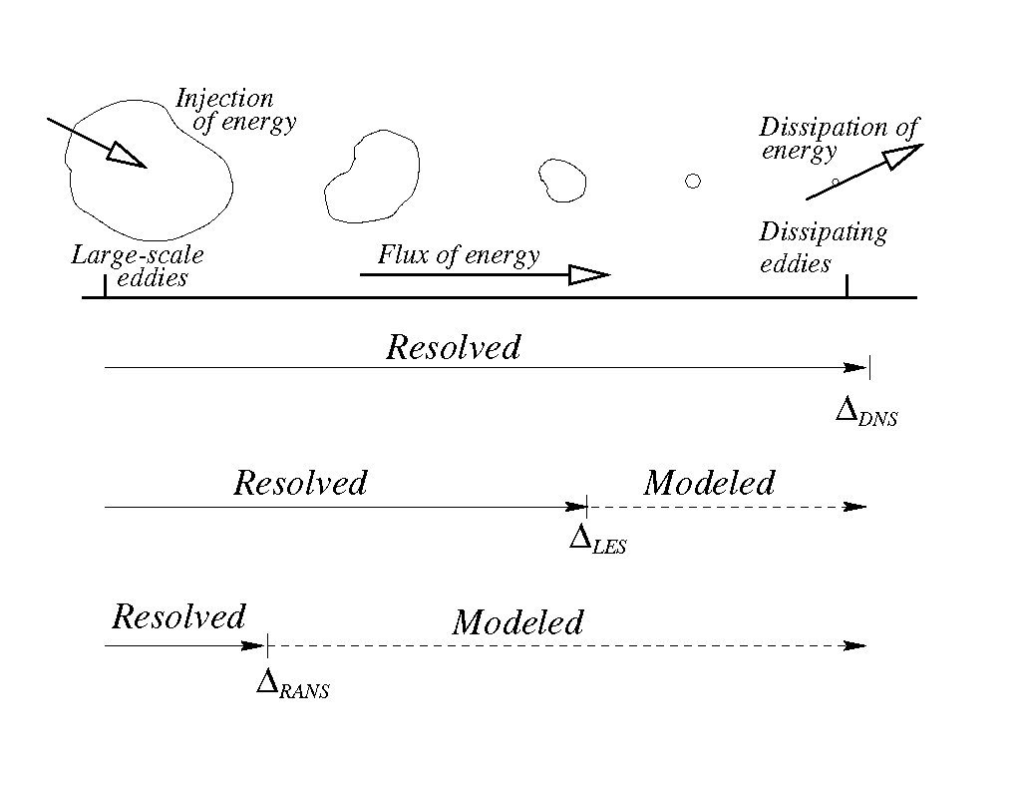
Prediction Methods
l
η = l/Re_{L}^{3/4}
Direct numerical simulation (DNS)
Large eddy simulation (LES)
Reynolds averaged Navier-Stokes equations (RANS)
Notes:
This slide summarizes the methods by which the impact of turbulence can be handled with CFD.
DNS utilizes a mesh fine enough to resolve the smallest eddies...

Slide 5
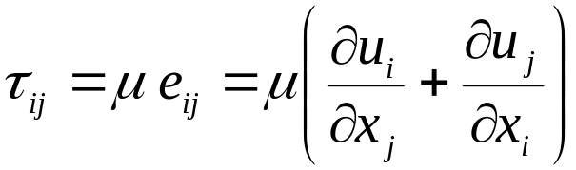
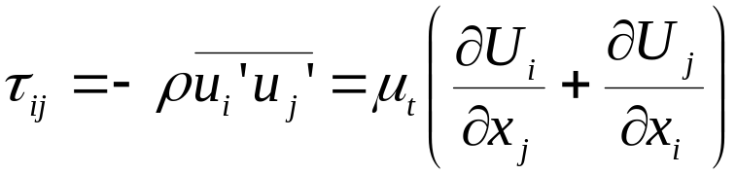
Boussinesq hypothesis
Many turbulence models are based upon the Boussinesq hypothesis.
  It was experimentally observed that turbulence decays unless there is shear in isothermal incompressible flows.
  Turbulence was found to increase as the mean rate of deformation increases.
  Boussinesq proposed in 1877 that the Reynolds stresses could be linked to the mean rate of deformation.
Using the suffix notation where i, j, and k denote the x-, y-, and z-directions respectively, viscous stresses are given by:
Similarly, link Reynolds stresses to the mean rate of deformation:

Slide 6
Turbulent viscosity
A new quantity appears: the turbulent viscosity μ_{t}.
Its unit is the same as that of the molecular viscosity: Pa.s.
It is also called the eddy viscosity.
We can also define a kinematic turbulent viscosity: ν_{t} = μ_{t}/ρ. Its unit is m²/s.
The turbulent viscosity is not homogeneous, i.e. it varies in space.
It is, however, assumed to be isotropic. It is the same in all directions. This assumption is valid for many flows, but not for all (e.g. flows with strong separation or swirl).

Slide 7
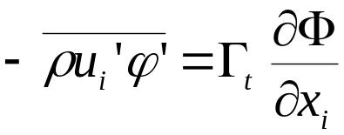
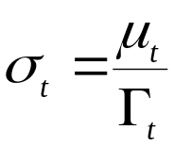
Turbulent Schmidt number
The turbulent viscosity is used to close the momentum equations.
We can use a similar assumption for the turbulent fluctuation terms that appear in the scalar transport equations.
For a scalar property φ(t) = Φ + ϕ’(t):
Here Γ_{t} is the turbulent diffusivity.
The turbulent diffusivity is calculated from the turbulent viscosity, using a model constant called the turbulent Schmidt number (AKA Prandtl number) σ_{t}:
Experiments have shown that the turbulent Schmidt number is nearly constant with typical values between 0.7 and 1.

Slide 8
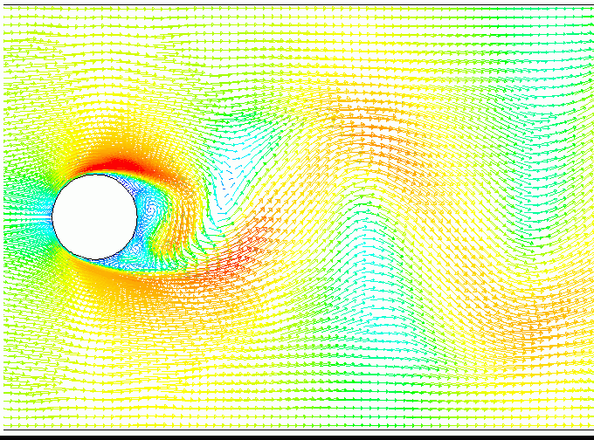
Flow around a cylinder
The flow is stable for Reynolds numbers below ~40.
For higher Reynolds numbers the flow is unstable.
This animation shows the flow pattern for Re = 1000.

Slide 9
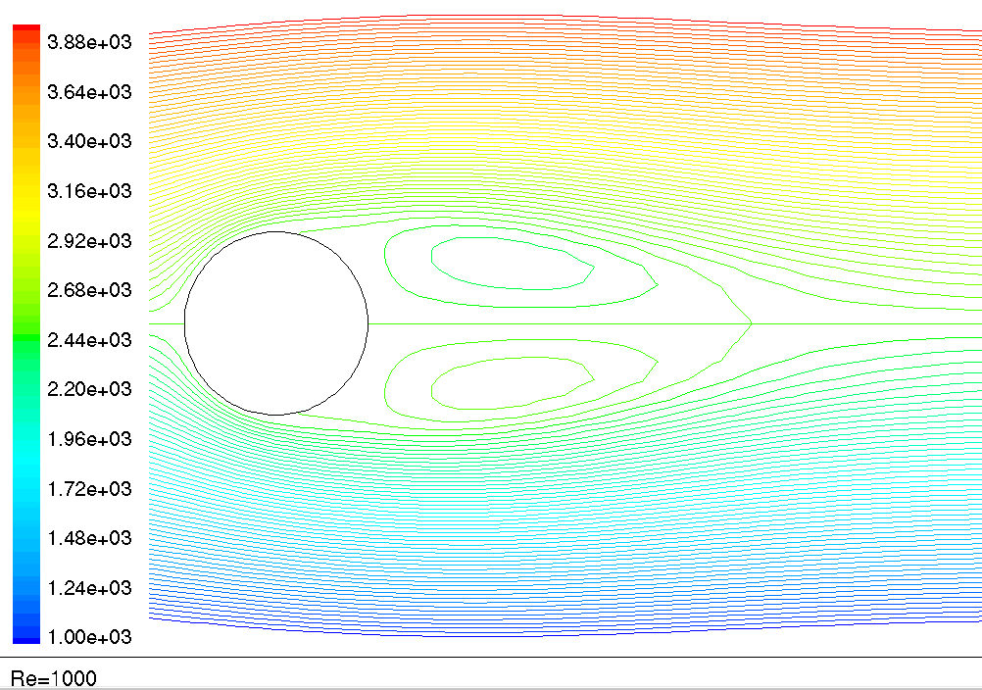
Time average streamlines (kg/s) - Re = 1000

Slide 10
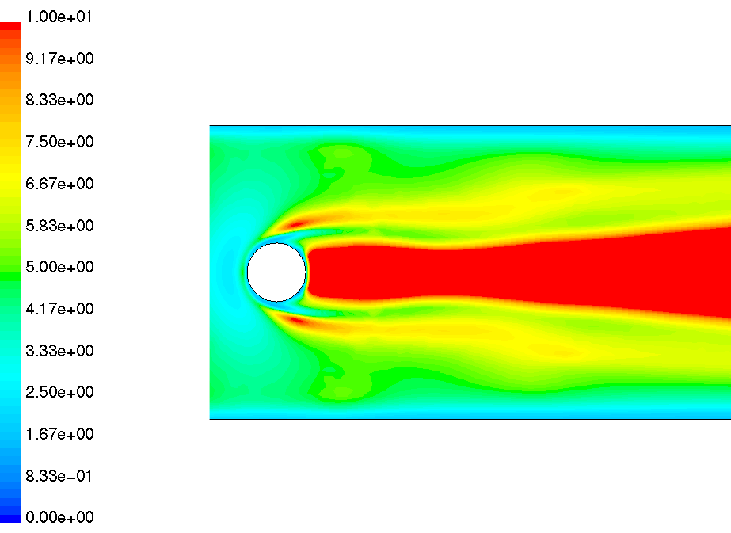
Effective viscosity (kg/m-s) - Re =1000

Slide 11
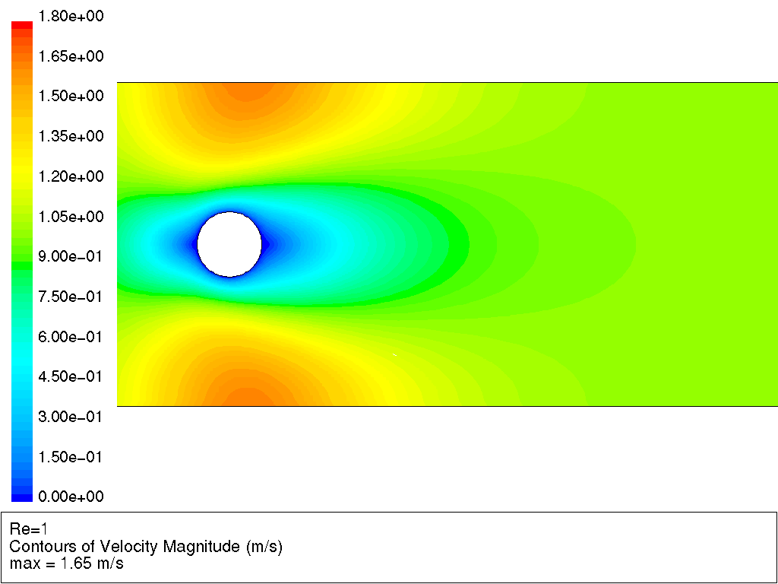
These animations show the flow pattern as a function of Reynolds number.

Slide 12
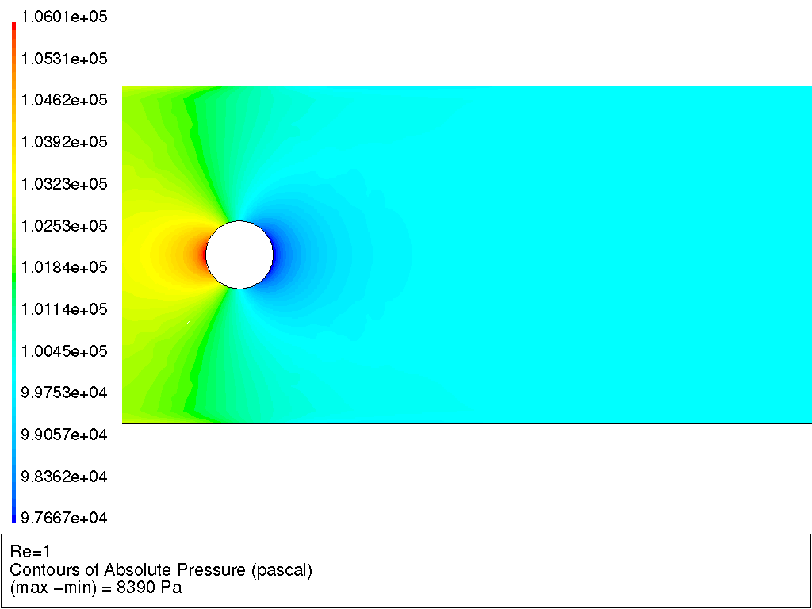
These animations show the flow pattern as a function of Reynolds number.

Slide 13
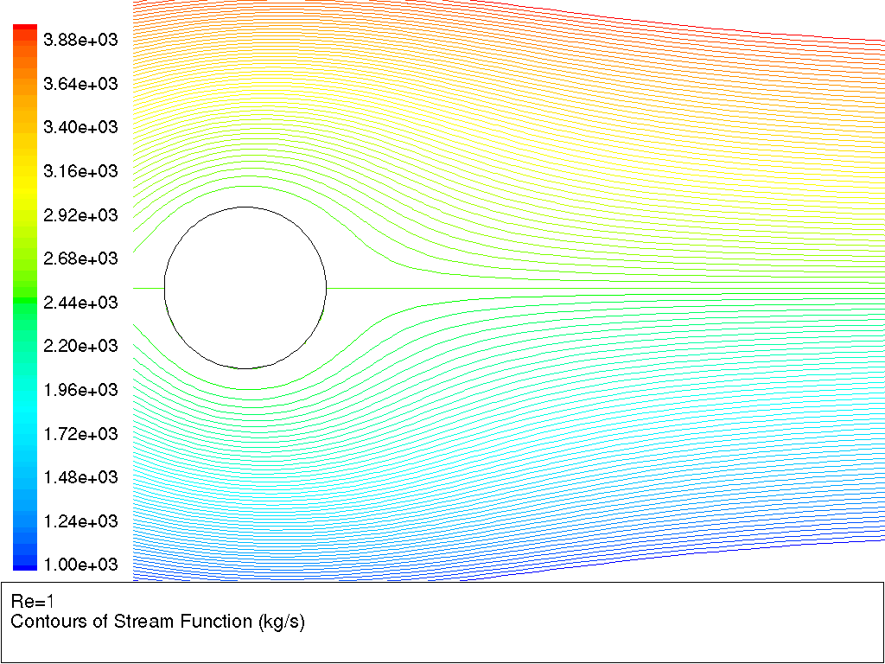
These animations show the flow pattern as a function of Reynolds number.

Slide 14
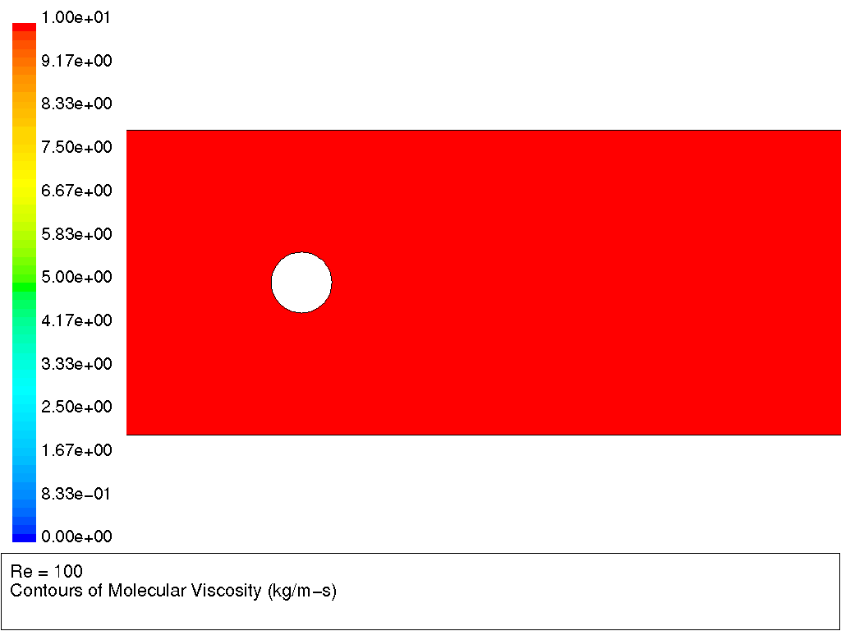
These animations show the flow pattern as a function of Reynolds number.

Slide 15
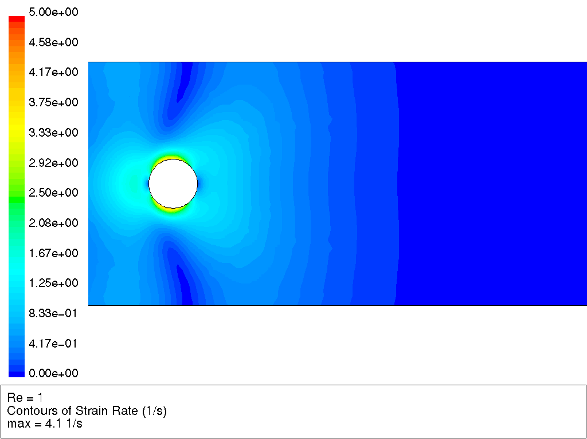
These animations show the flow pattern as a function of Reynolds number.

Slide 16
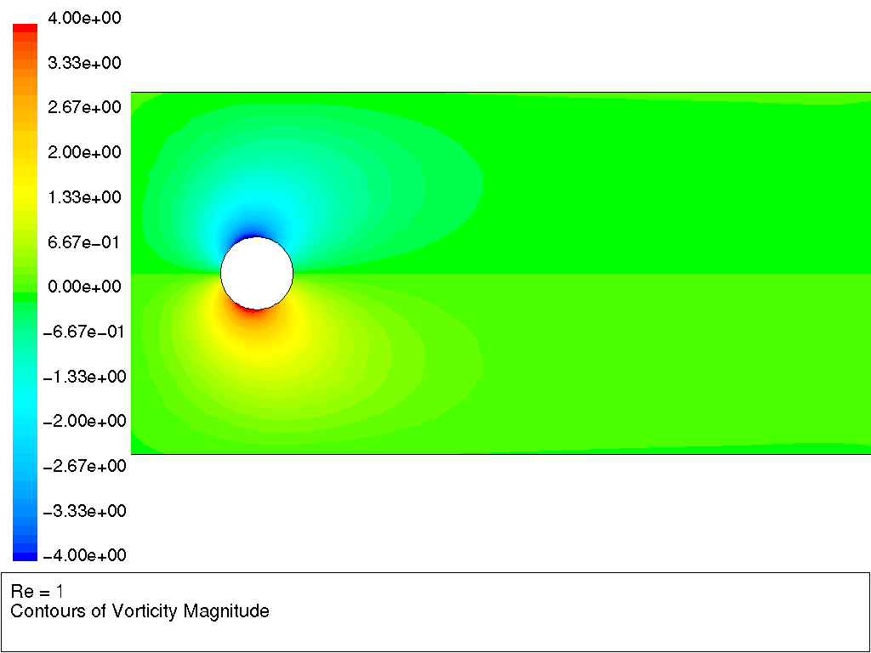
These animations show the flow pattern as a function of Reynolds number.

Slide 17
Predicting the turbulent viscosity
The following models can be used to predict the turbulent viscosity:
  Mixing length model.
  Spalart-Allmaras model.
  Standard k-ε model.
  k-ε RNG model.
  Realizable k-ε model.
  k-ω model.
We will discuss these one by one.

Slide 18

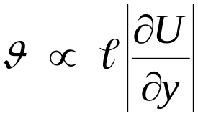
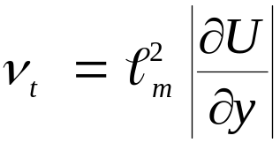
Mixing length model
On dimensional grounds one can express the kinematic turbulent viscosity as the product of a velocity scale and a length scale:
If we then assume that the velocity scale is proportional to the length scale and the gradients in the velocity (shear rate, which has dimension 1/s):
we can derive Prandtl’s (1925) mixing length model:
Algebraic expressions exist for the mixing length for simple 2-D flows, such as pipe and channel flow.

Slide 19
Mixing length model discussion
Advantages:
  Easy to implement.
  Fast calculation times.
  Good predictions for simple flows where experimental correlations for the mixing length exist.
Disadvantages:
  Completely incapable of describing flows where the turbulent length scale varies: anything with separation or circulation.
  Only calculates mean flow properties and turbulent shear stress.
Use:
  Sometimes used for simple external aero flows.
  Pretty much completely ignored in commercial CFD programs today.
Much better models are available.

Slide 20
Spalart-Allmaras one-equation model
Solves a single conservation equation (PDE) for the turbulent viscosity:
  This conservation equation contains convective and diffusive transport terms, as well as expressions for the production and dissipation of ν_{t}.
  Developed for use in unstructured codes in the aerospace industry.
Economical and accurate for:
  Attached wall-bounded flows.
  Flows with mild separation and recirculation.
Weak for:
  Massively separated flows.
  Free shear flows.
  Decaying turbulence.
Because of its relatively narrow use we will not discuss this model in detail.

Slide 21
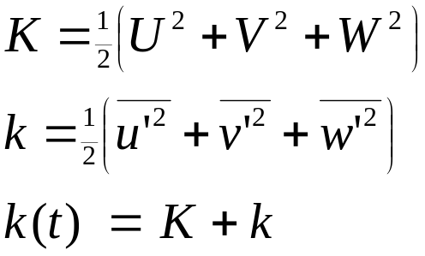
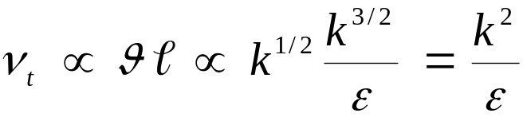
The k-ε model
The k-ε model focuses on the mechanisms that affect the turbulent kinetic energy (per unit mass) k.
The instantaneous kinetic energy k(t) of a turbulent flow is the sum of mean kinetic energy K and turbulent kinetic energy k:
ε is the dissipation rate of k.
If k and ε are known, we can model the turbulent viscosity as:
We now need equations for k and ε.

Slide 22
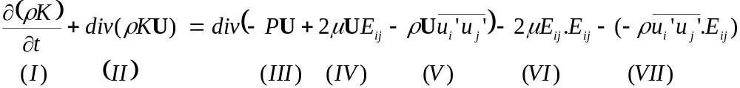
Mean flow kinetic energy K
The equation for the mean kinetic energy is as follows:
Here E_{ij} is the mean rate of deformation tensor.
This equation can be read as:
  (I) the rate of change of K, plus
  (II) transport of K by convection, equals
  (III) transport of K by pressure, plus
  (IV) transport of K by viscous stresses, plus
  (V) transport of K by Reynolds stresses, minus
  (VI) rate of dissipation of K, minus
  (VII) turbulence production.

Slide 23
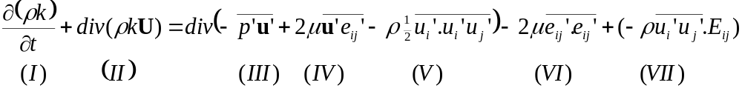
Turbulent kinetic energy k
The equation for the turbulent kinetic energy k is as follows:
Here e_{ij}’ is fluctuating component of rate of deformation tensor.
This equation can be read as:
  (I) the rate of change of k, plus
  (II) transport of k by convection, equals
  (III) transport of k by pressure, plus
  (IV) transport of k by viscous stresses, plus
  (V) transport of k by Reynolds stresses, minus
  (VI) rate of dissipation of k, plus
  (VII) turbulence production.

Slide 24
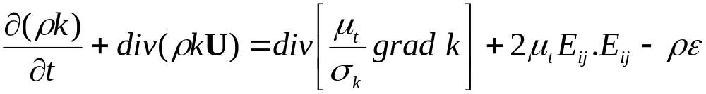
Model equation for k
The equation for k contains additional turbulent fluctuation terms, that are unknown. Again using the Boussinesq assumption, these fluctuation terms can be linked to the mean flow.
The following (simplified) model equation for k is commonly used.
The Prandtl number σ_{k} connects the diffusivity of k to the eddy viscosity. Typically a value of 1.0 is used.
Rate of
increase
Convective
transport
Rate of
destruction
Diffusive
transport
Rate of
production

Slide 25


Turbulent dissipation
The equations look quite similar.
However, the k equation mainly contains primed quantities, indicating that changes in k are mainly governed by turbulent interactions.
Furthermore, term (VII) is equal in both equations. But it is actually negative in the K equation (destruction) and positive in the k equation: energy transfers from the mean flow to the turbulence.
The viscous dissipation term (VI) in the k equation
describes the dissipation of k because of the work done by the smallest eddies against the viscous stresses.
We can now define the rate of dissipation per unit mass ε as:

Slide 26
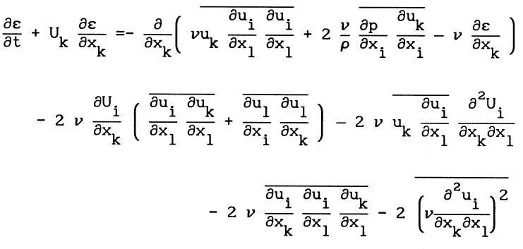
Dissipation rate - analytical equation
The analytical equation for ε is shown below. Because of the many unknown higher order terms, this equation can not be solved, and simplified model equations need to be derived.

Slide 27
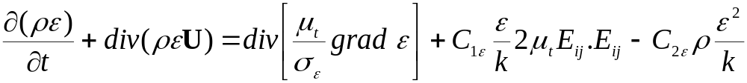
Model equation for ε
A model equation for ε is derived by multiplying the k equation by (ε/k) and introducing model constants.
The following (simplified) model equation for ε is commonly used.
The Prandtl number σ_{ε} connects the diffusivity of ε to the eddy viscosity. Typically a value of 1.30 is used.
Typically values for the model constants C_{1ε} and C_{2ε} of 1.44 and 1.92 are used.
Rate of
increase
Convective
transport
Rate of
production
Rate of
destruction
Diffusive
transport

Slide 28
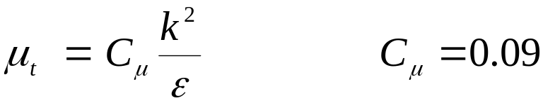
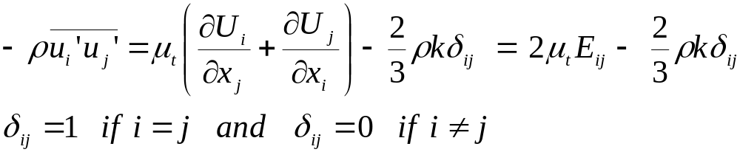
Calculating the Reynolds stresses from k and ε
The turbulent viscosity is calculated from:
The Reynolds stresses are then calculated as follows:
The (2/3)ρkδ_{ij} term ensures that the normal stresses sum to k.
Note that the k-ε model leads to all normal stresses being equal, which is usually inaccurate.

Slide 29
k-ε model discussion
Advantages:
  Relatively simple to implement.
  Leads to stable calculations that converge relatively easily.
  Reasonable predictions for many flows.
Disadvantages:
  Poor predictions for:
    swirling and rotating flows,
    flows with strong separation,
    axisymmetric jets,
    certain unconfined flows, and
    fully developed flows in non-circular ducts.
  Valid only for fully turbulent flows.
  Simplistic ε equation.

Slide 30
More two-equation models
The k-ε model was developed in the early 1970s. Its strengths as well as its shortcomings are well documented.
Many attempts have been made to develop two-equation models that improve on the standard k-ε model.
We will discuss some here:
  k-ε RNG model.
  k-ε realizable model.
  k-ω model.
  Algebraic stress model.
  Non-linear models.

Slide 31
Improvement: RNG k- ε
k-ε equations are derived from the application of a rigorous statistical technique (Renormalization Group Method) to the instantaneous Navier-Stokes equations.
Similar in form to the standard k-ε equations but includes:
  Additional term in ε equation for interaction between turbulence dissipation and mean shear.
  The effect of swirl on turbulence.
  Analytical formula for turbulent Prandtl number.
  Differential formula for effective viscosity.
Improved predictions for:
  High streamline curvature and strain rate.
  Transitional flows.
  Wall heat and mass transfer.
But still does not predict the spreading of a round jet correctly.

Slide 32
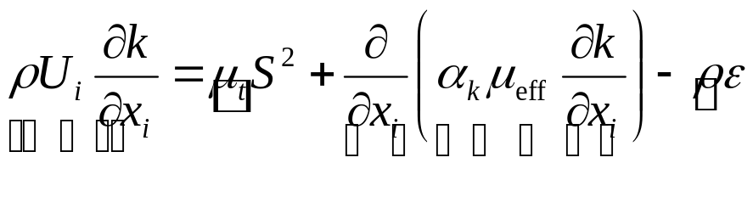
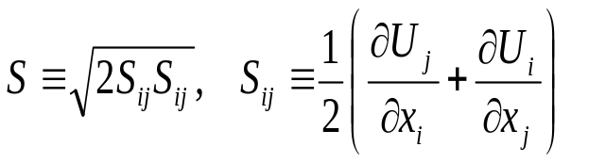
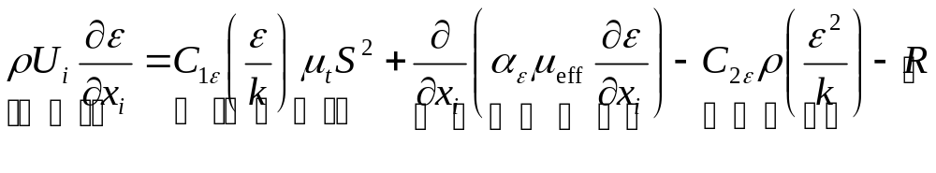

RNG k-ε equations
Turbulent kinetic energy:
Dissipation rate:
Equations written for steady, incompressible flow without body forces.
where
Generation
Dissipation
Convection
Diffusion
Additional term
related to mean strain
& turbulence quantities
Convection
Generation
Diffusion
Destruction
are derived using RNG theory

Slide 33
Improvement: realizable k-ε
Shares the same turbulent kinetic energy equation as the standard k-ε model.
Improved equation for ε.
Variable C_{μ} instead of constant.
Improved performance for flows involving:
  Planar and round jets (predicts round jet spreading correctly).
  Boundary layers under strong adverse pressure gradients or separation.
  Rotation, recirculation.
  Strong streamline curvature.

Slide 34
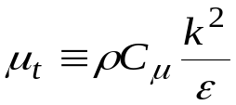
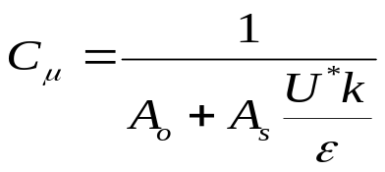


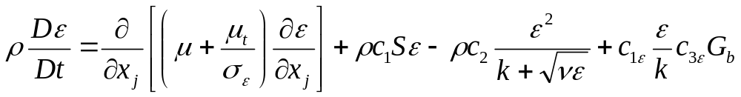
Realizable k- ε equations
Distinctions from standard k-ε model:
  Alternative formulation for turbulent viscosity:
  where is now variable.
    (A₀, A_{s}, and U* are functions of velocity gradients).
    Ensures positivity of normal stresses:
    Ensures Schwarz’s inequality:
  New transport equation for dissipation rate, ε:
Diffusion
Generation
Destruction
Buoyancy

Slide 35
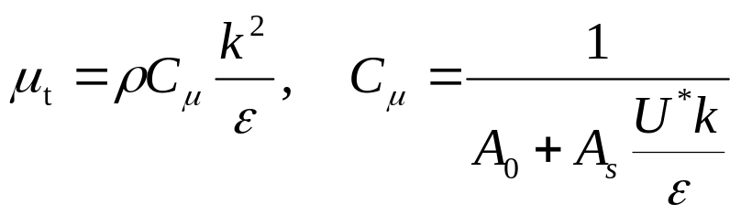
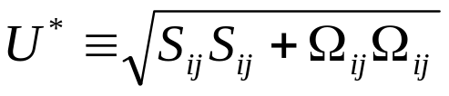
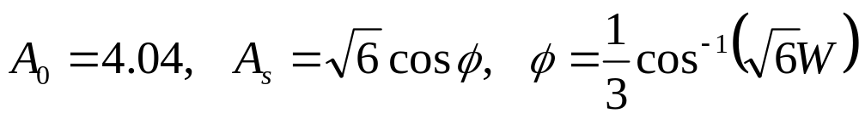
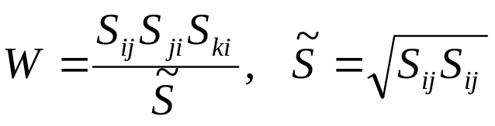
Realizable k- ε C_{μ} equations
Eddy viscosity computed from.

Slide 36
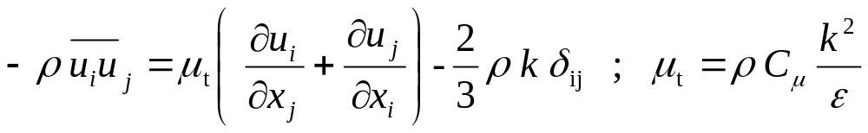
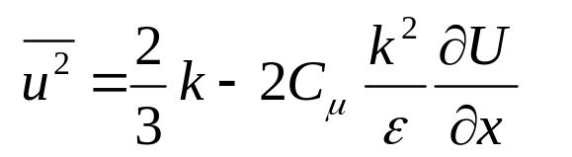
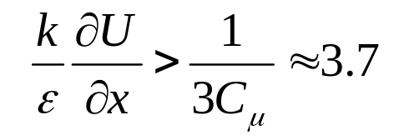
Realizable k- ε positivity of normal stresses
Boussinesq viscosity relation:
Normal component:
Normal stress will be negative if:

Slide 37
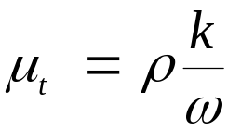
k-ω model
This is another two equation model. In this model ω is an inverse time scale that is associated with the turbulence.
This model solves two additional PDEs:
  A modified version of the k equation used in the k-ε model.
  A transport equation for ω.
The turbulent viscosity is then calculated as follows:
Its numerical behavior is similar to that of the k-ε models.
It suffers from some of the same drawbacks, such as the assumption that μ_{t} is isotropic.

Slide 38
Algebraic stress model
The same k and ε equations are solved as with the standard k-ε model.
However, the Boussinesq assumption is not used.
The full Reynolds stress equations are first derived, and then some simplifying assumptions are made that allow the derivation of algebraic equations for the Reynolds stresses.
Thus fewer PDEs have to be solved than with the full RSM and it is much easier to implement.
The algebraic equations themselves are not very stable, however, and computer time is significantly more than with the standard k-ε model.
This model was used in the 1980s and early 1990s. Research continues but this model is rarely used in industry anymore now that most commercial CFD codes have full RSM implementations available.

Slide 39
Non-linear models
The standard k-ε model is extended by including second and sometimes third order terms in the equation for the Reynolds stresses.
One example is the Speziale model:
Here f(…) is a complex function of the deformation tensor, velocity field and gradients, and the rate of change of the deformation tensor.
The standard k-ε model reduces to a special case of this model for flows with low rates of deformation.
These models are relatively new and not yet used very widely.

Slide 40
Reynolds stress model
RSM closes the Reynolds-Averaged Navier-Stokes equations by solving additional transport equations for the six independent Reynolds stresses.
  Transport equations derived by Reynolds averaging the product of the momentum equations with a fluctuating property.
  Closure also requires one equation for turbulent dissipation.
  Isotropic eddy viscosity assumption is avoided.
Resulting equations contain terms that need to be modeled.
RSM is good for accurately predicting complex flows.
  Accounts for streamline curvature, swirl, rotation and high strain rates.
    Cyclone flows, swirling combustor flows.
    Rotating flow passages, secondary flows.
    Flows involving separation.

Slide 41
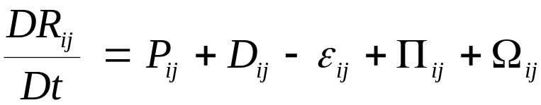

Reynolds stress transport equation
The exact equation for the transport of the Reynolds stress R_{ij}:
This equation can be read as:
  rate of change of plus
  transport of R_{ij} by convection, equals
  rate of production P_{ij}, plus
  transport by diffusion D_{ij}, minus
  rate of dissipation ε_{ij}, plus
  transport due to turbulent pressure-strain interactions π_{ij}, plus
  transport due to rotation Ω_{ij}.
This equation describes six partial differential equations, one for the transport of each of the six independent Reynolds stresses.

Slide 42
Reynolds stress transport equation
The various terms are modeled as follows:
  Production P_{ij} is retained in its exact form.
  Diffusive transport D_{ij} is modeled using a gradient diffusion assumption.
  The dissipation ε_{ij}, is related to ε as calculated from the standard ε equation, although more advanced ε models are available also.
  Pressure strain interactions π_{ij}, are very important. These include pressure fluctuations due to eddies interacting with each other, and due to interactions between eddies and regions of the flow with a different mean velocity. The overall effect is to make the normal stresses more isotropic and to decrease shear stresses. It does not change the total turbulent kinetic energy. This is a difficult to model term, and various models are available. Common is the Launder model. Improved, non-equilibrium models are available also.
  Transport due to rotation Ω_{ij} is retained in its exact form.

Slide 43
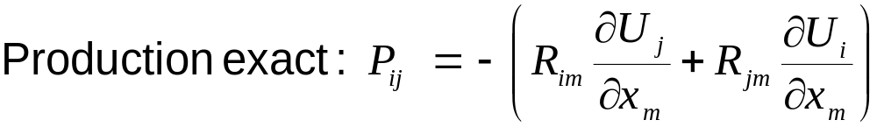
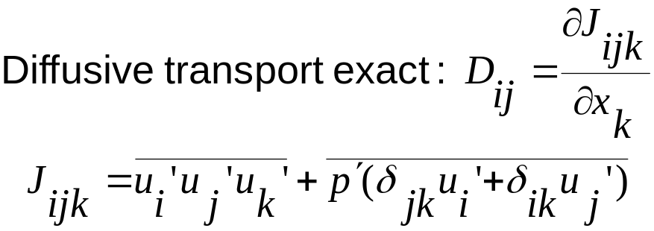
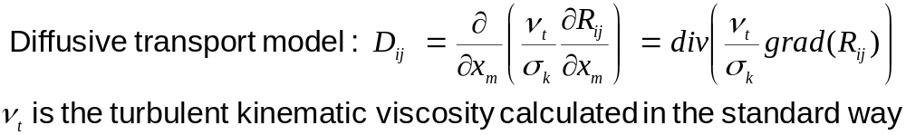
RSM equations

Slide 44
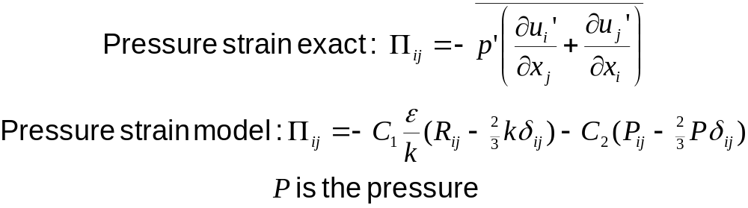
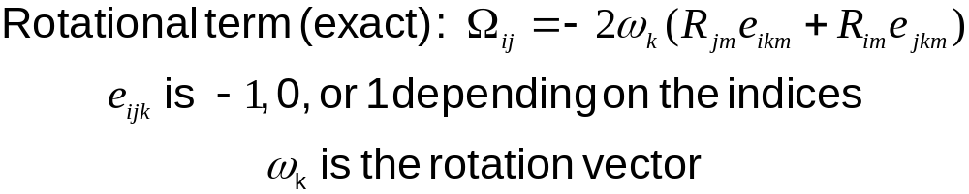
RSM equations continued

Slide 45

Setting boundary conditions
Characterize turbulence at inlets and outlets (potential backflow).
  k-ε models require k and ε.
  Reynolds stress model requires R_{ij} and ε.
Other options:
  Turbulence intensity and length scale.
    Length scale is related to size of large eddies that contain most of energy.
    For boundary layer flows, 0.4 times boundary layer thickness: l ≈ 0.4δ₉₉.
    For flows downstream of grids /perforated plates: l ≈ opening size.
  Turbulence intensity and hydraulic diameter.
    Ideally suited for duct and pipe flows.
  Turbulence intensity and turbulent viscosity ratio.
    For external flows:
Notes:
δ₉₉ is the boundary layer thickness – 99% of the free stream velocity

Slide 46
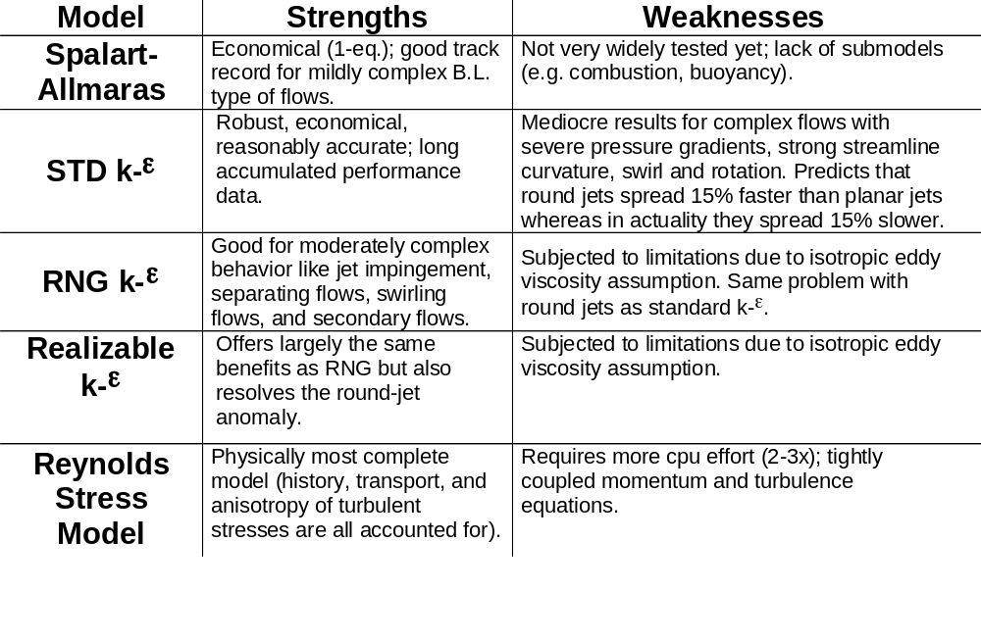
Comparison of RANS turbulence models

Slide 47
Recommendation
Start calculations by performing 100 iterations or so with standard k-ε model and first order upwind differencing. For very simple flows (no swirl or separation) converge with second order upwind and k-ε model.
If the flow involves jets, separation, or moderate swirl, converge solution with the realizable k-ε model and second order differencing.
If the flow is dominated by swirl (e.g. a cyclone or unbaffled stirred vessel) converge solution deeply using RSM and a second order differencing scheme. If the solution will not converge, use first order differencing instead.
Ignore the existence of mixing length models and the algebraic stress model.
Only use the other models if you know from other sources that somehow these are especially suitable for your particular problem (e.g. Spalart-Allmaras for certain external flows, k-ε RNG for certain transitional flows, or k-ω).

