Slide 1
Book Repository
By: Kyle Dailey
Created: 22 September 2020
Briefing date: 9 November 2020

Slide 2
Agenda
Overview and Why
Requirements
Initial
Mid
High
Design
Kanban
Issues
Questions

Slide 3
Overview and Why
Overview: Book repository is a cloud-based library of both rare and different texts. It serves as a resource for the curious and students alike and will act as a one stop shop for information, services, and products in future updates.
Why: I am a bibliophile. I want to provide a single location for services and information serving those interested in the subject matter presented.

Slide 4
Requirements
Initial –
ASP.NET Framework established
Initial Database created
CRUD
Full
Links to videos
Links to book sellers
Stretch
Blog functionality
Services/items for sale

Slide 5
Design - ERD
 | Videos
PK | Category | Nvarchar(50)
Key | Website | Nvarchar(50)
Key | Video | Nvarchar(50)
 | Book Data
PK | BookID | Int(10)
Key | Author | Nvarchar(50)
Key | Description | Nvarchar(1000)
Key/FK | Category | Nvarchar(50)
Key | Paradigm | Nvarchar(50)
Key/FK | BookSeller | Nvarchar(50)
 | BookSellers
PK | BookID | Int(10)
Key/FK | BookSeller | Nvarchar(50)
Key | Website | Nvarchar(50)
Key | Price | money

Slide 6
Design - Wireframe
Book Repository
Video Page

Slide 7
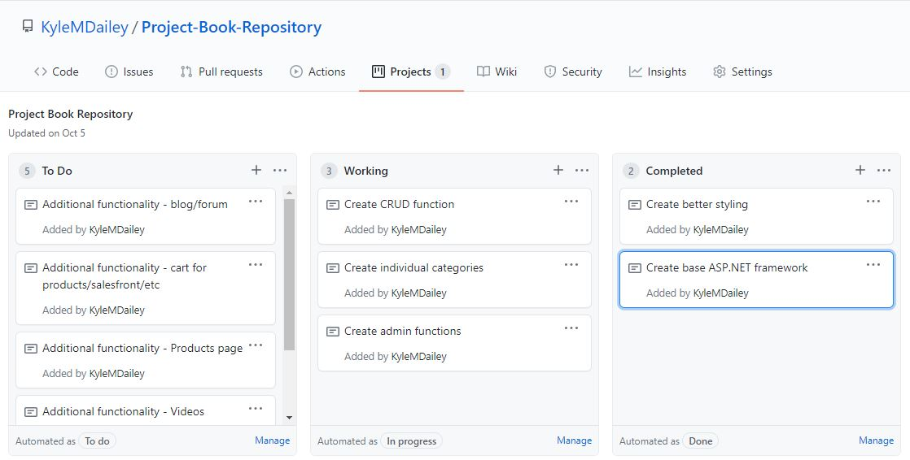
Kanban

Slide 8
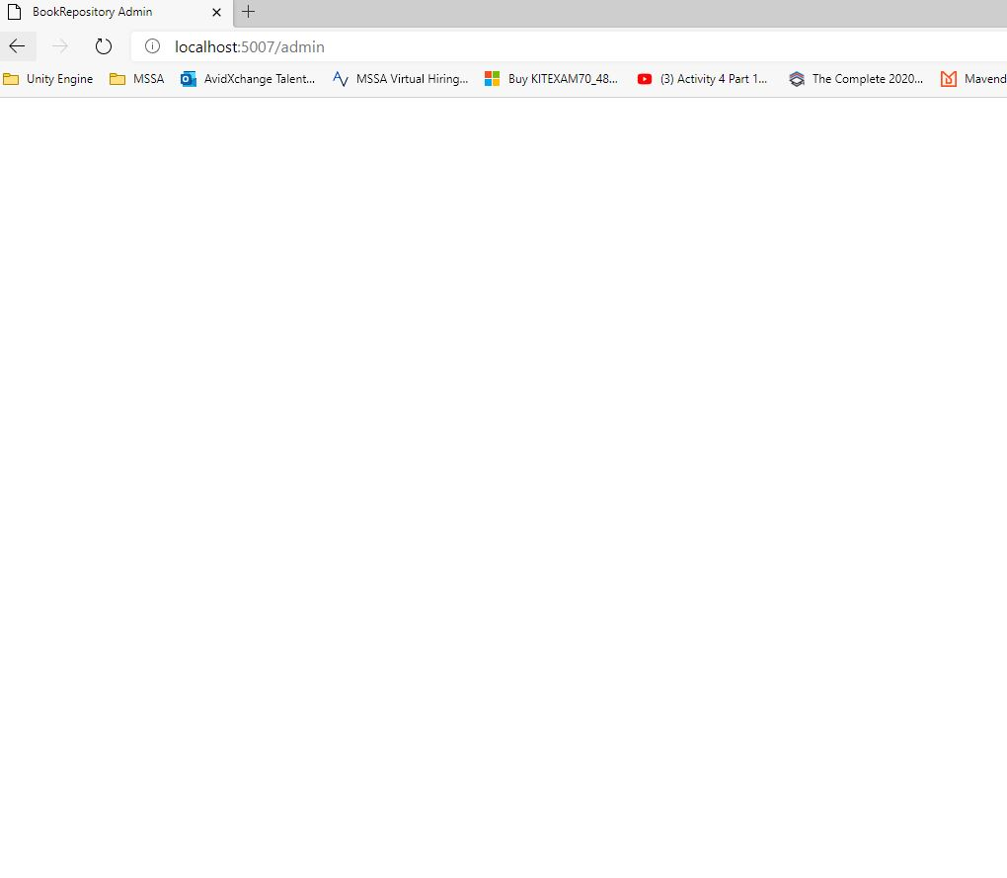
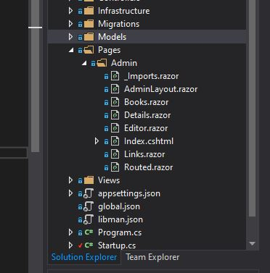
Issues
Bootstrap/Blazor not displaying CRUD portion
Not deployed to Azure yet
Need higher level functions created to meet intent

Slide 9
Questions
?

