Slide 1
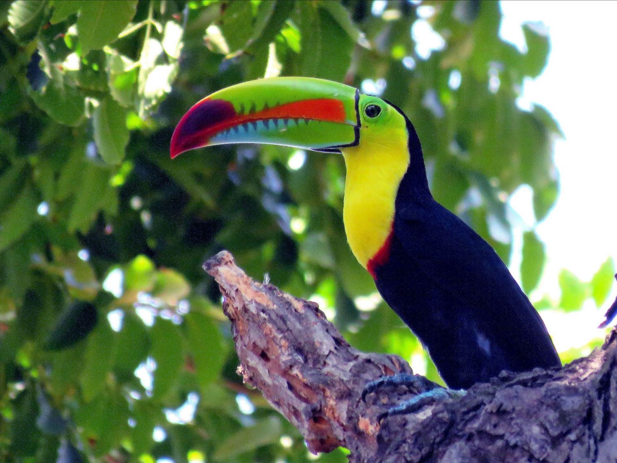
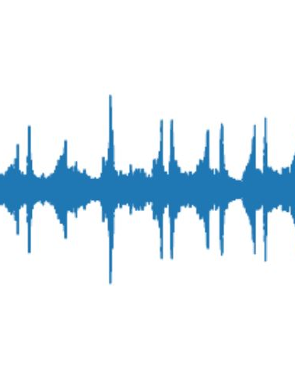

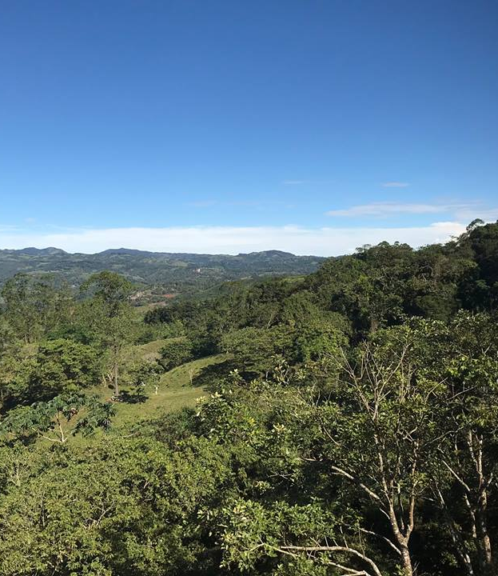
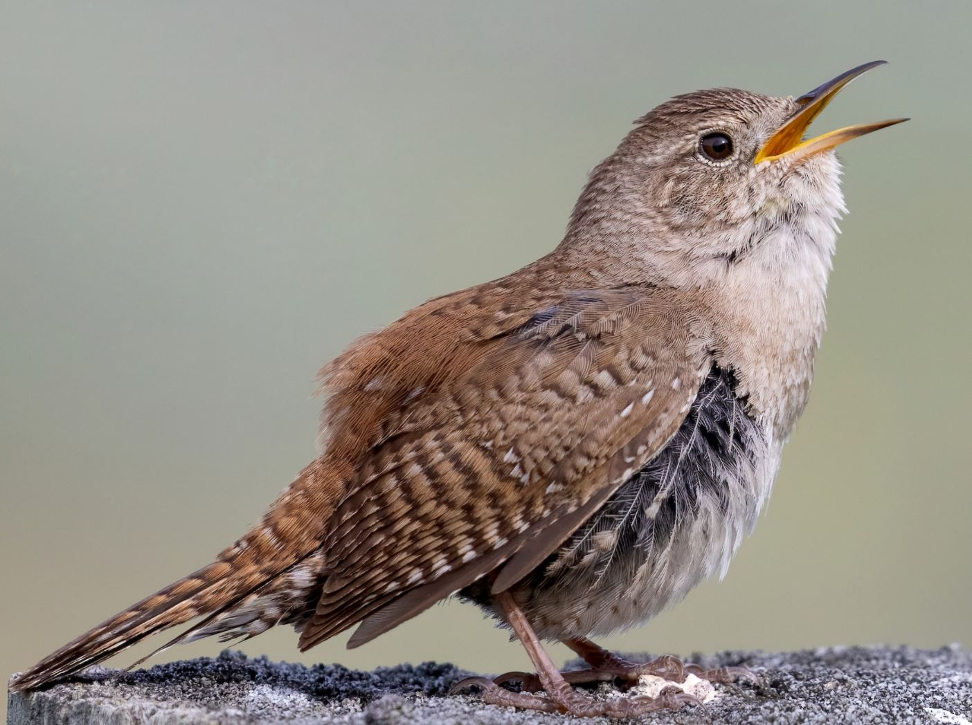

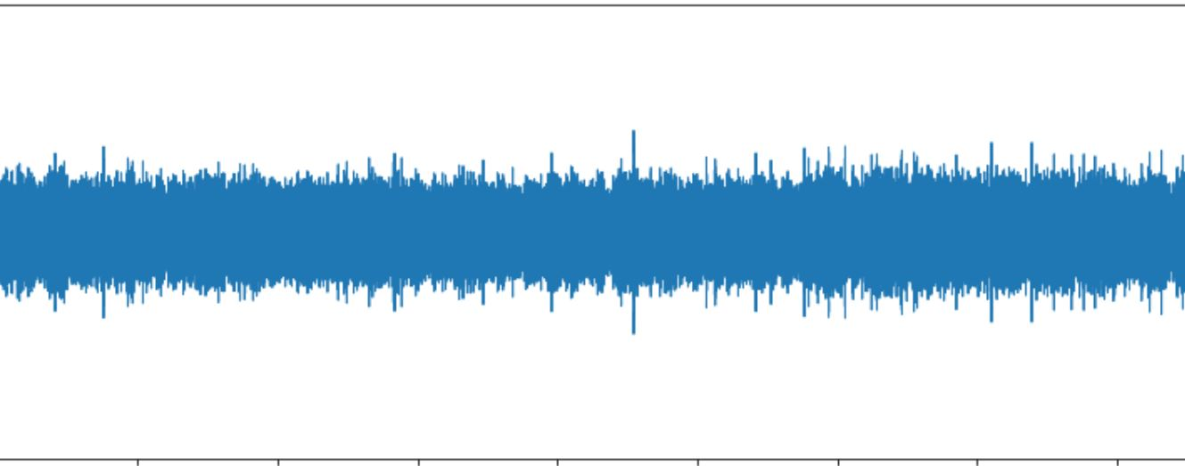
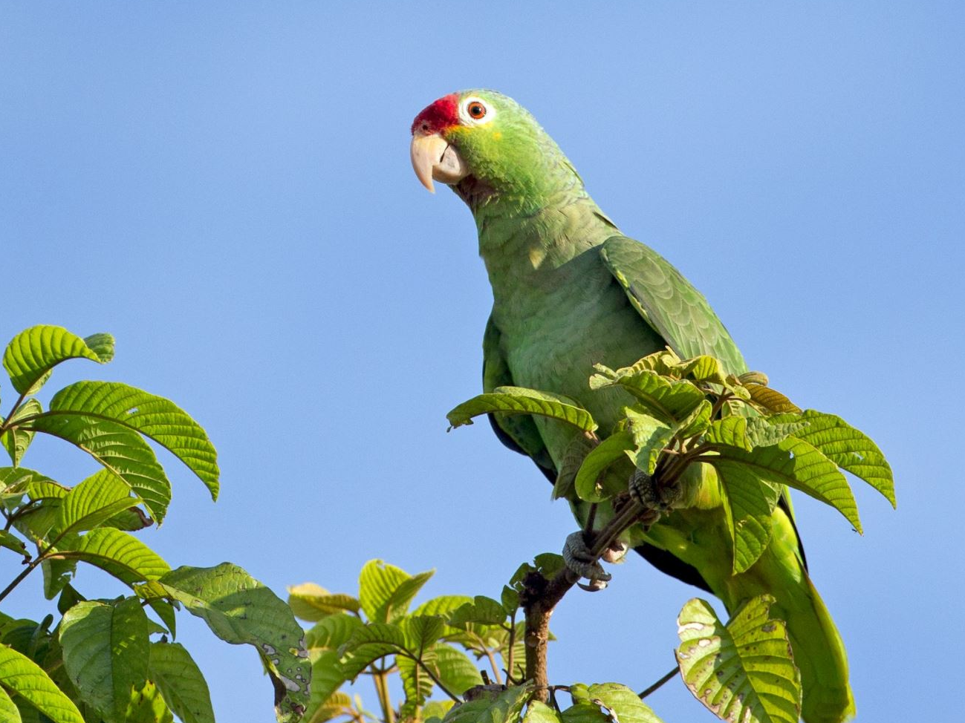
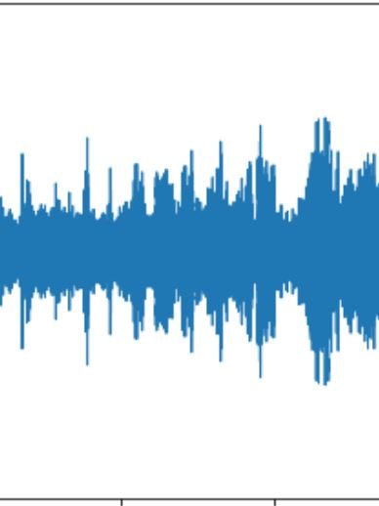
Keel-billed Toucan
Antioquia, Colombia
San Ramón, Costa Rica
House Wren
Red-lored Parrot
focals
soundscapes

Slide 2
focals
Keel-billed Toucan
House Wren
soundscapes
Antioquia, Colombia

