Slide 1
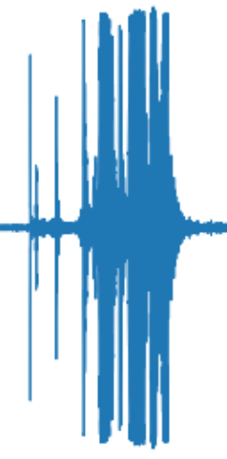
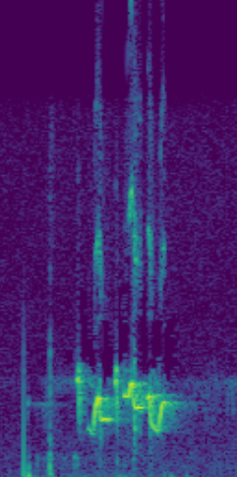
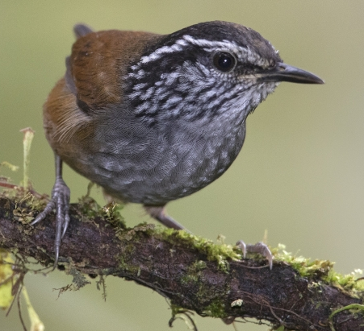
STFT
CNN-based
Pipeline
Grey-breasted Wood-Wren
Waveform (dB)
Spectrogram (Hz)
Species Label

