Slide 1
Dan’s Frappes & Raps
Abbey Allen, Hamilton Hardy,
Kyle McMullin, Andrew Wilkinson

Slide 2
Project Overview
Design Decisions
App
Firebase
Material 3
Jetpack Compose
Compartmentalization + Consistency
User focused views
Theme
MVVM
Abstraction & OOP
Realism
Drinks
Icons/Images/Loader
Task Breakdowns
Abbey
51 tasks
Hamilton
88 tasks
Kyle
92 tasks
Andrew
59 tasks
There was a total of 132 tasks. Some were done individually, while others were a collaborative effort for various group members.
Notes:
Identify the major design decisions and explain how those decisions reflected the team’s (desired?) abilities while satisfying the most important requirements
HAMILTON SLIDE

Slide 3
Project Breakdown
Phase 1:
Scrum Master: Kyle McMullin
Phase 2:
Scrum Master: Abbey Allen
Phase 3:
Scrum Master: Andrew Wilkinson
Phase 4:
Scrum Master: Hamilton Hardy
Project Medium:
App composed in Android Studio using Kotlin and Material 3 .
Group Strengths:
Abbey: Documentation
Hamilton: Frontend
Andrew: Backend
Kyle: Firebase

Slide 4
Ready for Deployment?
Features Ready
Payroll
Cart
Menu
Inventory
Features in Development
Order tracker
Manager bank account
Customizations (partially works)
Notes:
Explain why the project is ready to move into deployment, including a discussion of the correctness of the code and description of the testing phase.

Slide 5
Features
Overall UI
Sprint 1
Knew it was needed
Sprint 2
Color Scheme
Material 3 theming
Loader/Menu Images
Sprint 3
Implemented designs
Sprint 4
Fixed minor bugs
Finished up tasks
Cart
Sprint 1
Knew it was needed
Sprint 2
UML design
Connections
Sprint 3
Implemented design
Implemented connects
Usability testing
Sprint 4
Fixed minor bugs
Finished up tasks
Payroll
Sprint 1
Knew it was needed
Sprint 2
UML design
Connections
Sprint 3
Implemented design
Implemented connects
Usability testing
Sprint 4
Fixed minor bugs
Finished up tasks
Notes:
Using FURPS, audience oriented, and/or MOSCOW clearly state the requirement. Show where the requirement is in the documentation, the relevant modeling (UML, low-fi, high-fi, combination), and explain the design choices. Explain which scrum tasks went into developing this feature and highlight which team members completed which tasks (Being unable to itemize the work will result in a loss of points). Explain the relevant unit testing procedures

Slide 6
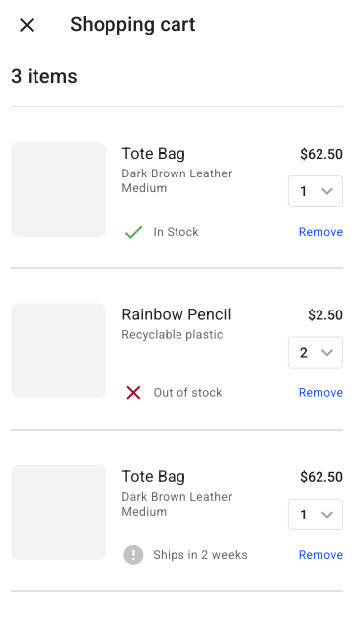
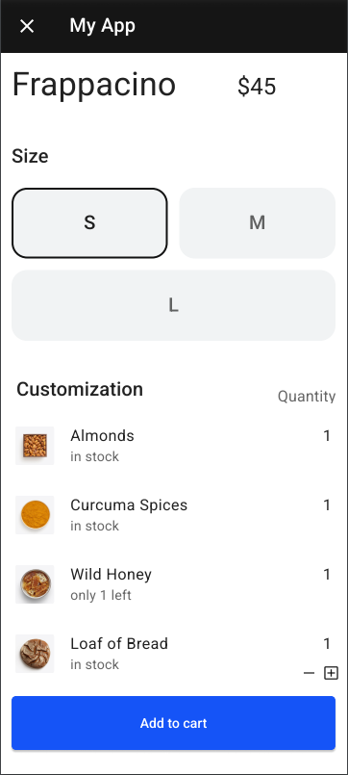
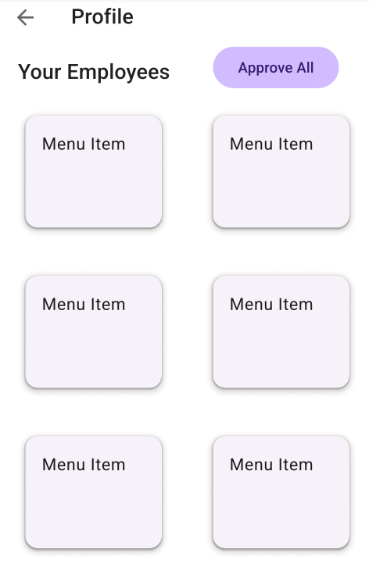
Feature: Overall UI
Requirements
Different Screens
Login
Menu
Images
Loader
Tasks
18 Tasks
Abbey (2) - Drinks, Images
Hamilton (18) - Design, Color implementation
Kyle (5) - Backend, Manager
Andrew (2) - Cart, Menu
Testing
Usability Testing
Notes:
Using FURPS, audience oriented, and/or MOSCOW clearly state the requirement. Show where the requirement is in the documentation, the relevant modeling (UML, low-fi, high-fi, combination), and explain the design choices. Explain which scrum tasks went into developing this feature and highlight which team members completed which tasks (Being unable to itemize the work will result in a loss of points). Explain the relevant unit testing procedures.
HAMILTON SLIDE

Slide 7
UI Customer Demo

Slide 8
UI Manager Demo

Slide 9
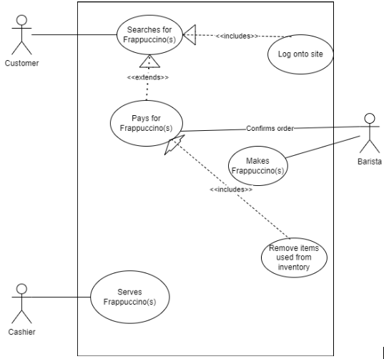
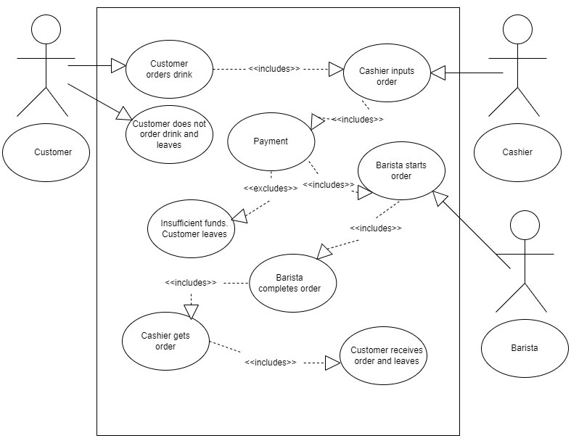
Feature: Cart
Requirements
Drinks
Items
Customization
Price
Money in account
Inventory
Ingredient available
Tasks
24 tasks
Abbey (6) - Documentation
Hamilton (5) - UI
Kyle (5) - App Structure
Andrew (20) - Implementation
Testing
Usability testing
Notes:
Using FURPS, audience oriented, and/or MOSCOW clearly state the requirement. Show where the requirement is in the documentation, the relevant modeling (UML, low-fi, high-fi, combination), and explain the design choices. Explain which scrum tasks went into developing this feature and highlight which team members completed which tasks (Being unable to itemize the work will result in a loss of points). Explain the relevant unit testing procedures

Slide 10
Cart Demo

Slide 11
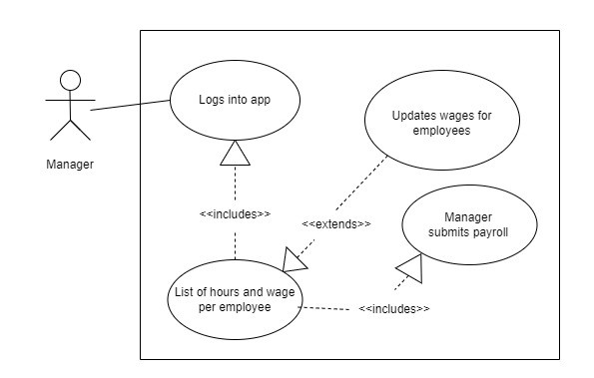
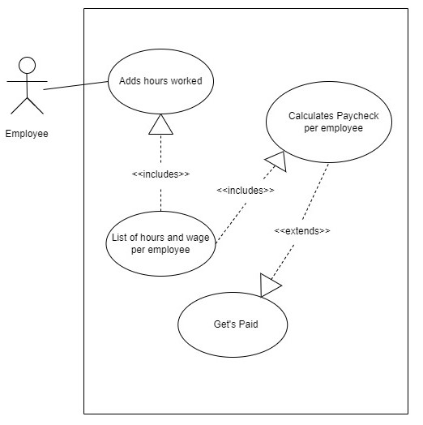
Feature: Payroll
Requirements
Manager can pay employees
Money comes out of managers account
Manager can adjust hours or wage
Employees and Managers can enter time
Tasks
5 tasks
Abbey (2) - Use Case diagrams
Kyle (3) - Implementation
Testing
Usability testing
Notes:
Using FURPS, audience oriented, and/or MOSCOW clearly state the requirement. Show where the requirement is in the documentation, the relevant modeling (UML, low-fi, high-fi, combination), and explain the design choices. Explain which scrum tasks went into developing this feature and highlight which team members completed which tasks (Being unable to itemize the work will result in a loss of points). Explain the relevant unit testing procedures.

Slide 12
Payroll Demo

Slide 13
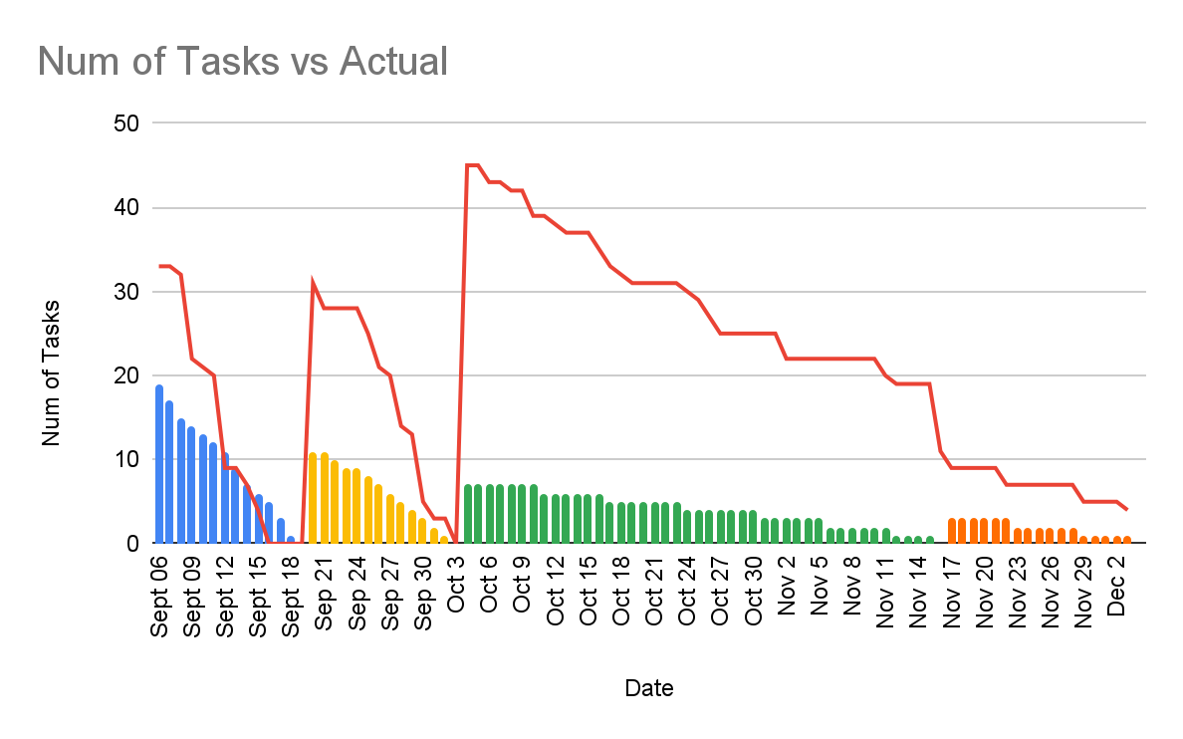
Project Burn-down
Requirements Gathering
34 tasks
High-level Design
5 tasks
Low-level Design
5 tasks
Development
87 tasks
Testing
1 task

Slide 14
Resources
Material 3 Documentation
https://developer.android.com/reference/kotlin/androidx/compose/material3/package-summary
Kotlin and Android
https://developer.android.com/kotlin
Android Studios Documentation
https://developer.android.com/docs
Joseph Ditton’s CS 3200 Introduction to Mobile Application Development Class
https://usu.instructure.com/courses/709856
Google
https://google.com

Slide 15
Questions?

