Slide 1

Shopsmart Solutions Threat Intelligence and Monitoring System
Group 7
5/6/2025
Sam Burns, Cole Hanson, Kyle Naluan, Logan George, Bryce Bohlman

Slide 2
Contents
Introduction & Project Objectives
Security Features & RM Approach
System Architecture & Tech Stack
Testing & Evaluation Metrics
Live System Demo
Challenges & Solutions
Future Improvements
01
04
02
05
03
06
07
Group 7

Slide 3

Project Overview
Objectives
The goal of this project is to ensure the optimal running at all times of ShopSmart Solutions.
01
02
03
04
Data Protection
Real-time Threat Intel
Risk Management
Risk Treatment
Our group aims to protect the confidentiality and integrity of business and customer data.
Our system monitors & analyzes threats using many OSINTs/sources to provide visible, immediate data every hour. This makes sure the security team is constantly updated.
Through our mapping system, we are able to properly calculate risk scores. Involving threat likelihood, and potential impact. The system also provides methods for risk treatment.
Our system also provides solutions through mitigation recommendations for an incident response.
Group 7

Slide 4







Tech stack
Tools used
Our project involved development implementation with frontend, backend, database, OSINT tools, & LLM.
01
02
Framework
Database
Flask (python)
PostgreSQL
03
04
OSINT Tools
LLM
Virustotal, AbuseIPDB, Securitytrails, & Shodan
OpenAI GPT-4 API
Group 7

Slide 5

Overview System architecture
Security features
Risk management (RM)
Risk prioritization
Automated fixing & Monitoring
API Key Protection
Automated IP Blocking
Role-based access
Logging of API actions
OSINT APIs are all done in real time.
GPT analyzes threats & predicts attack behavior.
AbuseIPDB
Uses Abuse confidence
VirusTotal
Malicious,suspicious & harmless ratio
Securitytrails
WHOIS data about a domain
Web application Firewall rules for SQL injection.
IPs blocked with Firewall rule being applied.
Suggested enabling 2FA to mitigate
phishing attempts.
Scripts are scheduled to refresh throughout the day.
Alerts & notifies security team of high risks.
Group 7

Slide 6

OSINT API TOOLS
The OSINT APIs we added to out system are tools that give us public threat intelligence data. This can be used to detect & respond to possible cyber threats. While still giving readable reports to the security team.
VirusTotal
SecurityTrails
AbuseIPDB
Shodan
Uses IP reputation scores to analyze data.
Detects Malware, watches for suspect activity, & knows of past threat data.
Real-time updates.
Has DNS records & WHOIS data.
Has domain intelligence (ex.creation time)
IP information
Real-time updates & past DNS records.
Uses an Abuse confidence score.
Reports last timestamp.
Gives/reports domain history.
Detailed readable report
Identifies open ports & internet-connected devices
Detects exposed services or weak/outdated software.
Has network intelligence (ex. Service banners & headers)
Group 7

Slide 7

Database
Schemas
Assets:
- Manages assets including Hardware, Software, Data, People, and Processes.
Schema:
- Contains core tables for threats, vulnerabilities, risk assessments, and incidents.
TVA_mapping:
- Supports Threat-Vulnerability-Asset (TVA) mapping and risk scoring.
Our database provides a way assess and mitigate risks. It is implemented in PostgreSQL and uses schemas to organize the components.

Slide 8
Database
Functions
1. Asset Management
- The assets table organizes assets into 5 categories; Hardware, Software, Data, People, and Processes.
2. Threat and Vulnerability Tracking
- The threats and vulnerabilities tables store info that can be used to link threats to specific assets
3. Risk Assessment
- The risk assessment table calculates risk scores using likelihood and impact.
4. Incident Logging
- The incident logs table tracks incidents/resolution steps. Can be used for post incident analysis
5. Threat Intelligence Integration
- The threat data table stores data from Shodan. Allows for real-time risk assessments/updates
6. Threat-Vulnerability-Asset Mapping
- The tva mapping table links assets, threats, and vulnerabilities together.
- Allows for automated updates to risk scores based on threat intelligence feeds.
7. Triggers and Auditing
- Triggers like update_modified_column ensure that updated_at timestamps are automatically updated.
- This allows for good record keeping and auditing

Slide 9

Live System Demo
Group 7

Slide 10
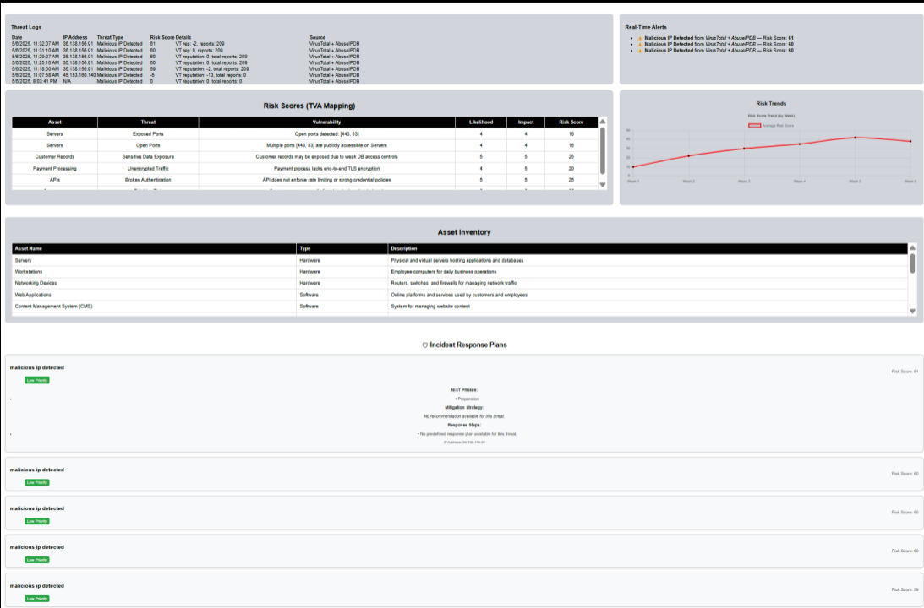
Dashboard
Group 7

Slide 11

Security Features
TVA Mapping &
Risk Scoring
Real-Time OSINT
Threat Data
Real-Time Alerts
for High Risk Threats
Automated Risk
Mitigation Recommendations & Incident Response
Blue Teaming Tasks
AI-Based Threat Protection
Blue teaming Tasks
Group 7

Slide 12


Risk Management Approach
Our system aims to align with the NIST Risk Management Framework (RMF) and
NIST Cybersecurity Framework (CSF) 2.0.
NIST RMF (Risk Management Framework)
NIST CSF 2.0 (Cybersecurity Framework)
Used by federal organizations to manage security & privacy to information systems. (System)
A broader guide for organizations to use for improving cybersecurity protection. (Life cycle)
Our system follows these guidelines by:
Assessing risks with OSINT scores.
Categorizing assets with domains, IPs, & threats.
With auto-blocking IPs with firewall rules we implement controls.
Automated scripts with API reports help continuously monitor the system.
Our system follows these guidelines by:
Identifying threat intelligence with OSINT.
We protect by enforcing 2FA & WAF suggestions.
Using AI with threat feeds we detect real-time concerns.
With the uses of IP blocking and other tools, we respond to these threats.
Our system remembers and reports different incident analysis. (Recover)
Group 7

Slide 13

Testing & Evaluation Metrics
Objectives
Testing our application involved testing for usability, system performance and evaluation for security risks. This is what we did or attempted to test during the creation of the project.
01
02
03
04
Basic security testing
System performance
Risk evaluation
Testing for usability
Finding vulnerabilities with nmap or OWASP.
Alignment with NIST guidelines.
API response logs.
Amount of time to take system to update a response.
Comparisons between logs to better understand threats.
Risk scoring comparisons, Seeing how consistent the data was.
Comparing predictions vs actual threats.
Dashboard features.
Success rate upon being able to see proper data.
How easy it was to navigate dashboard.
Group 7

Slide 14

Challenges & Solutions
Challenges
How we Responded
01
Unfamiliarity with chosen technology
Read documentation, followed tutorials, and increased exposure through completing project tasks.
02
Had some trouble setting up one of the OSINT APIs. (SecurityTrails)
Aside from working on the API we had trouble with, we also added another. ( Shodan)
03
Problems with getting everything uploaded to GIthub correctly.
We used discord to communicate and send files that were unable to be uploaded alone.
Group 7

Slide 15

Next Steps & Future Improvements
1
Role-based Access Control
Provide different features & views to users based on their role in the company.
2
AI Chat Assistant
Incorporate an AI Chatbot to communicate and provide support to users in real-time.
3
Web Hosting
Migrate all components of the application to the cloud/web so the application can be accessed without being locally hosted.
Group 7
‹#›

Slide 16
Next Steps & Future Improvements
4
Multi-Factor Authentication
Enforce MFA when logging in to increase the security of the system and prevent attacks.
5
Cloud platform
Later we could add a cloud platform to handle larger amounts of data. This would be good for larger businesses . It can also grow with the business in size.
6
Email Alerts
This small detail could help alert the security team or workers about any concerns or threats as soon as it happens.
Group 7
‹#›

Slide 17

Sources/References
NIST Cybersecurity Framework
https://www.nist.gov/cyberframework
Risk Management Framework (RMF)
https://csrc.nist.gov/projects/risk-management/about-rmf
VirusTotal API
https://www.virustotal.com/gui/home/upload
SecurityTrails API
https://securitytrails.com/
AbuseIPDB API
https://www.abuseipdb.com/api.html
Shodan
https://www.shodan.io/
PostgreSQL
https://www.postgresql.org/
LLM (ChatGPT)
https://chatgpt.com/

Slide 18

Thank you!
Group 7

