Slide 1
O(no) Group presentation
Karson Lant
Shane Grant
Kyle Parato
Nebil gokdemir

Slide 2
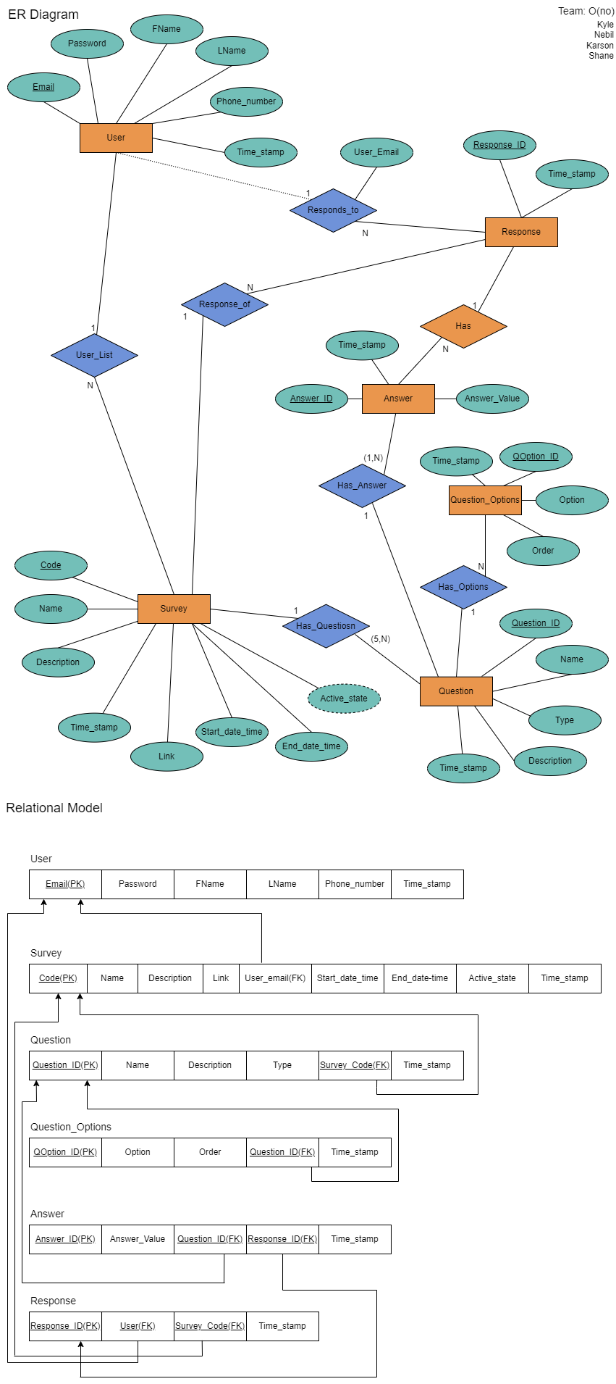
Database Schema

Slide 3
Relational Model

Slide 4
The Survey Database has Six tables
Users table has all user data
Survey table has all survey data
Question table has all questions of the surveys
Question_options table has all the options for each question
Answer Table has all the answers of each question from the survey
Response table has all the responses from each survey

Slide 5
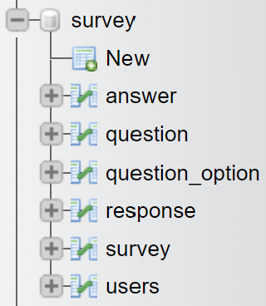
Image of survey database
Our survey database which contains six tables as discussed above.

Slide 6
There are ten Php files for our survey website
All files connect with the survey database.
Index.php: Takes the user email and password to log in or redirect to CreateUser.php
CreateUser.php: Takes all user information in the form and inserts it into the User table.
DeleteSurvey.php: Lists of all of the user's surveys, allows them to delete a survey from their list
CreateSurvey.php: Allows the user to create a survey
Question.php: Allows the user to create questions for the survey
AnswerOptions.php: Allows the user to create options for the questions
AllSurvey.php: Allows the user to view and participate in all surveys
AllQuestions.php: Lists all questions and options for a survey
Login.php: Allows the user to input an email and password. Then checks if there is a match in our database
LogOut.php: Allows the user to end their session and it will return them back to index.php

Slide 7
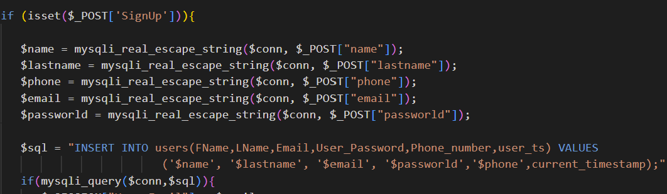
Image of inserting a new user into the User Table
On a click of the Signup button, store the name, lastname, phone, email, and password into variables. Then we insert them into the user table via the INSERT INTO keyword.

Slide 8
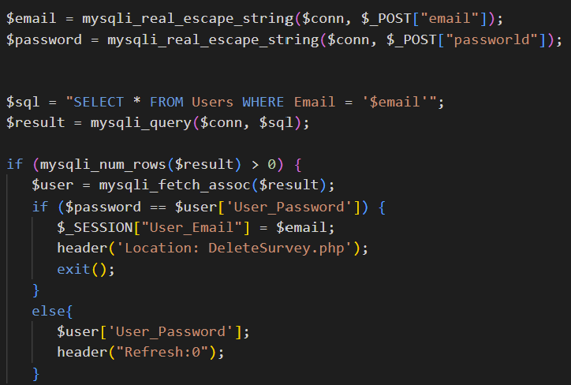
Query that check if the user exists in User Table for login
Stores email and password into variables. Then we check if we get a match between our email and password variables and the ones stored in our User Table.

Slide 9
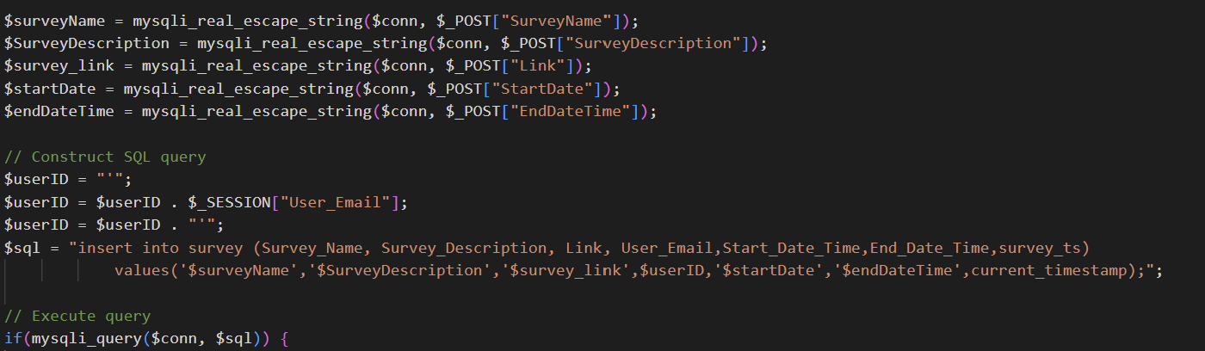
Image user creating a survey
We take surveyName, SurveyDescription survey_link, startDate, and endDateTime and insert them into our Survey Table.

Slide 10
Question.php: As soon as we create a survey, it transfers to the Question.php file with a Survey_Code. So then, the user can insert information of the question with a Survey_Code. Additionally, the question has two types: true, false and multiple choice.
AnswerOption.php: As soon as we create a Question, it take us to the AnswerOption.php file with a Question_ID, so the user can insert answers for each question into the Question_Option table correlating with a Question_ID.
AllSurvey.Php: Will do a Query of all surveys, and then print them on the page.

Slide 11
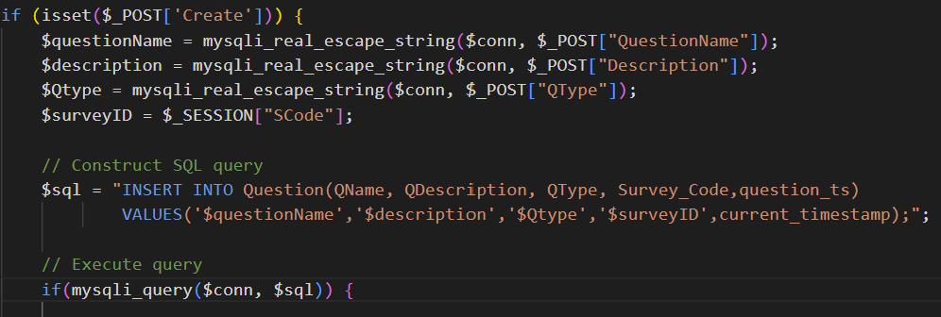
Insert Question Query into database
When Create button is clicked, it will Insert questionName, description, Qtype, and surveyID into the Question table in our database.

Slide 12
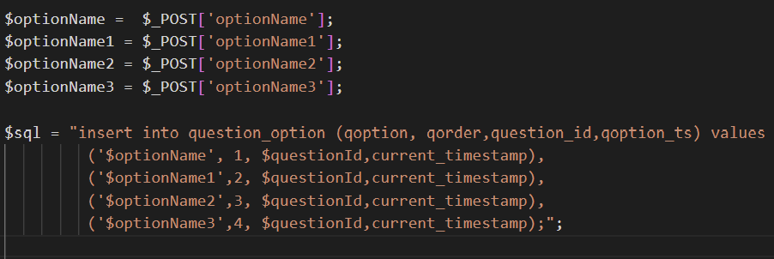
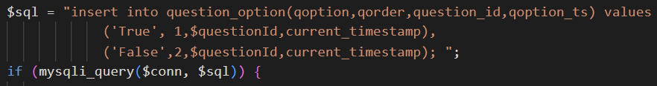
This Query is insert Question option base on question type

Slide 13

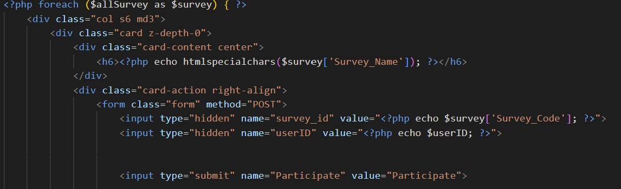
Query to take all surveys in the database

Slide 14
DeleteSurvey.php: Remove a survey from the user list without removing the data from the database.
AllQuestion.php: when the user clicks each survey, it will take the user to this page with a survey_code, and Query all questions in the Question table to allow the user to take a survey. Then it will create a Response and insert each answer value into the answer table.

Slide 15
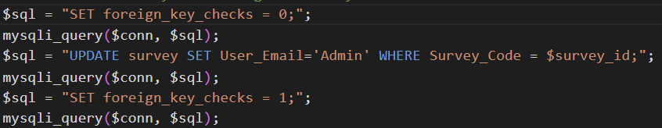
This query removes the selected survey from the user's list

Slide 16

This query Creates a response

Slide 17
This query takes all questions and answer options when the user clicks answer, it insert into Answer table

