Slide 1


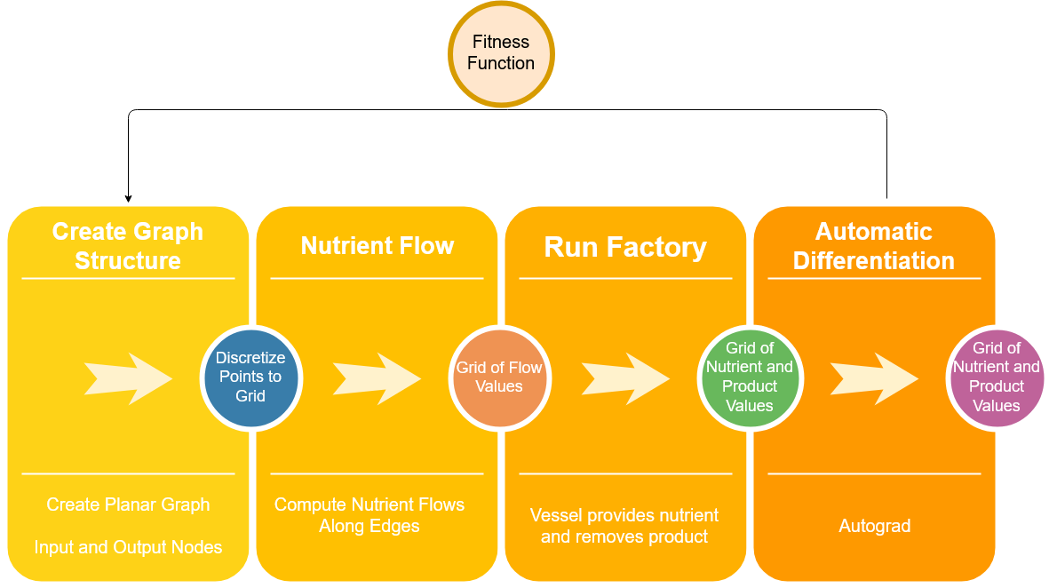
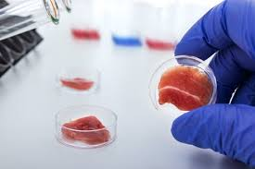
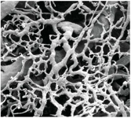
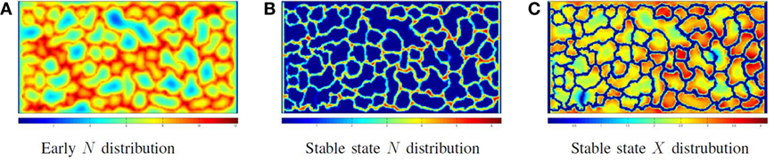
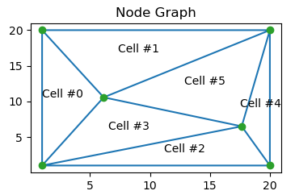
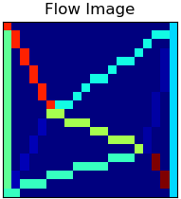
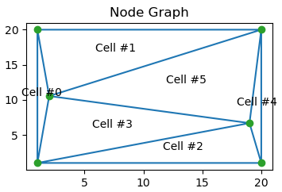
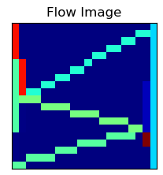
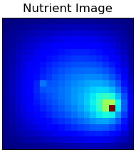
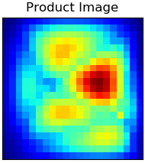
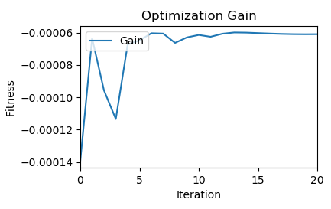
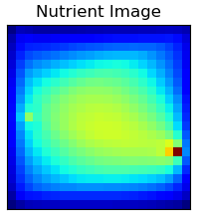
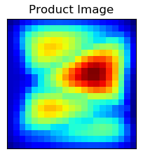
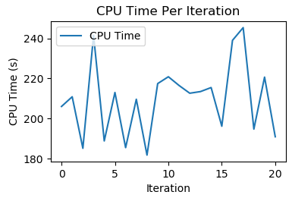
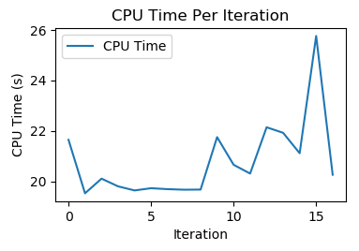
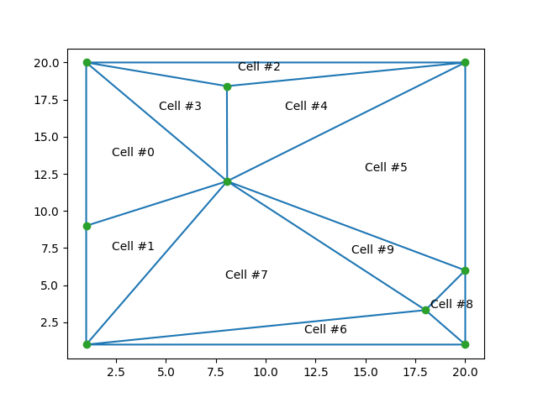
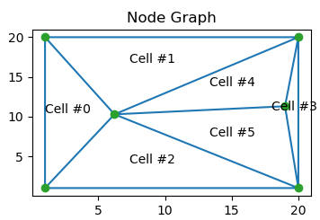
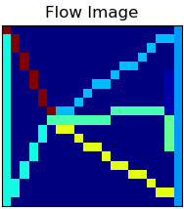
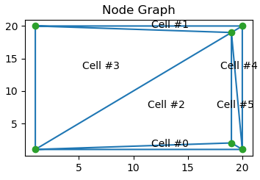
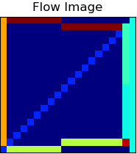
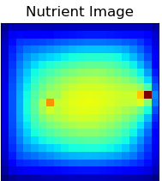
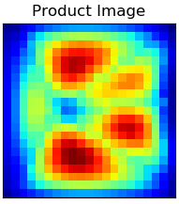
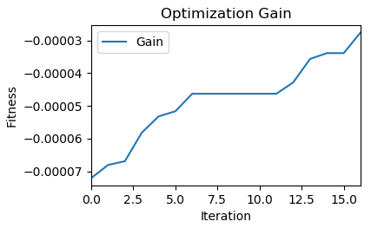
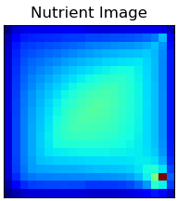
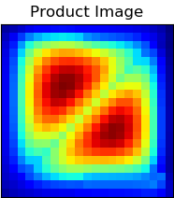
Optimized Vascular Structure for Lab-Grown Meat
Eric Bell, Zach Case, Kyle Reese
Machine Intelligence in Clean Energy ----- Fall 2019
Abstract
Summary
Lab-produced meat generates far fewer greenhouse emissions than traditional ranching and eliminates deforestation caused from housing livestock. This work demonstrates that Automatic Differentiation is effective at finding model parameters to obtain optimal vascular structures which produce healthy lab grown meat.
We use Automatic Differentiation (AD) to optimize the vascular structure of a cell system for Lab-Grown Meat. Due to heavy computation costs and the large amount of tracked information, Automatic Differentiation took significantly longer to run than a naive Hill Climber. However, AD was able to successfully adjust the position of parameter nodes to locations which allow cells to consume the most Nutrients and produce the most Product.
Conclusion
We demonstrate the use of Automatic Differentiation in an agent based spatial domain. Automatic Differentiation achieved about the same fitness gain as the Hill Climber. Since Hill Climber only reports the best gains, this explains differences within the graphs as AD continues to move in the direction that will produce the ultimate best gain.
Flow Diagram of Optimization System
Problem Description
We use a high fidelity biological model incorporating vascular flow, nutrient, production, uptake, diffusion, and genetic regulation. Our model implemented a coupled Ordinary Differential Equation (ODE) and Partial Differential Equation (PDE) system, which can be optimized for nutrient consumption or product removal. In our case the results show the optimization for the removal of product.
Computational Study
The growth efficiency, nutrient density, and overall health of growing meat greatly depends on the structure and organization of the vascular scaffolding holding the cells. Machine learning techniques such as Automatic Differentiation and Genetic Algorithms can be used to optimize a vascular structure to produce healthier meat cells more efficiently.
Previous work, as shown below, has shown that this problem can be solved using Genetic Algorithms
Automatic Differentiation
Advantages | Disadvantages
Knows the gradient (direction to move) | Computationally Intensive
Non Random Movements
Hill Climber
Advantages | Disadvantages
Not Computationally Intensive | Does not know the direction to move points
 | Random Movements
Results
The following graphs show the initial start and final end position for both Automatic Differentiation (AD) and Hill Climbing (HC) algorithms. AD and HC ended in different positions with HC having a better gain than AD.
Automatic Differentiation (200 Iterations, 0.5 Step Size)
Initial Positions
Final Positions
https://www.frontiersin.org/articles/10.3389/fbioe.2017.00027/full
Method
A planar graph of nodes and edges is used to model the structure of the vascular system and to simulate the flow of nutrients and waste through the system.
Automatic differentiation is applied to the model to reconfigure the structure into an optimal form.
Hill Climber (200 Iterations, Picks Best Gain)
Initial Positions
Final Positions
From the CPU graphs above, we can see, Automatic Differentiation took a lot longer to run per iteration than the Hill Climber algorithm. Hill Climber also ended with a better gain than AD found with its iteration limit of 200 and step size of 0.5.
References
https://www.frontiersin.org/articles/10.3389/fbioe.2017.00027/full
https://images.theconversation.com/files/210964/original/file-20180319-104671-pk2mjw.jpg
Initial Node Representation of Vascular System
Initial Cellular Image
Notes:
High fidelity biological model incorporating vascular flow, nutrient and product production and uptake, diffusion and genetic regulation.
Implemented as a coupled ODE and PDE system.
Two visualizations of solutions from HC and AD
Computational study:
Methods:
Table:
Advantage Disadvantate
HC fast (only run fitness) generate and test solution mods
AD slow (need to run autograd) know the gradient
Graph:
fitness (y) as a function of run time (cpu)
and/or
fitness(Y) as a function of iterations?
Contributions:
Demonstration of AD in agent based spatial domain
Summary
Results contract and compare the two methods

