Slide 2
Class
Encapsulates both structure and behavior
Defines the operations and attributes of its instances
An object is an instance of a class
Can be defined in terms of other classes using inheritance

Slide 3
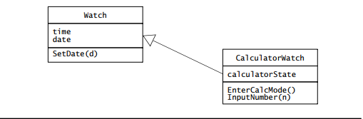
Inheritance
Assume there is a watch that can function as a calculator
Class CalculatorWatch refines (inherits) class Watch
Generalization class is called the Superclass
The specialized class is the Subclass

Slide 4
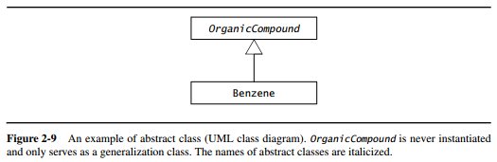
Abstract classes
Generalization class that exists only to share attributes and operations
Is not meant to be initialized
Introduced to reduce complexity in the model or promote reuse

Slide 5
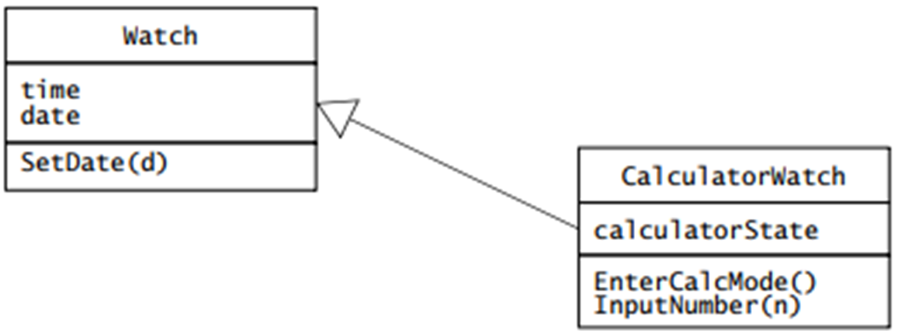
Parts of a class
Operations define what an instance can do
SetDate(d) in Watch applies to both, but InputNumber(n) only applies to subclass
Attributes are named slots in an instance where values are stored
Ex: Watches have time and date attributes, and CalculatorWatches also have a calculatorState attribute

Slide 6
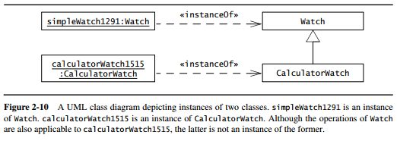
Objects
Instance of a class, and has an identity and stores attribute values
Each object belongs to exactly one class
In UML, instances are depicted by rectangles with underlined names

Slide 7
Event Classes
Abstractions representing a type of event for which the system has a common response
An event is an instance of an event class, and is a relevant occurrence in the system
Ex: user input, time-out, send a message between objects, etc.

Slide 8
Messages
A message is made of a name and a number of arguments
Sending a message is the process used by objects to call the execution of an operation of another object
Receiving object matches the message name to one of its operations, passes any arguments to it, and returns results to the sender
Like objects, messages are instances, and represent concrete occurrences in the system

Slide 9
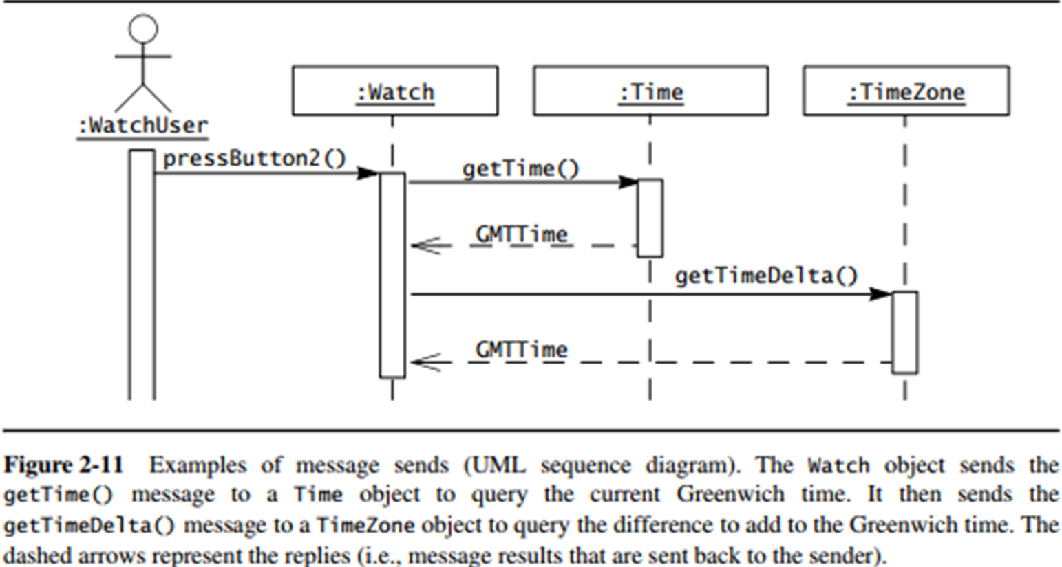
Events example

