Slide 1
Group 2, 2.3.3 to 2.4.2 Slides
Daniel Shrader, Robert Cromer, Kyle Remillard, Nick Grimaldi
CSCI 4400 – DB
Dr. Abi Salimi

Slide 2
Class
Encapsulates both structure and behavior
Defines the operations and attributes of its instances
An object is an instance of a class
Can be defined in terms of other classes using inheritance

Slide 3
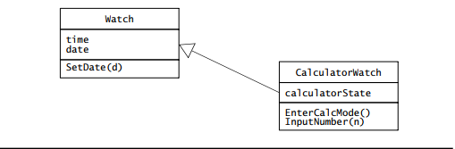
Inheritance
Assume there is a watch that can function as a calculator
Class CalculatorWatch refines (inherits) class Watch
Generalization class is called the Superclass
The specialized class is the Subclass

Slide 4
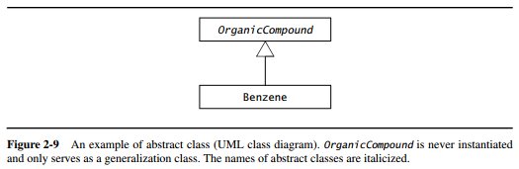
Abstract classes
Generalization class that exists only to share attributes and operations
Is not meant to be initialized
Introduced to reduce complexity in the model or promote reuse

Slide 5
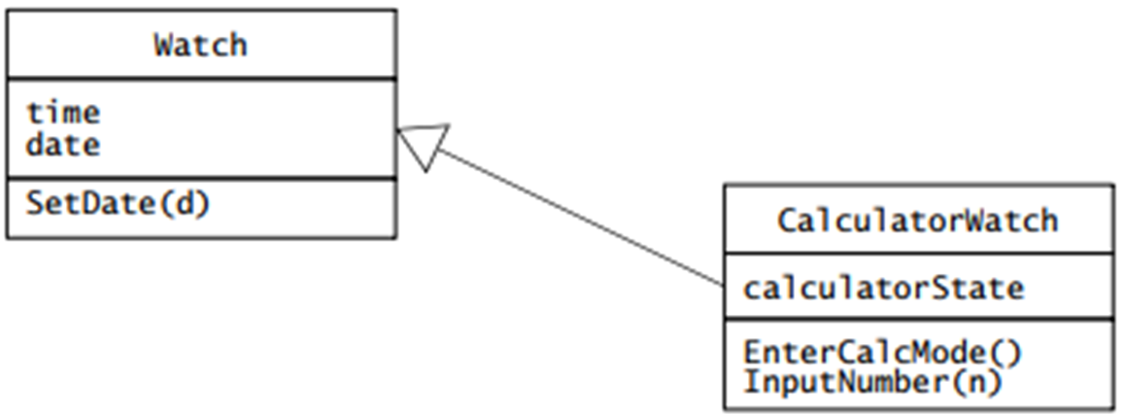
Parts of a class
Operations define what an instance can do
SetDate(d) in Watch applies to both, but InputNumber(n) only applies to subclass
Attributes are named slots in an instance where values are stored
Ex: Watches have time and date attributes, and CalculatorWatches also have a calculatorState attribute

Slide 6
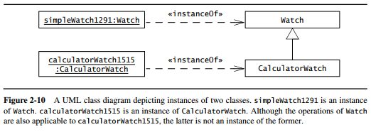
Objects
Instance of a class, and has an identity and stores attribute values
Each object belongs to exactly one class
In UML, instances are depicted by rectangles with underlined names

Slide 7
Event Classes
Abstractions representing a type of event for which the system has a common response
An event is an instance of an event class, and is a relevant occurrence in the system
Ex: user input, time-out, send a message between objects, etc.

Slide 8
Messages
A message is made of a name and a number of arguments
Sending a message is the process used by objects to call the execution of an operation of another object
Receiving object matches the message name to one of its operations, passes any arguments to it, and returns results to the sender
Like objects, messages are instances, and represent concrete occurrences in the system

Slide 9
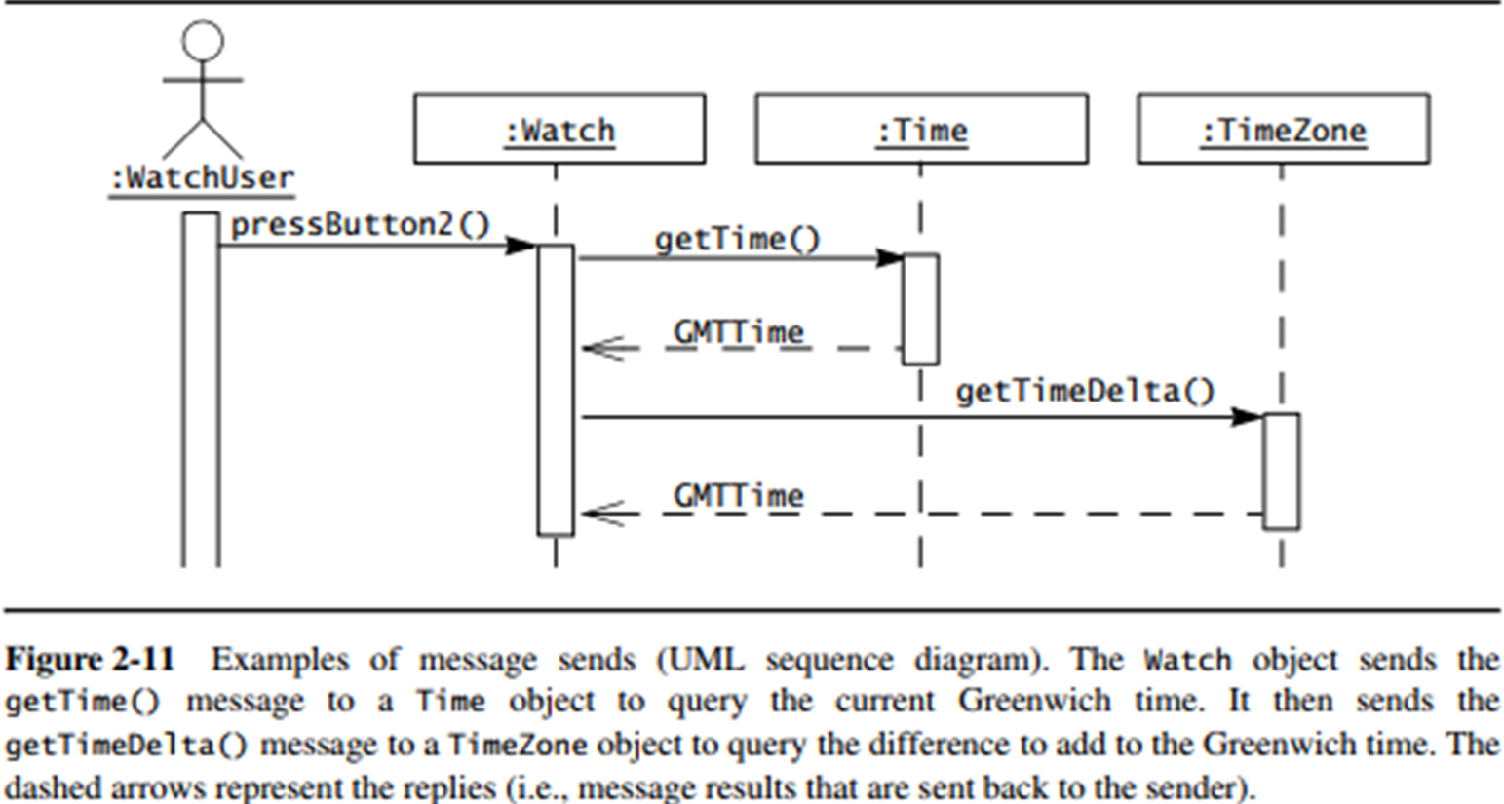
Events example

Slide 10
Object-Oriented Modeling
Application Domain: The representation on the user’s problem. Includes the system’s physical operating environment, the user, and other actors.
Solution Domain: The modeling space of the system.
Very volatile. New emergent technologies, deeper understanding, and requirement changes completely alter the solution domain.

Slide 11
Object-Oriented Modeling
Object-oriented Analysis: Modeling of application domain.
Object-oriented Design: Modeling of solution domain.

Slide 12
Falsification and Prototyping
Falsification: Representing relevent details incorrectly
Prototyping: System development technique.

Slide 13
UML Diagrams
Use case Diagrams: System Functionality representation based on the user’s point of view.
Class Diagrams: System operations, relationships, attributes represented in static terms.
Interaction Diagrams: Representation of the interactions between a set of system objects.
State Machine Diagrams: Behavior of nontrivial objects.
Activity Diagrams: Representation of data/control flow though the system.

Slide 14
Use case Diagrams
Actors: External entities that interact with the system.
Use cases: Descriptions of the behavior of the system from an actor’s point of view.
Behaviors described by use cases are called External Behaviors.
The exchange of information between an actor and an use case is called commincation.

Slide 15
Textual Use Cases
Six Fields
Name
Participating Actors
Entry conditions
Flow of Events
Exit Conditions
Quality Requirements

Slide 16
Name and Participating Actors
Name: A unique name used for reference
Participating Actors: The external entities interacting with the use case.

Slide 17
Entry Conditions and Flow of events
Entry Conditions: The prior actions or conditions that need to be satisfied before the initiation of the use case
Flow of Events: T he sequence of interactions within the use case.
Common case: Expected cases
Exceptional case: Unexpected cases

Slide 18
Exit Conditions and Quality Requirements
Exit Conditions: Conditions satisfied after the completion of the use case.
Quality Requirements: Requirements not related to the functional requirements of the system.
Performance Constraints
Hardware Platforms
Development Environments

Slide 19
Review of Use Case Diagrams: 3 Important Terms
Used during requirements elicitation and analysis to represent behavior visible from the outside of the system
An actor represents a role, that is, a type of user of the system
Student
A use case represents a class of functionality provided by the system
Use case model:
The set of all use cases that completely describe the functionality of the system.
DoHomework

Slide 20
Actor
An actor is a model for an external entity which interacts with the system:
EndUser, Administrator
External system (Another system)
Physical environment (e.g. Weather)
An actor has a unique name and an optional description
Examples:
Student: A studying person
Teaching Assistant: Member of teaching staff who supports the instructor.
Random Number generator
Student
Optional
Description
Name

Slide 21
Use Case
• A use case represents a class of functionality provided by the system
• Use cases can be described textually, with a focus on the event flow between actor and system
• The textual use case description consists of 6 parts:
Unique name
Participating actors
Entry conditions
Exit conditions
Flow of events
Special requirements.
DoHomework

Slide 22
Use Case Model
Classifier
Use Case
Actor.
System boundary
Use case diagrams represent the functionality of the system
from user’s point of view

Slide 23
Uses Cases can be related
Extend Relationship
To represent seldom invoked use cases or exceptional functionality
Include Relationship
To represent functional behavior common to more than one use case.

Slide 24
The <<extend>> Relationship
<<extend>> relationships model exceptional or seldom invoked cases
The exceptional event flows are factored out of the main event flow for clarity
The direction of an <<extend>> relationship is to the extended use case
Use cases representing exceptional flows can extend more than one use case.
Student
DoHomework
<<extend>>
<<extend>>
<<extend>>
FetchLostSheet
<<extend>>
Party
DrinkCoffee
Sleep

Slide 25
The <<include>> Relationship
<<include>> relationship represents common functionality needed in more than one use case
<<include>> behavior is factored out for reuse, not because it is an exception
The direction of a <<include>> relationship is to the using use case (unlike the direction of the <<extend>> relationship).
DoHomework
Student
HoldExercise
GiveLecture
<<include>>
<<include>>
<<extend>>
AskQuestion
<<extend>>
<<extend>>
NoAnswer
WrongAnswer
SillyQuestion

Slide 26
Textual Use Case Description Example
Student
1. Name: DoHomework
2. Participating actor: Student
3. Entry condition:
Student received exercise sheet
Student is in good health
4. Exit condition:
Student delivered solution
5. Flow of events:
1. Student fetches the exercise sheet
2. Student reads through the assignments
3. Student processes the assignments and types the solution in his Computer.
4. Student prints out the solution
5. Student delivers the solution in the following exercise
6. Special requirements:
None.
DoHomework
Notes:
Question: Anything missing? Answer: Exceptional cases!
Use cases represent functionality of the system
All use cases need to be described for the model to be useful
Use case diagrams are useful as an index into the use cases
The Textual Use case descriptions provide meat of model, not the use case diagrams.

Slide 27
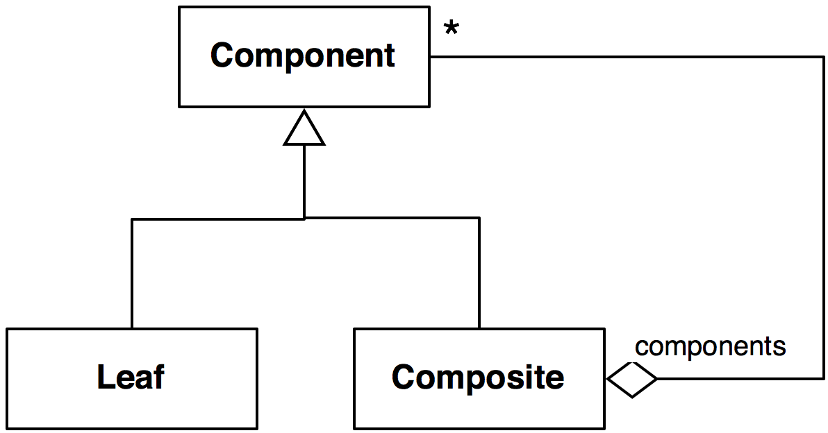
Review of Class Diagrams
Multiplicity
Inheritance
Association End Name (Role)
Class
Aggregation
Class diagrams represent the structure of the system
Notes:
Question: Does anybody know this as a pattern? What name? This is the class diagram of the composite pattern.

Slide 28
Actor vs Class vs Object
Actor
An entity outside the system to be modeled, interacting with the system (“Passenger”)
Class
An abstraction modeling an entity in the application or solution domain
The class is part of the system model (“User”, “Ticket distributor”, “Server”)
Object
A specific instance of a class (“Joe, the passenger who is purchasing a ticket from the ticket distributor”).
Notes:
What is the difference between an actor, a class and an instance?

Slide 29
Extended Relationships
Alternative method to reduce complexity
Adding events

Slide 30
Inheritance Relationship
Another method to reduce complexity by adding more detail to a generic use case.

Slide 31
Scenarios
An instance of a use case describing a concrete set of actions
Scenario Template
Name: Unique name for reference.
Participating Actors: Which actor instances are involved in the scenario.
Flow of Events: Description of the sequence of events step by step.

