Slide 1
Review of Use Case Diagrams:
3 Important Terms
Used during requirements elicitation and analysis to represent behavior visible from the outside of the system
An actor represents a role, that is, a type of user of the system
Student
A use case represents a class of functionality provided by the system
Use case model:
  The set of all use cases that completely describe the functionality of the system.
DoHomework

Slide 2
Actor
An actor is a model for an external entity which interacts with the system:
  EndUser, Administrator
  External system (Another system)
  Physical environment (e.g. Weather)
An actor has a unique name and an optional description
Examples:
  Student: A studying person
  Teaching Assistant: Member of teaching staff who supports the instructor.
  Random Number generator
Student
Optional
Description
Name

Slide 3
Use Case
• A use case represents a class of functionality provided by the system
• Use cases can be described textually, with a focus on the event flow between actor and system
• The textual use case description consists of 6 parts:
  Unique name
  Participating actors
  Entry conditions
  Exit conditions
  Flow of events
  Special requirements.
DoHomework

Slide 4
Use Case Model
Classifier
Use Case
Actor.
System boundary
Use case diagrams represent the functionality of the system
from user’s point of view

Slide 5
Uses Cases can be related
Extend Relationship
  To represent seldom invoked use cases or exceptional functionality
Include Relationship
  To represent functional behavior common to more than one use case.

Slide 6
The <<extend>> Relationship
<<extend>> relationships model exceptional or seldom invoked cases
The exceptional event flows are factored out of the main event flow for clarity
The direction of an <<extend>> relationship is to the extended use case
Use cases representing exceptional flows can extend more than one use case.
Student
DoHomework
<<extend>>
<<extend>>
<<extend>>
FetchLostSheet
<<extend>>
Party
DrinkCoffee
Sleep

Slide 7
The <<include>> Relationship
<<include>> relationship represents common functionality needed in more than one use case
<<include>> behavior is factored out for reuse, not because it is an exception
The direction of a <<include>> relationship is to the using use case (unlike the direction of the <<extend>> relationship).
DoHomework
Student
HoldExercise
GiveLecture
<<include>>
<<include>>
<<extend>>
AskQuestion
<<extend>>
<<extend>>
NoAnswer
WrongAnswer
SillyQuestion

Slide 8
Textual Use Case
Description Example
Student
1. Name: DoHomework
2. Participating actor: Student
3. Entry condition:
Student received exercise sheet
Student is in good health
4. Exit condition:
Student delivered solution
5. Flow of events:
  1. Student fetches the exercise sheet
  2. Student reads through the assignments
  3. Student processes the assignments and types the solution in his Computer.
  4. Student prints out the solution
  5. Student delivers the solution in the following exercise
6. Special requirements:
None.
DoHomework
Notes:
Question: Anything missing? Answer: Exceptional cases!
Use cases represent functionality of the system
All use cases need to be described for the model to be useful
Use case diagrams are useful as an index into the use cases
The Textual Use case descriptions provide meat of model, not the use case diagrams.

Slide 9
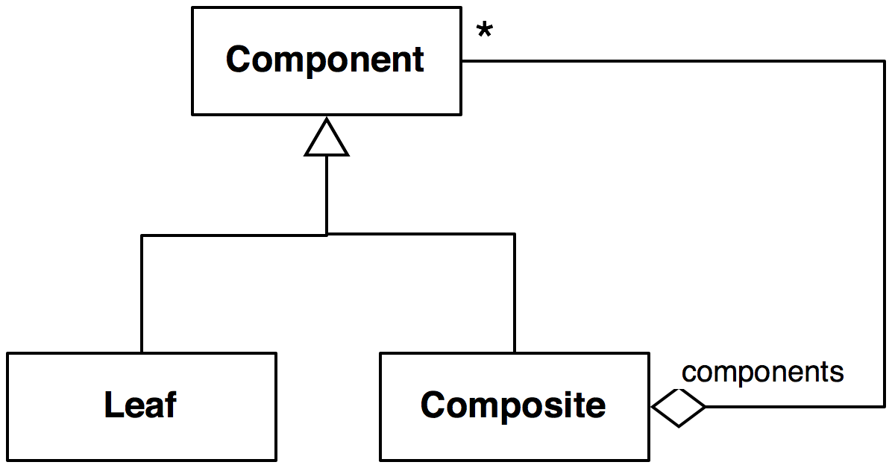
Review of Class Diagrams
Multiplicity
Inheritance
Association End
Name (Role)
Class
Aggregation
Class diagrams represent the structure of the system
Notes:
Question: Does anybody know this as a pattern? What name? This is the class diagram
of the composite pattern.

Slide 10
Actor vs Class vs Object
Actor
  An entity outside the system to be modeled, interacting with the system (“Passenger”)
Class
  An abstraction modeling an entity in the application or solution domain
  The class is part of the system model (“User”, “Ticket distributor”, “Server”)
Object
  A specific instance of a class (“Joe, the passenger who is purchasing a ticket from the ticket distributor”).
Notes:
What is the difference between an actor, a class and an instance?

