Slide 1
A Biomechanical Comparison of Long & Short Stride Lengths of the Baseball Swing
Kyle Wood

Slide 2
Introduction
Batted ball distance is most affected by bat speed
Sawicki, G. S., Hubbard, M., & Stronge, W. J. (2003).
Adult Hitters achieved peak Pelvis angular velocity before peak Torso was reached
Escamilla, R. F., Fleisig, G. S., DeRenne, C., Taylor, M. K., Moorman, C. T., III, Imamura, R., Barakatt, E., & Andrews, J. R. (2009).
Rear Leg X GRF peaked at -146 N and Stride Leg Z at -917 N on average
Welch, C. M., Banks, S. A., Cook, F. F., & Draovitch, P. (1995).
Adult Hitters achieved an average of 14º of Hip-Torso separation
Escamilla, R. F., Fleisig, G. S., DeRenne, C., Taylor, M. K., Moorman, C. T., III, Imamura, R., Barakatt, E., & Andrews, J. R. (2009).

Slide 3
Hypotheses
Long Stride would have higher linear bat speed
Long Stride would have greater GRF
Long Stride would have larger knee moment
Kinematic Sequence would be similar
Hip-Torso separation angle would be similar

Slide 4
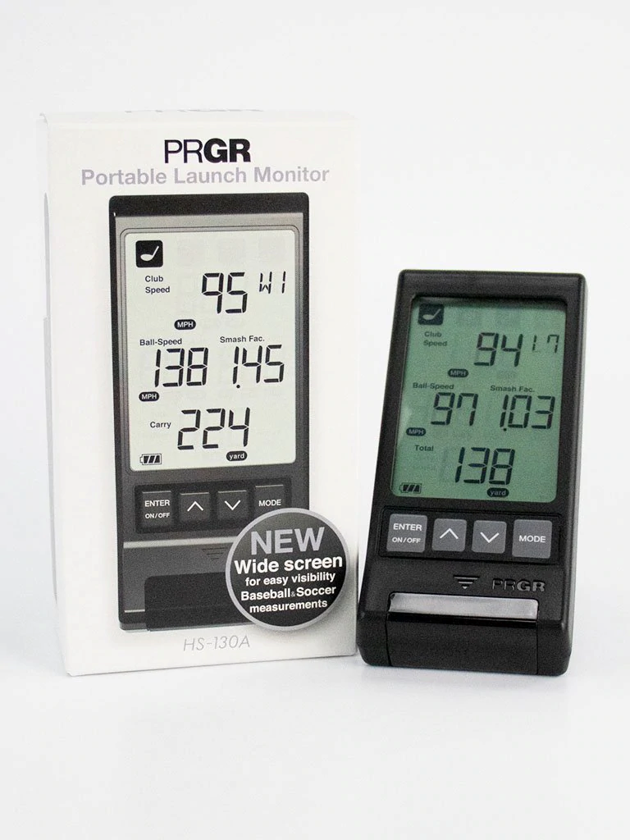
Methods
PRGR Black Portable Launch Monitor. (n.d.). SuperSpeed Slugger.
Subject
Height and Mass: 1.83m and 75kg
21-year-old male
High School level baseball player
Equipment
Vicon Nexus at 1000Hz
AMTI Force Plates at 1000Hz
PRGR Launch Monitor
Data Collection
Plug-in-Gait Marker-set
Tape placed on force plates
Analysis
Microsoft Excel
Visual 3D

Slide 5
Variables
Kinematic – Linear Bat Speed (Performance/Output)
GRF – X Plane Rear Leg
GRF – Z Plane Stride Leg
Moment – X Plane Knee Moment
Kinematic – Segment Sequencing (Angular Velocities)
Kinematic – Hip-Torso Separation Angle

Slide 6
Results

Slide 7
Results

Slide 8
Results

Slide 9
Results
Long Stride | Short Stride | % Difference
103.1607463 | 114.1237715 | 9.6%
Notes:
Graph is 1st trial of both conditions. Table is average peak of each condition.

Slide 10
Results
Notes:
First trial of both conditions.

Slide 11
Results
Notes:
First trial of both conditions.

Slide 12
Summary
Long Stride condition had greater GRFs in both planes
Long Stride condition had greater Hip-Torso Separation angle
Long Stride condition had greater Hip-Torso Separation angle
Both conditions showed similar rotational velocities
Short Stride had greater average bat speed
Short Stride condition had greater knee moment
Short Stride had better timing of the Kinematic Sequence

Slide 13
Limitations
Removed trial
Stationary ball
Single Subject
Only analyzed lower half
Did not include batted ball velocity
Indicator of bat-ball contact quality

Slide 14
References
Escamilla, R. F., Fleisig, G. S., DeRenne, C., Taylor, M. K., Moorman, C. T., III, Imamura, R., Barakatt, E., & Andrews, J. R. (2009). A comparison of age level on baseball hitting kinematics. Journal of Applied Biomechanics, 25, 210-218.
PRGR Black Portable Launch Monitor. (n.d.). SuperSpeed Slugger. https://superspeedslugger.com/collections/all-products/products/ prgr-black-pocket-launch-monitor
Sawicki, G. S., Hubbard, M., & Stronge, W. J. (2003). How to hit home runs: Optimum baseball bat swing parameters for maximum range trajectories. American Journal of Physics, 71(11), 1152-1162. https://doi.org/10.1119/ 1.1604384
Welch, C. M., Banks, S. A., Cook, F. F., & Draovitch, P. (1995). Hitting a baseball: A biomechanical description. Journal of Orthopaedic & Sports Physical Therapy, 22(5), 193-201. https://doi.org/10.2519/ jospt.1995.22.5.193

