Slide 1

Vision Transformer
CVPR 2020 Google Brain
報告者：楊朝凱

Slide 2
Outline
01.
Introduction
02.
Method
03.
Result
04.
Conclusion

Slide 3
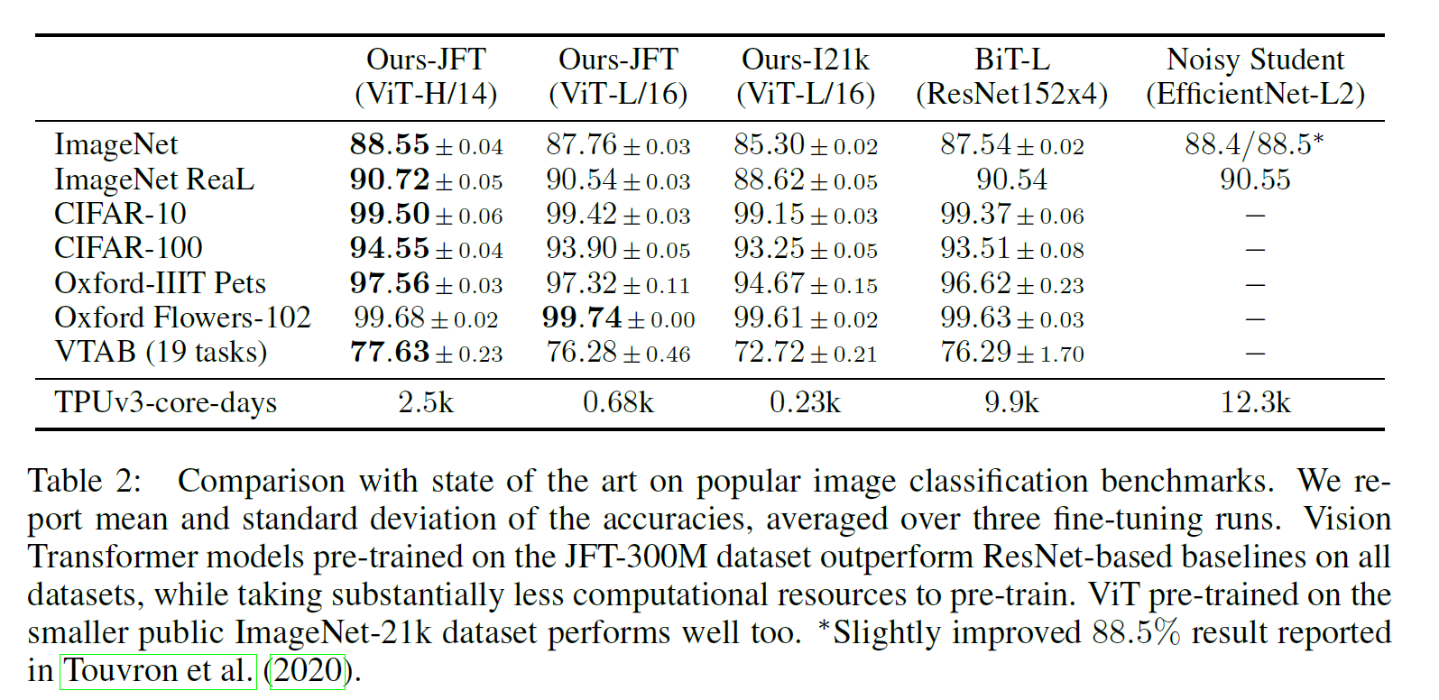
Introduction

Slide 4
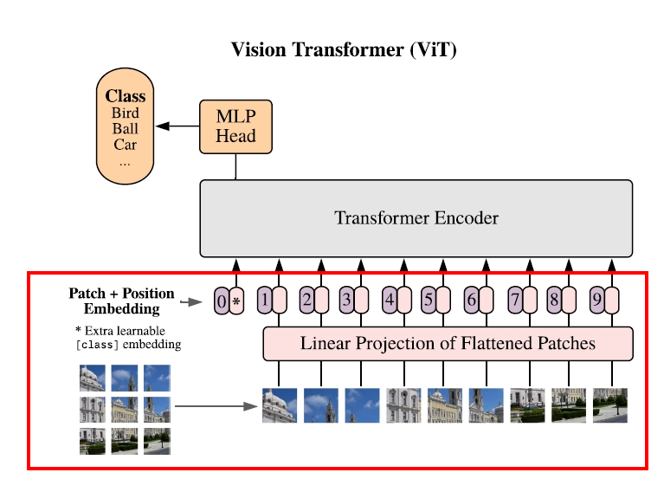
Method
[224,224,3]->Convolution
->[14,14,768]->Flattened->[196,768]
Class token -> [1,768] concat [196,768]
->[197,768] (BERT)
Position Embedding
[197,768]->[197,968]
Notes:
下半部分其實就是用一個卷積層來實現embedding kernel size是16*16 步距也是16卷積核數量是768 classtoken 是參考BERT

Slide 5
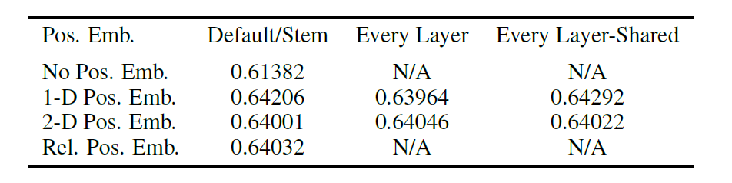
Method-Position Embedding
Notes:
有無使用postion embedding 有沒有用差很多 但怎麼用沒什麼差 (1D 2D relative) 這篇的改良版swin transformer是用relative

Slide 6
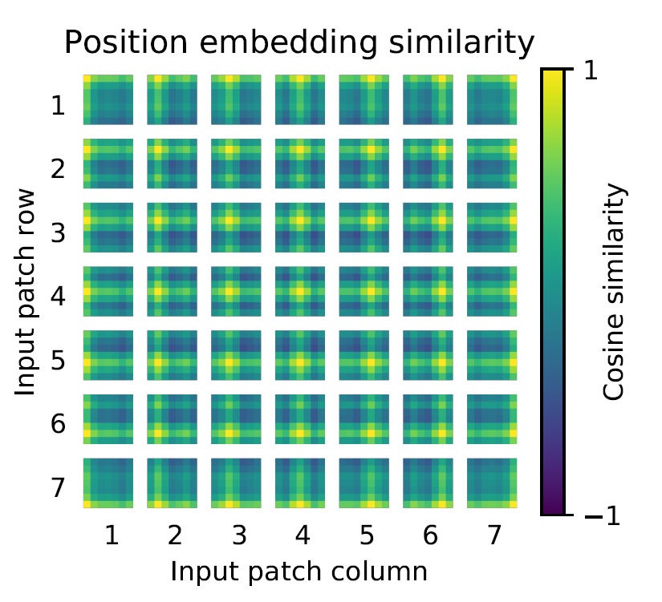
Method-Position Embedding
Notes:
論文中有這張圖 怎麼理解這張圖呢 就是自己這個點跟其他點的position embedding去求一個餘弦相似度，所以看到他們自己跟自己都是最高的也就是黃色，這張圖基本是想講，最後訓練出來的postion embedding 其實會跟自己同行同列的相似度比較高

Slide 7
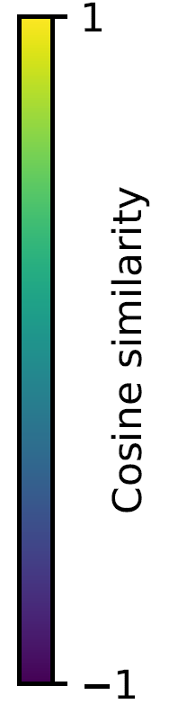
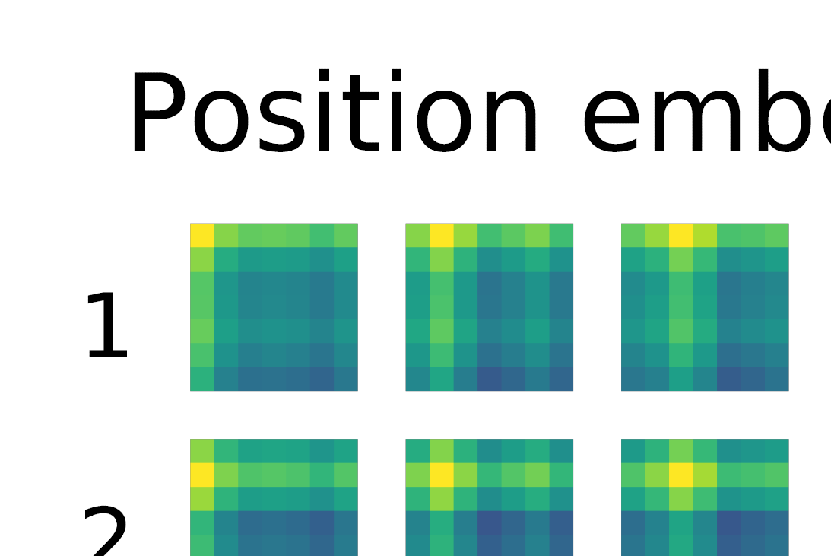
Method-Position Embedding

Slide 8
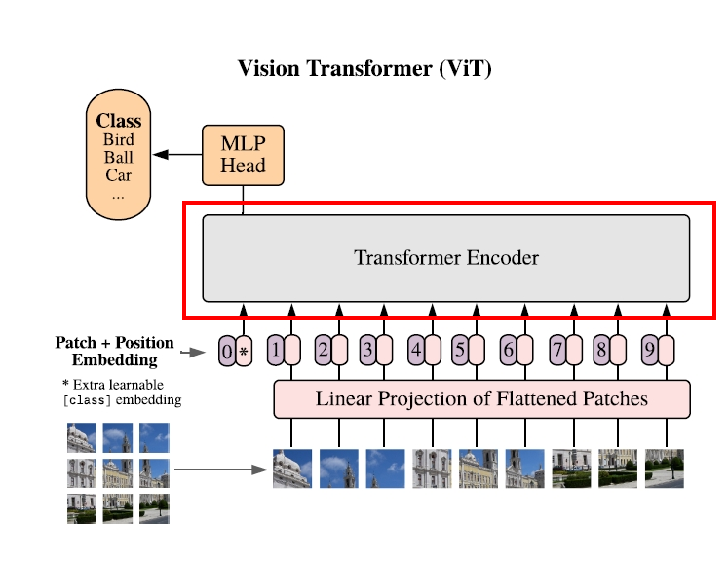
Method-Transformer Encoder
Notes:
下半部分其實就是用一個卷積層來實現embedding kernel size是16*16 步距也是16卷積核數量是768

Slide 9
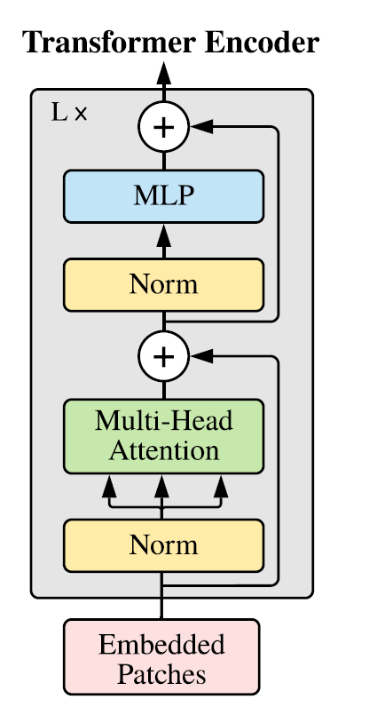
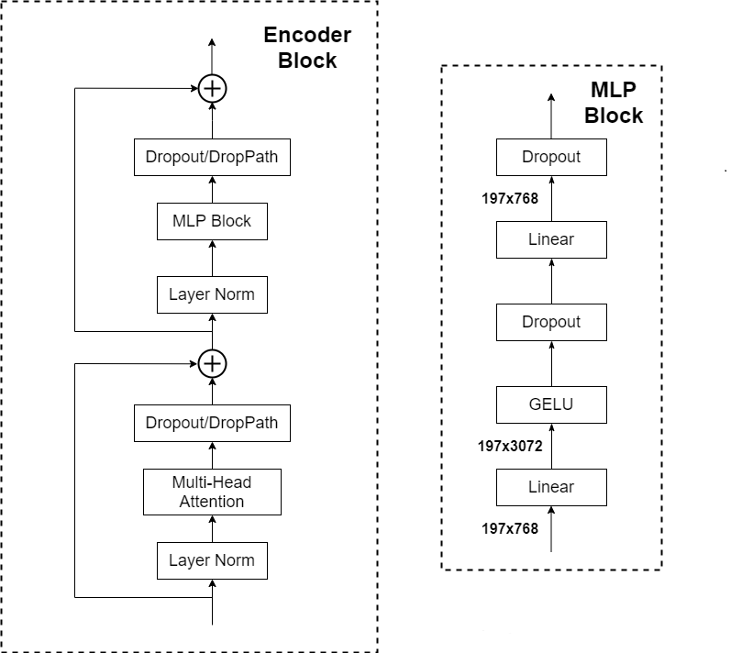
Method-Transformer Encoder

Slide 10
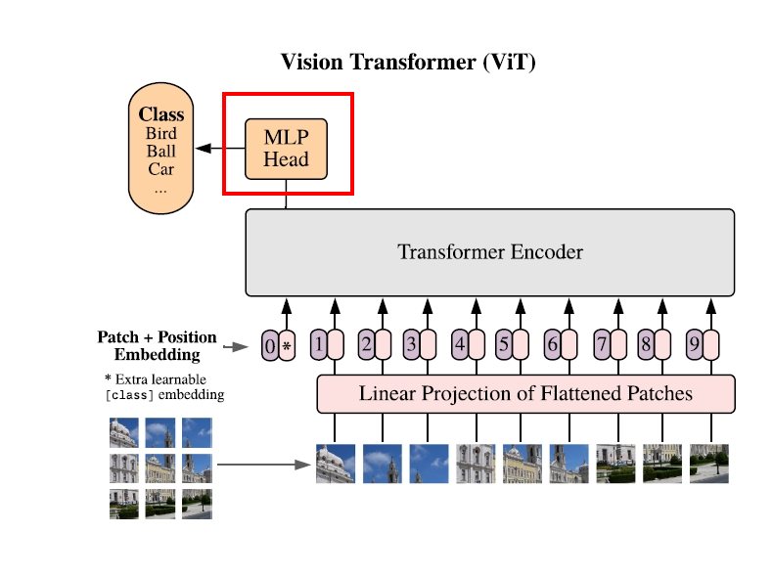
Method-MLP
Linear->Activation function(tanh)->Linear

Slide 11
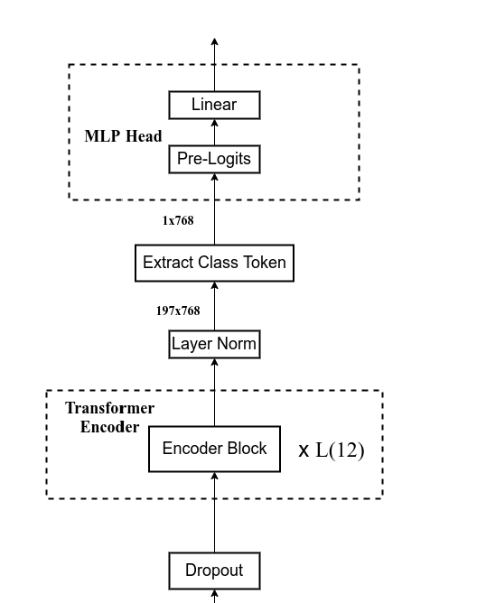
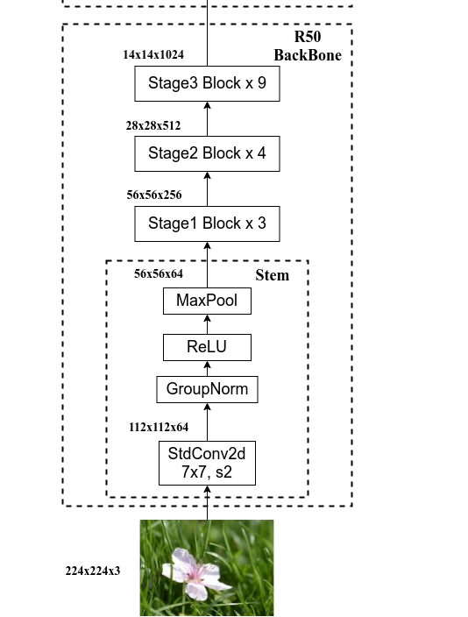
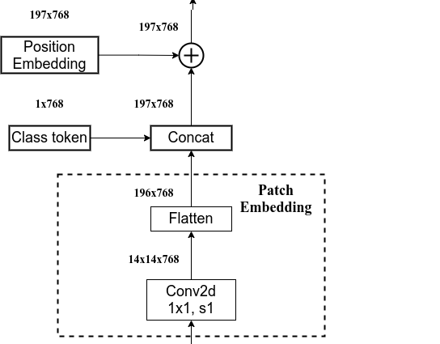
Method-Hybrid Module

Slide 12
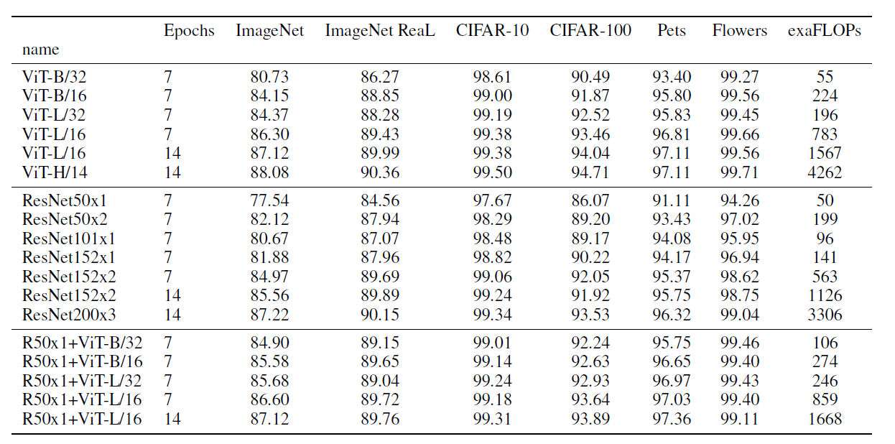
Result

Slide 13
Conclusion
Successfully applied the Transformer used in NLP in the past to CV field
The paper proposes a new Transformer architecture that has achieved
leading SOTA results in recognition tasks such as image classification,
target detection, and semantic segmentation.

Slide 14
Thank

