Slide 1

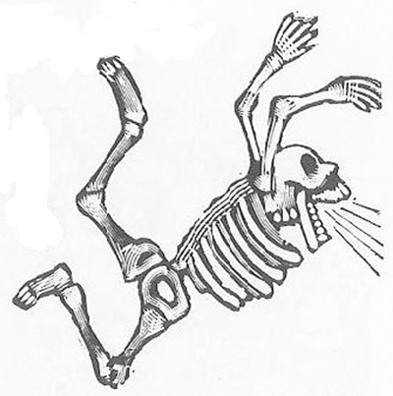

Bone Mechanobiology
Kyle Cripps
Cornell Center for Materials Research REU
Advised by: Christopher J. Hernandez
Mentored by: Erin Cresswell
hernandezresearch.com
Cornell –HSS
Program in Biomechanics
Notes:
Slide Show -> Monitors -> Use Presenter View

Slide 2


Understanding Bone’s Adaptive Ability
Bone has the ability to respond to mechanical stimuli
Want to study bone forming processes at the microscopic level
Higher Bone Density
Lower Bone Density
Notes:
(1) Hello everyone my name is Kyle Cripps. This summer I worked in the Hernandez Lab which specializes in bone research.
Bone is a very unique material because it has the ability to adapt to its mechanical environment. For example, you can increase your bone density by lifting weights, because cells inside your bone can sense mechanical forces exerted on your body by the weights and will actually trigger a bone formation response as a result. But, if your bone is not experiencing these forces, no formation response will be triggered, and bone density will not be increased. While this effect has been observed at the macroscopic scale, little research has been done to study bone forming processes at the microscopic scale. The goal of my project was to study and gain a deeper understanding of how bone behaves at the microscopic level. Hopefully knowledge gained by this study can contribute to studies involving osteoporosis, which is a bone disease characterized by decreased bone density.

Slide 3
Overview of Project
Want to study bone-forming processes at the microscopic level
Applied mechanical loads to vertebrae in rats to stimulate bone formation
Obtained different types of 3D images of the vertebrae
Notes:
As I said, we wanted to study bone forming processes at the microscopic level. Prior to this summer, students in the hernandez research lab did experiments that were designed to stimulate bone growth in the vertebrae of rats by applying directed mechanical loads to their vertebrae. After experimentation, they were able to obtain different types of 3D images of the rats’ vertebrae. Each type of image served a different purpose in our analysis. Micro-CT images were used to generate finite element models, while another type of image was able to tell us where bone formed in the vertebrae as a result of the experiments.

Slide 4
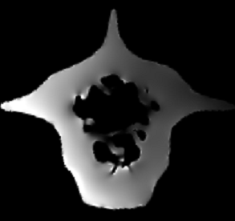
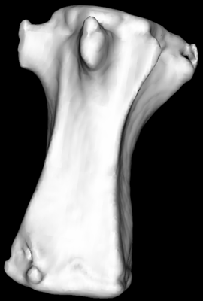
Micro-CT images used to generate Finite Element Models
Micro-CT image of
caudal 8 rat vertebra
Finite Element Model cross-section
Finite Element
Modeling
Higher stress
and strain
magnitudes
Lower stress
and strain
magnitudes
Notes:
Micro-CT, or micro-computed tomography, is an x-ray methodology that is used to obtain 3D images of bone with a resolution on the scale of microns. Micro-CT images of the vertebrae were used as structural models for computer simulations that generated finite element models, which basically approximate the stresses and strains experienced at each location in the vertebrae during loading. Here is a two-dimensional cross section from a three-dimensional finite element model. The bright regions in this image correspond with higher stresses and strains in the vertebra, while darker regions correspond with lower stresses and strains.

Slide 5
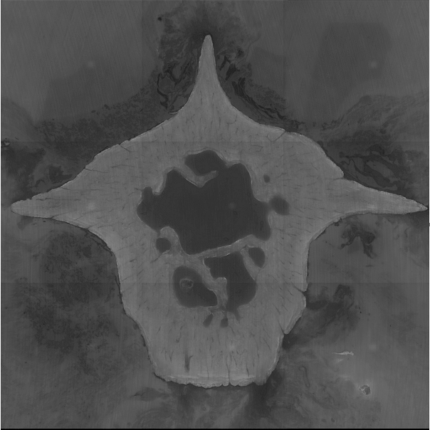
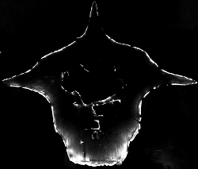
Fluorescent Bone Formation Images
Image taken of bone
cross section fluoresced
with ultraviolet light
Image taken of cross section with light that fluoresces a specific bone formation marker
Bone formation
Notes:
The other type of images we worked with were not generated from computer simulations, but were taken directly of the rats’ vertebrae. During experimentation, the rats were injected with different fluorescent bone formation markers, and after the experiments, images of the vertebrae were taken under fluorescent light so that these bone formation markers were easily visible. These images were used to determine where bone did and did not form as a result of mechanical loading in the experiments. Here is a cross section of one of the 3D bone formation images next to the same cross section fluoresced with ultraviolet light. The white regions of the bone formation image are where bone formed on the actual vertebrae, and as you can see, most bone formation occurred at the edges of the cross-section, which correspond with the surfaces of the whole vertebra.

Slide 6
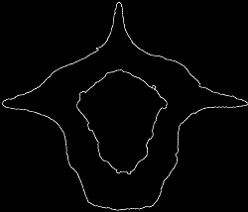
Identifying Regions of Interest
Periosteal
Edge
Periosteal
Edge
Image
Processing
Trabeculae (spongy
Bone) - not part of
endosteal edge
Endosteal
Edge
Endosteal
Edge
Notes:
Because most new bone forms at the surface of old bone, we wanted to only study the surfaces of the vertebrae. However, a computer cannot decide what part of these images correspond with a surface without some external help, which is where I came in. My primary job with this project was to write Matlab code to process these images so that we could focus on only the regions of the bone that we cared about. The two regions that we cared about were the endosteal and periosteal surfaces of the vertebrae. In this cross section, you can see that the endosteal surface is defined by the edge that is inside the vertebrae, minus the edges of the trabeculae, or spongy bone. Also, the periosteal surface is defined by the edge that borders the outside of the vertebrae. I was able to use image processing techniques to remove unwanted regions from the images, leaving only the endosteal and periosteal edges. On the right you can see that the endosteal and periosteal edges have been identified, as a result of image processing.

Slide 7
Results: Endosteal Surface may be less mechano-responsive than periosteal surface
Bone formation locations at higher stresses and strains than non-bone-forming locations on periosteal surface
Bone formation locations at lower stresses and strains than non-bone-forming locations on endosteal surface
More bone-forming periosteal surface than bone-forming endosteal surface (53% average vs 3% average)
Notes:
After identifying our regions of interest, I wrote more code in Matlab to do an analysis of the stresses and strains and bone formation at these regions. It was found that, at the periosteal surfaces, bone forming locations were at higher stresses and strains than non bone forming locations. However, at the endosteal surfaces, it was found that bone forming locations were at lower stresses and strains than non bone forming locations. We also found that the periosteal surfaces had a much higher ratio of bone forming surface to total bone surface than the endosteal surfaces.
This could mean that there is some difference between the biological environments at the endosteal and periosteal surfaces that we are unaware of; and this difference is causing the endosteal surface to be less responsive to mechanical stimuli than the periosteal surface. If this is true, then mechanical loading would trigger an observable bone formation response at the periosteal surface while having little effect on the endosteal surface of the vertebrae.

Slide 8
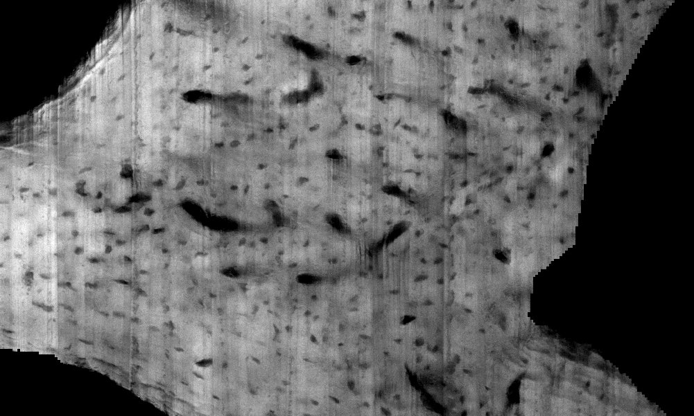
Future Analysis
Associate SED, bone formation, and osteocyte lacunar density near the endosteal and periosteal surfaces of the vertebrae
Osteocyte
Lacunae
Endosteal
Edge
Periosteal
Edge
Notes:
We can also use the images we obtained for future analysis. In one of the sets of images, we can actually see osteocyte lacunae, which are microscopic caves in bone where cells called osteocytes are located. Another student in the hernandez lab has been working on a Matlab program that can automatically identify these lacunae. Here is a magnified image of a vertebral cross-section, and you can see the endosteal and periosteal edges here and here as a reference point. The osteocyte lacunae are the small black dots scattered throughout this image. Using the other student’s program, we will be able to conduct analyses that will relate magnitudes of stresses and strains, bone formation locations, and osteocyte lacunar density near the endosteal and periosteal surfaces of the vertebrae.

Slide 9
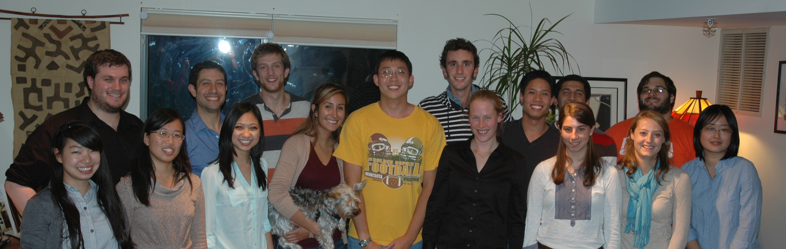
Hernandez Research Group
hernandezresearch.com
Notes:
I’d like to thank my lab group for being so awesome and helpful throughout the summer,

Slide 10


Acknowledgements
Funding Agencies
NSF Research Experience for Undergraduates program (DMR-1460428 and DMR-1120296)
NIH/NIAMS F33 AR065348 (Hernandez)
Hernandez Lab
Faculty
Christopher J. Hernandez, Ph.D.
Ph.D. Students
Erin Cresswell, M.S.
Cornell Center for Materials Research
Notes:
especially my mentor Erin Creswell and my advisor Dr. Chris Hernandez. And also thank you to CCMR for organizing everything. Are there any questions?

