Slide 1
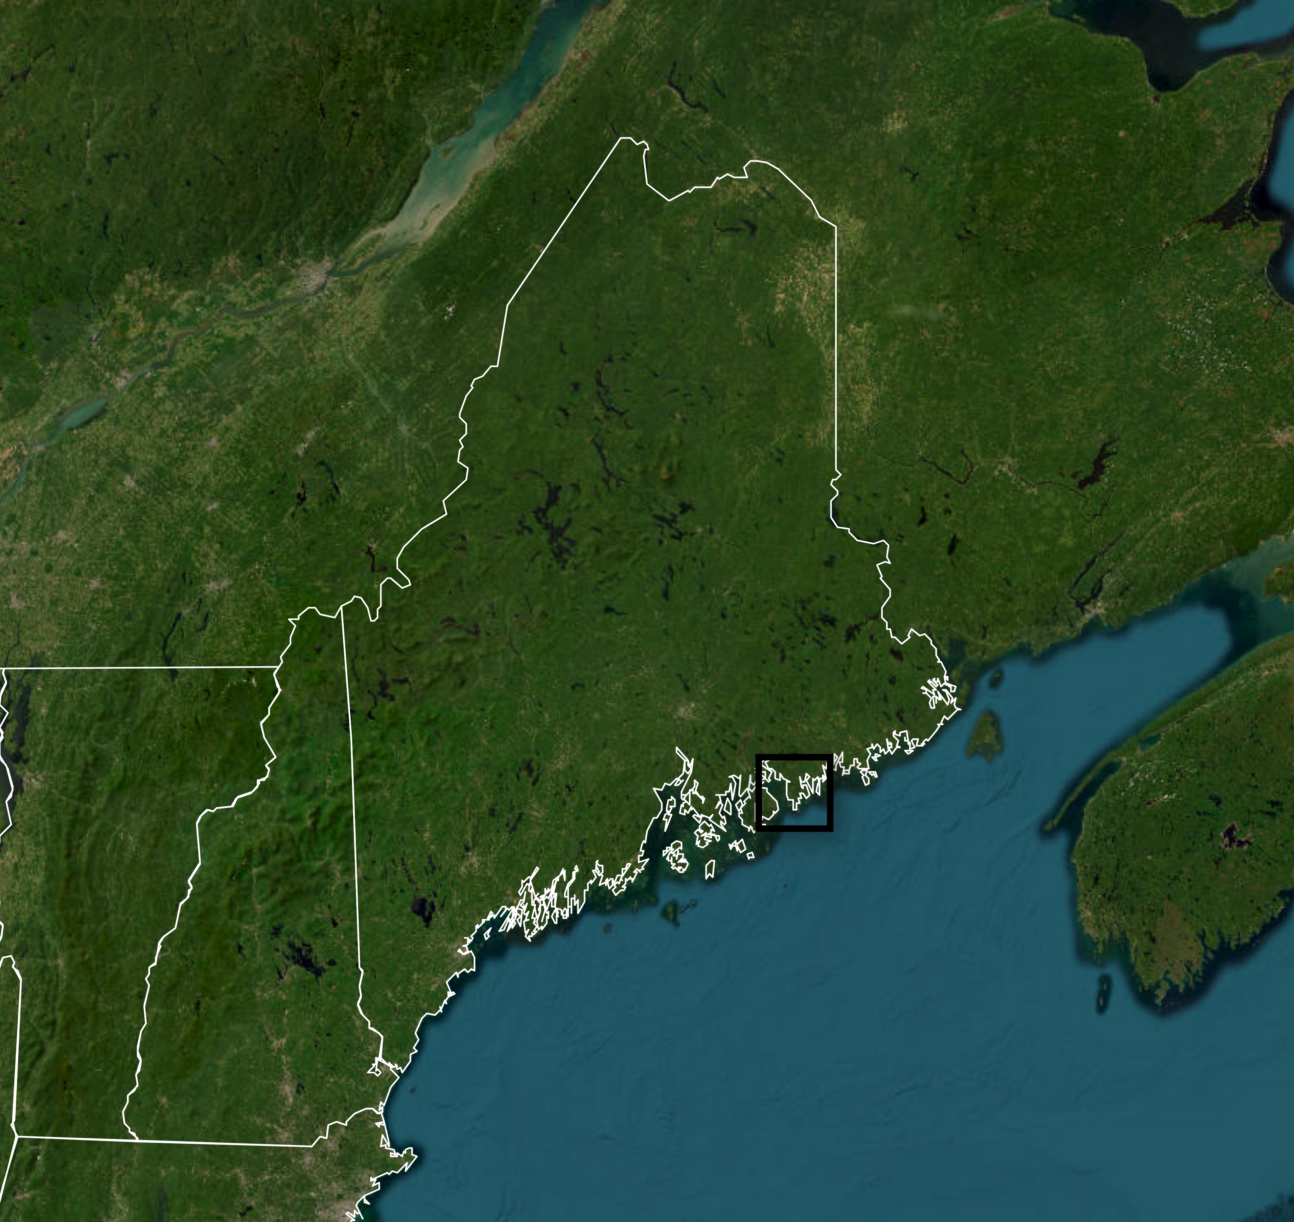
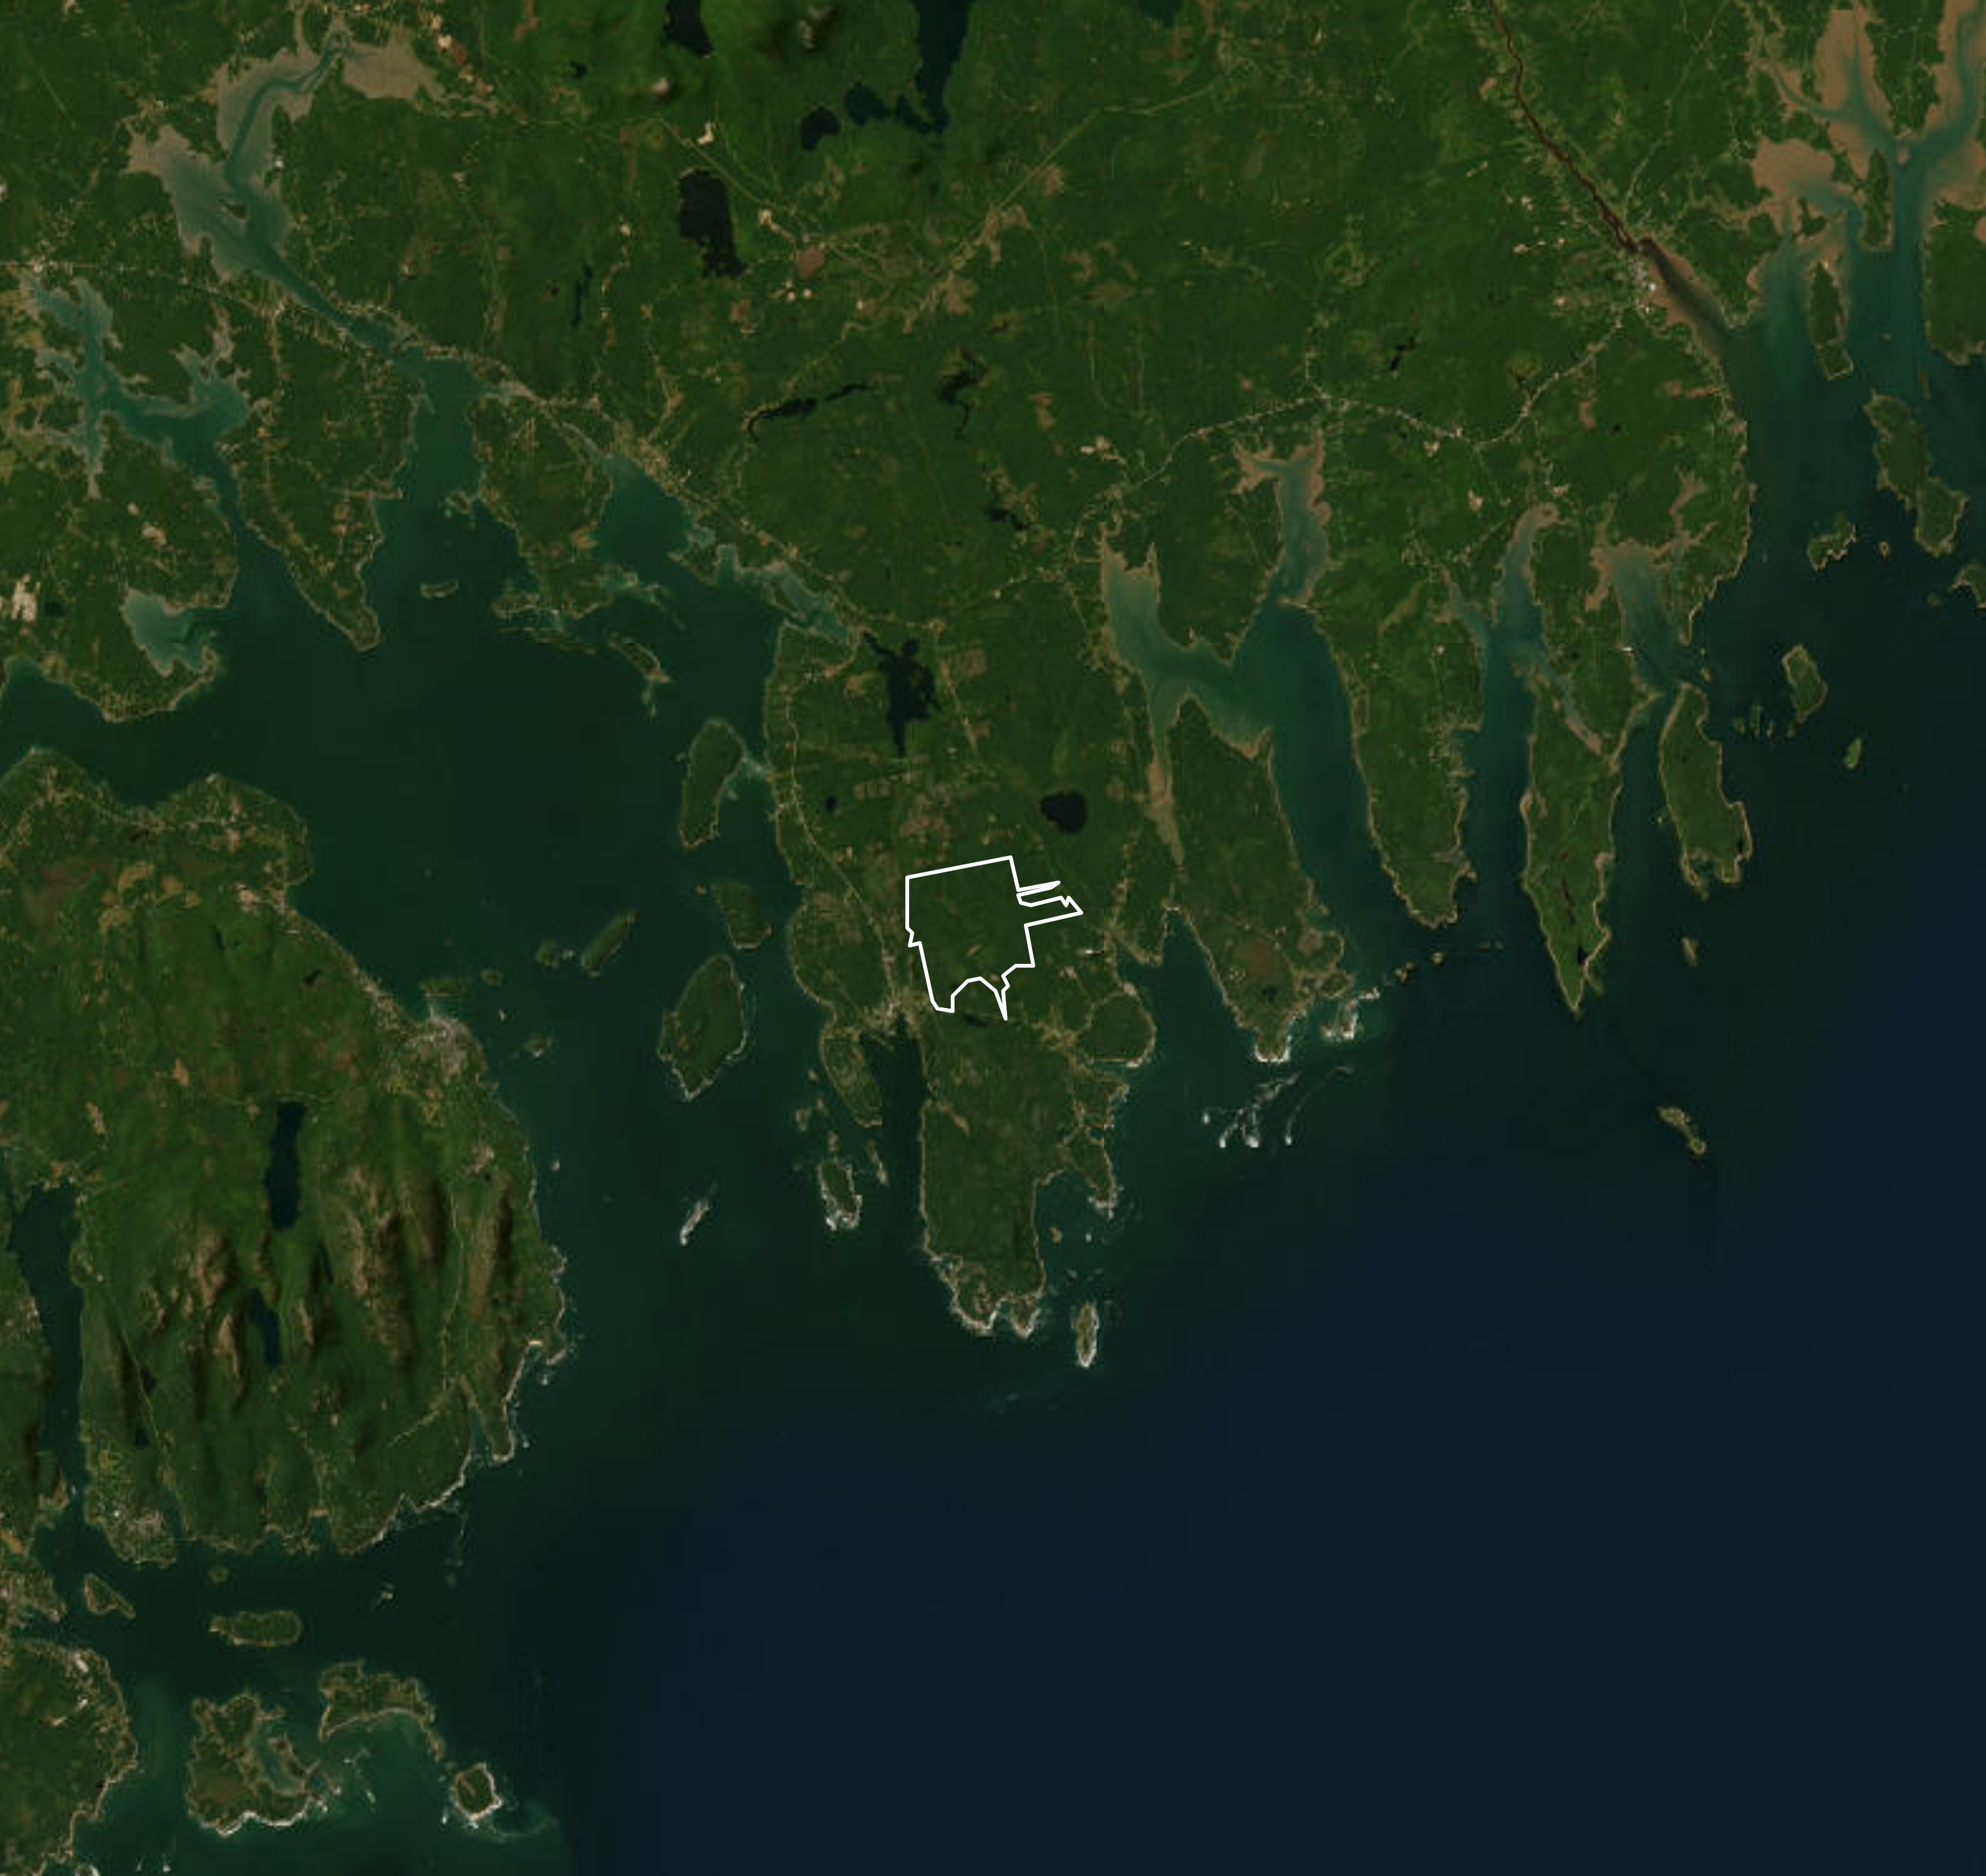

New Brunswick
Quebec
Maine
Bar Harbor
New Hampshire
Schoodic Forest
Vermont

Slide 2
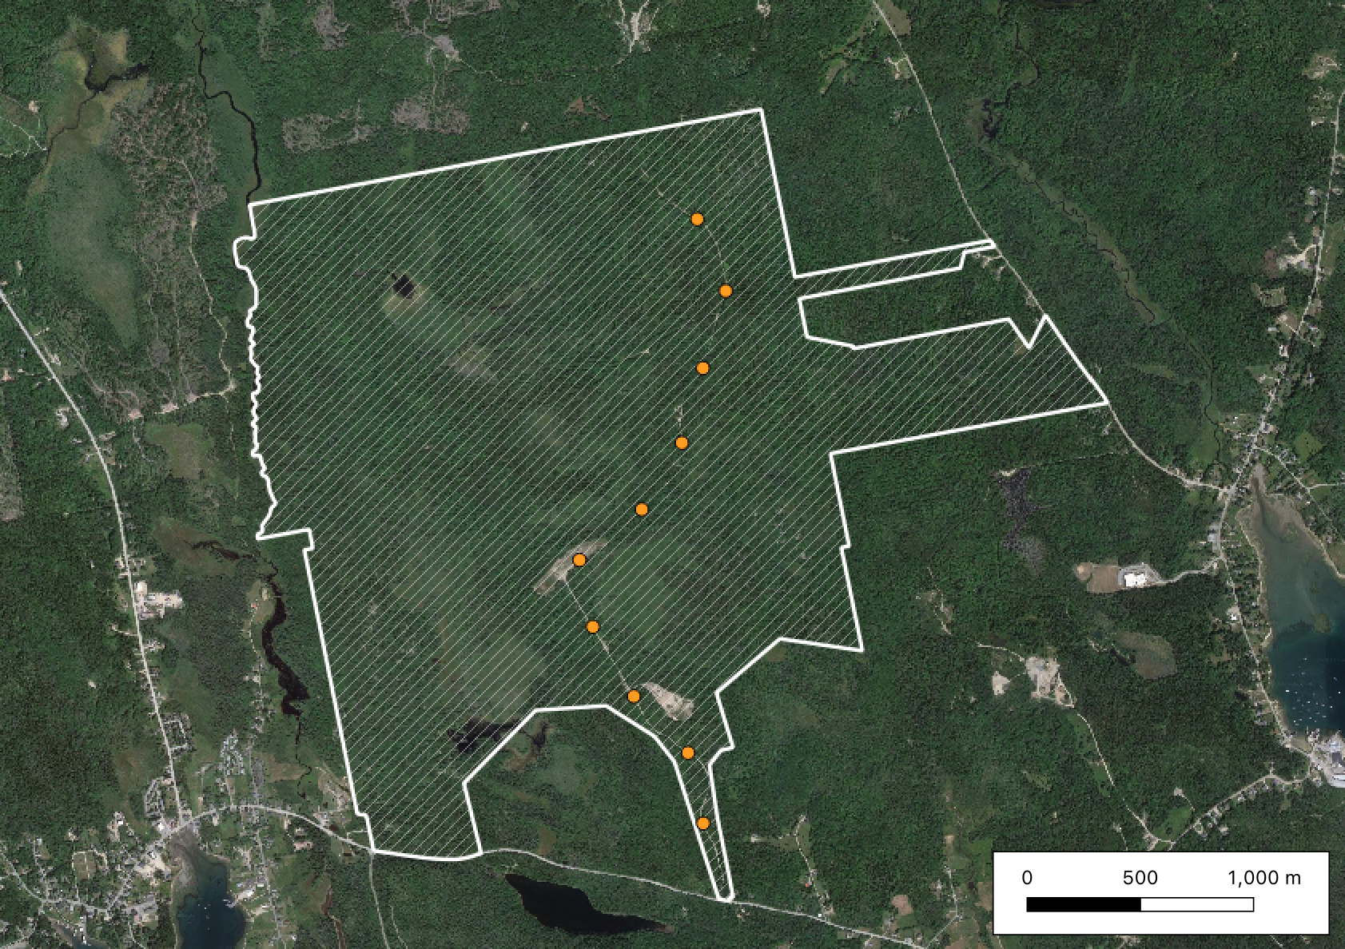
Schoodic Forest
Point-count sites
Curtis Road
Point 10
500m
Point 1

