Slide 1
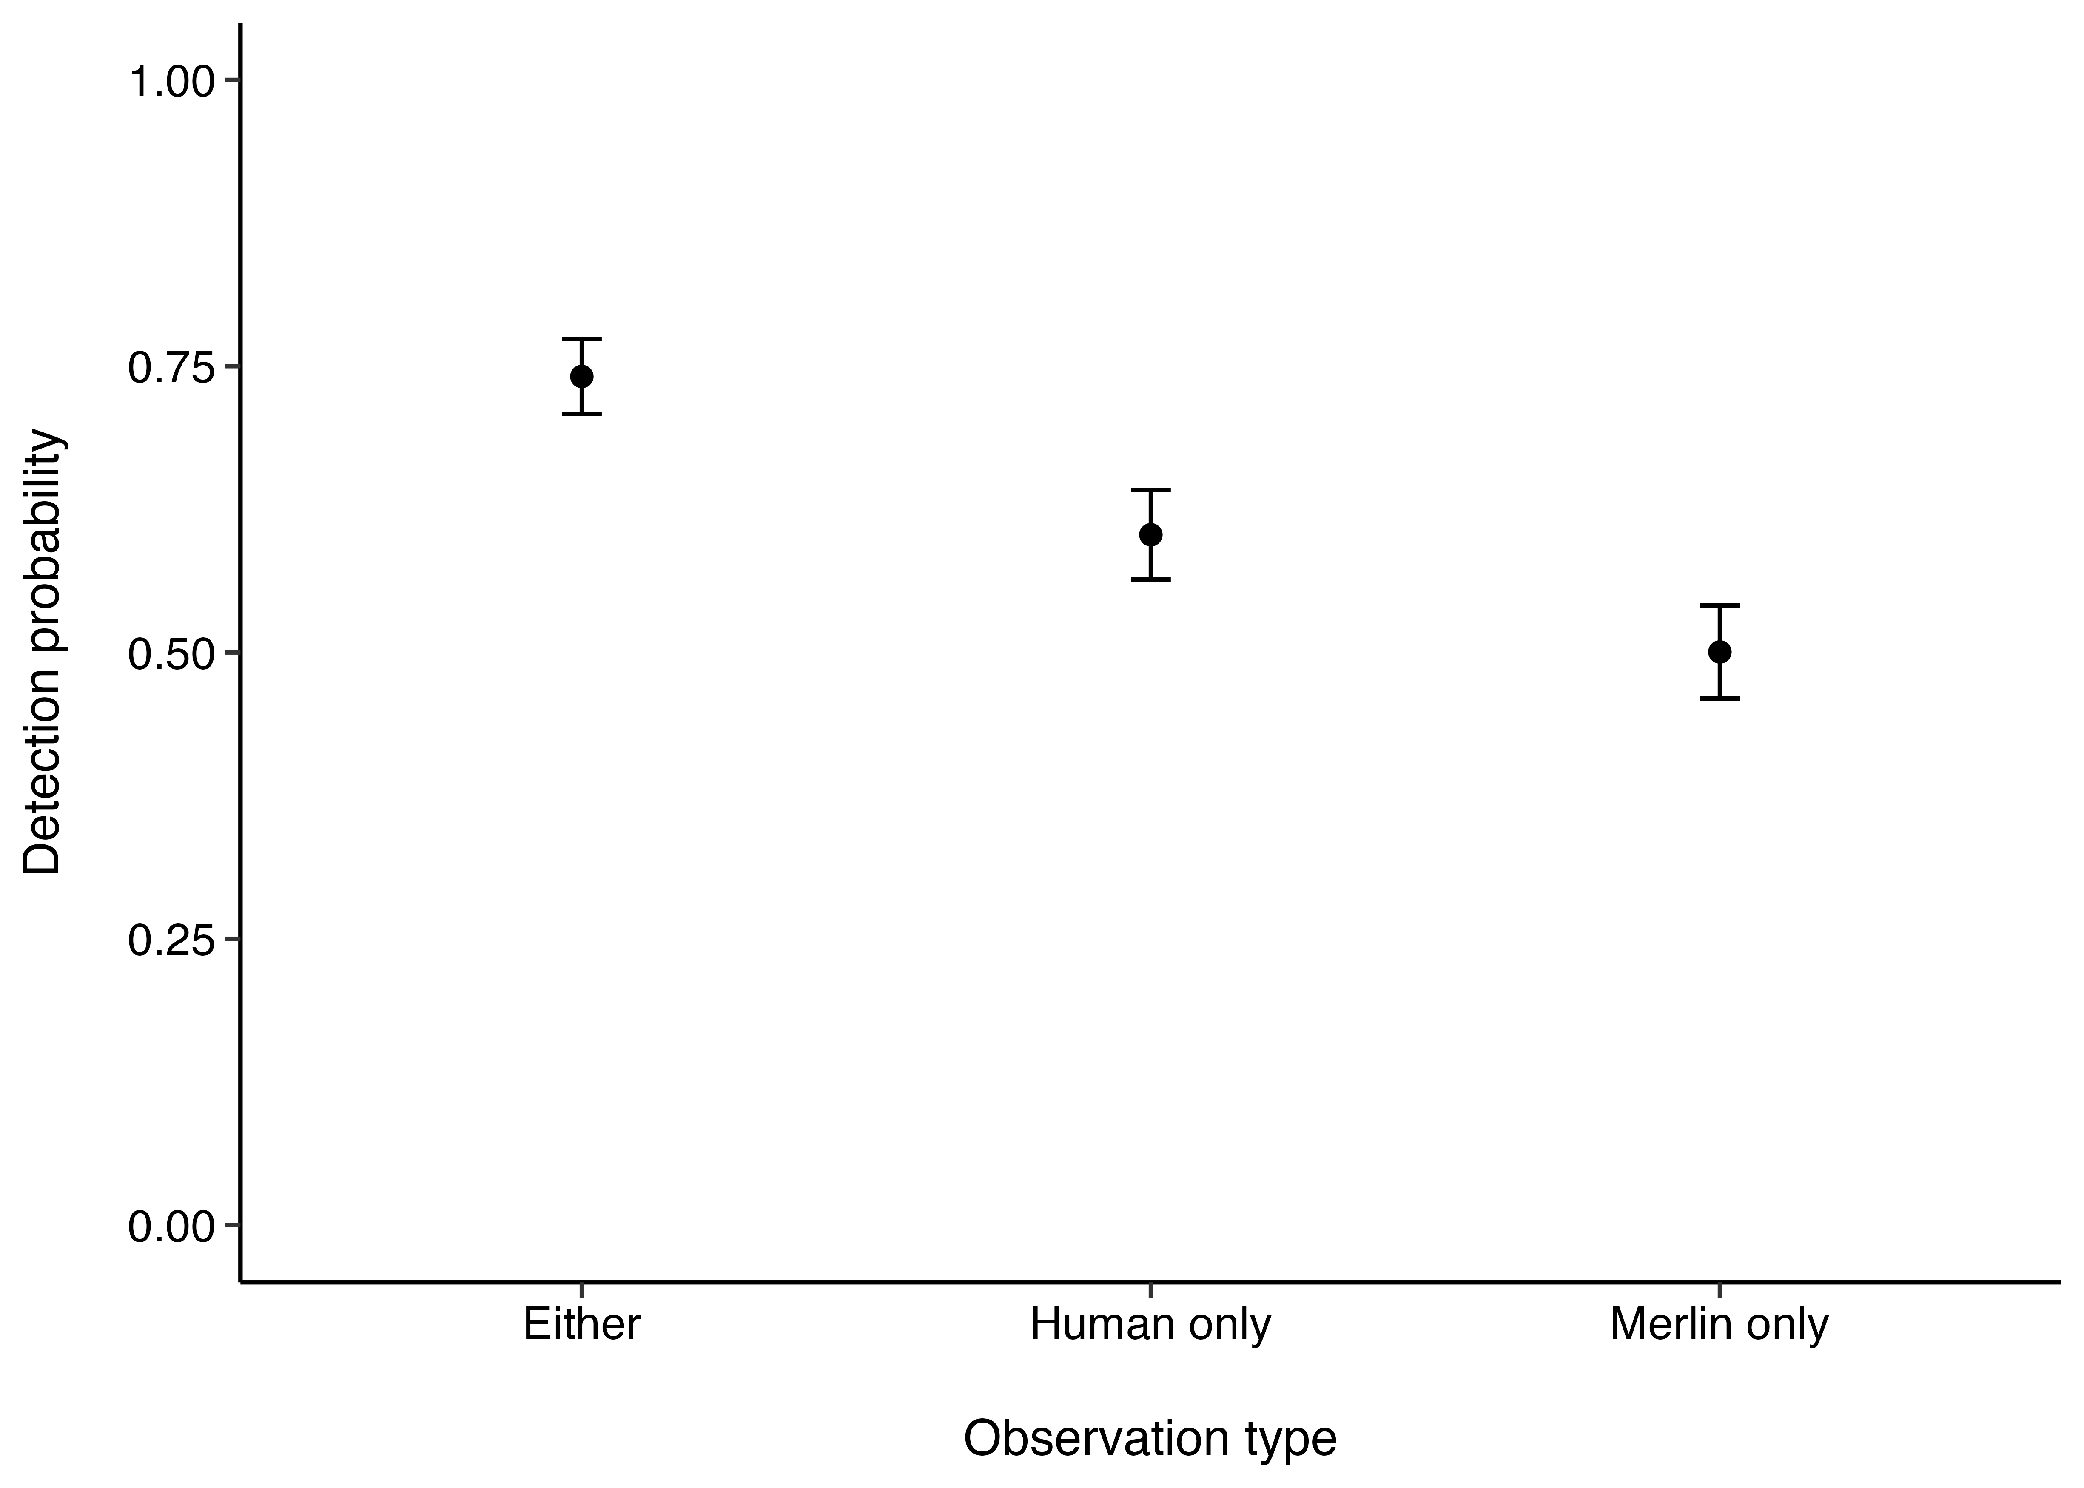
P < 0.001
P = 0.001
P = 0.029

