Slide 1
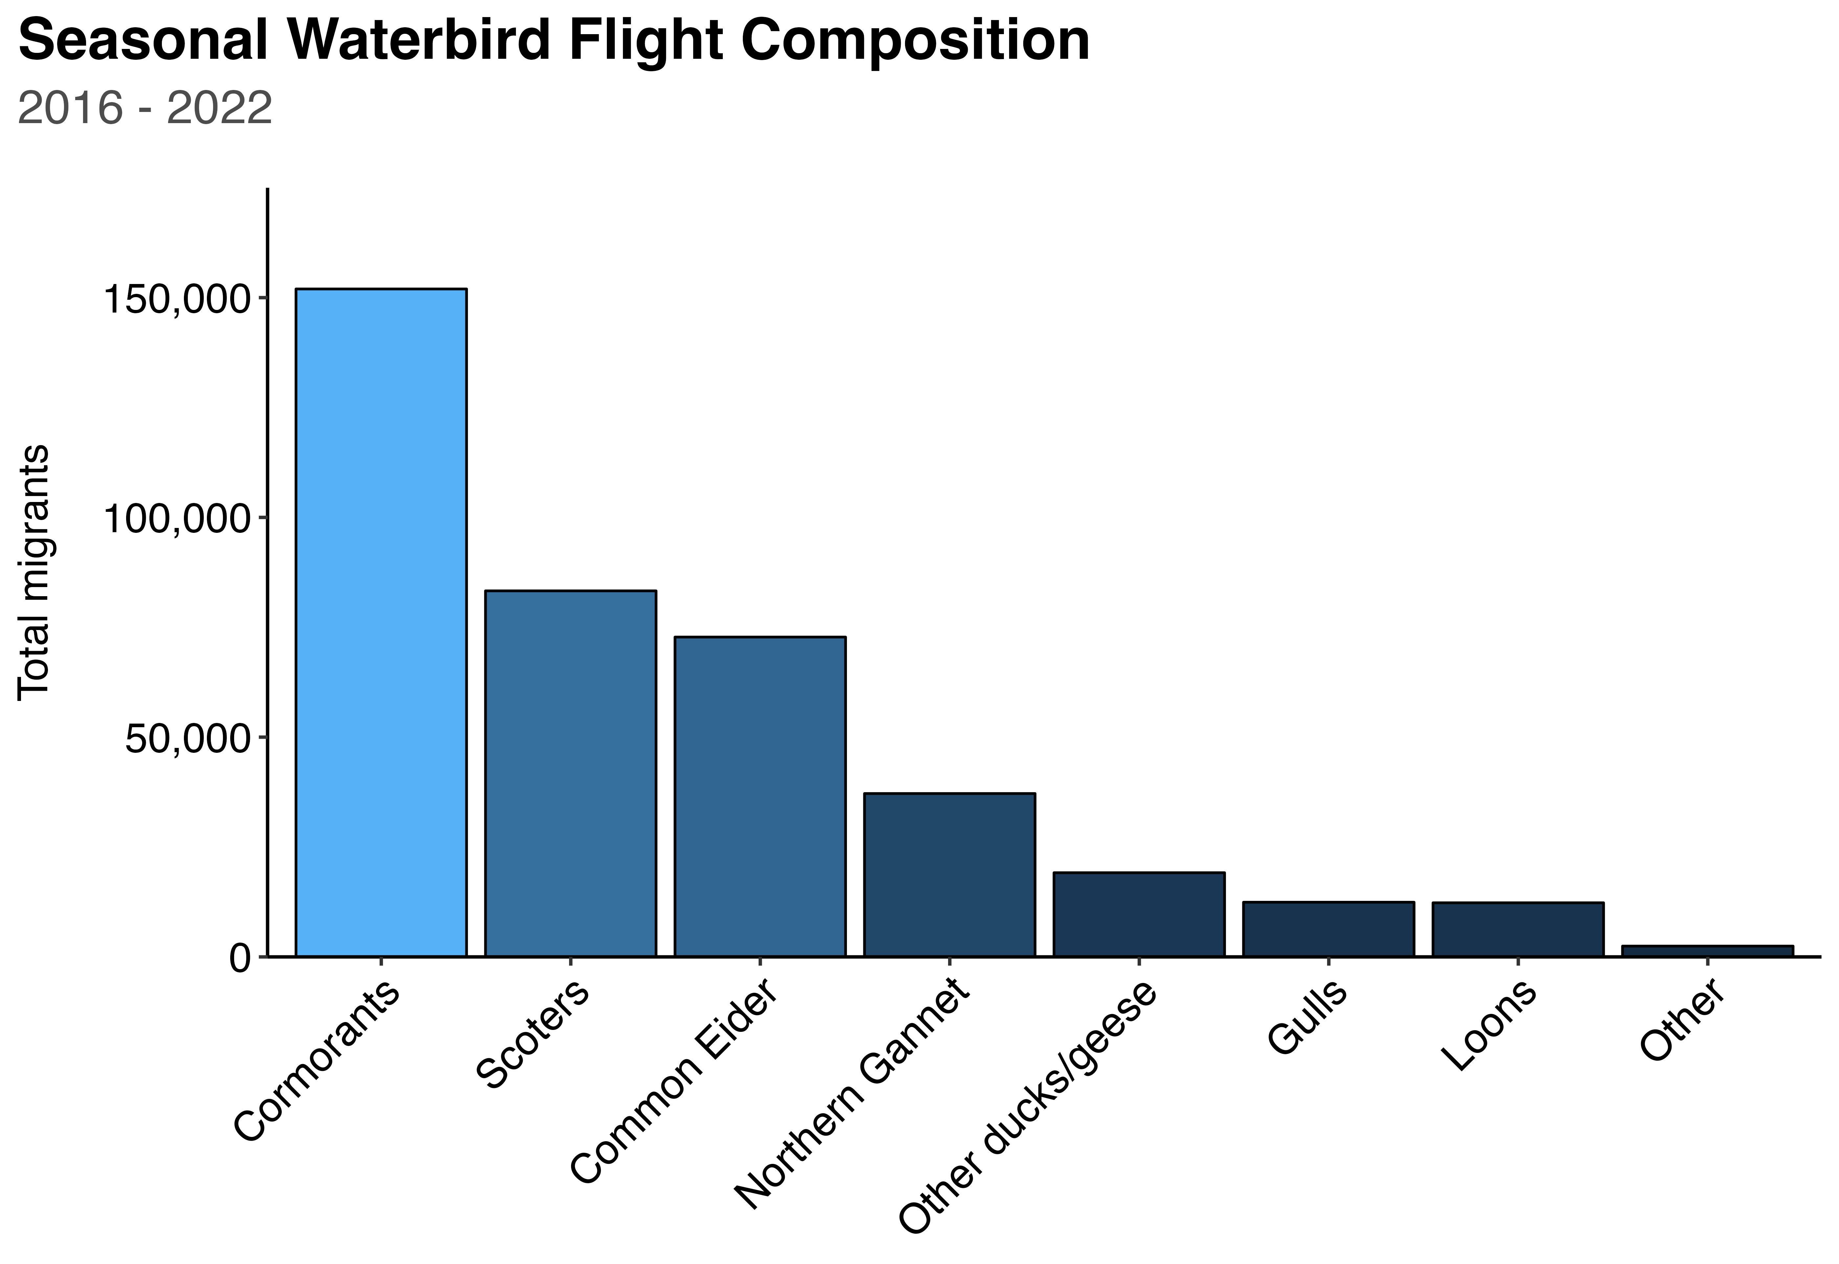









39%
21%
19%
9%
5%

