Slide 1
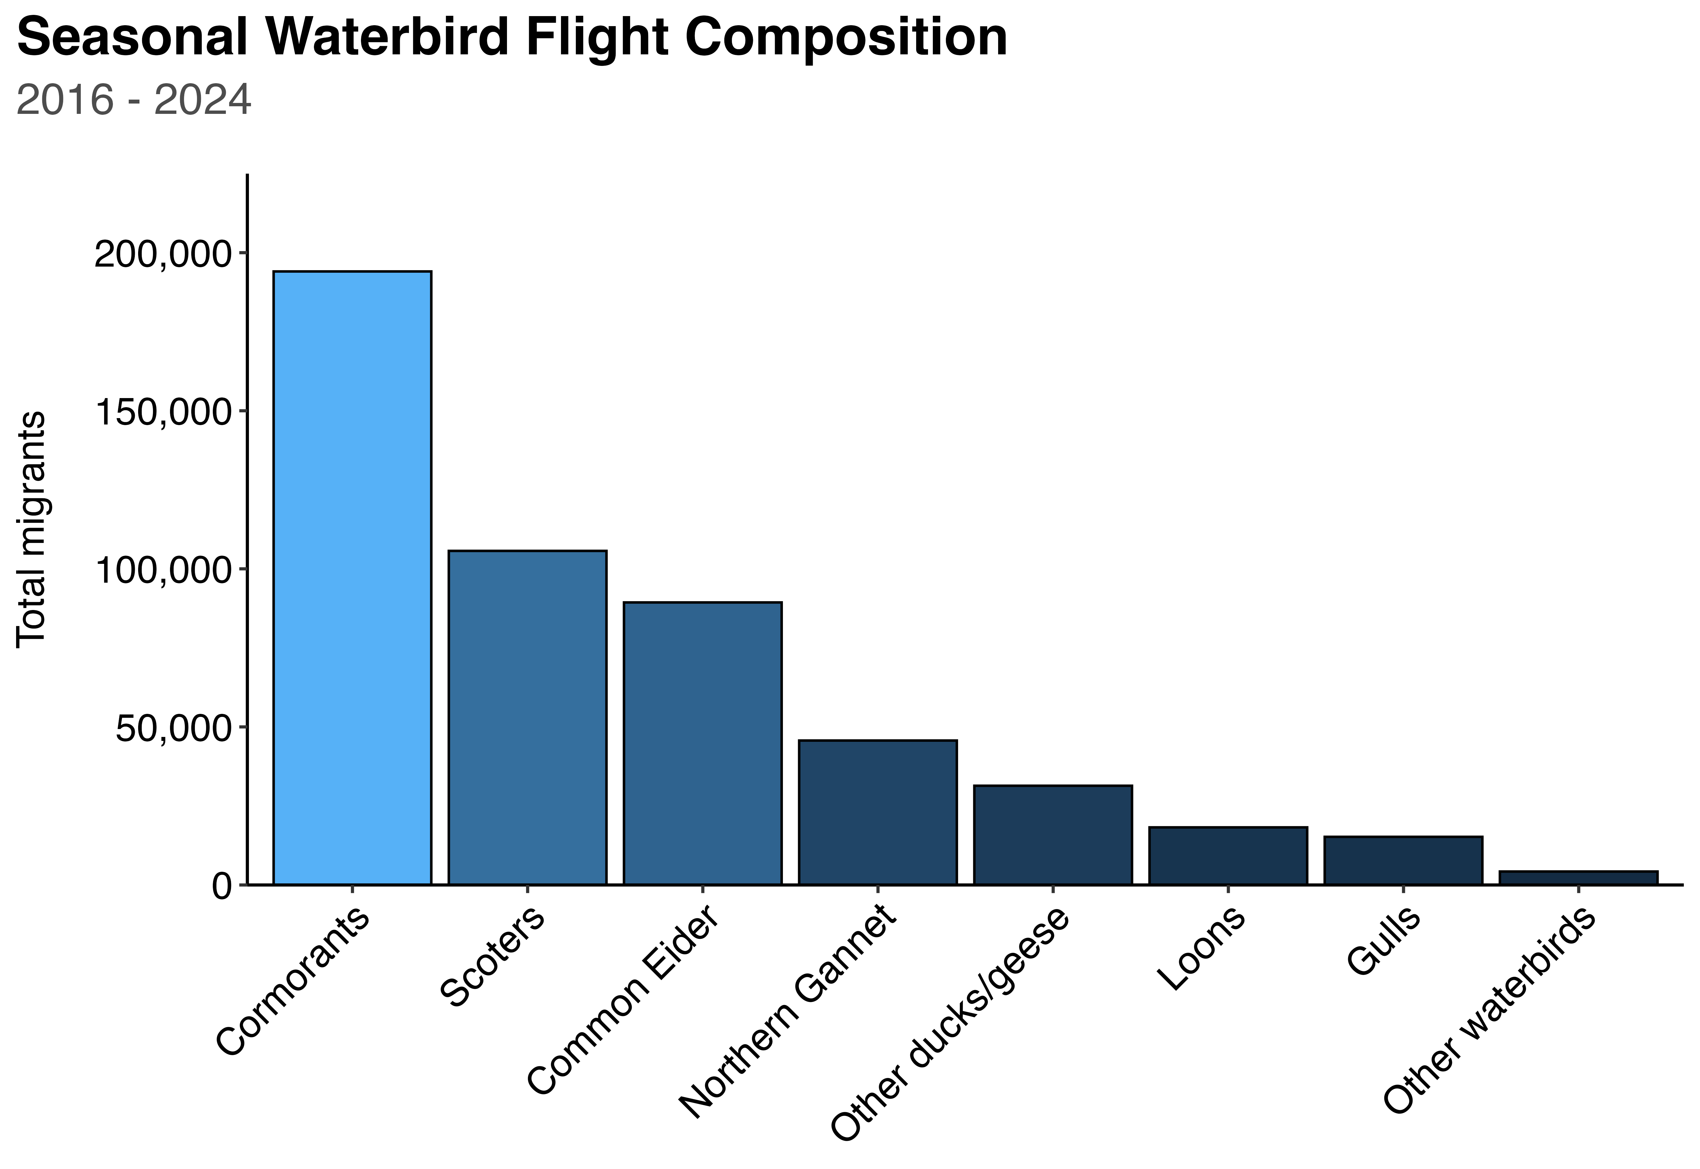








39%
21%
18%
9%
6%

Slide 2

39%
21%
19%
9%
5%

