Slide 1
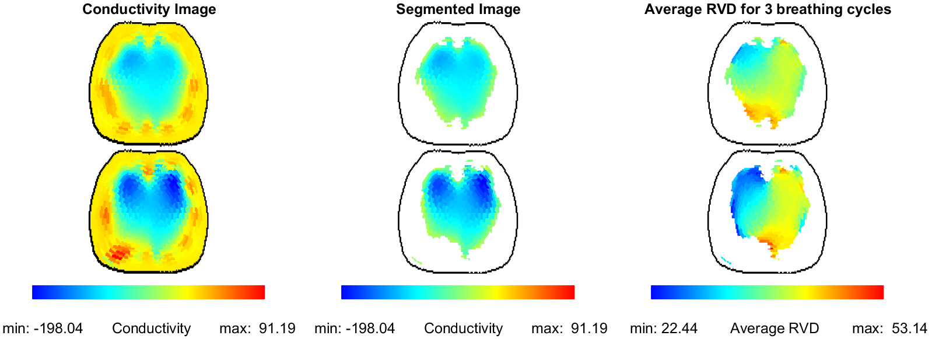
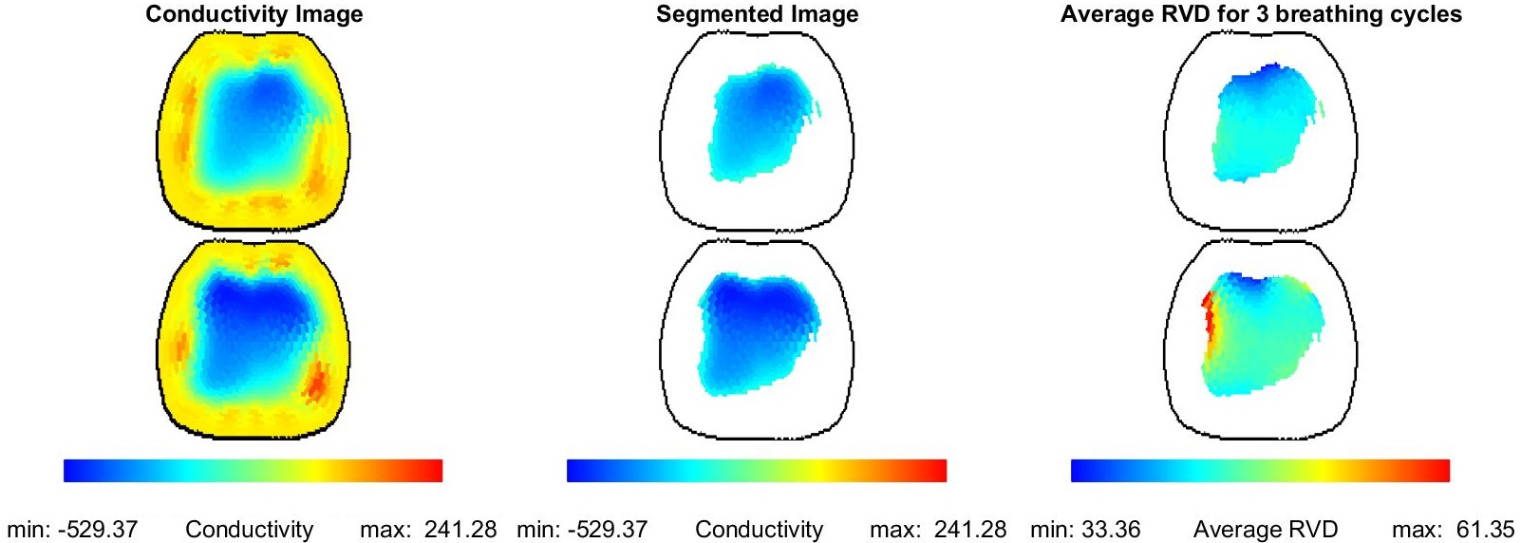
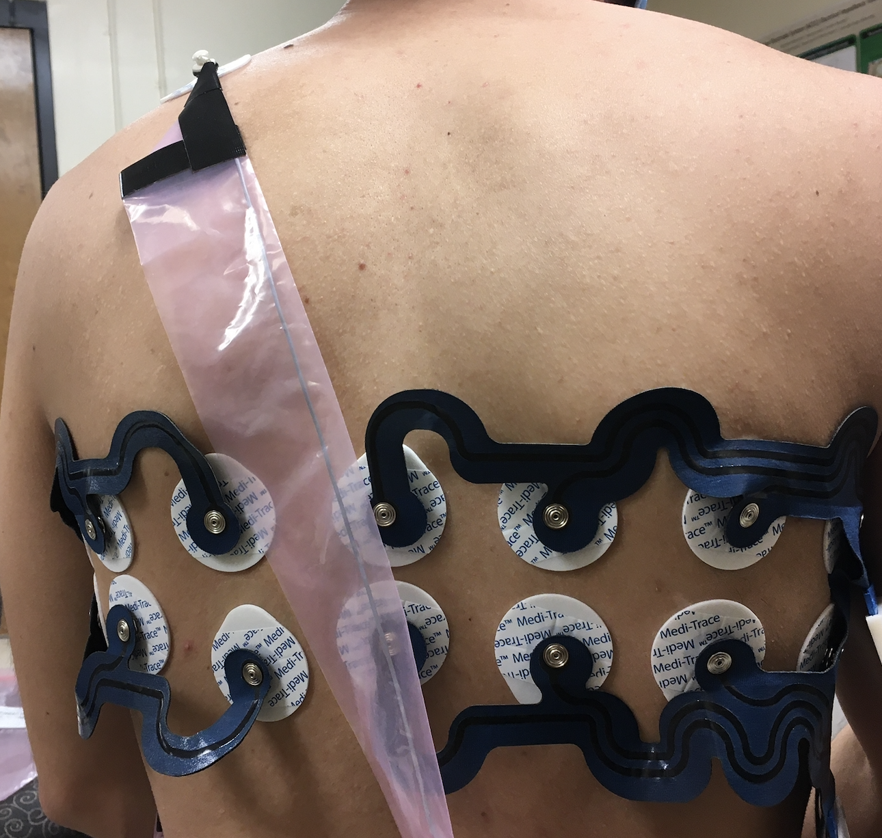
Assessment of ventilatory heterogeneity by measures derived from 3D functional Electrical Impedance Tomography (EIT) imaging of patients with ARDS and healthy controls: a pilot study
N. Barbosa Da Rosa¹, J. Brinton², A. Vieira Pigatto¹, T. Kao³, P. Offner⁴, J. L. Mueller⁵, E. L. Burnham⁶
¹School of Biomedical Engineering, Colorado State University, Fort Collins, CO, United States, ²University of Colorado - Denver, Denver, CO, United States, ³GE Research, Niskayuna, NY, United States, ⁴University of Colorado Anschutz Medical Campus, Aurora, CO, United States, ⁵Mathematics and School of Biomedical Engineering, Colorado State University, Fort Collins, CO, United States, ⁶Pulmonary Sciences and Critical Care Medicine, University of Colorado, Aurora, CO, United States.
INTRODUCTION
Table 1: Summary statistics of EIT measures by group (N=7), (b) BMI by group.
The distribution of intrapulmonary gas in mechanically ventilated patients with acute respiratory distress syndrome (ARDS) is typically heterogeneous due to both pulmonary pathology and gravitational effects. The Electrical Impedance Tomography (EIT)-derived measure of regional ventilation delay (RVD) provides 3D pixel-wise measurements of the delay time between the start of inspiration and a chosen threshold. Its standard deviation, RVDI, measures RVD heterogeneity. CV denotes its spatial coefficient of variation, RVDI/global_mean(RVD), which quantifies the variation in RVD through the lungs. While such measures may concisely provide clinically useful information about ventilatory heterogeneity, they have not been studied for 3D reconstructions or compared to those of healthy human subjects.
 | Control | ARDS
Measures | Mean (SD) | Mean (SD) | p-value
RVD_Global | 44.08(6.17) | 39.11(9.26) | 0.1156
RVD_Mean | 44.76(6.09) | 40.06(8.08) | 0.1008
RVDI | 4.86(1.22) | 9.04(3.44) | 0.0053
CV_RVD | 0.11(0.03) | 0.23(0.09) | 0.0008
METHODS
EIT data were collected using the GE GENESIS prototype EIT system
System provides real-time 3D images
32 electrodes arranged in two rows encircling the chest (Figure 1)
7 mechanically ventilated supine ARDS patients and 7 healthy controls
Three successive breaths were chosen for the analysis
The RVD plotted in Figures 2 and 3 was computed pixel-wise after segmentation using the start of inspiration from the global time curve as the reference time point to the time required to reach 40% of the maximum global amplitude
EIT outcomes were modeled with hierarchical mixed models including fixed effects for group and measure number, and random effects inducing an unstructured correlation matrix on repeated measures
Top
Bottom
Figure 2: ARDS subject - EIT conductivity reconstruction (left), Segmented Lung image (center), and the RVD distribution (right)
Top
Bottom
Figure 1: 2x16 electrode configuration on a healthy subject in the lab
RESULTS
Figure 3: Control subject - EIT conductivity reconstruction (left), Segmented Lung image (center), and the RVD distribution map (right)
RVDI and CV differed statistically between groups (Table 1)
Figures 2 and 3 show the EIT conductivity reconstruction and RVD map from ARDS and Control subjects, respectively
Images are at full inspiration and the RVD image shows the average RVD for 3 breathing cycles
Green/Blue means ventilated areas segmented in the conductivity image and segmented image in Figures 2 and 3
Blue areas mean low RVD while red areas mean high RVD in the RVD map
CONCLUSIONS
Results suggest that EIT-derived RVD measures from 3D reconstructions may provide a useful assessment of ventilatory heterogeneity. Since the RVD map provides regional information about the delay of inspired air, it may help identify regions of atelectasis at the bedside.
ACKNOWLEDGMENTS
This project was supported by Award Number 3R01EB026710-02S1 from the National Institute Of Biomedical Imaging And Bioengineering. The content is solely the responsibility of the authors and does not necessarily represent the official view of the National Institute Of Biomedical Imaging And Bioengineering or the National Institutes of Health.

