Slide 1



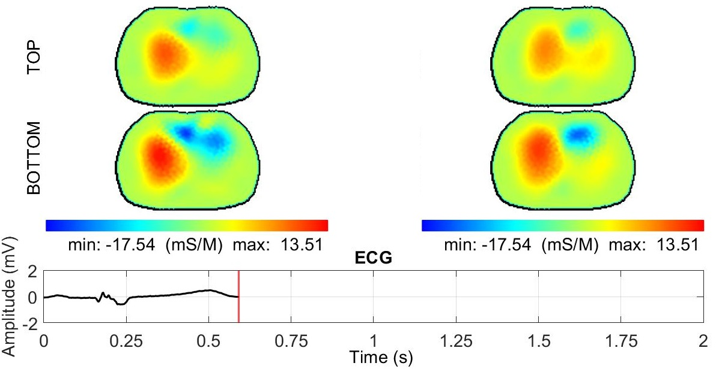
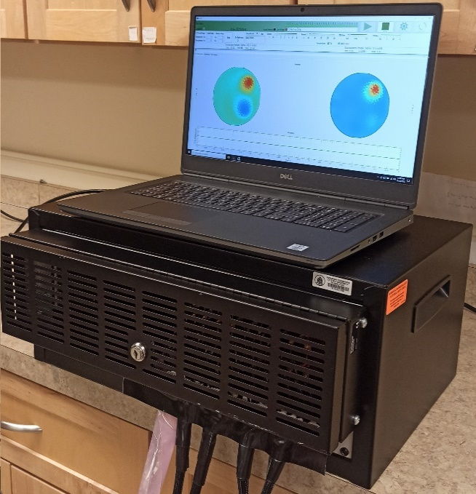
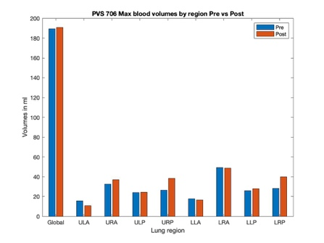
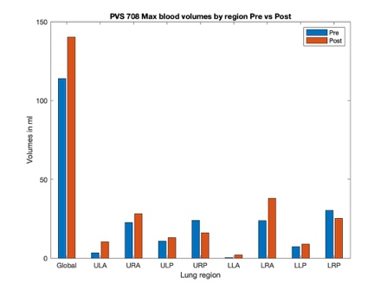
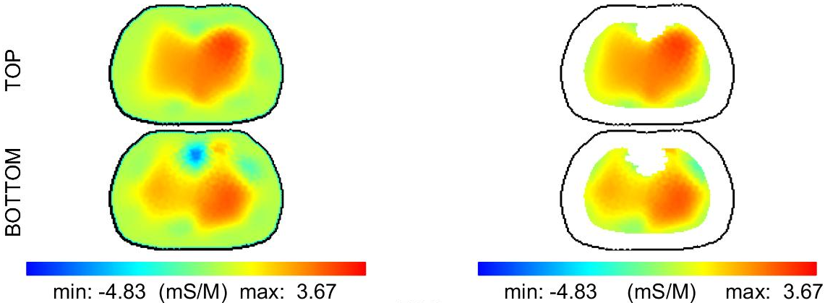
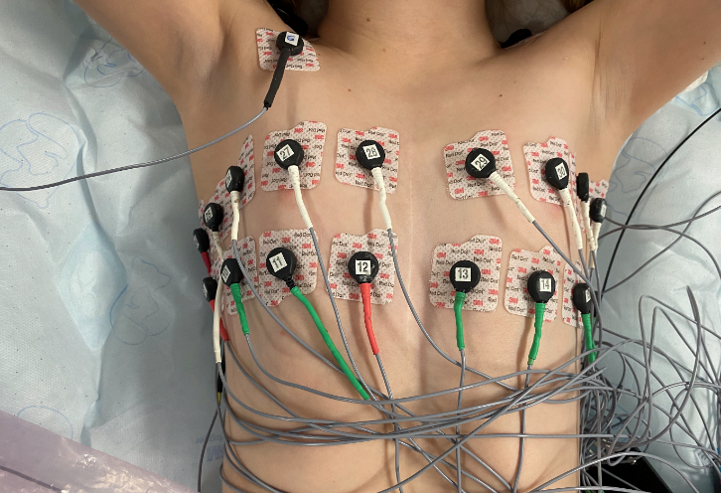
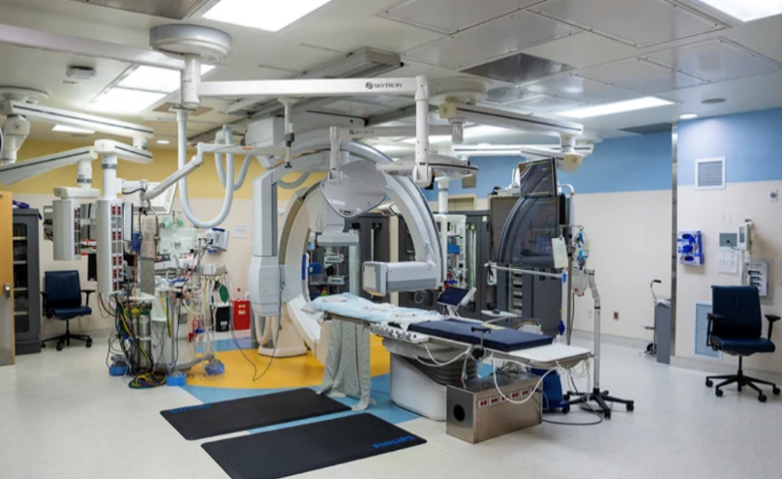
Evaluation of blood volume changes in the lung using EIT pre and post catheterization in pediatric patients with pulmonary vein stenosis
Children’s Hospital Colorado
Breathing Institute
Nilton Barbosa da Rosa Jr¹, Catalina Vargas-Acevedo², Omid Rajabi Shishvan³, Gary Saulnier³, Jonathan Newell⁴,
David Isaacson⁴, Jennifer L. Mueller⁵, Jenny Zablah⁶
¹School of Biomed. Engr., Colorado State University, ²Children’s Hospital Colorado, ³Dept of Elect & Cmptr Engr, University at Albany, SUNY, ⁴Rensselaer Polytechnic Institute, ⁵Dept. of Math. and School of Biomed. Engr., Colorado State University, ⁶Dept. of Pediatrics, University of Colorado School of Medicine
Background
Pulsatile Pulmonary EIT Images
Outcomes
Patients with pulmonary vein stenosis (PVS) frequently undergo catheterization and stent placement to open one or more stenosed pulmonary veins.
Typical evaluations include echocardiograms, cardiac computed tomography (CT), lung perfusion scans, or cardiac catheterization.
Electrical impedance tomography (EIT) is a functional, non-ionizing portable imaging technique.
EIT provides real-time images of pulsatile pulmonary perfusion and quantitative estimates of blood volume changes.
Dynamic images of pulsatile perfusion were computed at 27 fr/s in 3-D with a frame at end-QRS as the reference.
In the images below, red represents areas with an increase in blood, and blue represents areas with a decrease.
The upper image is the reconstruction in the plane of the upper row of electrodes and the lower image is in the plane of the lower row. The EIT-measured ECG is also plotted in real-time.
The maximum blood volume in the whole lung computed from the EIT images increased from pre- to post-procedure in 8 of the 11 patients.
Patient 708 (images at left) was a 4-yr old male with PVS and PH who received intervention in the left lower and left upper pulmonary veins with balloon angioplasty. EIT-derived regional blood volumes showed an increase in blood flow to the upper left and right anterior, lower right anterior, upper and lower left posterior regions following the procedure. The global percent increase in pulmonary blood volume from pre to post was 23%.
Patient 706 was a 2-yr-old female with PVS and PH who received intervention in the left lower and left upper pulmonary veins with balloon angioplasty. EIT-derived regional blood volumes showed a small increase in blood flow to nearly all regions.
Pre/Post intervention EIT images
Pre Intervention
Post Intervention
Collection & Analysis of EIT Data
11 pediatric patients undergoing cardiac catheterization for pulmonary vein stent placement or balloon angioplasty
Data were collected immediately pre- and post-procedure.
Patients were mechanically ventilated and under anesthesia.
Data were collected using:
ACT5 EIT System
Radiolucent electrodes
Segmenting EIT images
EIT images are segmented before blood volume calculations to identify the lung region
EIT-computed blood volumes by octant pre and post intervention. ULA = upper left anterior, URA = upper right anterior, ULP = upper left posterior, URP = upper right posterior LLA = lower left anterior, LRA = lower right anterior, ULP = lower left posterior, URP = lower right posterior.
ACT5 EIT System
Pre Segmentation
Post Segmentation
3D EIT Electrode Configuration
Cardiac Catheterization Lab at CHCO
Conclusions
These preliminary results suggest that EIT could be a useful technique for assessing the effects of intervention in PVS patients as well as treatment planning and patient monitoring.
Two rows of 16 electrodes
EIT data were collected in the cath lab pre and post procedure
Acknowledgements
We would like to thank the patients and their families for participation in this study. Data collected at the Children’s Hospital of Colorado in Aurora, CO under COMIRB approval No. 18-1843.

