Slide 1
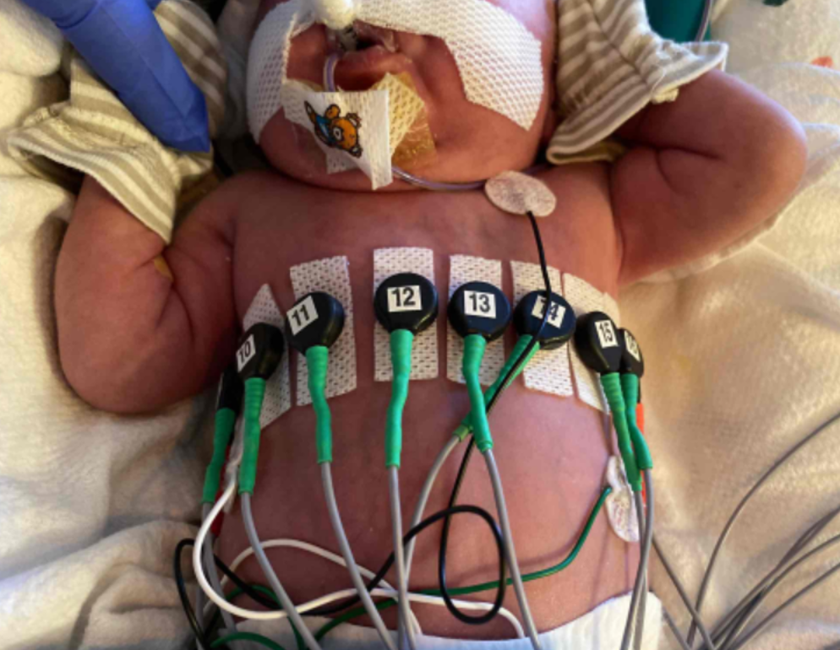
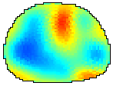
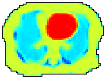
Old
New
Notes:
Imagine waking up in the morning and not being able to take a breath. This is the reality for many premature babies who are born with respiratory issues. Around 6% of infants born at term suffer from Respiratory Distress Syndrome, and some reports say that this number jumps up to between 20 and 30% of neonates born at 28 weeks or later. Our lab is to use an imaging method called electrical impedance tomography, or EIT, to help these premature newborns.
The end goal of my research is to track the position of an intubation tube. We want to be able to tell the doctors in real-time if they put the tube correctly in the trachea, or if they misplaced it in the esophagus. The underdeveloped trachea can be structurally very similar to the esophagus, making it hard to differentiate by feel alone. these algorithms could also tell clinicians if they went too far in the trachea and entered one of the mainstem bronchi instead. As only one of the lungs would be filling with air, this can be hard to see from watching the chest rise and fall.
EIT is a medical imaging technique that is real time, bed-side, and uses no radiation. EIT applies a low frequency, low amplitude current on electrodes placed around the body, and then measures corresponding voltages on the electrodes. From this, we can create conductivity images as shown on the bottom. Tissues like the lungs are full of air so they will have very low conductivity and will appear blue, while tissues like the heart are full of blood and are highly conductive, showing up as red. The standard images produced using EIT, which we can see an example of in the bottom left, normally have low spatial resolution but are very fast in terms of time, so we can see things like the breathing in the lungs and blood pumping in the heart.
Our lab is working on using machine learning and other statistical algorithms to help improve the resolution of the images making them more like what is shown on the bottom right. Last spring I worked on curating a dataset of CT scans from 90 newborns and used those scans to create anatomical information about the lungs and other tissues. We used this to generate around 80,000 simulated images that then trained different algorithms. For all of the algorithms used, we were able to produce images with higher resolution, and with many of them we were also able to do so faster than the original method. The image shown in the bottom right is from a machine learning program that took the original method’s results, and post processed it to be clearer for a clinician.
Hopefully, our algorithms can be used clinically to help save the lives of babies, and make sure they get the breaths of air that they so vitally need. Thank you.
(2:52)

