Slide 1
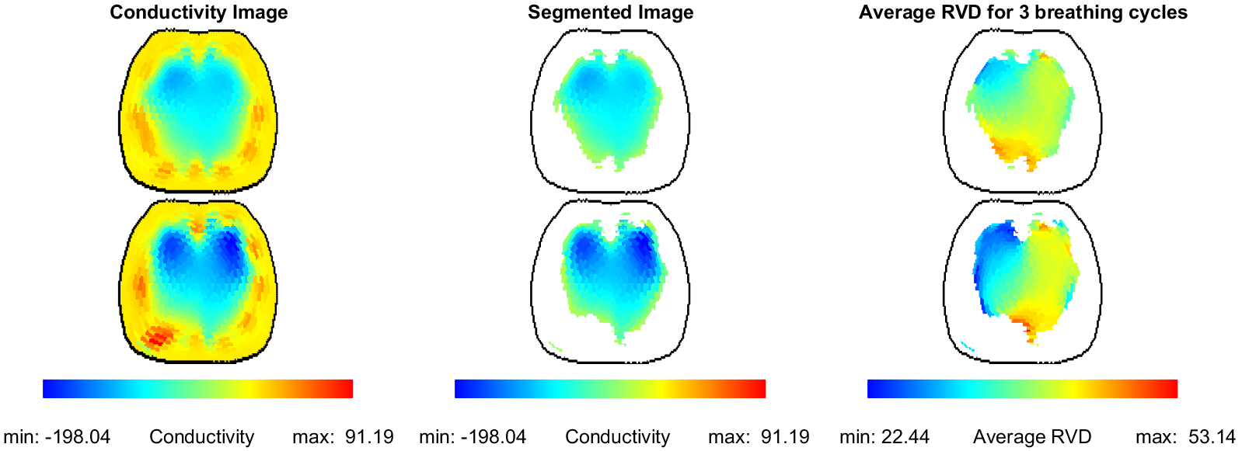
Nilton Barbosa da Rosa
Poster Board Number: 207
Assessment of Ventilatory Heterogeneity by Measures Derived From 3D Functional Electrical Impedance Imaging of Patients With Acute Respiratory Distress Syndrome and Healthy Controls: A Pilot Study
Electrical impedance tomography (EIT) is a functional, non-ionizing bedside imaging technique that provides real-time images of regional ventilation
The EIT-derived measure of regional ventilation delay (RVD) and time constant (TC) provides voxel-wise measurements of the delay time between the start of inspiration and a chosen threshold and the time for expiration, respectively
The standard deviation (RVDI) measures RVD heterogeneity, CV denotes its spatial coefficient of variation
Seven mechanically ventilated supine ARDS patients and seven healthy controls were imaged using 32 electrodes arranged in 2 rows encircling the chest
EIT Reconstructions
Table of the model estimated marginal differences between the Control Group and ARDS group (N=7)
Measure | delta (95% CI) | p-value
RVD_Global | -5.99(-13.68,1.70) | 0.1156
RVD_Mean | -5.44(-12.11,1.23) | 0.1008
RVDI | 4.03(1.45,6.62) | 0.0053
CV_RVD | 0.09(0.05,0.14) | 0.0008
TC_Mean | -0.15(-0.25,-0.04) | 0.0118
TC_std | 0.01(-0.06,0.09) | 0.7015
CV_TC | 0.08(-0.02,0.17) | 0.1024

