Slide 1
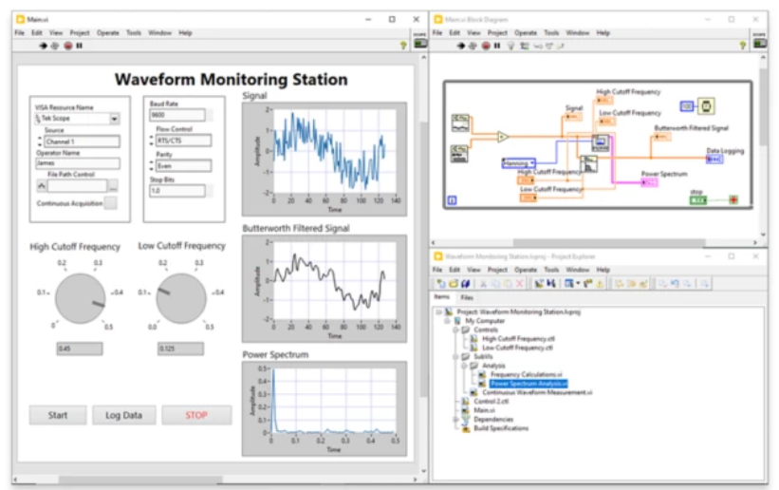
Title of Poster, Bold, 80-120 points Sponsor: Sponsoring Company Mentor(s): Name(s) of Mentor(s) Names of Team Members, Bold, 45-65 points
Company
Logo
Abstract
Process and graph mass spectrometer data
Develop a modular system for different data perspectives and transformations.
Efficient data processing, structured storage, and intuitive visualization.
Body
Body
Previous Solution: LabVIEW
Unfamiliar for newer generation of researchers/developers
Limited flexibility and extendibility
Git incompatibility
Poor cross-platform support
Paid Licensing
Glossary
Acknowledgements
Figure 1: LabVIEW Screenshot
Team Name; Bold; 40-60 points

