Slide 1


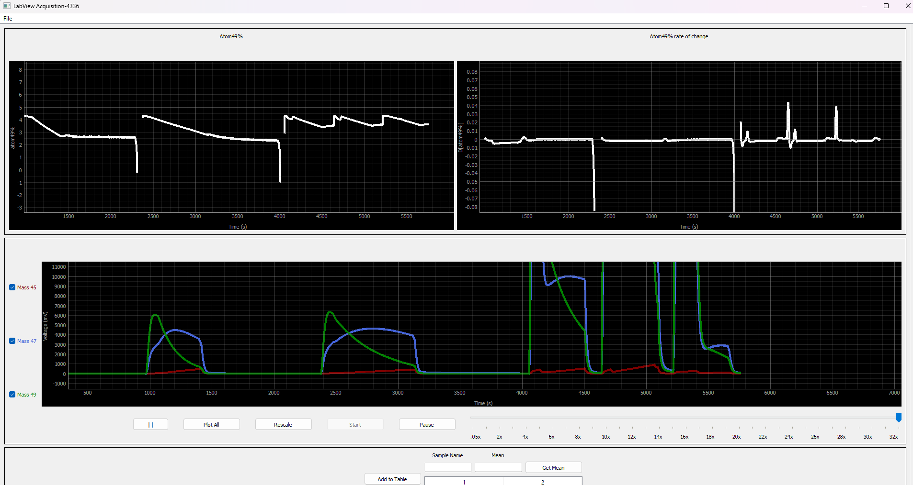
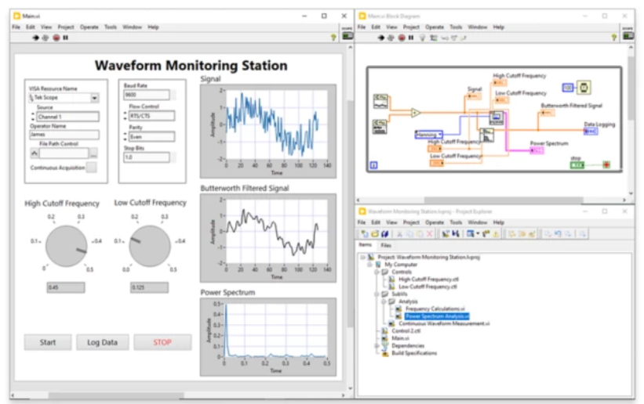
Mass Spectrometer Interface Sponsor: WSU School of Biology Cousins Lab Mentor: Dr. Asaph Cousins Erik Holtrop, Kyler Kupp
Abstract
Process and graph mass spectrometer data
Develop a modular system for different data perspectives and transformations.
Efficient data processing, structured storage, and intuitive visualization.
Our Solution: A Powerful Python-based Graph Interface
Process data from CSV’s
Extract relevant datapoints
Calculate derived values
Display data in one or more graphs
Different versions for different situations
Sample or complete exporting
Body
Previous Solution: LabVIEW
Unfamiliar for newer generation of researchers/developers
Limited flexibility and extendibility
Git incompatibility
Poor cross-platform support
Paid Licensing
Mass Spectrometer – An instrument used to identify the molecular composition of an object, liquid, or gas.
Figure 2: Interface Project Screenshot
Acknowledgements
Figure 1: LabVIEW Screenshot
Team Linnaea Borealis

