Slide 1
Uno
Kyler Smith
Tresor Cyubahiro
Kevin Hale
Adrian Vasquez
Gaurav Deshpande

Slide 2
Game Description
AV

Slide 3
Rules
2 players
Draw pile and a Discard pile
Have to match either color or number to play. (There are color, number , and action cards)
Must draw if you cannot play
Discard all cards to win

Slide 4
Features
Numbered Colored Cards
Action Cards

Slide 5
Game Board
Draw Pile
Discard Pile
Players Hand

Slide 6
Game Design
KH KS

Slide 7
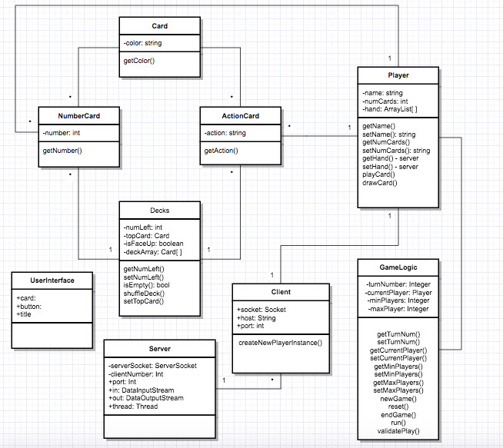

Slide 8
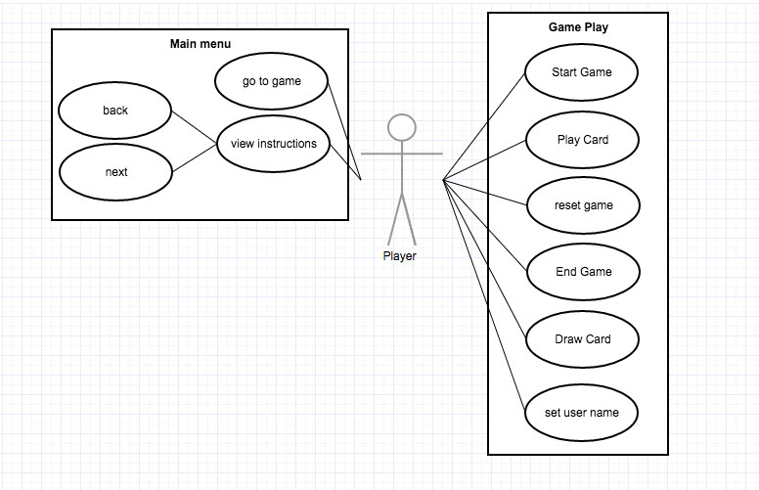

Slide 9
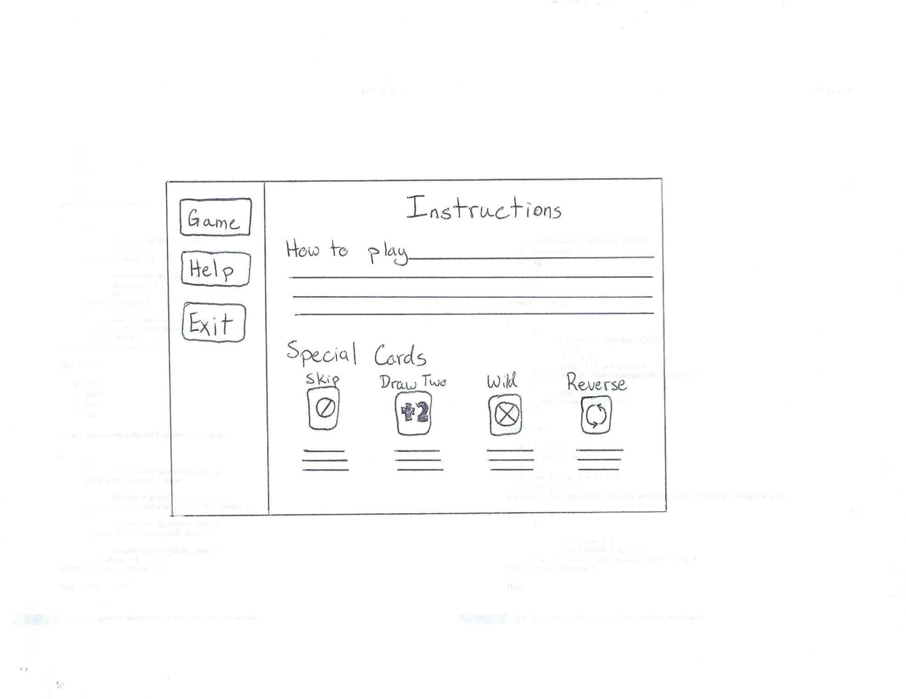

Slide 10
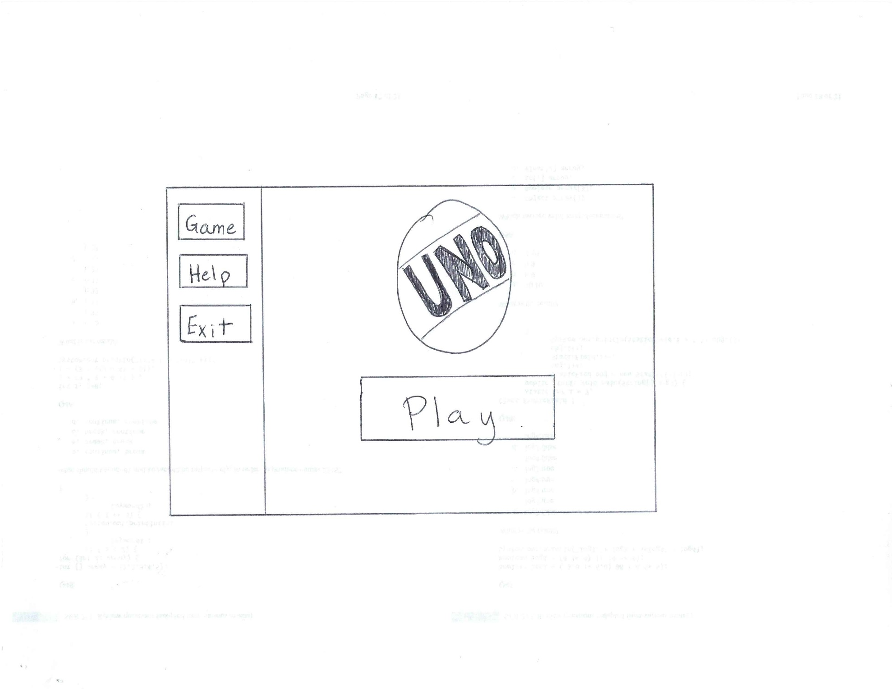

Slide 11
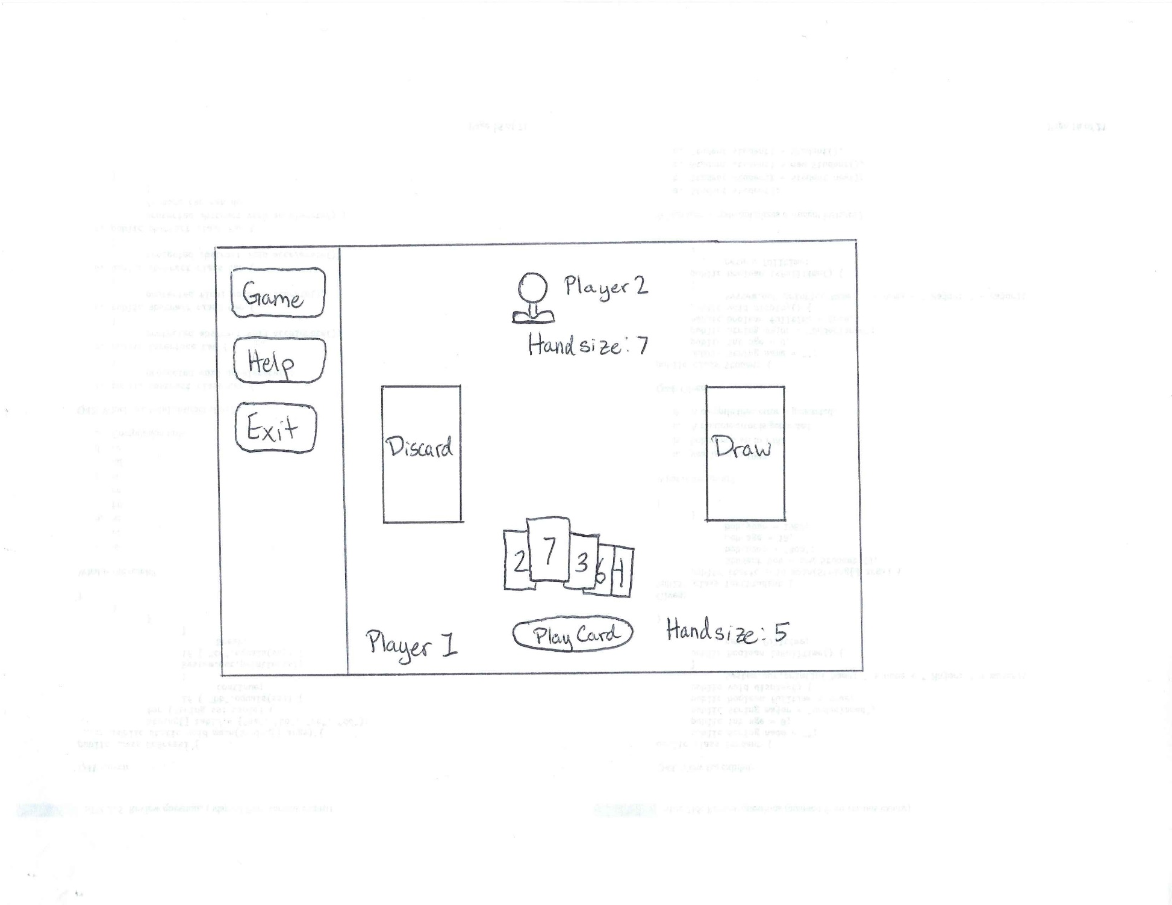

Slide 12
Demonstration
TC

Slide 13
Role of Each Team Member
Kyler // Card Infrastructure, Game Logic
Tresor // GUI and Client Interface
Kevin // Server Communication, Misc Coding
Adrian // Presentation, Testing, Debugging
Gaurav // Testing, Debugging
GD

Slide 14
Project Status
30% X Deck Built, Server Runs, GUI Started
40% X Server Game Logic Started
50% X GUI Displays Correct Cards
70% // All Coding Completed 11/26
80% // Testing Begins 11/28
90% // Final Changes and Bug Fixes 11/29
100% // Final testing 12/1
GD

