Slide 1
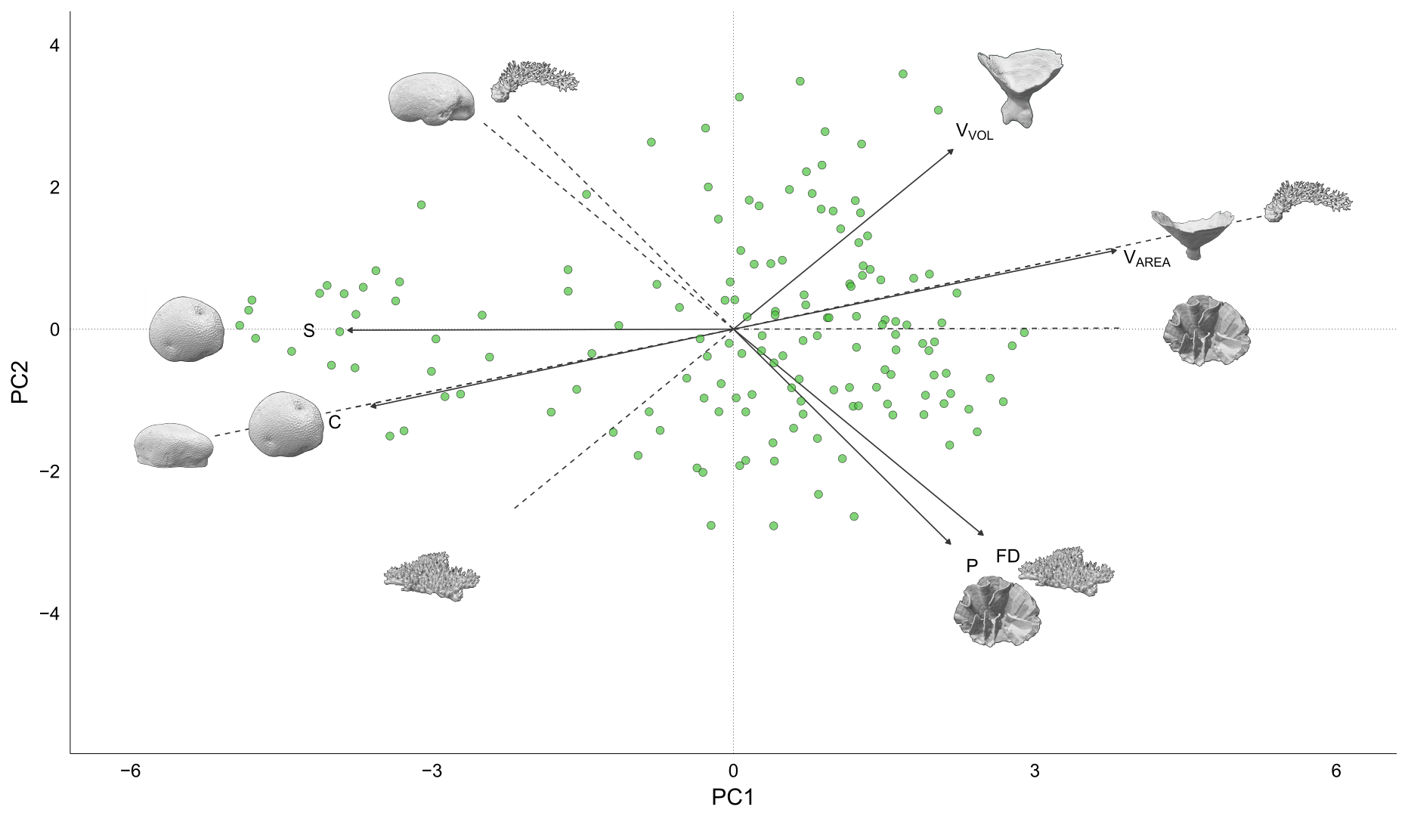

PCA of six continuous shape variables from 152 3D scanned colonies

Slide 2
The shape variables pair off into three major components
Top-heaviness
Skeleton Compactness
Surface Complexity

Slide 3
Skeleton compactness constrains the variation in the other two axes; When compactness is high, variation in surface complexity and top heaviness is much smaller
Top-heaviness
Skeleton Compactness
Surface Complexity

Slide 4
These axes capture demographic trade-offs...
More competitive but higher whole colony mortality
Slower growth but less partial mortality through fragmentation
More biomass per volume but less resources per unit biomass

Slide 5
…contribute to reef function in different ways…
More space for refuge and benthic shading ->
<- More reef accretion|| More space for refuge ->
Greater variation in abiotic conditions ->

Slide 6
…and react to disturbances in different ways
Increased mortality due to storms and cyclones ->
<- More resistant to thermal bleaching || Increasing fragmentation ->
Better resistance to sedimentation ->

Slide 7
The occupied functional shape space of a given coral community at a given time point will likely determine the functioning of the community and it’s susceptibility to disturbance.
Community Functional Occupancy

Slide 8
If a disturbance effects different morphological strategies asymmetrically, the post-disturbance community function will also shift.
Disturbance
Community Functional Occupancy
Post-disturbance Functional Occupancy

Slide 9
An example of these shifts is already apparent with our results (see ShapeDistributionExample)
Shift in convexity values
Community Functional Occupancy
Post-disturbance Functional Occupancy

Slide 10
Multiple axes of long term and acute changes to environmental conditions and disturbance regimes associated with the Anthropocene may fundamentally alter the available space of valid morphological strategies, and with it the functioning of the reef ecosystem as a whole.
Increased cyclones
Thermal bleaching events
Increased pCO2
Higher SSTs
Increased sedimentation
Pre-Anthropocene valid morpho-strategies?
Post-Anthropocene valid morpho-strategies?

Slide 11
It should be possible to quantify and make predictions on these ideas through the use of the field results as well as other data on morphology and coral demographics rates. Possibly through simulation studies or through actually tracking these shifts in the lizard island coral community.
Increased cyclones
Thermal bleaching events
Increased pCO2
Higher SSTs
Increased sedimentation
Pre-Anthropocene valid morpho-strategies?
Post-Anthropocene valid morpho-strategies?

