Slide 1
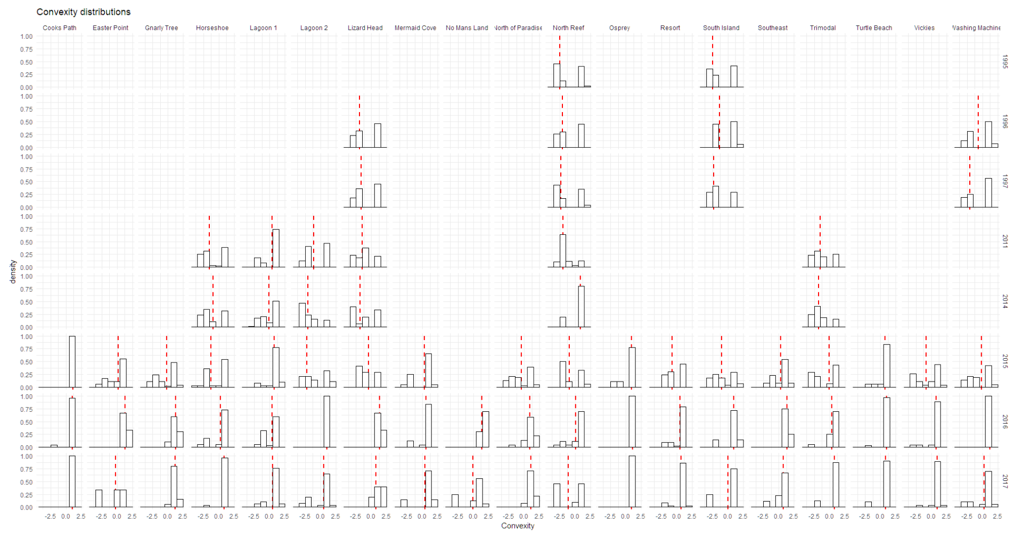

Slide 2
Density distributions of convexity using Lizard Island LIT dataset. Red line = weighted average of convexity, weighted by intercept. This shows how convexity (higher = more convex morphology, i.e. less branch-y) shape distributions change spatially, temporally and in response to disturbances.

Slide 3
Shape variables were predicted using growth form and planar area (estimated by using intercept as the radius of a circle, and calculating area.)

Slide 4
Some growth forms were present in the LIT data that were not included in the laser scan dataset. These colonies have been left out of the plots

Slide 5
2014: Ita hits north Lizard island

Slide 6
2014: Ita hits north Lizard island
North reef: big shift in convexity from low to high (more massive dominated)

Slide 7
2014: Ita hits north Lizard island
Southern sites: remain more or less consistent where Ita doesn’t make landfall

Slide 8
2015: Nathan hits south-east Lizard island

Slide 9
2015: Nathan hits south-east Lizard island
Trimodal: big shift in convexity from low to high (more massive dominated)

Slide 10
2015: Nathan hits south-east Lizard island
North reef: big shift in convexity from high to low, odd result…

Slide 11
2015: Nathan hits south-east Lizard island
Not much in these sites, except maybe lagoon 1 and lizard head.

Slide 12
2016: Mass bleaching hits south-east Lizard island

Slide 13
2016: Mass bleaching hits south-east Lizard island
General increase in convexity across sites in response

Slide 14
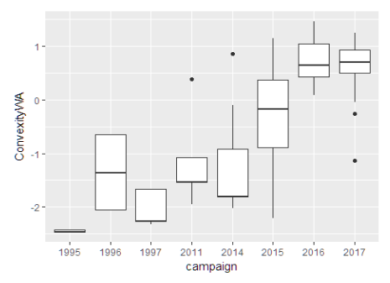
2016: Mass bleaching hits south-east Lizard island
General increase in convexity across sites in response

Slide 15
2016: Mass bleaching hits south-east Lizard island
General increase in convexity across sites in response
Preliminary results with fish data (Luisa’s work) show a link between increased convexity and reduced juvenile fish abundance (less branching corals for refuge)

Slide 16
Also note the relative stability of shape distributions through years where no disturbance was recorded (with some exceptions; Washine machine)

Slide 17
This is a solid example of how we can look at continuous shape distributions and track how they spatially and temporally vary, and most importantly, how they respond to disturbances. There are also some preliminary results from a separate paper we are working on with fish abundances at these sites that also provides a direct morphology-habitat provision link.

Slide 18
Next up are the same graphs but for different size and shape variables without any interpretation at this point for reference.

Slide 19
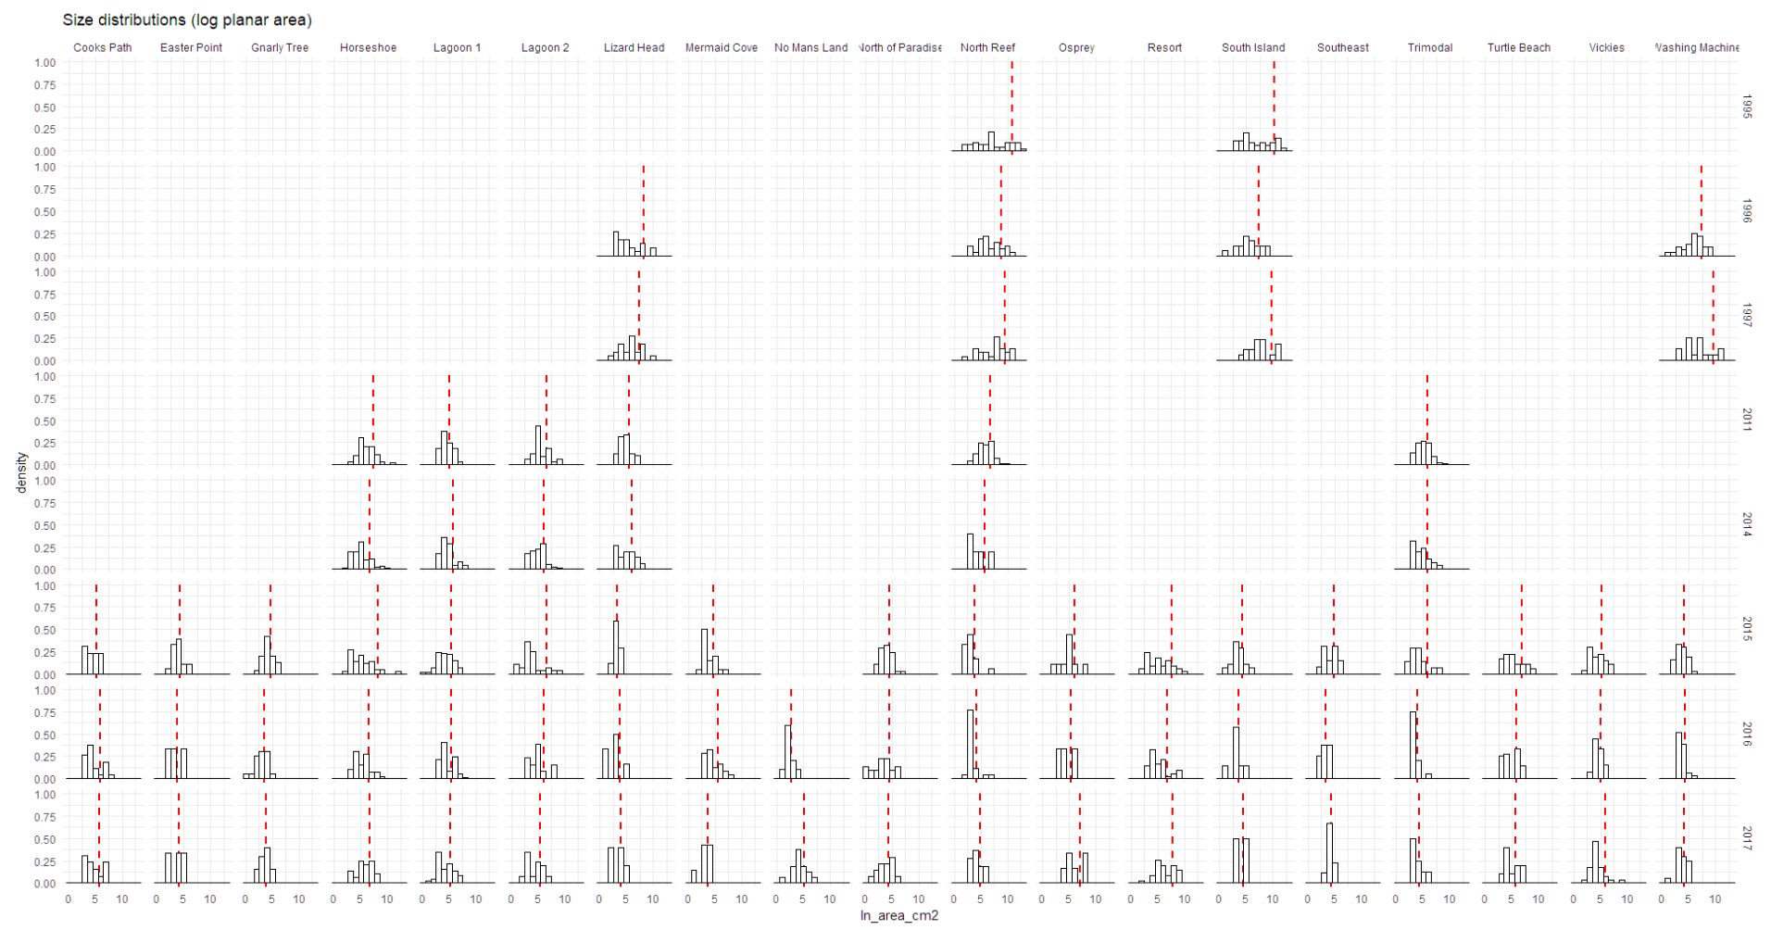

Slide 20
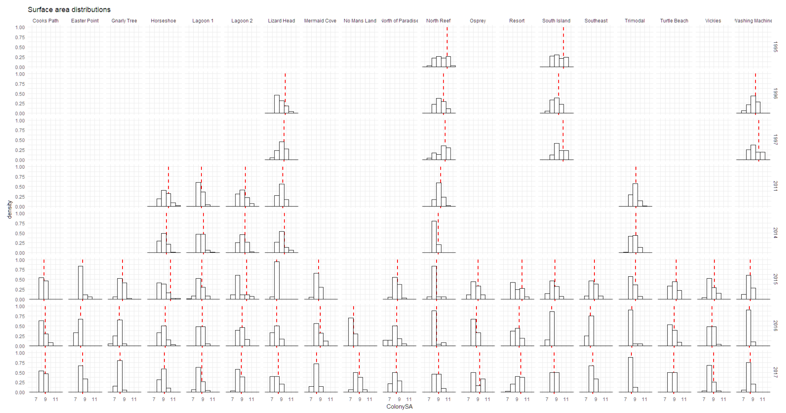

Slide 21
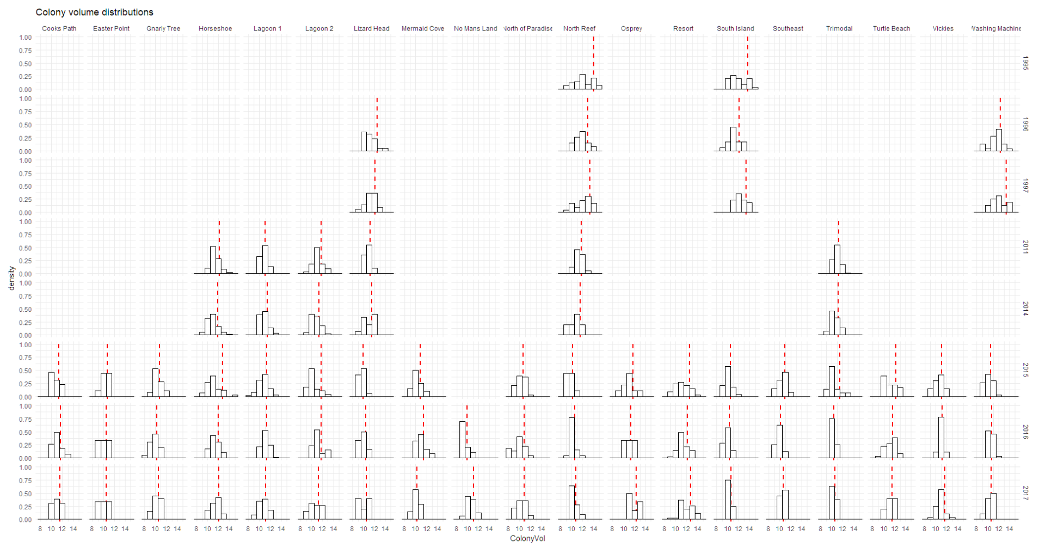

Slide 22
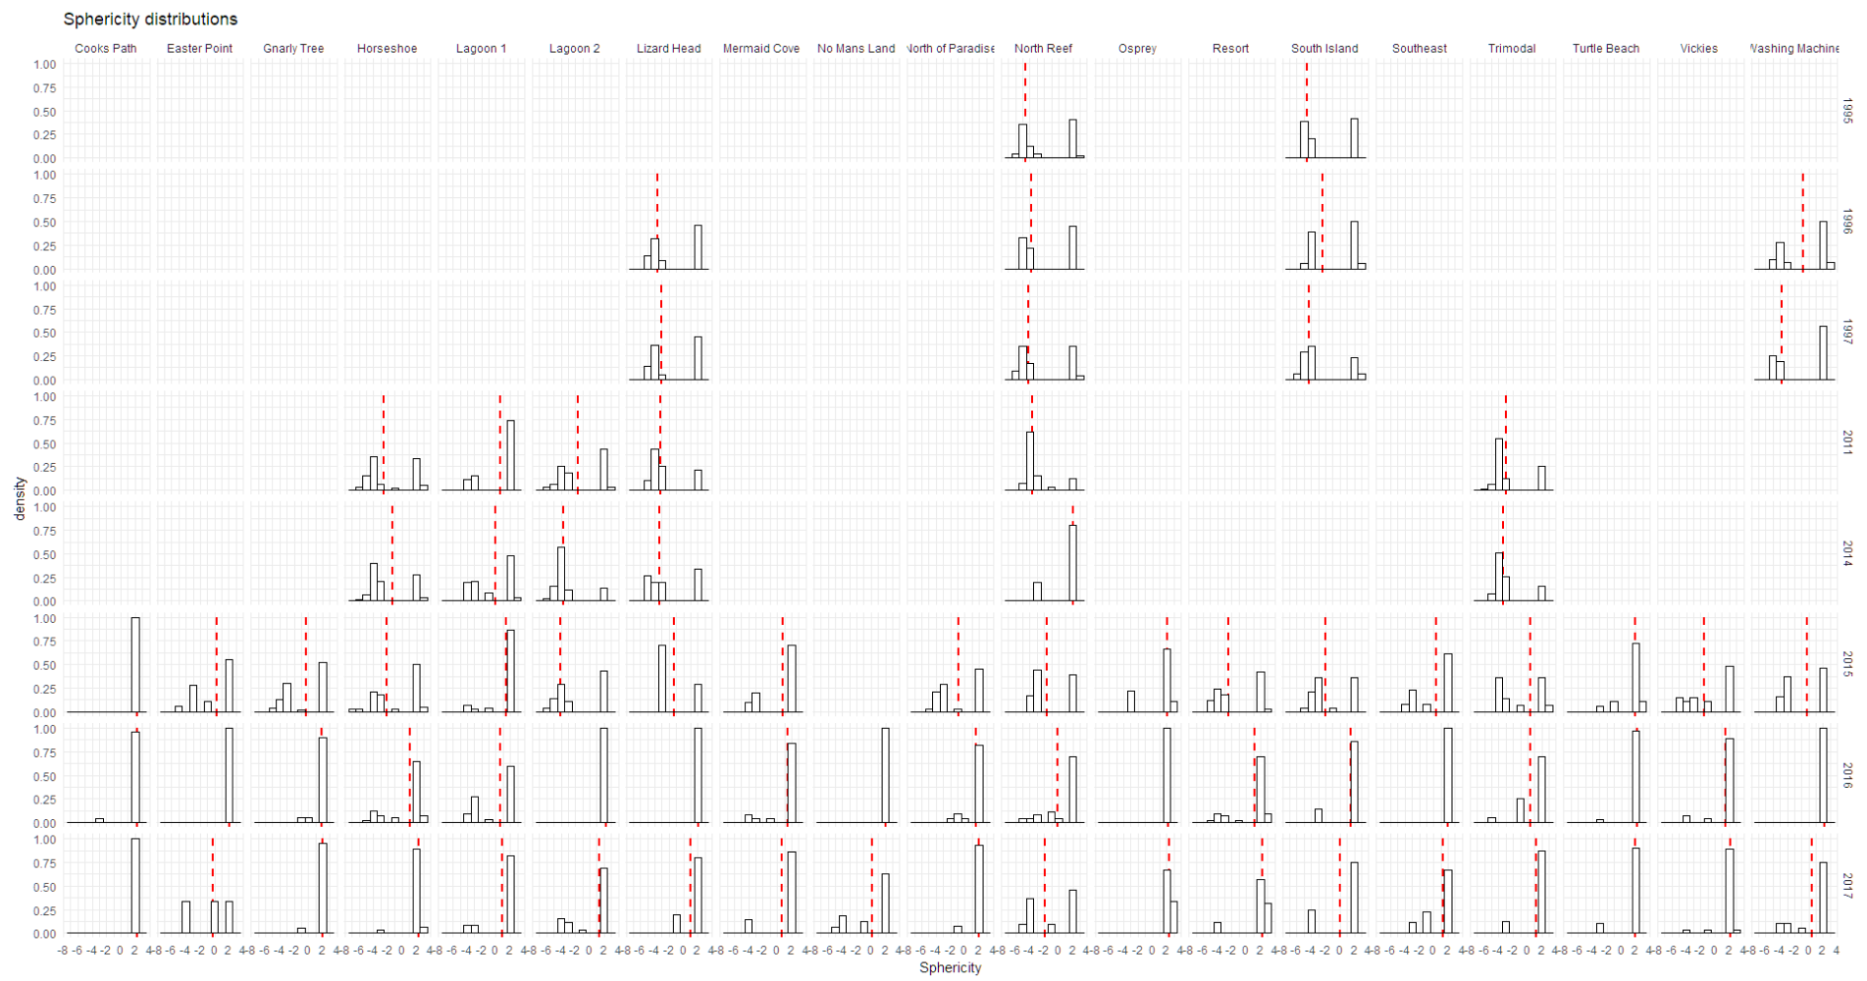

Slide 23
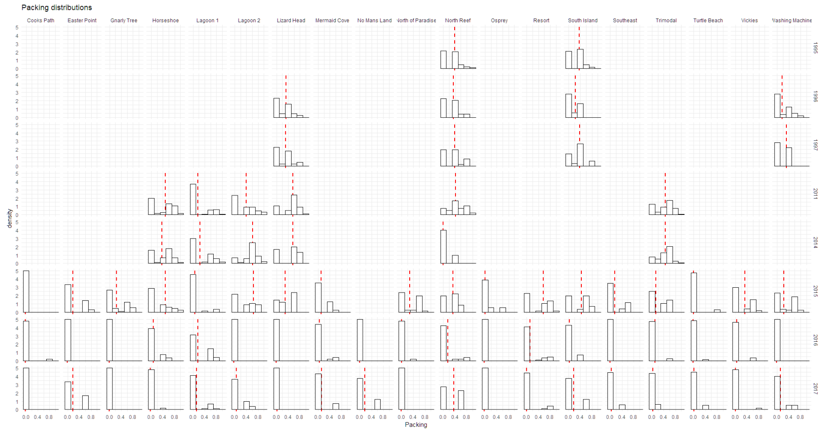

Slide 24
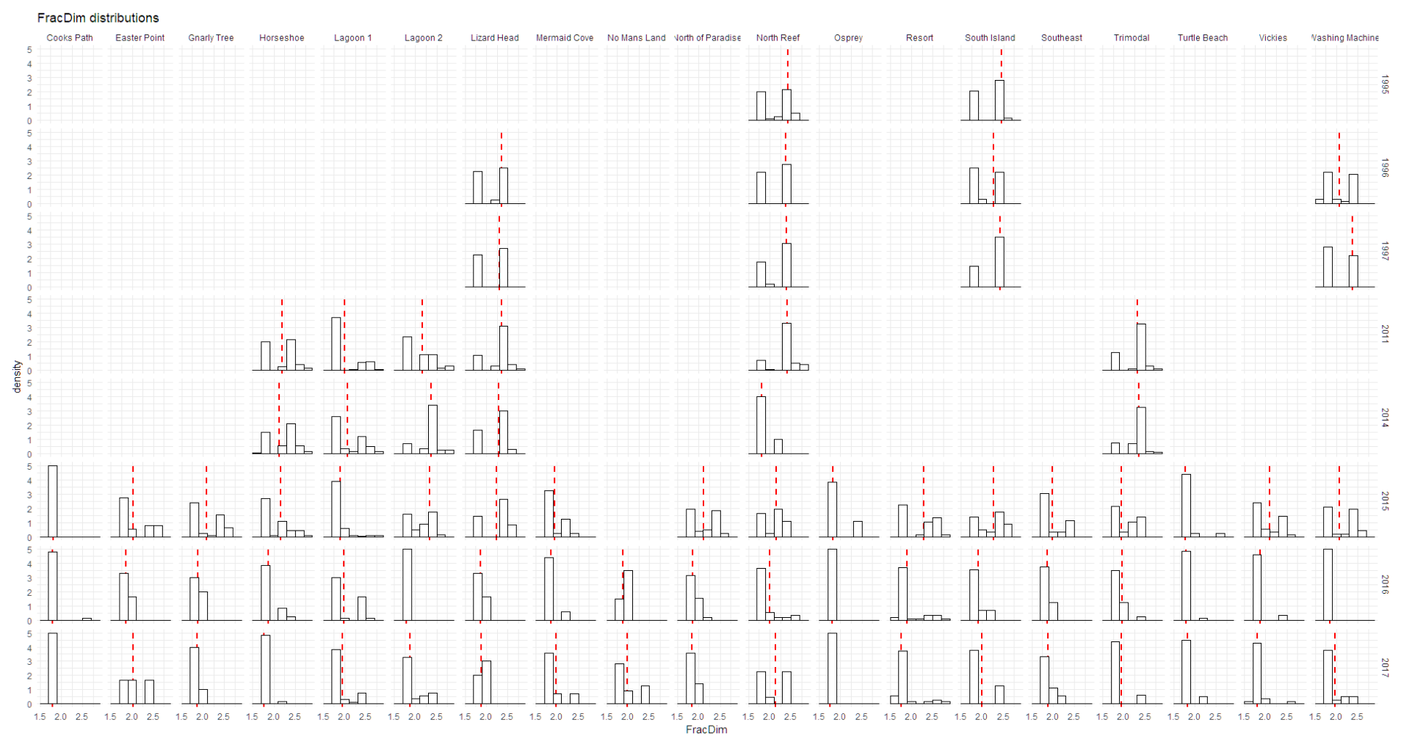

Slide 25
