Slide 1



Positionning systems Projects demonstration Kyllian Cuevas | Thomas Mirbey
M1 IOT | EIPHI GRADUATE SCHOOL 27/03/2025

Slide 2

Presentation outline
1- Methodology
3- N-Lateration
4- Kbest neighbors
5- Hidden Markov model
2- Architecture
Conclusion
M1 IOT | EIPHI GRADUATE SCHOOL
Kyllian Cuevas | Thomas Mirbey

Slide 3
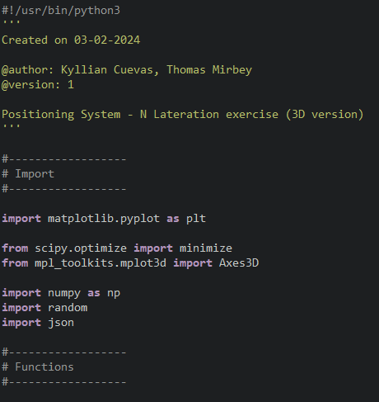
1- Methodology
1
1. Focus on Independent Functionality:
Each positioning system subject (N-Lateration, K-Best Neighbors, Hidden Markov Model) was implemented as a set of independent Python functions.
2. Code Template for Readability:
A standardized Python code template was employed to ensure consistency and enhance readability across all subjects.
3. Iterative Development & Testing:
Development followed an iterative approach:
Develop: Implement a specific function or functionality.
Test:
Validate the implemented component.
Continue: Proceed to the next functionality.
M1 IOT | EIPHI GRADUATE SCHOOL
Kyllian Cuevas | Thomas Mirbey

Slide 4


2- Architecture
2
All scripts were developed in Python (3.9). Module used:
json: For working with JSON data (serialization/deserialization).
random: For generating pseudo-random numbers.
numpy: For numerical operations and array manipulation.
matplotlib.pyplot: For creating 2D plots and visualizations.
scipy.optimize.minimize: For finding the minimum of a function.
mpl_toolkits.mplot3d.Axes3D: For creating 3D plots.
collections.defaultdict: For dictionaries with default values.
flask: For building web applications.
M1 IOT | EIPHI GRADUATE SCHOOL
Kyllian Cuevas | Thomas Mirbey

Slide 5
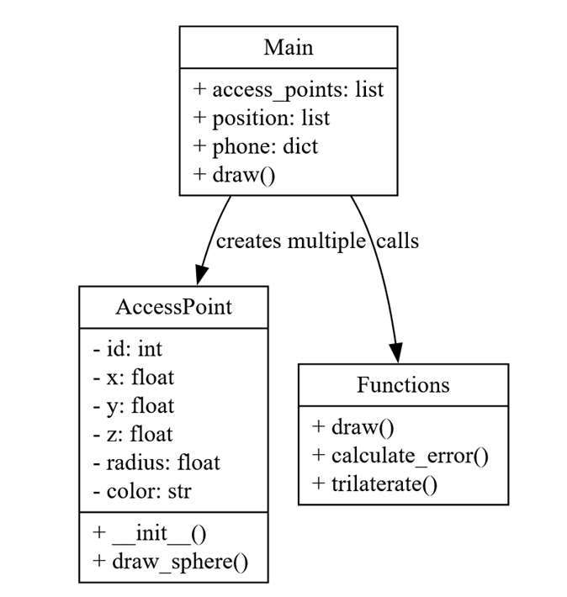
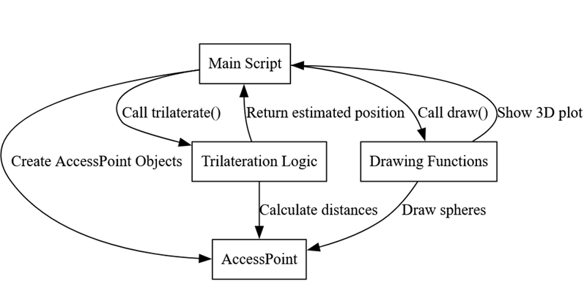
3- N-Lateration
3
N-lateration is a method used to determine the location of a point by measuring its distance from multiple known points.
Our implementation:
7
5
2
4
1
3
6
M1 IOT | EIPHI GRADUATE SCHOOL
Kyllian Cuevas | Thomas Mirbey

Slide 6
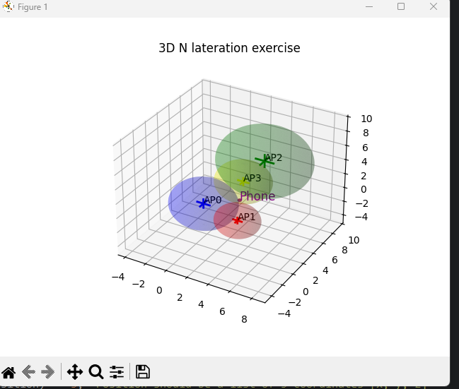
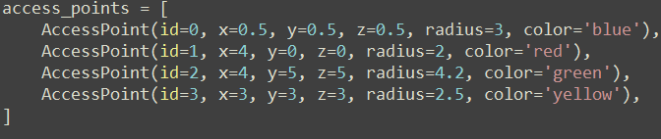
3- N-Lateration
4
The script shows a 3D visualization representing access points and their emission radius as spheres and estimating the phone's location based on their distances.
Our implementation:
M1 IOT | EIPHI GRADUATE SCHOOL
Kyllian Cuevas | Thomas Mirbey

Slide 7
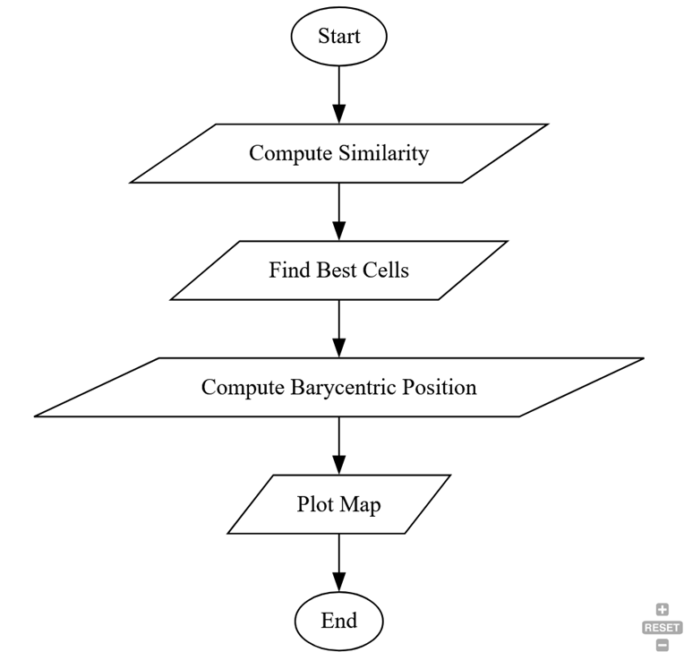
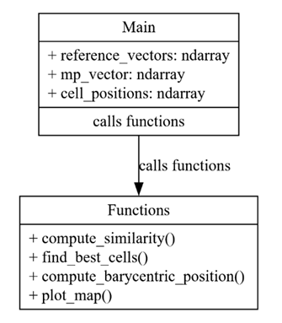
4- Kbest neighbors
5
The k-Nearest Neighbors (k-NN) algorithm is technique used for determining the positions of the k-nearest neighbors for a given data point.
Our implementation:
M1 IOT | EIPHI GRADUATE SCHOOL
Kyllian Cuevas | Thomas Mirbey

Slide 8
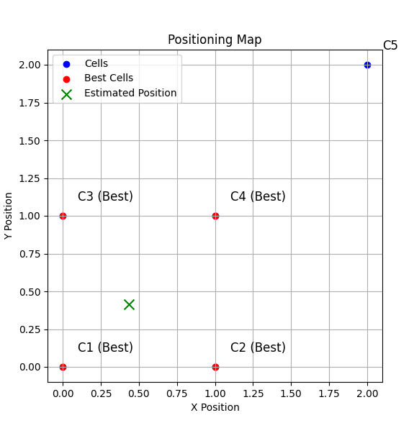
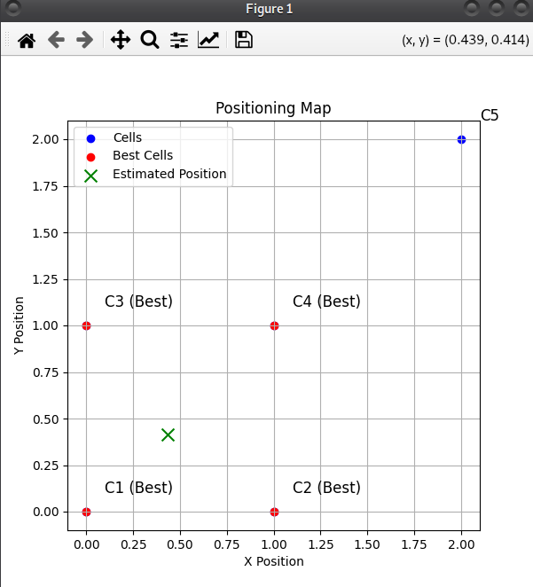
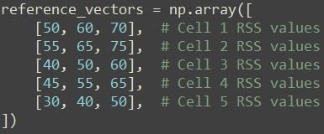
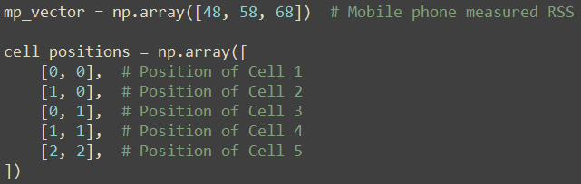

4- Kbest neighbors
6
The script shows the phone's estimated location based on the 4 cells with the closest signal readings. The blue dots are all the cell locations.
Output:
M1 IOT | EIPHI GRADUATE SCHOOL
Kyllian Cuevas | Thomas Mirbey

Slide 9
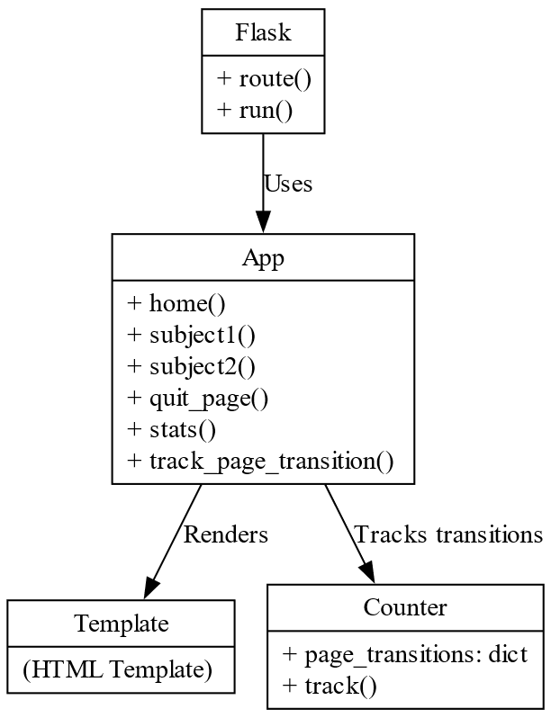
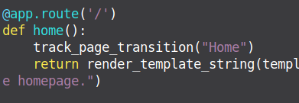
5- Hidden Markov model
7
The Hidden Markov Model (HMM) can track user navigation on a webpage by modeling hidden user states and browsed pages.
Our implementation:
M1 IOT | EIPHI GRADUATE SCHOOL
Kyllian Cuevas | Thomas Mirbey

Slide 10
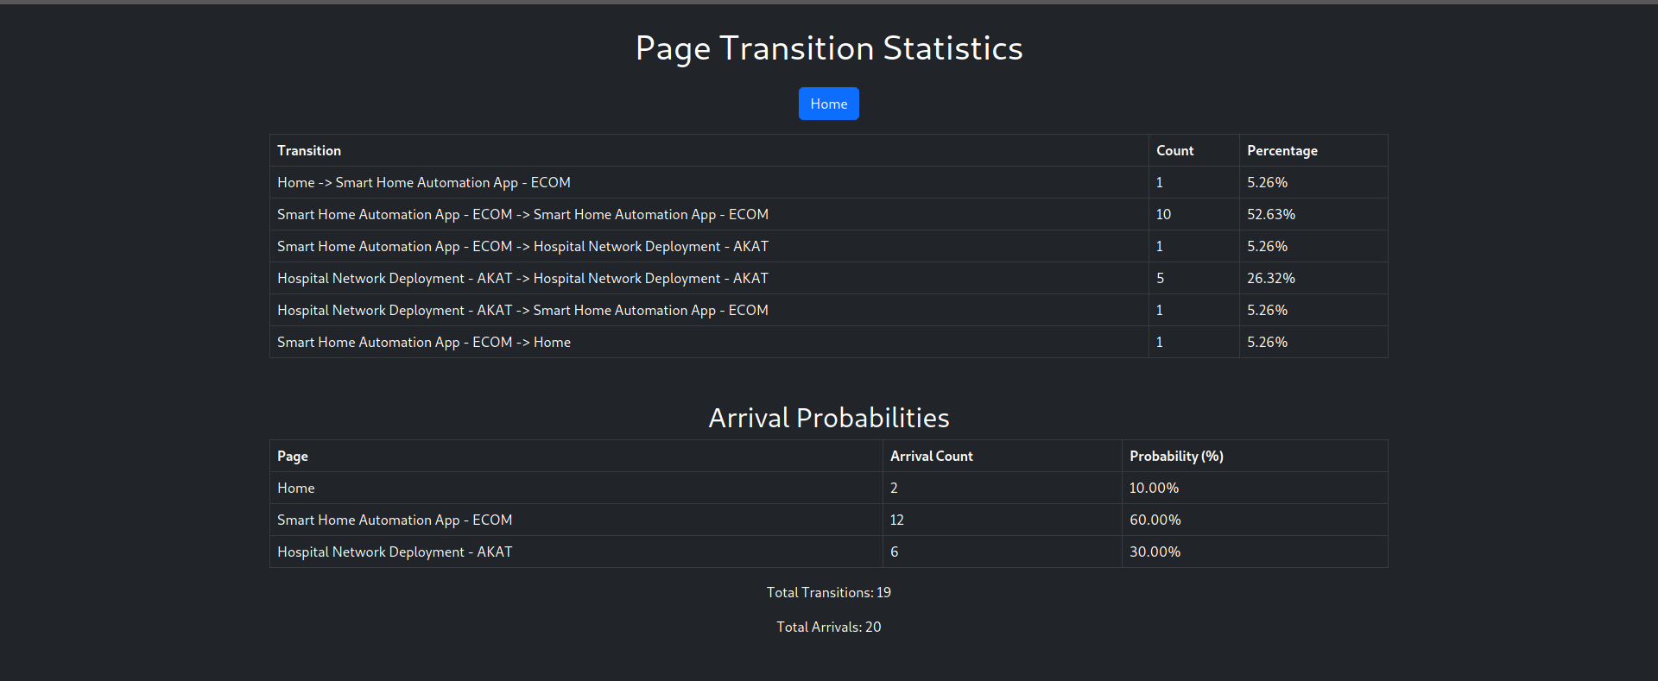
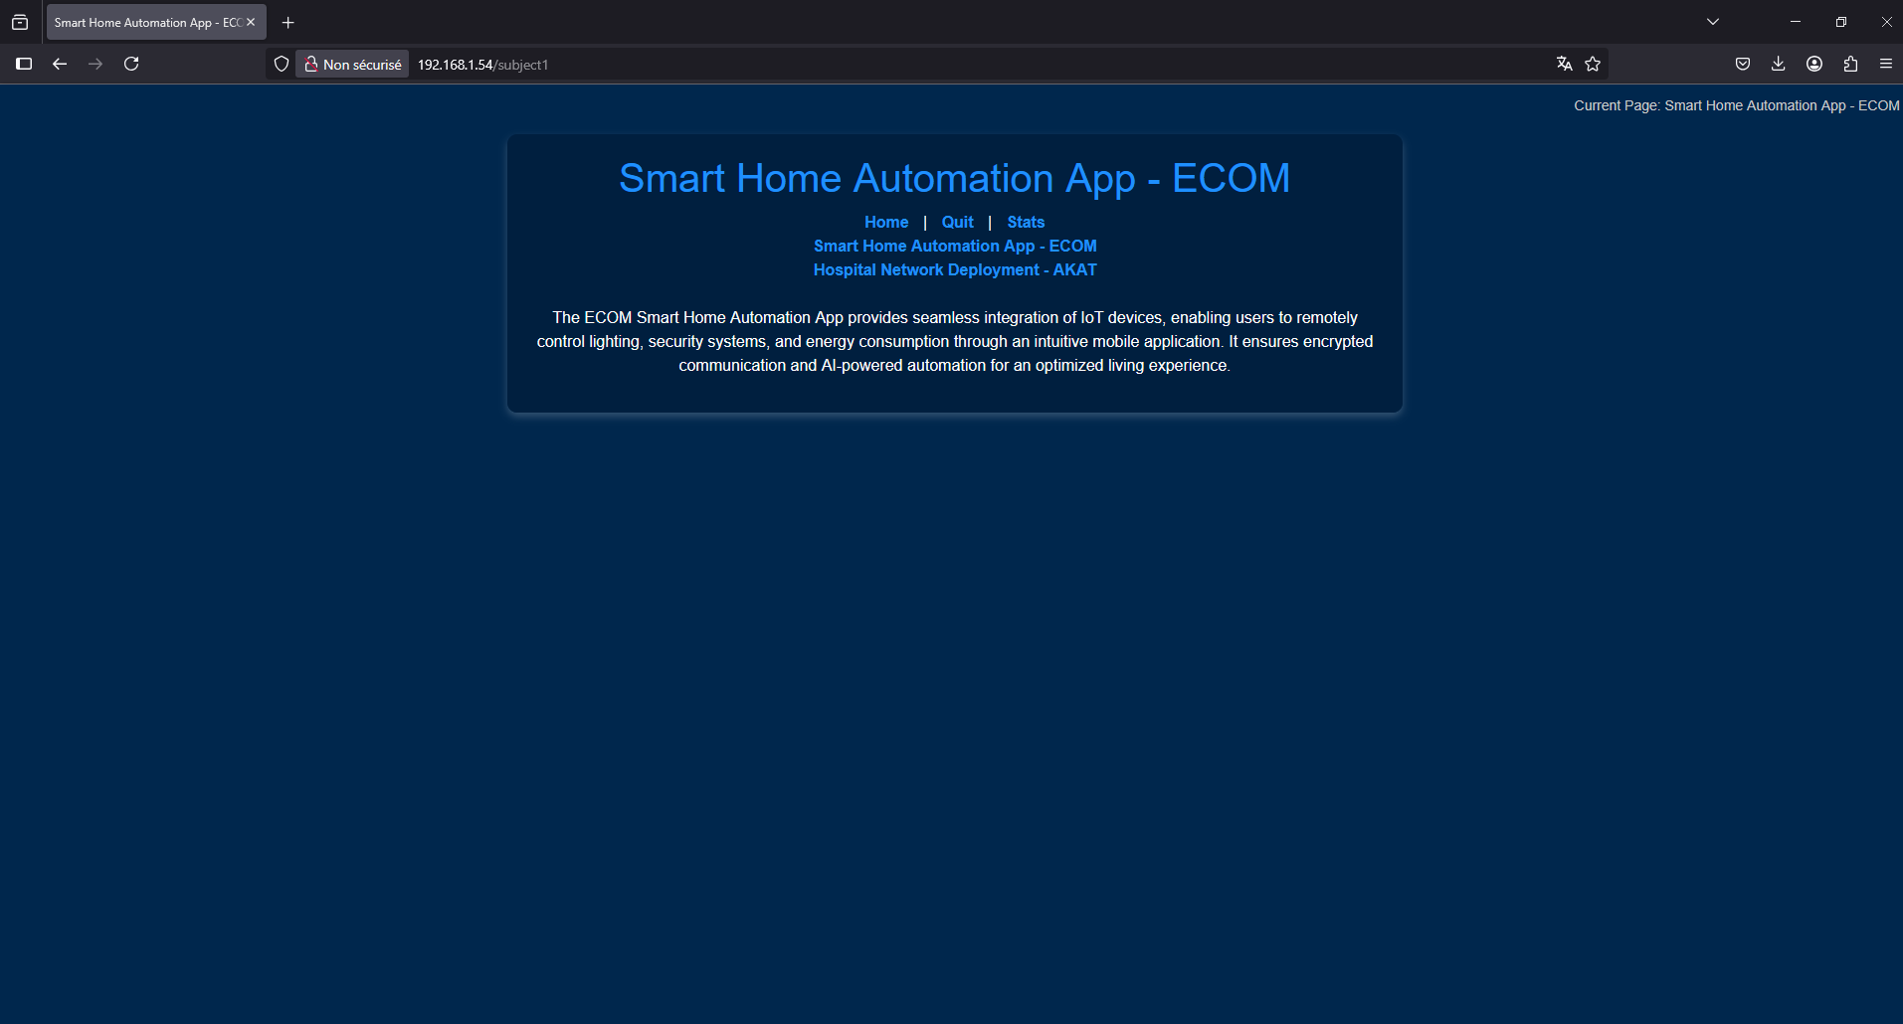
5- Hidden Markov model
8
Output:
M1 IOT | EIPHI GRADUATE SCHOOL
Kyllian Cuevas | Thomas Mirbey

Slide 11
Conclusion
Use of Python (3.9). Positioning methods implemented:
N-Lateration
K-Best Neighbors
Hidden Markov Model.
No major issues were faced. All scripts implemented using Agile Methodology.
Contribution
Scripts and Reports realization: Kyllian Cuevas, Thomas Mirbey
Resources used: python.org, NSI courses (Bruno Jaillet, Philippe Lucien)
Projects proposed by: Philippe Canalda
M1 IOT | EIPHI GRADUATE SCHOOL
Kyllian Cuevas | Thomas Mirbey

Slide 12
Thank you for your attention Do you have any questions? Kyllian Cuevas | Thomas Mirbey
M1 IOT | EIPHI GRADUATE SCHOOL 27/03/2025

