Slide 1

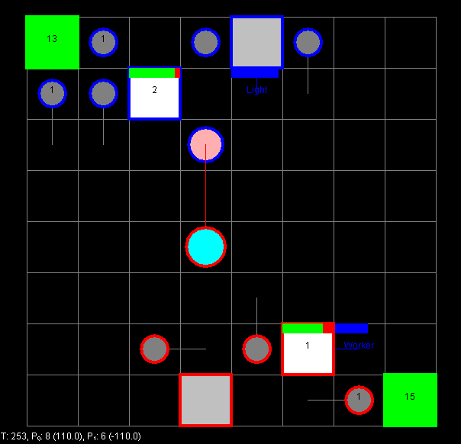
Attack = Random
Range = Random
Speed = Random
Etc…
Original
Neighbor 1
Neighbor 2
…
Neighbor n
Generate Random Unit
Choose best one, repeat
Stop once neighbor can’t outperform the original
Evaluator

