Slide 1
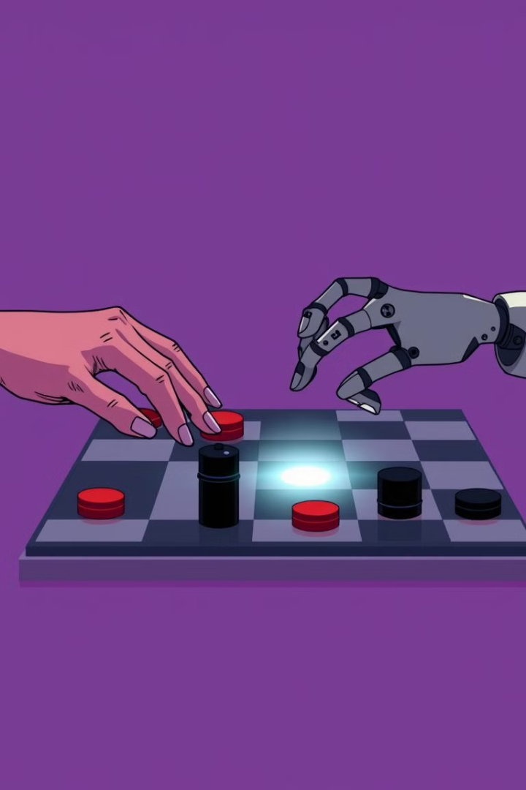
Building a Checkers AI Web App
This presentation outlines the development of a checkers game web application with an AI opponent.

Slide 2
Project Overview: Goals and Technologies
Goals
Technologies
Develop a playable checkers game with an AI opponent.
HTML, CSS, JavaScript, Gemini AI API.

Slide 3
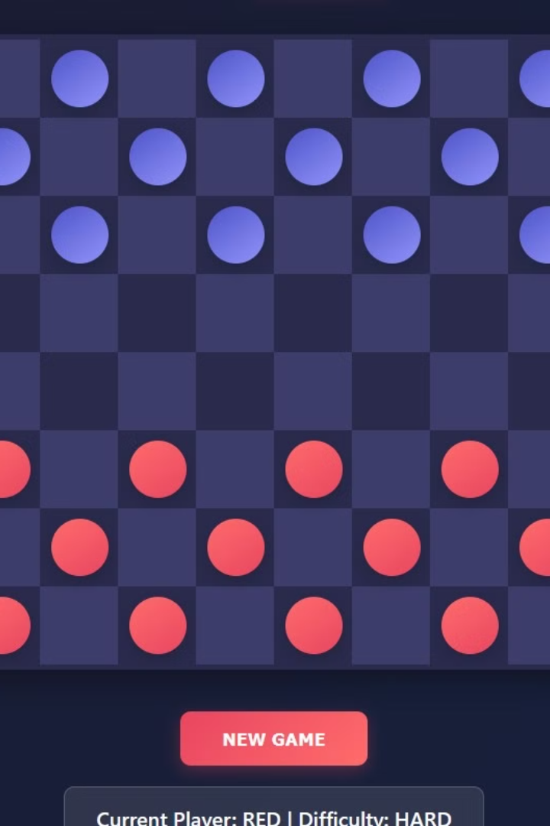
Frontend: Designing the User Interface with HTML/CSS/JS
Board
Pieces
Create a visually appealing checkerboard.
Design checkers pieces with distinctive colors.
Controls
Implement buttons for starting, restarting, and AI difficulty.

Slide 4
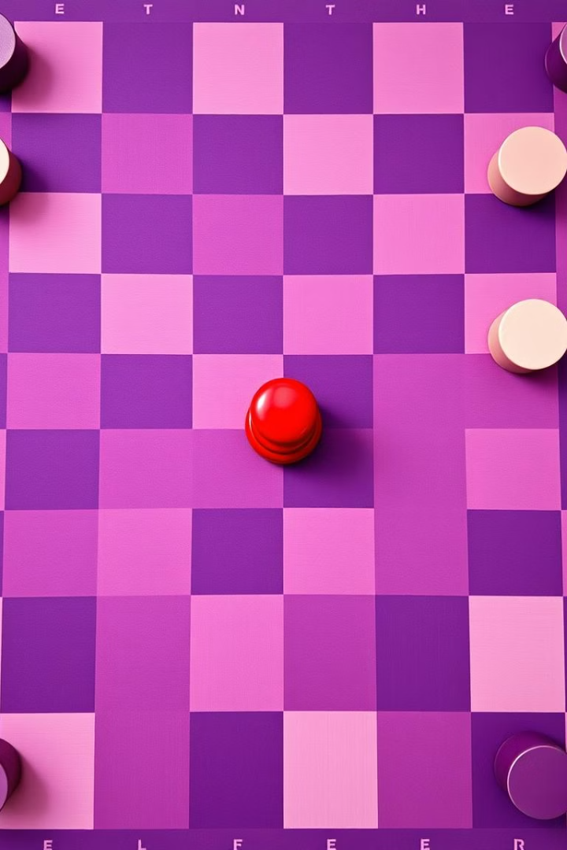



Backend: Implementing the Game Logic in Java Script
Game Logic
Data Structures
Communication
We implemented rules for piece movement, kinging, and winning conditions.
It creates data structures to store the game state and board.
Gemini API was used to exchange game state and player moves between the frontend and backend.

Slide 5

AI Opponent: Minimax Algorithm and Using API for Gemini
1
Minimax
Implemented the Minimax algorithm to analyze possible moves and choose the best one for the AI in medium difficulty.
2
Gemini AI
Used the Gemini AI API to enhance AI decision-making and provide more sophisticated gameplay in hard difficulty

Slide 6
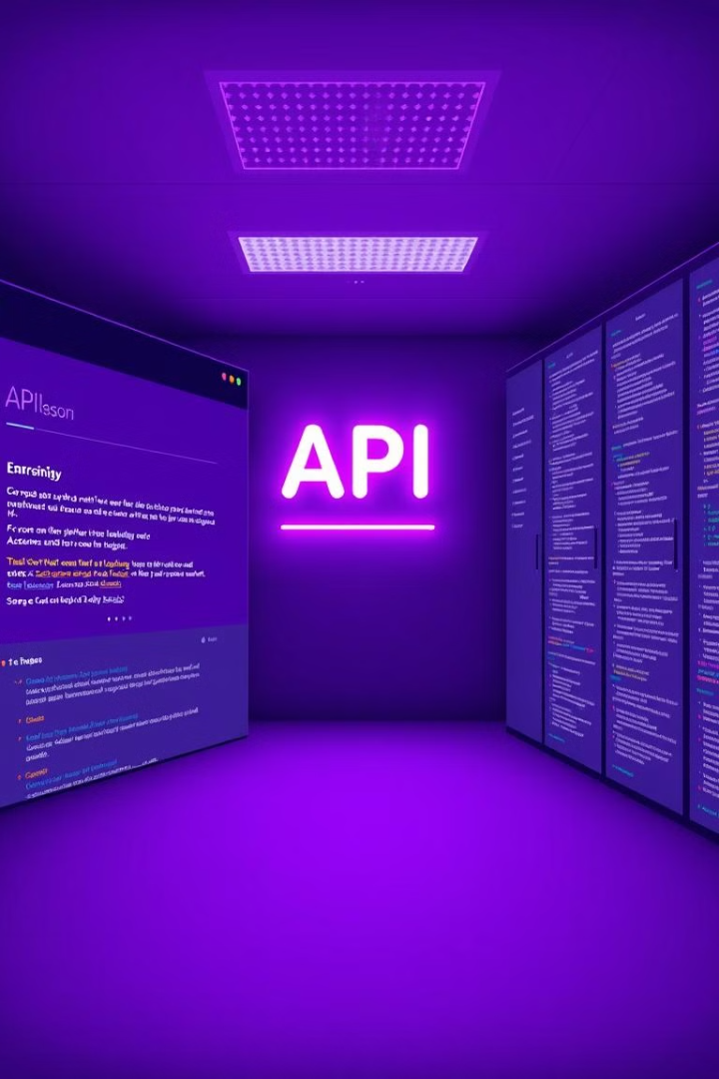


Connecting Frontend and Backend with APIs
Data Exchange
Used API to send player moves and game state between the frontend and backend.
Real-time Updates
Implemented real-time updates on the board to reflect AI moves and user interactions.

Slide 7

Conclusion
This checkers game application provides a fun and interactive experience for players of all skill levels. It highlights the power of web development and AI integration.

