Slide 1
QML Research
Combined outputs synthesis
Classical SVM matched or beat QSVM on every dataset in the experiment pack.
01
Classical SVM matched or exceeded QSVM accuracy on all four datasets.
02
QSVM search was always the longest phase, making runtime the dominant tradeoff.
The strongest signal in the logs is not a breakthrough from QSVM, but a persistent compute tradeoff: much longer search time for equal or weaker test accuracy.
03
Heart Disease was the only run with GPU visibility, but the GPU still appeared mostly idle.
04
The first Iris attempt failed because the classical SVM grid passed a scalar C instead of a list.
Source base: logs, metadata, tables, and plots in `combined_outputs`.
1

Slide 2
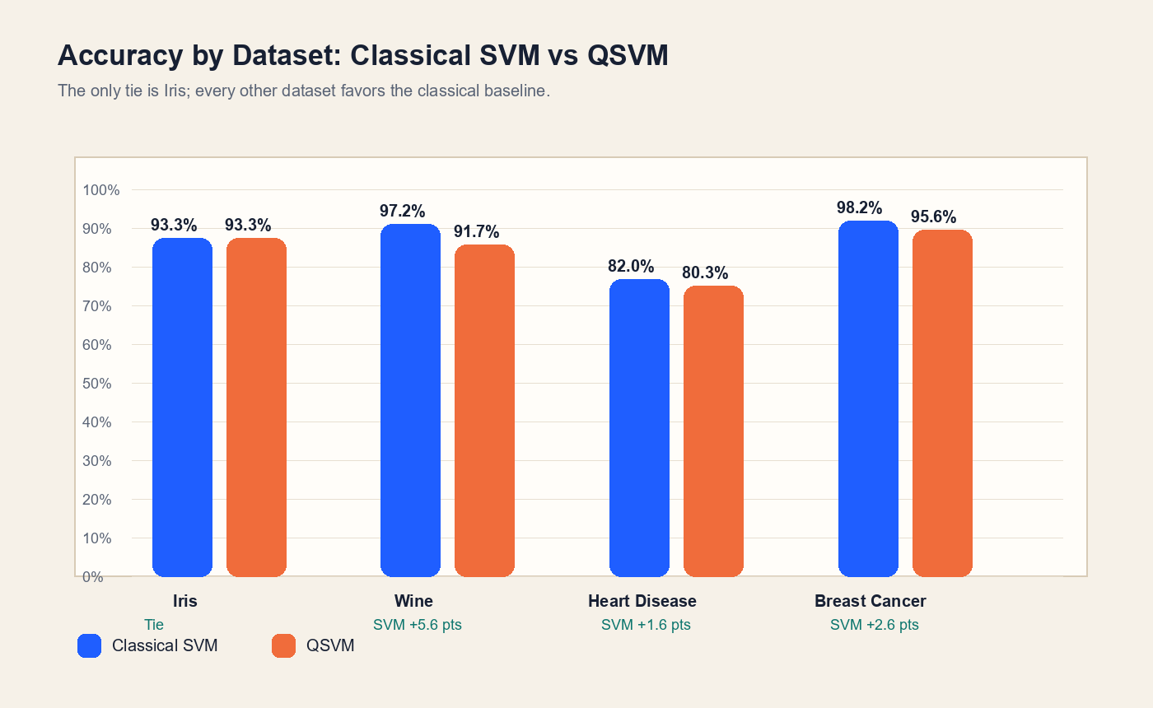
Accuracy
Accuracy leadership stays with the classical baseline in three of four datasets.
Wine
SVM 97.2% | QSVM 91.7%
Gap: 5.6 pts | 178 rows | 13 features
Breast Cancer
SVM 98.2% | QSVM 95.6%
Gap: 2.6 pts | 569 rows | 30 features
Heart Disease
SVM 82% | QSVM 80.3%
Gap: 1.6 pts | 303 rows | 13 features
Iris
SVM 93.3% | QSVM 93.3%
Tie | 150 rows | 4 features
Interpretation: the empirical case for QSVM is weakest on Wine and Breast Cancer, where the accuracy gap is meaningful and the classical model remains cleaner.
2

Slide 3
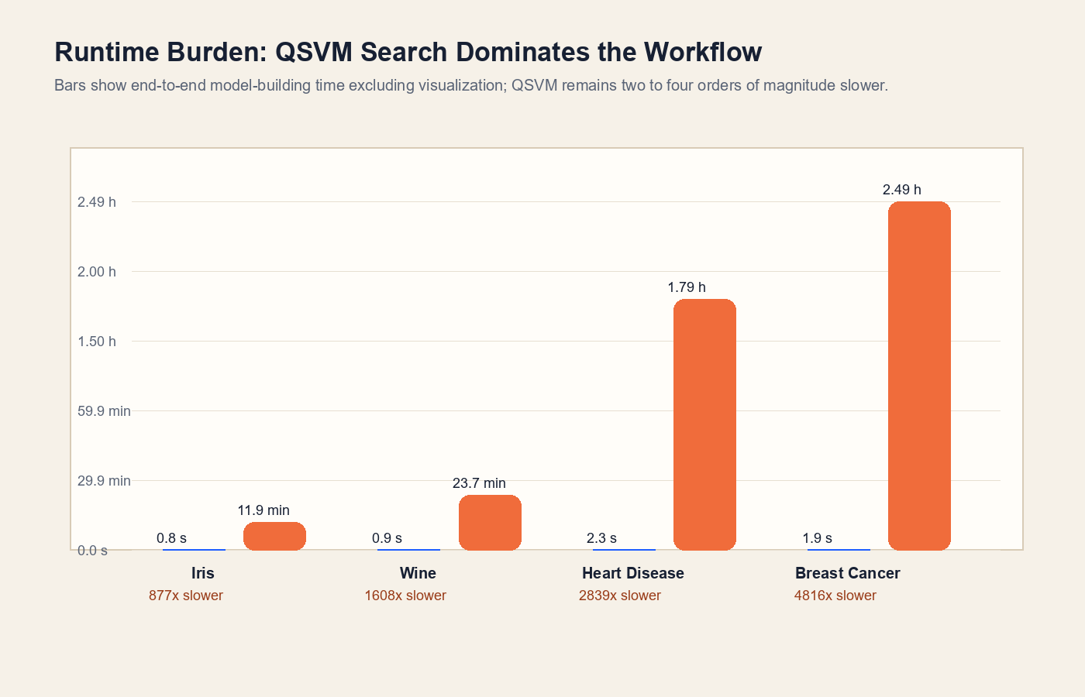
Runtime
The runtime story is decisive: QSVM search consumes the budget long before it creates an accuracy advantage.
Breast Cancer
QSVM build: 149.6 min | 4816x slower
Classical build: 1.9 s
No GPU detected in the recorded runtime summary.
Heart Disease
QSVM build: 107.6 min | 2839x slower
Classical build: 2.3 s
GPU visible, but still not the main accelerator.
Wine
QSVM build: 23.7 min | 1608x slower
Classical build: 0.9 s
No GPU detected in the recorded runtime summary.
Implication: any future QSVM iteration should begin with search-space reduction and pipeline profiling, not broader dataset expansion.
3

Slide 4
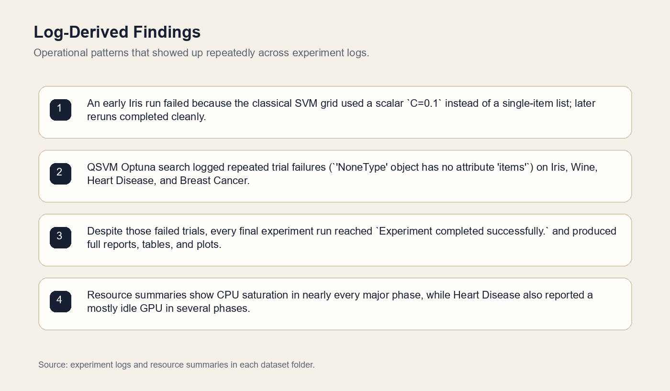
Logs and diagnostics
The logs show a pipeline that eventually completes, but not one that is yet stable enough to call mature.
The first Iris attempt failed before the classical search even began because the SVM grid passed a scalar `C` instead of a list.
All four datasets then logged repeated QSVM Optuna trial failures with the same `NoneType` error signature.
Even so, the final reruns completed and exported the expected reports, tables, and decision-boundary plots.
Heart Disease is the only case with recorded GPU visibility, yet its runtime summary still flagged several phases as mostly idle on GPU.
Operational takeaway
Fix the QSVM trial-failure path and standardize the compute environment before expanding the experiment suite.
4

Slide 5
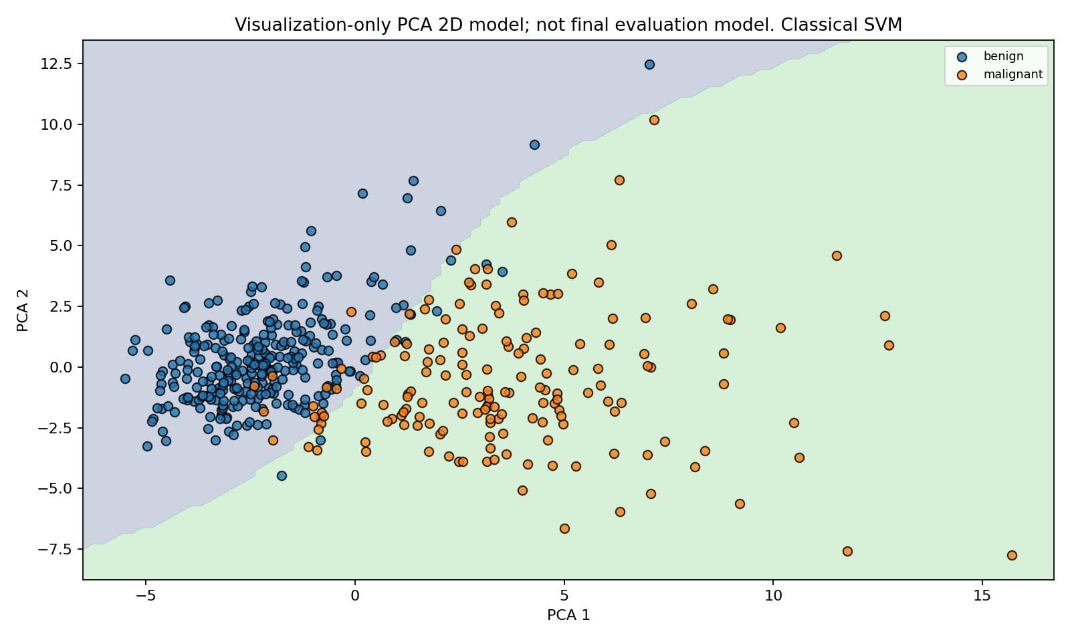
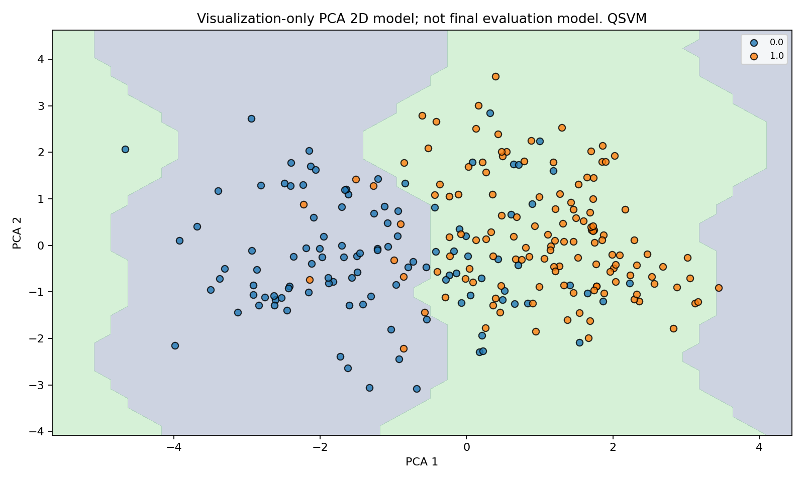
Dataset drill-down
The practical decision is clearest on Breast Cancer and Heart Disease: classical SVM stays ahead without the quantum tax.
Breast Cancer
Heart Disease
Accuracy: 98.2% vs 95.6%
149.6 min QSVM build time
Accuracy: 82.0% vs 80.3%
107.6 min QSVM build time
Type I errors: 0, Type II errors: 2 for positive class malignant.
Type I errors: 10, Type II errors: 1 for positive class 1.0.
These plots are illustrative rather than decisive on their own, but they pair well with the tabular results: QSVM does not convert its extra search time into better generalization on the harder datasets.
5

Slide 6
Recommendations
What to do next
1
Keep classical SVM as the benchmark and likely default.
2
Stabilize the QSVM search path before scaling.
It wins or ties everywhere in this experiment pack.
The repeated Optuna `NoneType` trial failures are a reliability warning, not just noise.
3
Make runtime studies apples-to-apples.
4
Only revisit QSVM with a narrower question.
Heart Disease ran on stronger hardware than the other datasets, so future comparisons should normalize the environment.
Good candidates are feature-map ablations, smaller search spaces, and profiling-focused runs rather than broad reruns.
Bottom line: the current evidence supports classical SVM as the more efficient and more reliable choice in this experiment set.
6

