Slide 1

Data anonymization: A workflow
How and why anonymize data
Jiří Novák November 20, 2024

Slide 2

About me – Jiří Novák
From Prague, Czech Republic,
PhD in Statistics
Research topics
Data privacy and data anonymization
Statistical disclosure control
Responsible for data confidentiality of Czech Census 2021
Currently working at FHNW on a SNF project: Harnessing event and longitudinal data in industry and health sector through privacy preserving technologies
PhD student of Carolin Strobl with topic: Data anonymization of longitudinal psychological data
https://www.linkedin.com/in/jiri-novak-8b748718/

Slide 3
Data anonymization
My work is Data Anonymization in the context of the field of Statistical Disclosure Control (SDC)
Statistical Disclosure Control seeks to protect statistical data in such a way that they can be released without giving away confidential information that could be linked to specific individuals or entities.
Importance of Data Anonymization
1. Principle Statistical records of individual persons, businesses, or events used to produce Statistics are strictly confidential.
2. Legal Laws mandate protection of business and personal data, regulating publication of private information.
3. Quality Trust in confidentiality ensures respondents provide accurate information.
4. Ethical Disclosing information that can be linked to specific individuals or entities is unethical.
Notes:
Principle It’s a core principle in statistics that individual data — whether from people, businesses, or events — must be kept strictly confidential. This data is only to be used for statistical purposes, ensuring privacy and protecting individual identities.
Legal There are legal obligations to safeguard both personal and business information. Laws define what information can be shared and what must remain private to prevent unauthorized disclosure of sensitive data.
Quality To collect accurate data, respondents need confidence that their information is secure and confidential. Without trust in confidentiality, people may not provide honest or precise data, which can compromise the quality of the statistics.
Ethical Ethically, we must avoid disclosing any data that could identify specific individuals or organizations. Protecting privacy is not just a legal issue but also a moral responsibility in statistical work

Slide 4
Relevance to Open Science
Open Science, Open Access, Open Data are important trends in the scientific community.
Research data that results from publicly funded research should be FAIR:
Findable,
Accessible,
Interoperable,
Reusable
therefore replicable, transparent, trustworthy, verifiable and accountable
Principle: As open as possible, as closed as necessary
Commission Recommendation (EU) 2018/790 on access to and preservation of scientific information
Notes:
Enables data sharing and collaboration
Facilitates reproducible research
Balances transparency with privacy

Slide 5
Key Concepts
Disclosure
Disclosure occurs when new information is revealed via released data.
(1) Identity disclosure: Revealing the identity of an individual.
(2) Attribute disclosure: Revealing sensitive attributes of an individual.
(3) Inferential disclosure: Making inferences about an individual based on the released data.
(4) Membership disclosure: Determining whether a specific individual is included in a dataset
Re-identification risk
Risk that an intruder can link a record in the released data to a specific individual in the population.
Data utility
Usefulness of the data for the intended purpose.
Notes:
A disclosure occurs when a person or an organization recognizes or learns something that they did not already know about another person or organization, via released data.

Slide 6
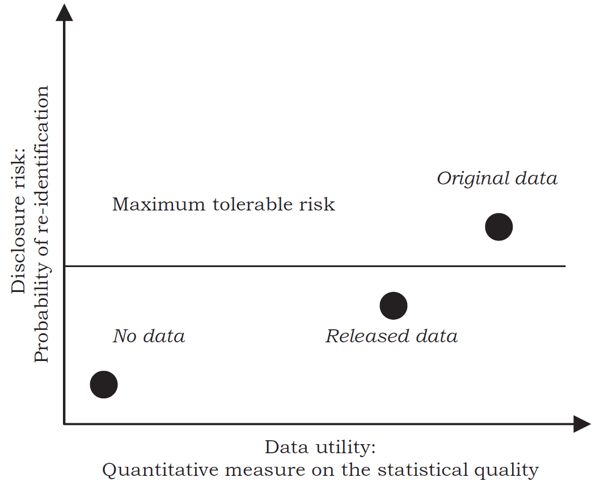

Risk vs. Utility
The goal is to find a balance between risk and utility,
so there is a risk-utility trade-off.
Risk: the probability of a disclosure event occurring.
Utility: the usefulness of the data for the intended purpose.
R-U confidentiality map (Duncan et al.,2001)
Notes:
SDC seeks to optimize the trade-off between the disclosure risk and the utility of the
protected released data.
The goal is to find a balance between risk and utility,
so there is a risk-utility trade-off.

Slide 7
Disclosure control methods
Masking original data
Non-perturbative masking Generalize data to hide identities without changing actual values.
Perturbative masking Add noise or alter data values.
Generating synthetic data
Parametric methods Statistical models based on the data‘s assumed distribution
Non-parametric methods Techniques that do not assume an underlying distribution
Generative Adversarial Networks (GANs) Machine learning models that generate synthetic data by training two neural networks in tandem.

Slide 8

Mostly AI
https://mostly.ai/
MOSTLY AI's synthesizer uses a proprietary AI-driven approach that draws on deep learning principles similar to those found in generative adversarial networks (GANs).
You can use point-and-click environment, or python code.

Slide 9


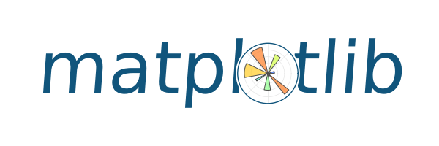

Libraries used
os and sys
Set the working directory to the folder
Matplotlib
For visualization
Pandas
For data manipulation
MostlyAI
Synthetize data with Mostly AI

Slide 10
Challenges and error
Open word document Problems.docx

Slide 11

Thank you
for the attention
Contact
Jiří Novák
PhD student
jiri.novak@uzh.ch
Swiss Data Anonymization Competence Center
https://swissanon.ch

