Slide 1

Data anonymization: A workflow
How and why anonymize data
Jiří Novák November 20, 2024

Slide 2

About me – Jiří Novák
From Czech Republic, Prague
Master's and PhD in Statistics
Research topic
Data privacy and data anonymization
Statistical disclosure control
At Czech Statistical Office responsible for data confidentiality of Czech Census 2021
Currently working at FHNW on a SNF project: Harnessing event and longitudinal data in industry and health sector through privacy preserving technologies
PhD student of Carolin Strobl with topic: Data anonymization of longitudinal psychological data
https://www.linkedin.com/in/jiri-novak-8b748718/

Slide 3
Data anonymization
My work is Data Anonymization in the context of the field of Statistical Disclosure Control (SDC)
Statistical Disclosure Control seeks to protect statistical data in such a way that they can be released without giving away confidential information that can be linked to specific individuals or entities.
Importance of Data Anonymization
1. Principle It is a fundamental principle of Official Statistics that the statistical records of individual persons, businesses, or events used to produce Official Statistics are strictly confidential and to be used only for statistical purposes.
2. Legal Legislation imposes a legal obligation to protect individual business and personal data. Legal frameworks regulate what is allowed and what is not allowed regarding the publication of private information.
3. Quality Respondents need confidence in the preservation of the confidentiality of individual information. If they do not trust the confidentiality of the data, they may not provide accurate information.
4. Ethical Disclosing information that can be linked to specific individuals or entities is unethical.

Slide 4
Relevance to Open Science
Open Science, Open Access, Open Data are important trends in the scientific community.
Research data that results from publicly funded research should be FAIR:
findable, accessible, interoperable, reusable
therefore replicable, transparent, trustworthy, verifiable and accountable
Principle: As open as possible, as closed as necessary
Enables data sharing and collaboration
Facilitates reproducible research
Balances transparency with privacy
Commission Recommendation (EU) 2018/790 on access to and preservation of scientific information

Slide 5
Key Concepts
Disclosure
A disclosure occurs when a person or an organisation recognises or learns something that they did not know already about another person or organisation, via released data.
(1) Identity disclosure: Revealing the identity of an individual.
(2) Attribute disclosure: Revealing sensitive attributes of an individual.
(3) Inferential disclosure: Making inferences about an individual based on the released data.
(4) Membership disclosure: Determining whether a specific individual is included in a dataset
Re-identification risk
Re-identification risk is the risk that an intruder can link a record in the released data to a specific individual in the population.
Data utility
Data utility is the usefulness of the data for the intended purpose.

Slide 6
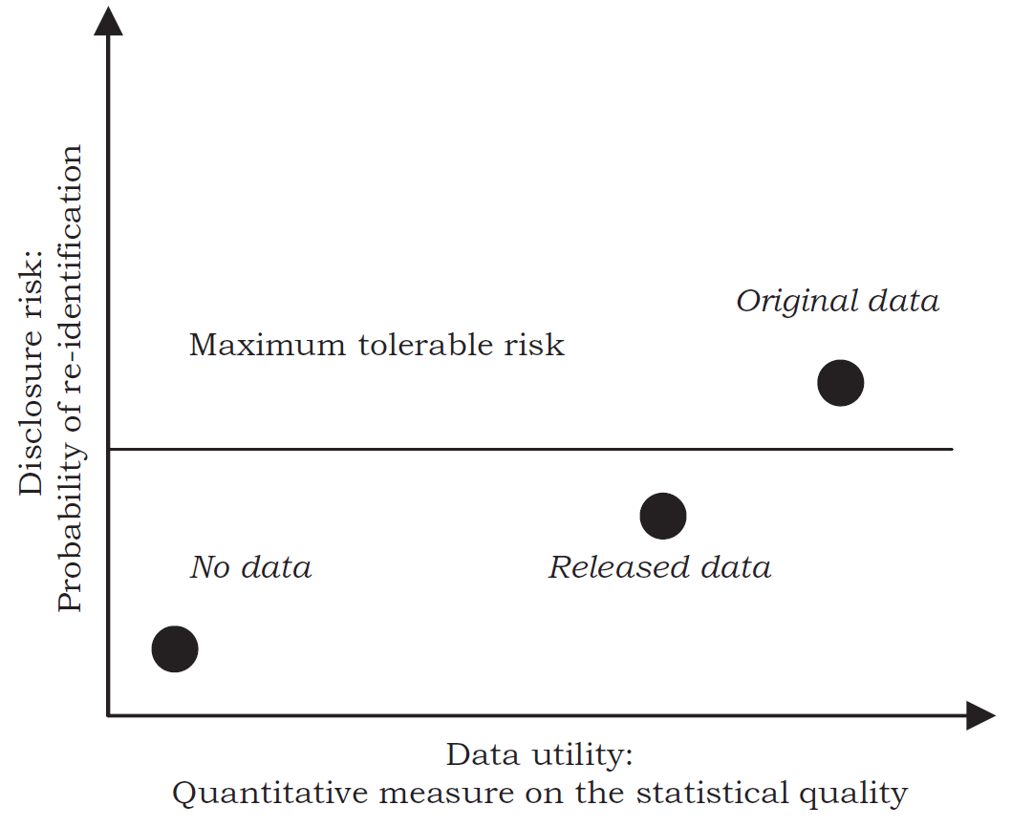
Risk and utility
SDC seeks to optimise the trade-off between the disclosure risk and the utility of the
protected released data.
Risk: the probability of a disclosure event occurring.
Utility: the usefulness of the data for the intended purpose.
The goal is to find a balance between risk and utility,
so there is a risk-utility trade-off.
R-U confidentiality map (Duncan et al.,2001)

Slide 7
Disclosure control methods
Masking original data
Non-perturbative masking - Methods that alter data to hide identities without changing its actual values
Perturbative masking - Methods that add noise or alter data values to prevent identification
Generating synthetic data
Parametric methods - Techniques that use statistical models based on the data’s distribution to generate synthetic data.
Non-parametric methods - Techniques that do not assume an underlying distribution, using methods like bootstrapping to generate synthetic data.
Generative Adversarial Networks (GANs) - Advanced machine learning models that generate highly realistic synthetic data by training two neural networks in tandem.

Slide 8
Disclosure control methods
Masking original data
Non-perturbative masking - Methods that alter data to hide identities without changing its actual values
Perturbative masking - Methods that add noise or alter data values to prevent identification
Generating synthetic data
Parametric methods - Techniques that use statistical models based on the data’s distribution to generate synthetic data.
Non-parametric methods - Techniques that do not assume an underlying distribution, using methods like bootstrapping to generate synthetic data.
Generative Adversarial Networks (GANs) - Advanced machine learning models that generate highly realistic synthetic data by training two neural networks in tandem.

Slide 9

Mostly AI
https://mostly.ai/
MOSTLY AI's synthesizer uses a proprietary AI-driven approach that draws on deep learning principles similar to those found in generative adversarial networks (GANs).
You can use point-and-click environment, or python code.

Slide 10
Libraries used
os and sys
Set the working directory to the folder
Matplotlib
For vizualiztion
Pandas
For data manipulation
MostlyAI
Synthetize data with Mostly AI

Slide 11

Thank you
for the attention
Contact
Jiří Novák
PhD student
jiri.novak@uzh.ch
Swiss Data Anonymization Competence Center
https://swissanon.ch

