Slide 1

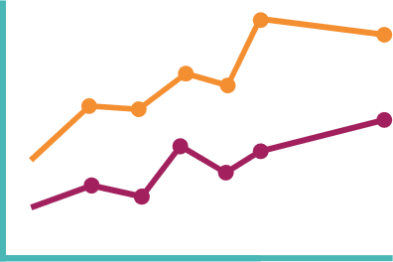






Main finding goes here, translated into plain English. Emphasize the important words.
Jiří Novák
Non-Cognitive Predictors of Student Success: A Predictive Validity Comparison Between Domestic and International Students
Anonymization of longitudinal demographic data
AMMO BAR
Delete this and replace it with your…
Extra Graphs
Extra Correlation tables
Extra Figures
Extra nuance that you’re worried about leaving out.
Keep it messy! This section is just for you.
Jiří Novák
- University of Zürich
- University of Applied Sciences Northwestern Switzerland
- Swiss Data Anonymization Competence Center
BACKGROUND: Who cares? Explain why your study matters in the fastest, most brutal way possible (feel free to add graphics!).
METHODS
Collected [what] from [population]
Tested it with X process.
Illustrate your methods if you can.
Try a flowchart!
RESULTS
Graph/table with essential results only.
All the other correlations in the ammo bar.
Visualize your findings with an image, graphic, or a key figure.
Open Science, Open Access, Open Data
Research data that results from publicly funded research should be
findable, accessible, interoperable, reusable (‘FAIR principles’)
therefore replicable, transparent, trustworthy
as open as possible, as closed as necessary
Commission Recommendation (EU) 2018/790 on access to and preservation of scientific information

